Slide 1
Equilibrium
Le Châtelier’s Principle

Slide 2
Le Châtelier’s Principle
Le Châtelier's principle- guides us in predicting the effect various changes in conditions have on the position of equilibrium.
If a system at equilibrium is disturbed, the position of equilibrium will shift to minimize the disturbance.

Slide 3
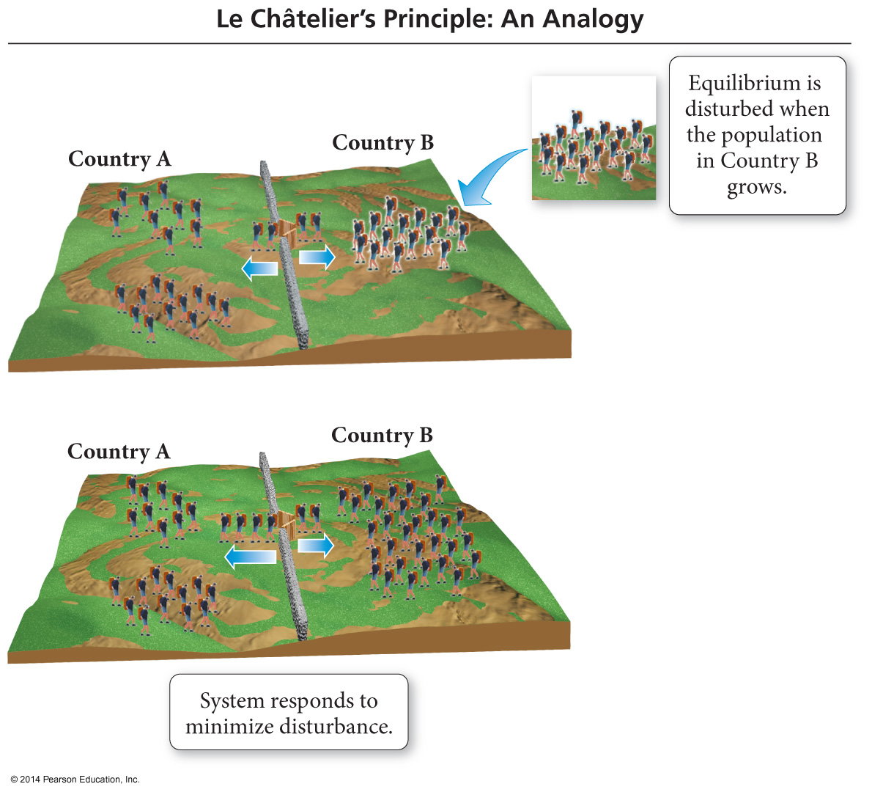
An Analogy: Population Changes
When the populations of Country A and Country B are in equilibrium, the emigration rates between the two countries are equal so the populations stay constant.

Slide 4
An Analogy: Population Changes
When an influx of population enters Country B from somewhere outside Country A, it disturbs the
equilibrium established between Country A and Country B.

Slide 5
An Analogy: Population Changes
The result will be people moving from Country B into Country A faster than people moving from Country A into Country B.
This will continue until a new equilibrium between the populations is established; the new populations will have different numbers of people than the old ones.

Slide 6
Le Chatelier Example #1
A closed container of ice and water is at equilibrium. Then, the temperature is raised.
Ice + Energy  Water
right
The system temporarily shifts to the _______ to restore equilibrium.

Slide 7
Le Chatelier Example #2
A closed container of N₂O₄ and NO₂ is at equilibrium. NO₂ is added to the container.
N₂O₄ (g) + Energy  2 NO₂ (g)
left
The system temporarily shifts to the _______ to restore equilibrium.

Slide 8
Le Chatelier Example #3
A closed container of water and its vapor is at equilibrium. Vapor is removed from the system.
water + Energy  vapor
right
The system temporarily shifts to the _______ to restore equilibrium.

Slide 9
Le Chatelier Example #4
A closed container of N₂O₄ and NO₂ is at equilibrium. The pressure is increased.
N₂O₄ (g) + Energy  2 NO₂ (g)
left
The system temporarily shifts to the _______ to restore equilibrium, because there are fewer moles of gas on that side of the equation.

Slide 10
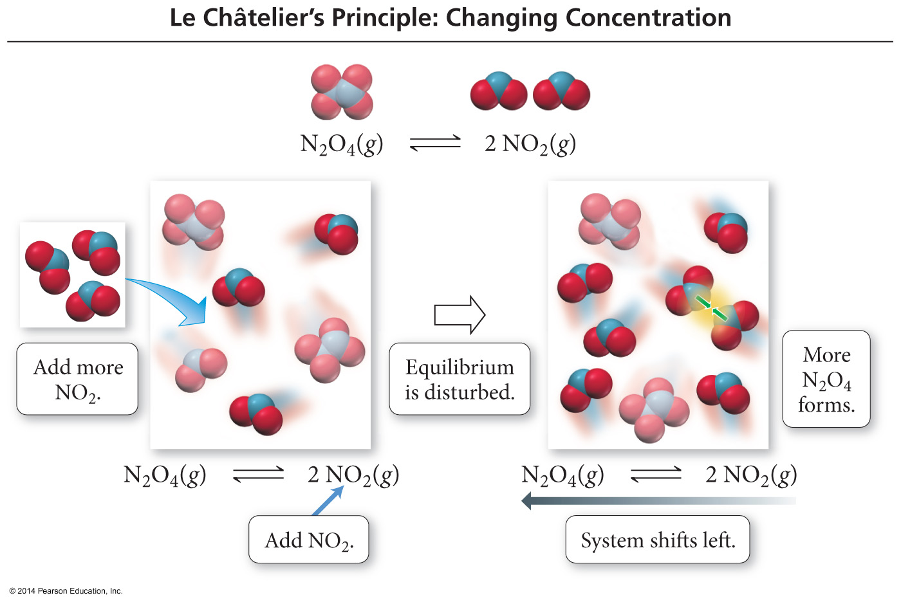
The Effect of [ ] Changes on Equilibrium
When NO₂ is added, some of it combines to make more N₂O₄.

Slide 11
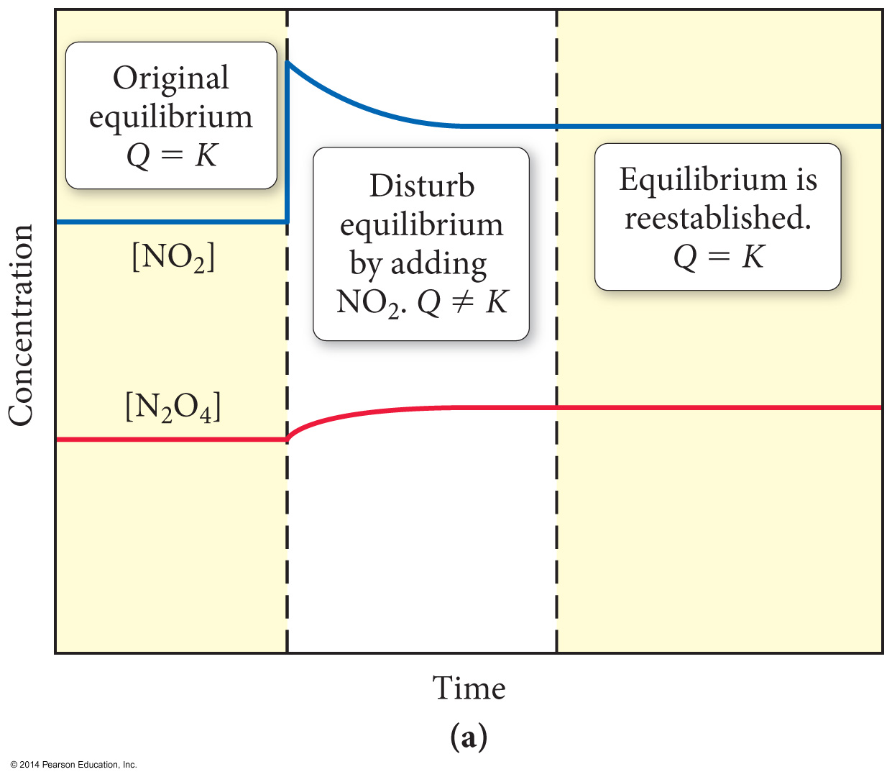
The Effect of [ ] Changes on Equilibrium
When N₂O₄ is added, some of it decomposes to make more NO₂.

Slide 12
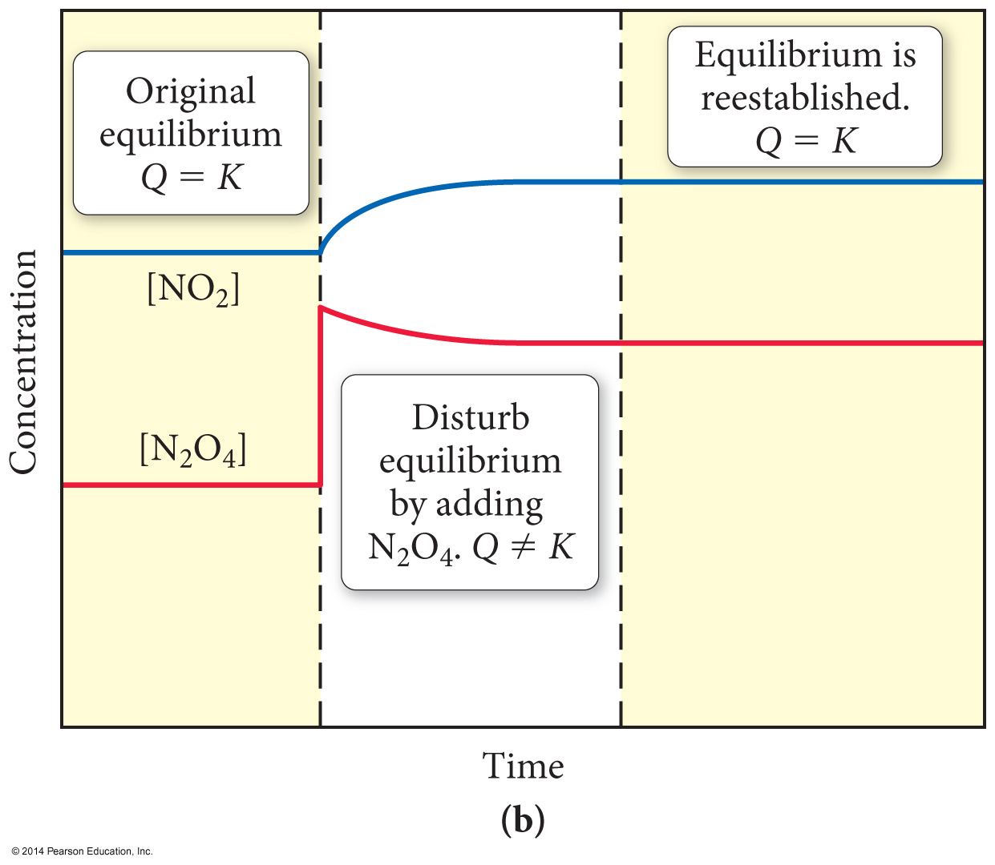
The Effect of [ ] Changes on Equilibrium
When N₂O₄ is added, some of it decomposes to make more NO₂.

Slide 13
The Effect of Volume Changes on Equilibrium
Because there are more gas molecules on the reactants side of the reaction, when the pressure is increased, the position of equilibrium shifts toward the side with fewer molecules to decrease the pressure.

Slide 14
The Effect of Volume Changes on Equilibrium
When the pressure is decreased by increasing the volume, the position of equilibrium shifts toward the side with the greater number of molecules—the reactant side.

Slide 15
The Effects of Catalysts
Provide an alternative, more efficient mechanism.
Work for both forward and reverse reactions.
Affect the rate of the forward and reverse reactions by the same factor.
Therefore, catalysts do not affect the position of equilibrium.
They do not change the position of equilibrium…
You just get to equilibrium faster!

