Slide 1
Equilibrium
Reaction Quotient – Q
and ICE Tables

Slide 2
The Reaction Quotient
If a reaction mixture containing both reactants and products is not at equilibrium, how can we determine in which direction it will proceed?
The answer is to compare the current concentration ratios to the equilibrium constant.
The concentration ratio of the products (raised to the power of their coefficients) to the reactants (raised to the power of their coefficients) is called the reaction quotient, Q.

Slide 3
Significance of the Reaction Quotient
For the gas phase reaction
aA + bB ⇔ cC + dD
the reaction quotient is:
Set up the same way as K, but the [ ] values you plug in are not necessarily the same as the ones at equilibrium.

Slide 4
The Reaction Quotient
If Q = K, the system is at equilibrium
If Q > K, there are more products than when at equilibrium, the system shifts to the left, consuming products and forming reactants until equilibrium is achieved
If Q < K, there are more reactants than when at equilibrium, the system shifts to the right, consuming reactants and forming products until equilibrium is achieved

Slide 5
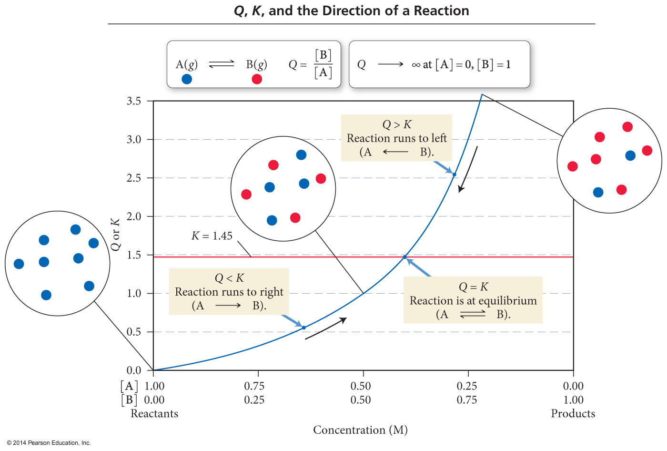
The Reaction Quotient – Predicating the Direction of Change
If Q > K, the reaction will proceed fastest in the reverse direction.
The products will decrease and reactants will increase.

Slide 6
The Reaction Quotient – Predicating the Direction of Change
If Q < K, the reaction will proceed fastest in the forward direction.
The products will increase and reactants will decrease.

Slide 7
The Reaction Quotient – Predicating the Direction of Change
If Q =K, the reaction is already at equilibrium!
The products and reactants will not change.

Slide 8
The Reaction Quotient – Predicating the Direction of Change
If a reaction mixture contains just reactants, then Q = 0, and the reaction will proceed in the forward direction.

Slide 9
The Reaction Quotient – Predicating the Direction of Change
If a reaction mixture contains just products, then Q = ∞, and the reaction will proceed in the reverse direction.

Slide 10
Solving for Equilibrium Concentrations
Consider this reaction at some temperature:
H₂O(g) + CO(g)  H₂(g) + CO₂(g) K = 2.0
Assume you start with 8 molecules of H₂O and 6 molecules of CO. How many molecules of H₂O, CO, H₂, and CO₂ are present at equilibrium?
Here, we learn about “ICE” – one the most important problem solving technique in the year. You will use it a lot!

Slide 11
Solving for Equilibrium Concentration
H₂O(g) + CO(g)  H₂(g) + CO₂(g) K = 2.0
Step #1: Write the law of mass action for the rxn

Slide 12
Solving for Equilibrium Concentration
Step #2: We “ICE” the problem, beginning with the Initial concentrations
H₂O(g) + CO(g)  H₂(g) + CO₂(g)
Initial:
Change:
Equilibrium:
8
6
0
0
-x
-x
+x
+x
8-x
6-x
x
x

Slide 13
Solving for Equilibrium Concentration
Step #3: Plug equilibrium concentrations into the equilibrium expression, and solve for x
H₂O(g) + CO(g)  H₂(g) + CO₂(g)
Equilibrium: | 8-x | 6-x | x | x

Slide 14
Solving for Equilibrium Concentration
Step #3: Plug equilibrium concentrations into the equilibrium expression, and solve for x
H₂O(g) + CO(g)  H₂(g) + CO₂(g)
Equilibrium: | 8-x | 6-x | x | X
Answer | 8-4 = 4 | 6-4 = 2 | 4 | 4

Slide 15
Some of These Can Get Really Tricky…
Quadratic Equations
Perfect squares
Approximations – Remember the 5% rule from Honors Chemistry ????
Crazy substitutions and rearrangements
But the concept is always the same!
You HAVE to practice to see crazy examples!

