Slide 1
CHEMICAL EQUILIBRIUM

Slide 2
Chemical Equilibrium
Reversible Reactions:
A chemical reaction in which the products
can react to re-form the reactants
Chemical Equilibrium:
When the rate of the forward reaction
equals the rate of the reverse reaction
and the concentration of products and
reactants remains unchanged
2HgO(s)  2Hg(l) + O2(g)
Arrows going both directions (  ) indicates equilibrium in a chemical equation

Slide 3
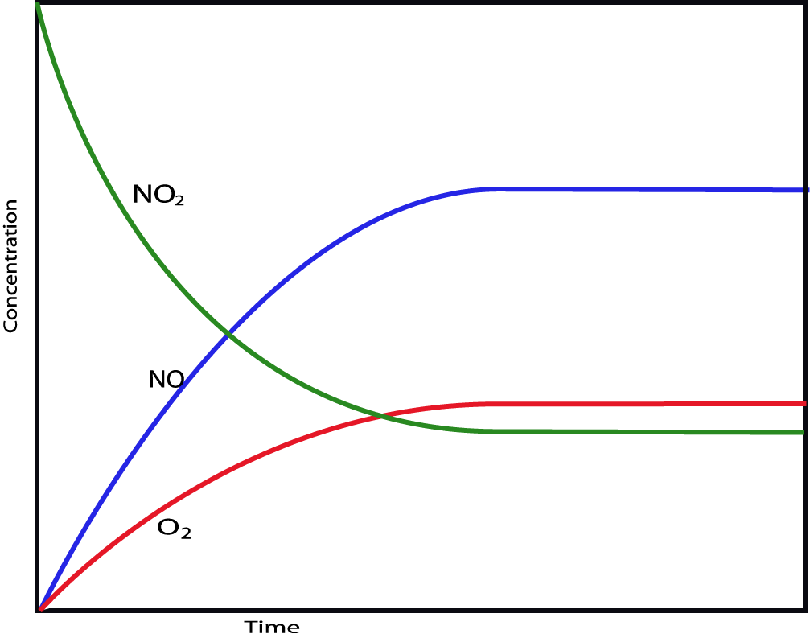
2NO₂(g)  2NO(g) + O₂(g)
Remember this from
Kinetics?
Why was it so important to measure reaction rate at the start of the reaction
(method of initial rates?)

Slide 4
2NO₂(g)  2NO(g) + O₂(g)

Slide 5
H₂(g) + I₂(g) ⇔ 2 HI(g)
As the concentration of product increases and the concentrations of reactants decrease, the rate of the forward reaction slows down, and the rate of the reverse reaction speeds up.

Slide 6
H₂(g) + I₂(g) ⇔ 2 HI(g)
At dynamic equilibrium, the rate of the forward reaction is equal to the rate of the reverse reaction.
The concentrations of reactants and products no longer change.

Slide 7
Equilibrium ≠ Equal
The rates of the forward and reverse reactions are equal at equilibrium.
But that does not mean the concentrations of reactants and products are equal.
Some reactions reach equilibrium only after almost all the reactant molecules are consumed; we say the position of equilibrium favors the products.
Other reactions reach equilibrium when only a small percentage of the reactant molecules are consumed; we say the position of equilibrium favors the reactants.

Slide 8
An Analogy: Population Changes
When Country A citizens feel overcrowded, some will emigrate to Country B .

Slide 9
An Analogy: Population Changes
However, after a time, emigration will occur in
both directions at the same rate, leading to
populations in Country A and Country B that are
constant, but not necessarily equal.

Slide 10
Equilibrium Constant
Even though the concentrations of reactants and products are not equal at equilibrium, there is a relationship between them.
The relationship between the chemical equation and the concentrations of reactants and products is called the law of mass action.

Slide 11
Equilibrium Constant
For the general equation aA + bB ⇔ cC + dD, the law of mass action gives the relationship below.
The lowercase letters represent the coefficients of the balanced chemical equation.
Always products over reactants
K is called the equilibrium constant.
Unitless

Slide 12
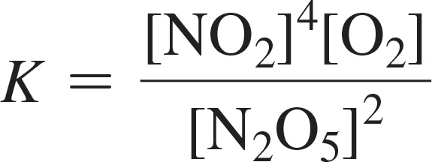
Writing Equilibrium Constant Expressions
So, for the reaction
2 N₂O_{5(g)} ⇔ 4 NO_{2(g)} + O_{2(g)}
the equilibrium constant expression is as follows:

Slide 13
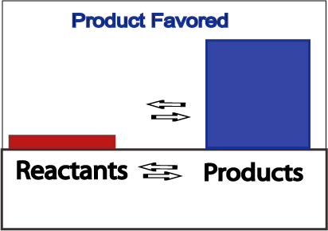
Product Favored Equilibrium
Large values for K signify the reaction is “product favored”
When equilibrium is achieved, most reactant has been converted to product

Slide 14
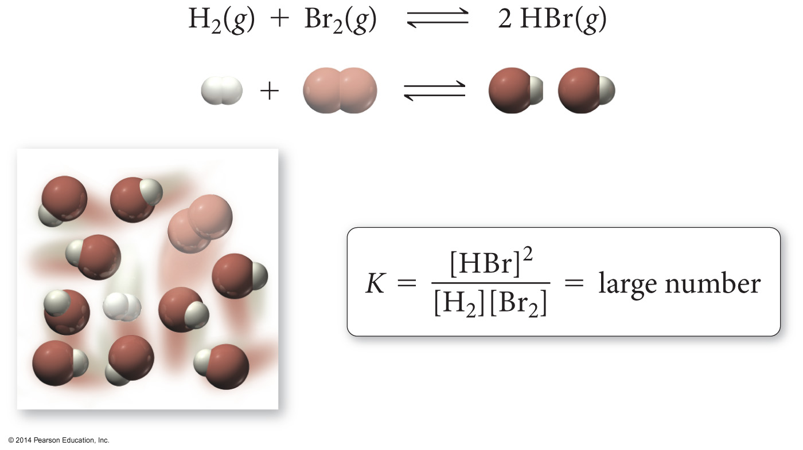
A Large Equilibrium Constant

Slide 15
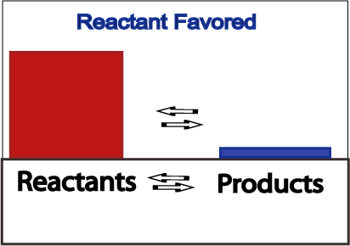
Reactant Favored Equilibrium
Small values for K signify the reaction is “reactant favored”
When equilibrium is achieved, very little reactant has been converted to product

Slide 16
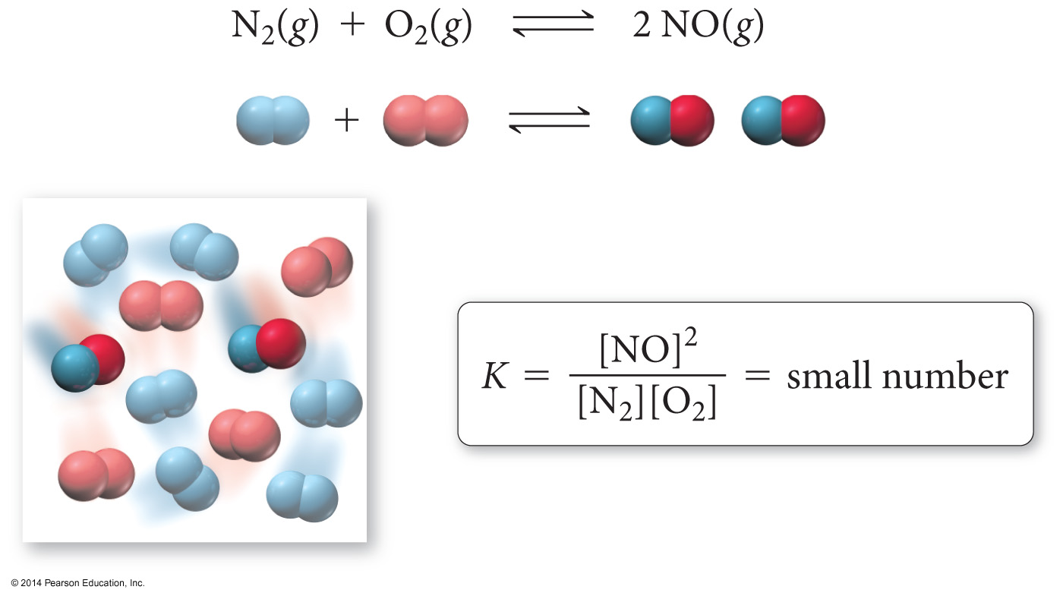
A Small Equilibrium Constant

Slide 17
Relationships between K and Chemical Equations
When the reaction is written backward, the equilibrium constant is inverted.
For the reaction aA + bB ⇔ cC + dD
the equilibrium constant expression is as follows:
For the reaction cC + dD ⇔ aA + bB
the equilibrium constant expression is as follows:

Slide 18
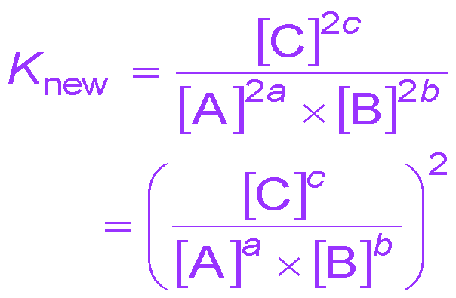
Relationships between K and Chemical Equations
When the coefficients of an equation are multiplied by a factor, the equilibrium constant is raised to that factor.
For the reaction aA + bB ⇔ cC
the equilibrium constant expression is as follows:
For the reaction 2aA + 2bB ⇔ 2cC
the equilibrium constant expression is as follows:

Slide 19
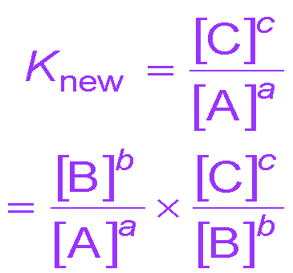
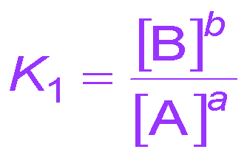
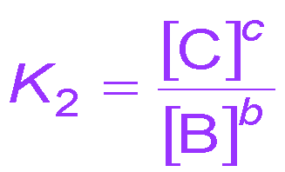
Relationships between K and Chemical Equations
When you add equations to get a new equation, the equilibrium constant of the new equation is the product of the equilibrium constants of the old equations.
For the reaction aA ⇔ cC
the equilibrium constant expression is as follows:
For the reactions (1) aA ⇔ bB and (2) bB ⇔ cC the equilibrium constant expressions are as follows:

Slide 20
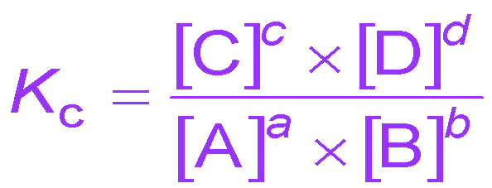
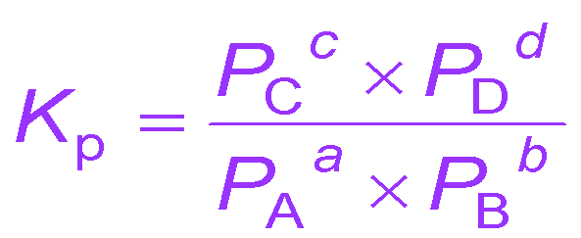
Equilibrium Constants for Reactions Involving Gases
The concentration of a gas in a mixture is proportional to its partial pressure.
Therefore, the equilibrium constant can be expressed as the ratio of the partial pressures of the gases.
For aA(g) + bB(g) ⇔ cC(g) + dD(g) the equilibrium constant expressions are as follows:
or

Slide 21
K_{c} and K_{p}
In calculating K_{p}, the partial pressures are always in atm.
The values of K_{p} and K_{c} are not necessarily the same because of the difference in units.
K_{p} = K_{c} when Δn = 0
The relationship between them is as follows:
Δn is the difference between the number of moles of reactants and moles of products.

Slide 22
Deriving the Relationship between K_{p} and K_{c}

Slide 23
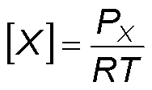
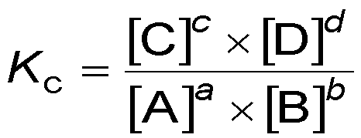
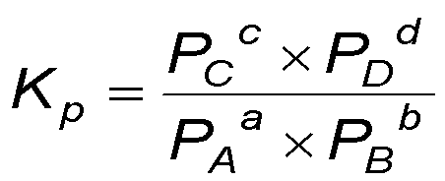
Deriving the Relationship between K_{p} and K_{c}
for aA(g) + bB(g) ⇔ cC(g) + dD(g)
substituting

Slide 24
Heterogeneous Equilibria
The concentrations of pure solids and pure liquids do not change during the course of a reaction.
Because their concentration doesn’t change, solids and liquids are not included in the equilibrium constant expression.
For the reaction the equilibrium constant expression is as follows:

Slide 25
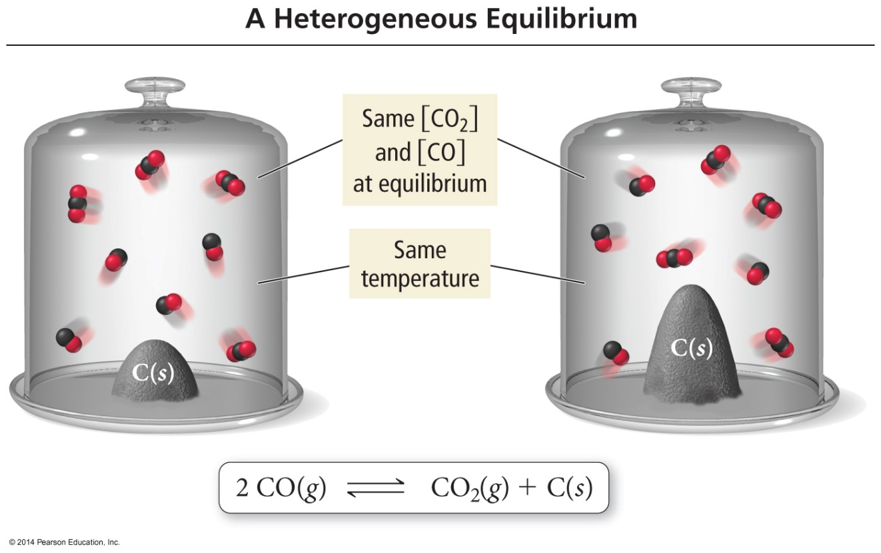
Heterogeneous Equilibria
The amount of C is different, but the amounts of CO and CO₂ remain the same. Therefore, the amount of C has no effect on the position of equilibrium.

Slide 26
The Reaction Quotient
If a reaction mixture containing both reactants and products is not at equilibrium, how can we determine in which direction it will proceed?
The answer is to compare the current concentration ratios to the equilibrium constant.
The concentration ratio of the products (raised to the power of their coefficients) to the reactants (raised to the power of their coefficients) is called the reaction quotient, Q.

Slide 27
The Reaction Quotient
For the gas phase reaction
aA + bB ⇔ cC + dD
the reaction quotient is as follows:

Slide 28
Significance of the Reaction Quotient
If Q = K, the system is at equilibrium
If Q > K, the system shifts to the left, consuming products and forming reactants until equilibrium is achieved
If Q < K, the system shifts to the right, consuming reactants and forming products until equilibrium is achieved

Slide 29
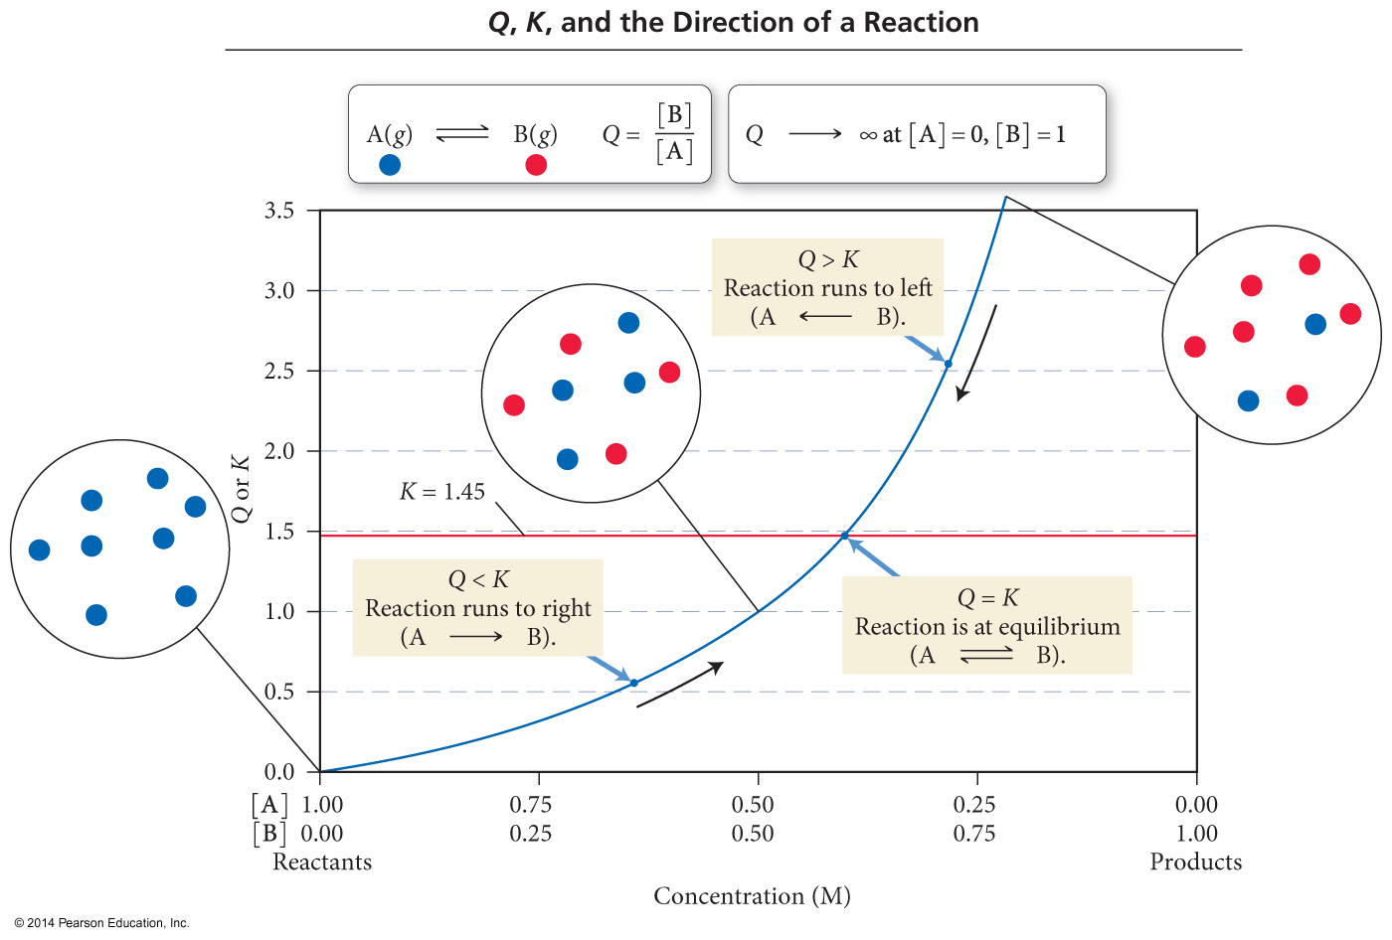
The Reaction Quotient: Predicting the Direction of Change
If Q > K, the reaction will proceed fastest in the reverse direction.
The products will decrease and reactants will increase.

Slide 30
The Reaction Quotient: Predicting the Direction of Change
If Q < K, the reaction will proceed fastest in the forward direction.
The products will increase and reactants will decrease.

Slide 31
The Reaction Quotient: Predicting the Direction of Change
If Q = K, the reaction is at equilibrium
The products and reactants will not change.
If a reaction mixture contains just reactants, then Q = 0, and the reaction will proceed in the forward direction.
If a reaction mixture contains just products, then Q = ∞, and the reaction will proceed in the reverse direction.

Slide 32
Solving for Equilibrium Concentration
Consider this reaction at some temperature:
H₂O(g) + CO(g)  H₂(g) + CO₂(g) K = 2.0
Assume you start with 8 molecules of H₂O and 6 molecules of CO. How many molecules of H₂O, CO, H₂, and CO₂ are present at equilibrium?
Here, we learn about “ICE” – the most important problem solving technique in the second semester. You will use it a lot

Slide 33
Solving for Equilibrium Concentration
H₂O(g) + CO(g)  H₂(g) + CO₂(g) K = 2.0
Step #1: We write the law of mass action for the reaction:

Slide 34
Solving for Equilibrium Concentration
Step #2: We “ICE” the problem, beginning with the Initial concentrations
H₂O(g) + CO(g)  H₂(g) + CO₂(g)
Initial:
Change:
Equilibrium:
8
6
0
0
-x
-x
+x
+x
8-x
6-x
x
x

Slide 35
Solving for Equilibrium Concentration
Step #3: We plug equilibrium concentrations into our equilibrium expression, and solve for x
H₂O(g) + CO(g)  H₂(g) + CO₂(g)
Equilibrium: | 8-x | 6-x | x | x

Slide 36
Solving for Equilibrium Concentration
Step #4: Substitute x into our equilibrium concentrations to find the actual concentrations
H₂O(g) + CO(g)  H₂(g) + CO₂(g)
Equilibrium: | 8-x | 6-x | x | x
Equilibrium: | 8-4=4 | 6-4=2 | 4 | 4

Slide 37
Le Châtelier’s Principle
Le Châtelier's principle guides us in predicting the effect various changes in conditions have on the position of equilibrium.
It says that if a system at equilibrium is disturbed, the position of equilibrium will shift to minimize the disturbance.
Disturbances all involve making the system open.

Slide 38
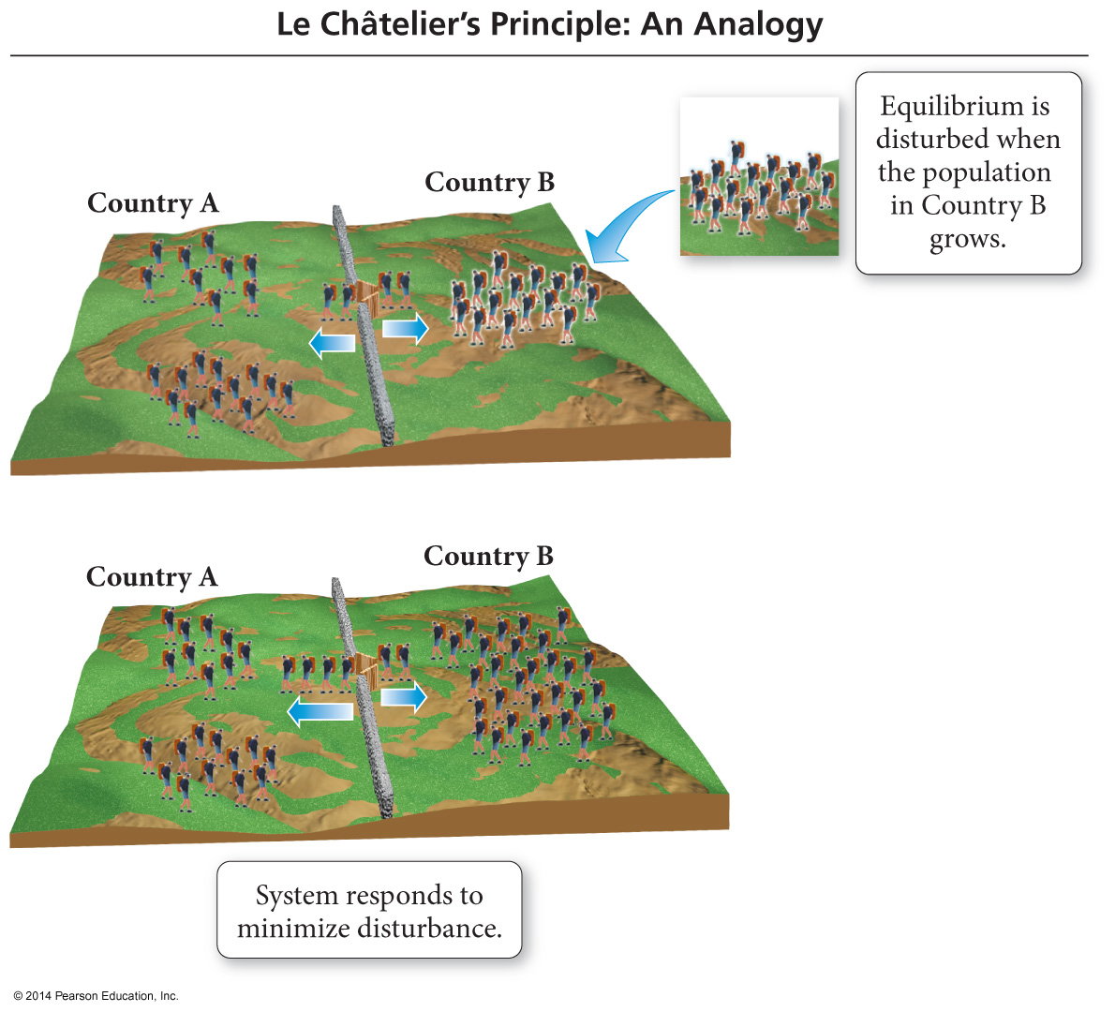
An Analogy: Population Changes
When the populations of Country A and Country B
are in equilibrium, the emigration rates between the
two countries are equal so the populations stay constant.

Slide 39
An Analogy: Population Changes
When an influx of population enters Country B
from somewhere outside Country A, it disturbs the
equilibrium established between Country A and Country B.

Slide 40
An Analogy: Population Changes
The result will be people moving from Country B into Country A faster than people moving from Country A into Country B.
This will continue until a new equilibrium between the populations is established; the new populations will have different numbers of people than the old ones.

Slide 41
LeChatelier Example #1
A closed container of ice and water is at equilibrium. Then, the temperature is raised.
Ice + Energy  Water
The system temporarily shifts to the _______ to restore equilibrium.
right

Slide 42
LeChatelier Example #2
A closed container of N₂O₄ and NO₂ is at equilibrium. NO₂ is added to the container.
N₂O₄ (g) + Energy  2 NO₂ (g)
The system temporarily shifts to the _______ to restore equilibrium.
left

Slide 43
LeChatelier Example #3
A closed container of water and its vapor is at equilibrium. Vapor is removed from the system.
water + Energy  vapor
The system temporarily shifts to the _______ to restore equilibrium.
right

Slide 44
LeChatelier Example #4
A closed container of N₂O₄ and NO₂ is at equilibrium. The pressure is increased.
N₂O₄ (g) + Energy  2 NO₂ (g)
The system temporarily shifts to the _______ to restore equilibrium, because there are fewer moles of gas on that side of the equation.
left

Slide 45
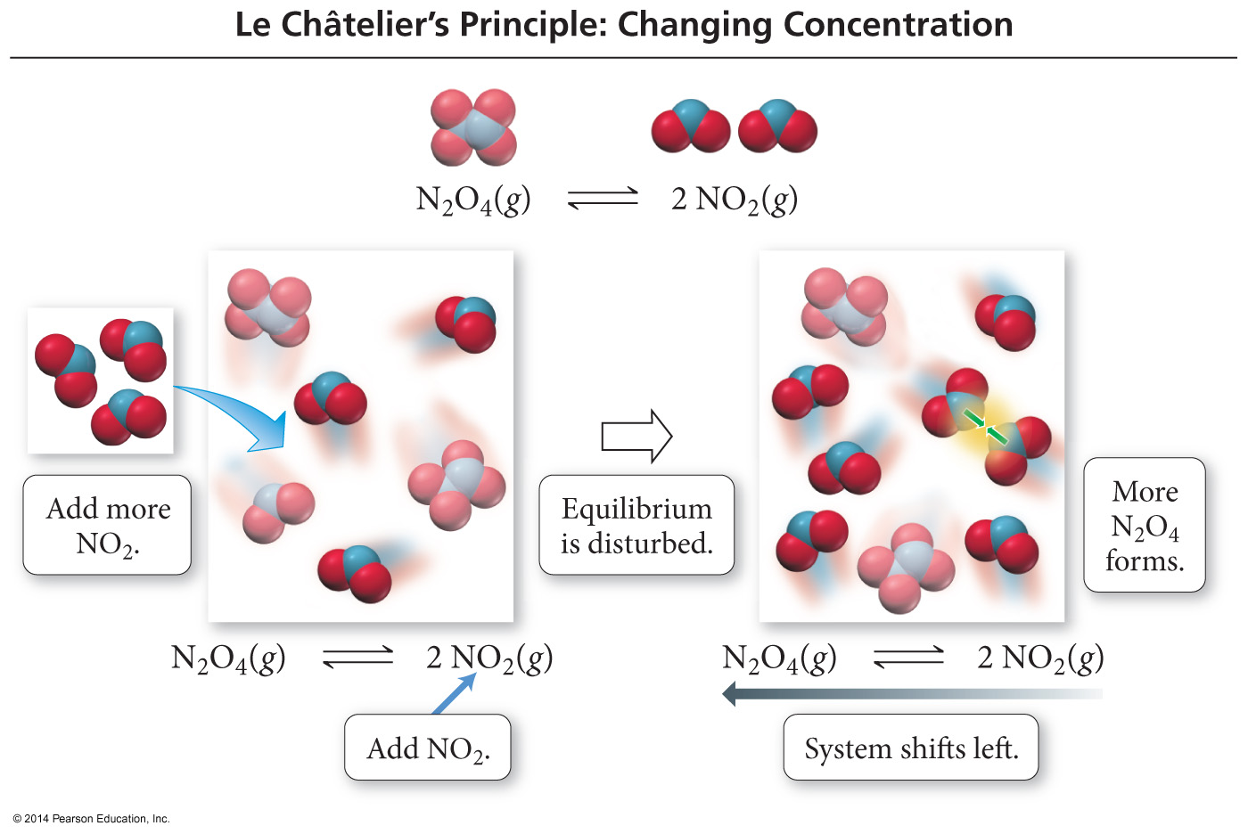
The Effect of Concentration Changes on Equilibrium
When NO₂ is added, some of it combines to make more N₂O₄.

Slide 46
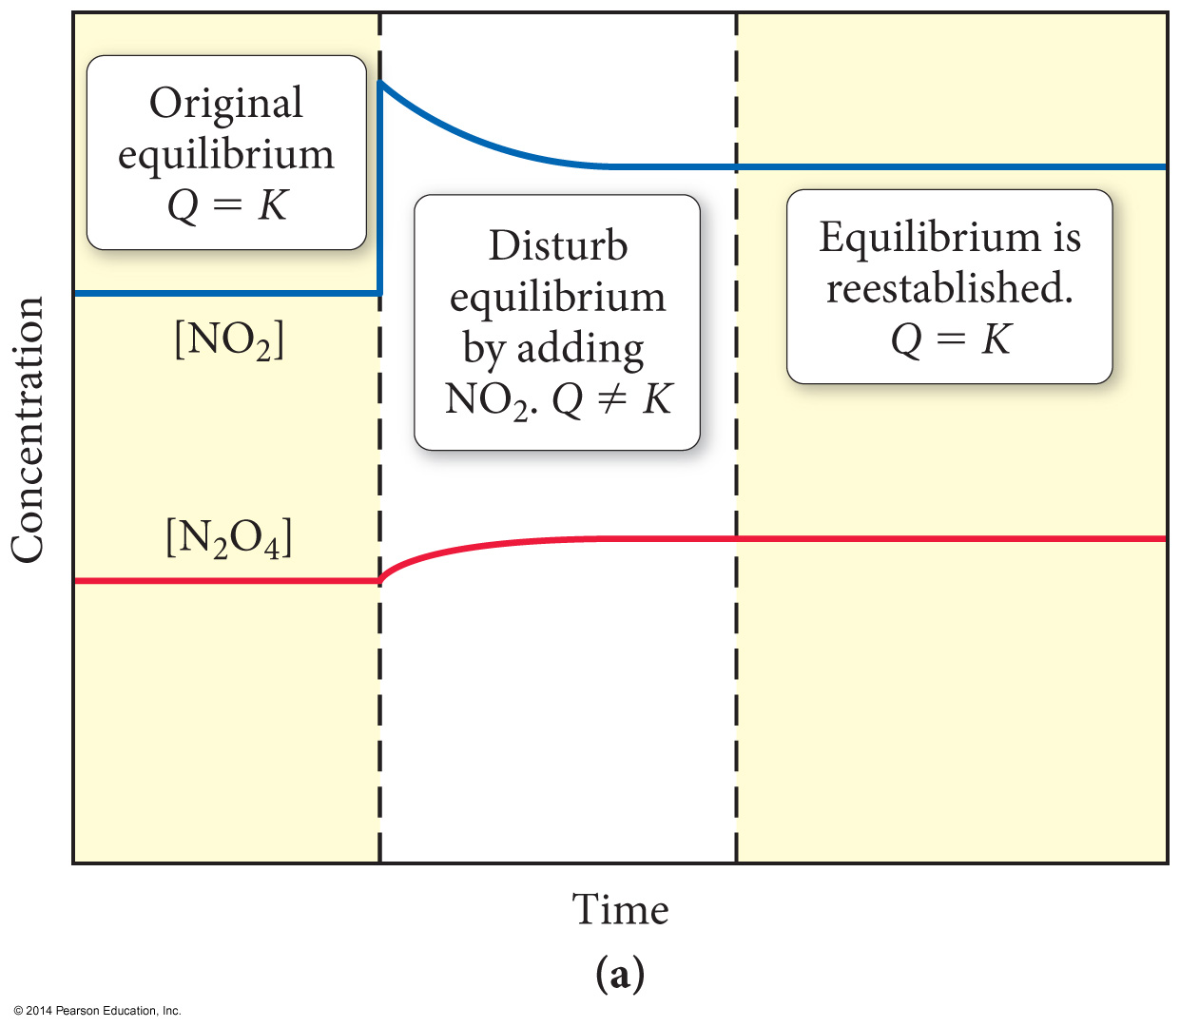
The Effect of Concentration Changes on Equilibrium
When N₂O₄ is added, some of it decomposes to make more NO₂.

Slide 47
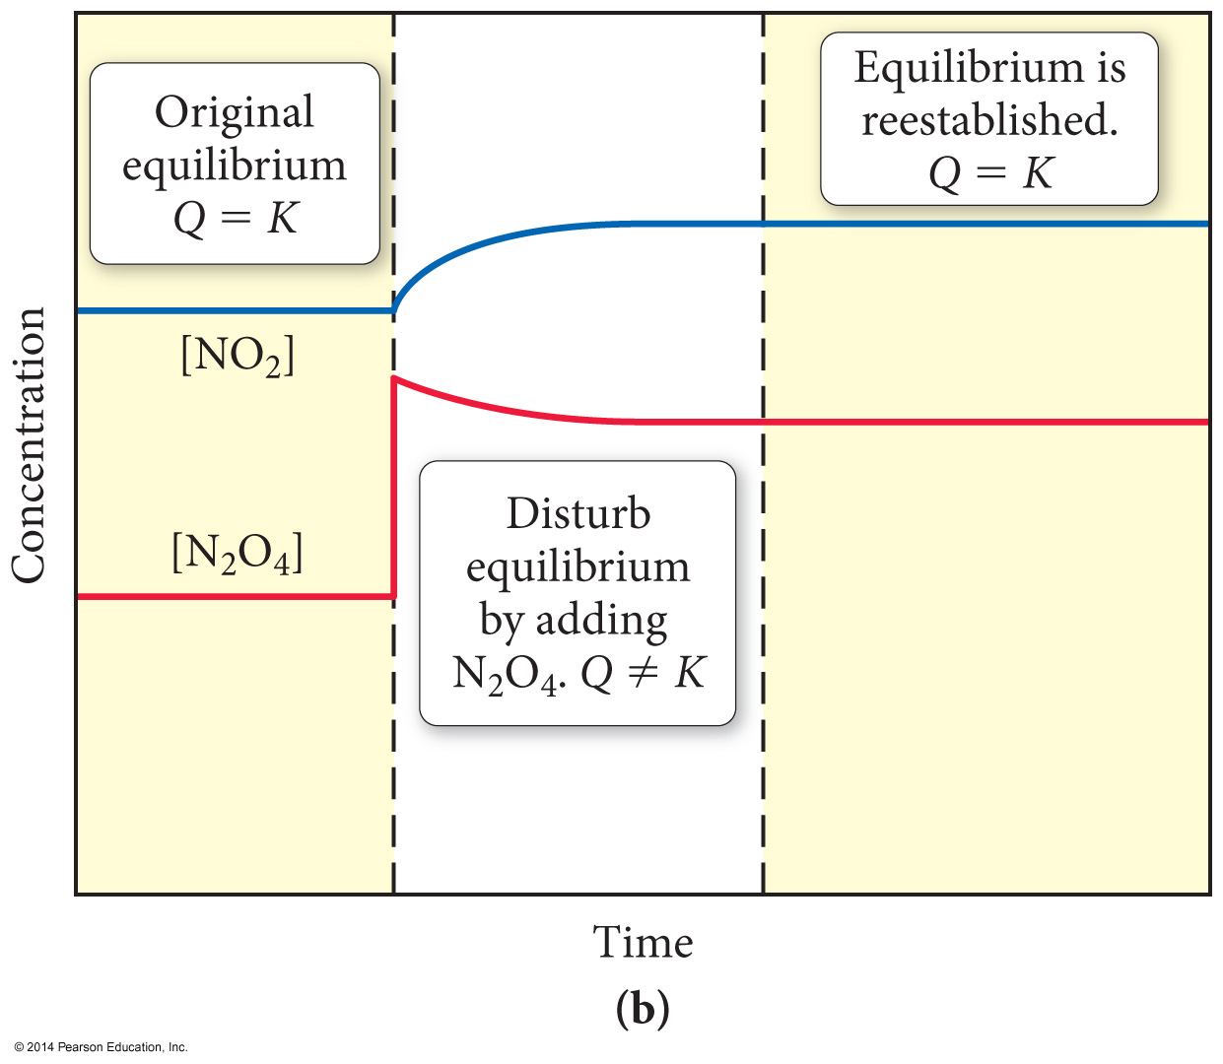
The Effect of Concentration Changes on Equilibrium
When N₂O₄ is added, some of it decomposes to make more NO₂.

Slide 48
The Effect of Volume Changes
on Equilibrium
Left side of figure 14.11
Because there are more gas molecules on the reactants side of the reaction, when the pressure is increased, the position of equilibrium shifts toward the side with fewer molecules to decrease the pressure.

Slide 49
The Effect of Volume Changes on Equilibrium
Right side of figure 14.11
When the pressure is decreased by increasing the volume, the position of equilibrium shifts toward the side with the greater number of molecules—the reactant side.

Slide 50
Not Changing the Position of Equilibrium: The Effect of Catalysts
Catalysts provide an alternative, more efficient mechanism.
Catalysts work for both forward and reverse reactions.
Catalysts affect the rate of the forward and reverse reactions by the same factor.
Therefore, catalysts do not affect the position of equilibrium.

