Slide 1
N12 - Equilibrium
Quick Review
Link to YouTube Presentation: https://youtu.be/3Cz5orCdGMM

Slide 2
N12 - Equilibrium
Quick Review
Target: I can recall and describe what “dynamic equilibrium” is

Slide 3
Chemical Equilibrium
Reversible Reactions
A chemical reaction in which the products can react to re-form the reactants
Chemical Equilibrium
When the rate of the forward reaction equals the rate of the reverse reaction and the concentration of products and reactants remains unchanged
2HgO_{(s)}  2Hg_{(l)} + O_{2(g)}
(  ) indicates equilibrium in a chemical equation

Slide 4
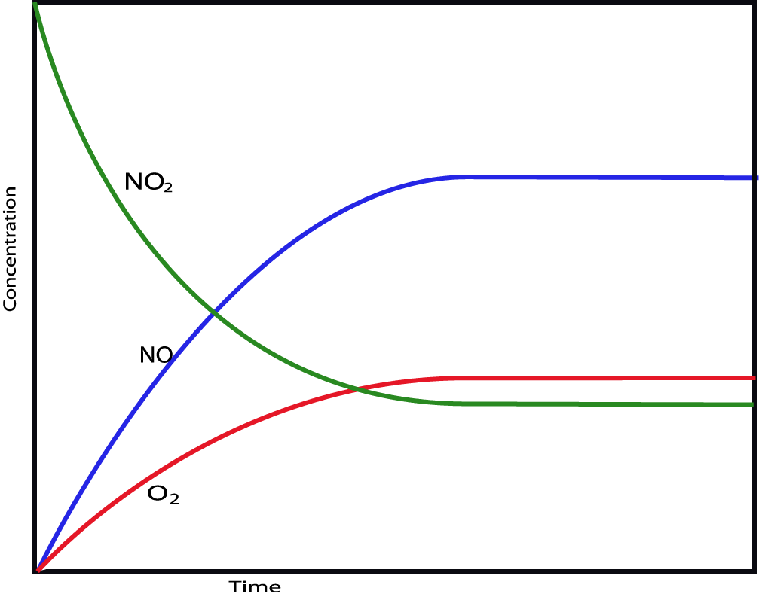
2NO₂(g)  2NO(g) + O₂(g)
Remember this from
Kinetics?
Why was it so important to measure reaction rate at the start of the reaction
(method of initial rates?)

Slide 5
2NO₂(g)  2NO(g) + O₂(g)

Slide 6
H₂(g) + I₂(g) ⇔ 2 HI(g)
As the concentration of product increases and the concentrations of reactants decrease, the rate of the forward reaction slows down, and the rate of the reverse reaction speeds up.

Slide 7
H₂(g) + I₂(g) ⇔ 2 HI(g)
At dynamic equilibrium, the rate of the forward reaction is equal to the rate of the reverse reaction.
The concentrations of reactants and products no longer change.

Slide 8
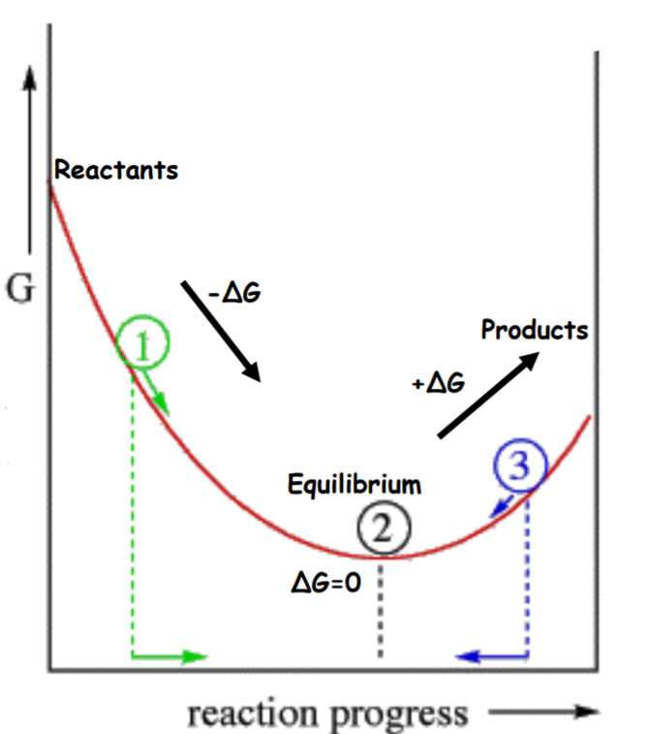
Remember Thermodynamics???
If ΔG = (-) then forward direction is favored.
If ΔG = (+) then reverse direction is favored.
ΔG = 0 then at equilibrium!

Slide 9
Equilibrium ≠ Equal Concentrations!
The rates of the forward and reverse rxns are equal at equilibrium.
But that does NOT mean the concentrations of reactants and products are equal.
Product Favored - Some reactions reach equilibrium only after almost all the reactant molecules are consumed; we say the position of equilibrium favors the products.
Reactant Favored - Other reactions reach equilibrium when only a small percentage of the reactant molecules are consumed; we say the position of equilibrium favors the reactants.

Slide 10
An Analogy:
https://youtu.be/dUMmoPdwBy4

Slide 11
YouTube Link to Presentation
https://youtu.be/3Cz5orCdGMM

