Slide 1
N13 - Equilibrium
K – Equilibrium Constant (Capitalized!)
Link to YouTube Presentation: https://youtu.be/JbbaquQpHsw

Slide 2
N13 - Equilibrium
K – Equilibrium Constant (Capitalized!)
Target: I can calculate K, convert K when changes to a reaction are made, and can use the size of K to determine product or reactant favored.

Slide 3
Equilibrium Constant
Even though the concentrations of reactants and products are not equal at equilibrium, there is a relationship between them.
Law of Mass Action or also Equilibrium Expression The relationship between the chemical equation and the concentrations of reactants and products.

Slide 4
Equilibrium Constant
For the general equation aA + bB → cC + dD
The law of mass action gives the relationship below.
The lowercase letters represent the coefficients of the balanced chemical equation.
Always products over reactants
K is called the equilibrium constant.
Unitless

Slide 5
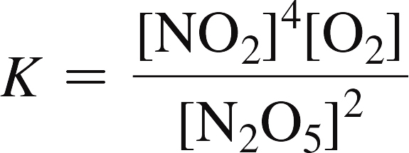
Writing Equilibrium Constant Expressions
2 N₂O_{5(g)} ⇔ 4 NO_{2(g)} + O_{2(g)}
The equilibrium constant expression is:

Slide 6
Heterogeneous Equilibria
[ ]s of pure solids and pure liquids do not change during the course of a reaction.
Because their [ ]s don’t change, solids and liquids are not included in the equilibrium constant expression.
the equilibrium constant expression is as follows:

Slide 7
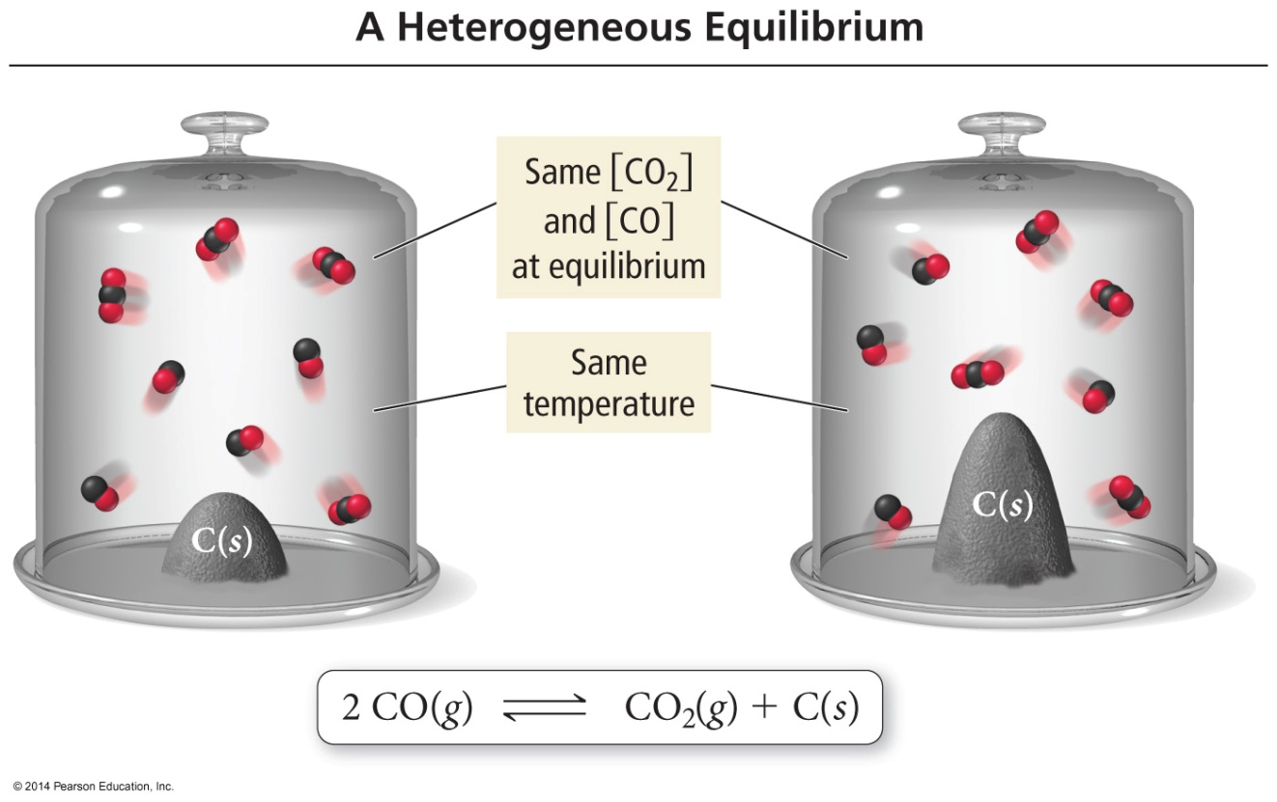
Heterogeneous Equilibria
The amount of C is different, but the concentrations of CO and CO₂ remain the same. Therefore, the amount of C has no effect on the position of equilibrium.

Slide 8
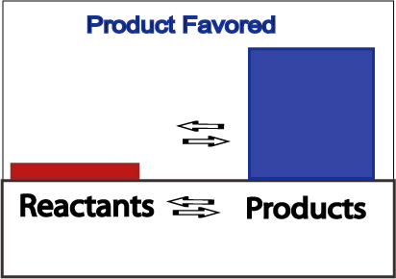
Product Favored Equilibrium
Large values for K signify the reaction is product favored
When equilibrium is achieved, most reactant has been converted to product

Slide 9
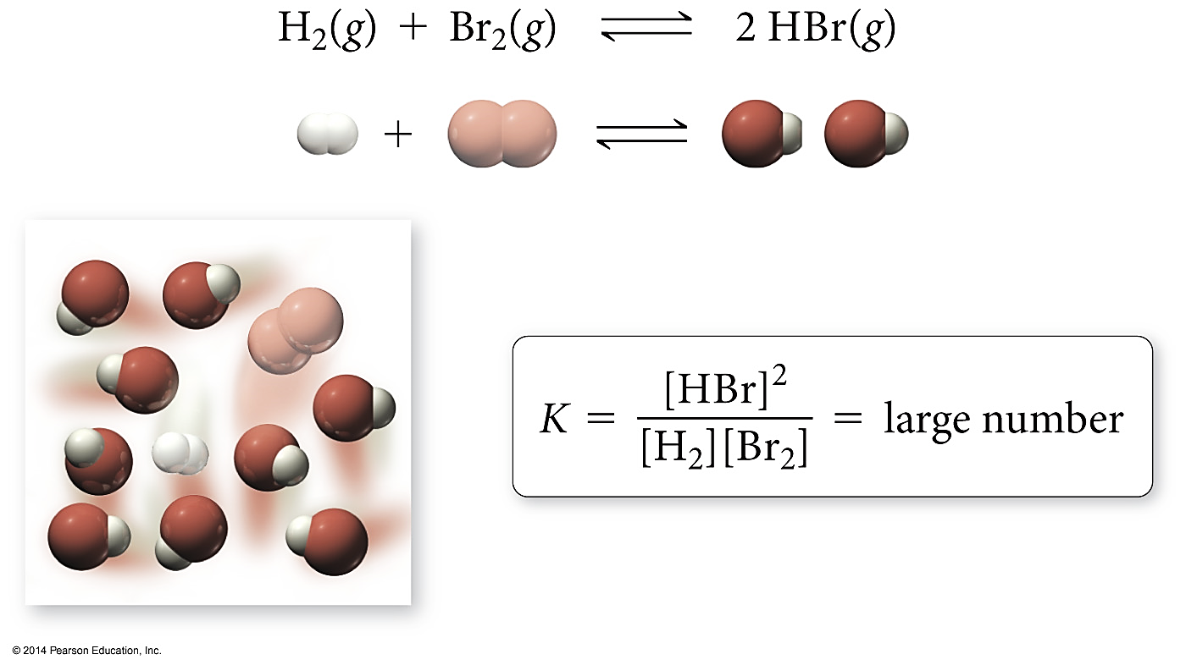
A Large Equilibrium Constant
PRODUCT FAVORED
Lots of products = Large numerator =
Large K value

Slide 10
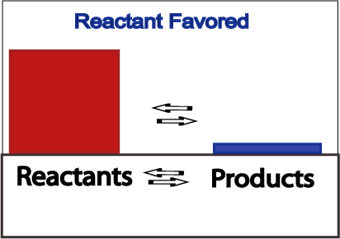
Reactant Favored Equilibrium
Small values for K signify the reaction is reactant favored
When equilibrium is achieved, very little reactant has been converted to product

Slide 11
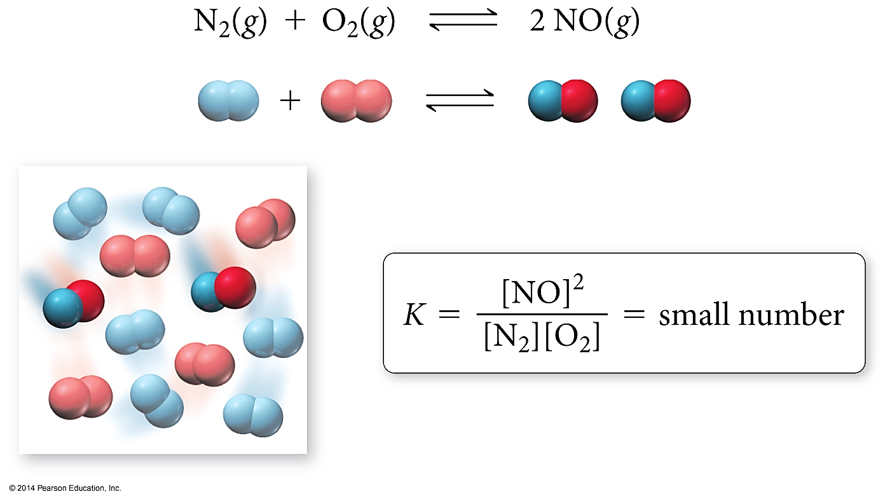
A Small Equilibrium Constant
Reactant FAVORED
Lots of reactants = Large denomenator =
Small K value

Slide 12
Relationships between K and Chemical Equations
When the reaction is written backward, the equilibrium constant is inverted.
aA + bB → cC + dD
the equilibrium constant expression is:
cC + dD → aA + bB
the equilibrium constant expression is:
$$K_{backwards}=\frac{1}{K_{forward}}$$

Slide 13
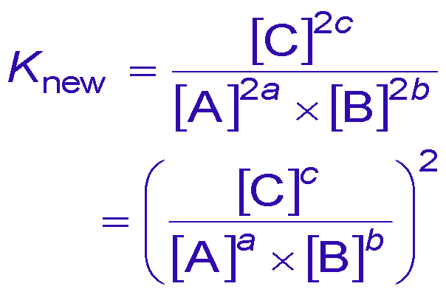
Relationships between K and Chemical Equations
When the coefficients of an equation are multiplied by a factor, the equilibrium constant is raised to that factor.
aA + bB ⇔ cC
the equilibrium constant expression is:
2aA + 2bB ⇔ 2cC
the equilibrium constant expression is:
$$K_{new}=K_{original}^{n}$$

Slide 14
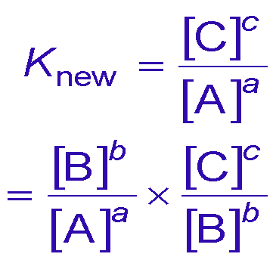
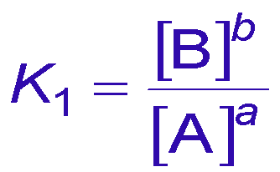
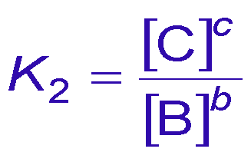
Relationships between K and Chemical Equations
When you add equations to get a new equation, the equilibrium constant of the new equation is the product of the equilibrium constants of the old equations.
aA ⇔ bB
bB ⇔ cC
the equilibrium constant expressions are:
aA ⇔ cC
the equilibrium constant is:
$$K_{new}=K_{1} x K_{2}$$

Slide 15
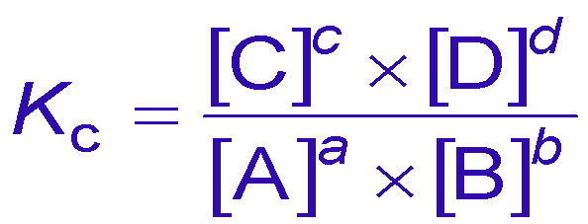
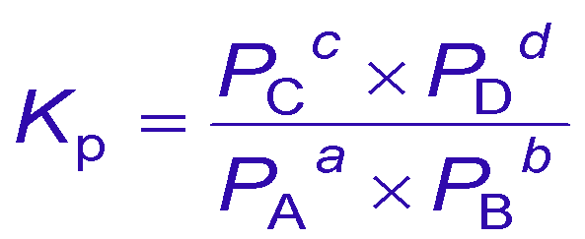
Equilibrium Constants for Rxns Involving Gases
The [ ]s of a gas in a mixture is proportional to its partial pressure.
Therefore, K can be expressed as the ratio of the partial pressures of the gases.
aA(g) + bB(g) ⇔ cC(g) + dD(g) the equilibrium constant expressions are:
or

Slide 16
Kc and Kp
K_{p}, the partial pressures are always in atm.
K_{p} and K_{c} are not necessarily the same because of the difference in units.
K_{p} = K_{c} when Δn = 0
$$K_{p}=K_{c} x {\left(RT\right)}^{∆n}$$
Δn is the difference between the number of moles of reactants and moles of products.

Slide 17
Connecting K to k
$$\text{K}\text{eq}\text{ = }\frac{{[C]}^{2}}{{[A]}^{2}{[B}_{2}]}$$
At equilibrium 2A + B₂ → 2C
rate forward = rate backwards
Rate_{forward} = k_{f}[A]²[B₂] Rate_{reverse} = k_{r}[C]²
k_{f} [A]² [B₂] = k_{r} [C]²
Rearrange to look like this!
$$\frac{{[C]}^{2}}{{[A]}^{2}{[B}_{2}]}= \frac{k_{f}}{k_{r}}$$
Now you can find K_{eq} if you know k_{f} and k_{r} !

Slide 18
YouTube Link to Presentation
https://youtu.be/JbbaquQpHsw

Slide 19
Deriving the Relationship Between Kc and Kp
$$\left[A\right]=\frac{P_{A}}{RT}$$

Slide 20
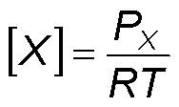
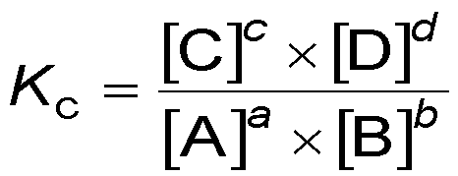
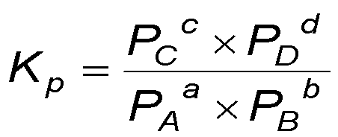
Deriving the Relationship Between Kc and Kp
aA(g) + bB(g) ⇔ cC(g) + dD(g)
substituting

