Slide 1
N14 - Equilibrium
Le Châtelier’s Principle
Link to YouTube Presentation: https://youtu.be/lUdunOfj-OE

Slide 2
N14 - Equilibrium
Le Châtelier’s Principle
Target: I can describe how a reaction shifts in response to a change in conditions (a stress) in order to reach a new equilibrium position.

Slide 3
Le Châtelier’s Principle
Le Châtelier’s Principle
Guides us in predicting the effect various changes in conditions have on the position of equilibrium.
If a system at equilibrium is disturbed, the position of equilibrium will shift to minimize the disturbance.
You don’t go back to the ORIGINAL equilibrium position, you will find a NEW equilibrium position.

Slide 4
Le Châtelier’s Principle
Equilibrium Position = numerical K value
LOTS of [ ]’s lead to same K value!
$\frac{2}{1}=2 \frac{4}{2}=2$ $\frac{3}{1.5}=2$

Slide 5
What is the only thing that changes K value ?
TEMPERATURE!
Exothermic
Increase temp, shift left, make more reactants - K ↓
Decrease temp, shift right, make more products – K ↑
Endothermic
Increase temp, shift right, make more products - K ↑
Decrease temp, shift left, make more reactants - K ↓

Slide 6
Don’t forget BEFORE vs DURING vs AFTER!
NOT at equilibrium YET....calculate Q!
Which way are you shifting DURING a stress?
How much of everything do you have at the end after the adjustment?
Can be really hard to talk about. Remember when talking about comparisons you need to ACTUALLY compare! This time that might include TIME aspects! Before, during, or after!
There is more of _____ THAN before the stress was applied

Slide 7
[N₂] DURING the Stress no longer @ equilibrium
Didn’t get back to starting point, but better than during the stress!
So comparing BEFORE stressor to AFTER stressor, there is a SLIGHT increase to the thing you added extra of.
[N₂] AFTER reacting a NEW equilibrium position
[N₂] BEFORE Stress Applied @ ORIGINAL equilibrium position

Slide 8
Le Chatelier Example #1
A closed container of ice and water is at equilibrium. Then, the temperature is raised.
Ice + Energy  Liquid Water
right
The system temporarily shifts to the _______ to reach a new equilibrium.

Slide 9
Le Chatelier Example #2
A closed container of N₂O₄ and NO₂ is at equilibrium. NO₂ is added to the container.
N₂O₄ (g) + Energy  2 NO₂ (g)
left
The system temporarily shifts to the _______ to reach a new equilibrium.

Slide 10
Le Chatelier Example #3
A closed container of water and its vapor is at equilibrium. Vapor is removed from the system.
water + Energy  vapor
right
The system temporarily shifts to the _______ to reach a new equilibrium.

Slide 11
Le Chatelier Example #4
A closed container of N₂O₄ and NO₂ is at equilibrium. The pressure is increased.
N₂O₄ (g) + Energy  2 NO₂ (g)
left
The system temporarily shifts to the _______ to reach a new equilibrium, because there are fewer moles of gas on that side of the equation.

Slide 12
The Effect of Volume Changes on Equilibrium
Increase Pressure, Lower Volume
Equilibrium will shift to the side that has fewer moles of gas particles. Helps to relieve the pressure.
N_{2(g)} + 3H_{2(g)} ↔ 2NH_{3(g)}
4 moles of gas
2 moles of gas
Reaction would shift to right, make more products

Slide 13
The Effect of Volume Changes on Equilibrium
Decrease Pressure, Increase Volume
Equilibrium will shift to the side that has more moles of gas particles. Helps to raise the pressure.
N_{2(g)} + 3H_{2(g)} ↔ 2NH_{3(g)}
4 moles of gas
2 moles of gas
Reaction would shift to left, make more reactants

Slide 14
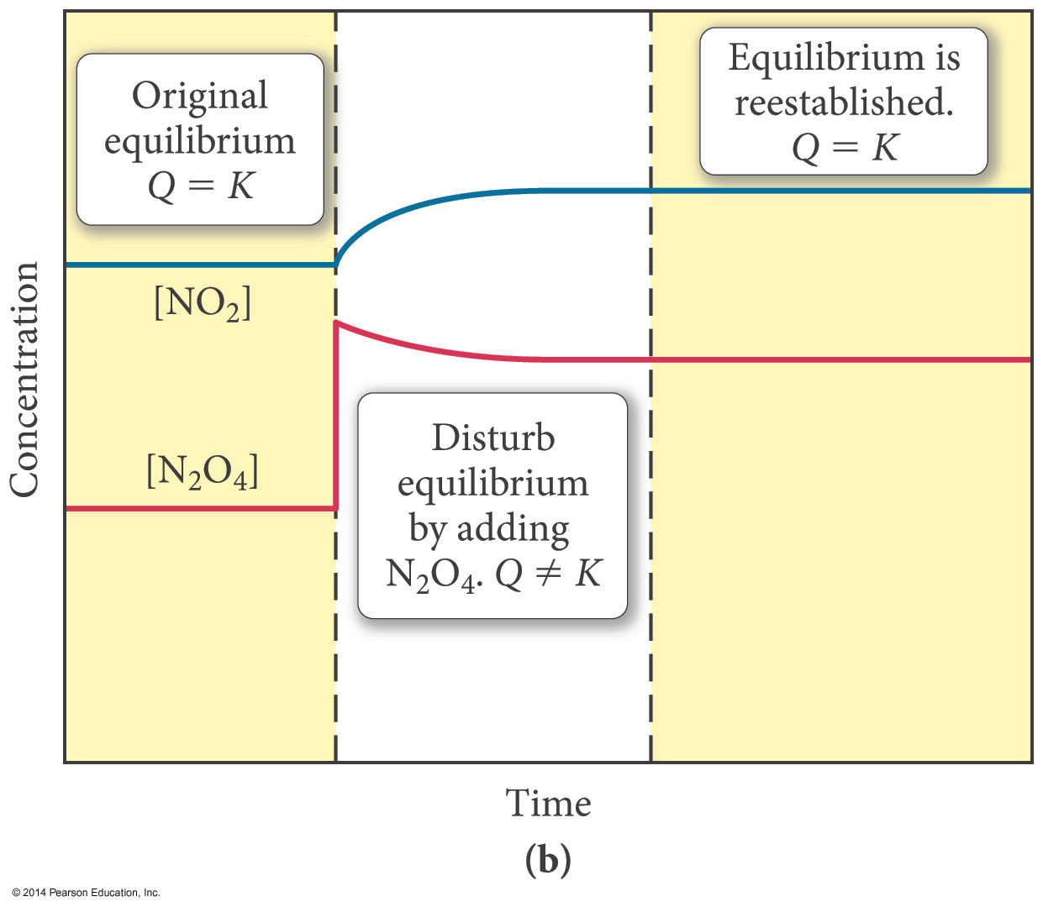
The Effect of [ ] Changes on Equilibrium
When N₂O₄ is added, some of it decomposes to make more NO₂.

Slide 15
The Effect of [ ] Changes on Equilibrium
When N₂O₄ is added, some of it decomposes to make more NO₂.

Slide 16
The Effect of [ ] Changes on Equilibrium
LOTS of [ ]’s lead to same K value!
$$\frac{2}{1}=2$$
$$\frac{4}{2}=2$$
$$\frac{3}{1.5}=2$$
Notice how it is at a NEW equilibrium?
When N₂O₄ is added, some of it decomposes to make more NO₂.

Slide 17
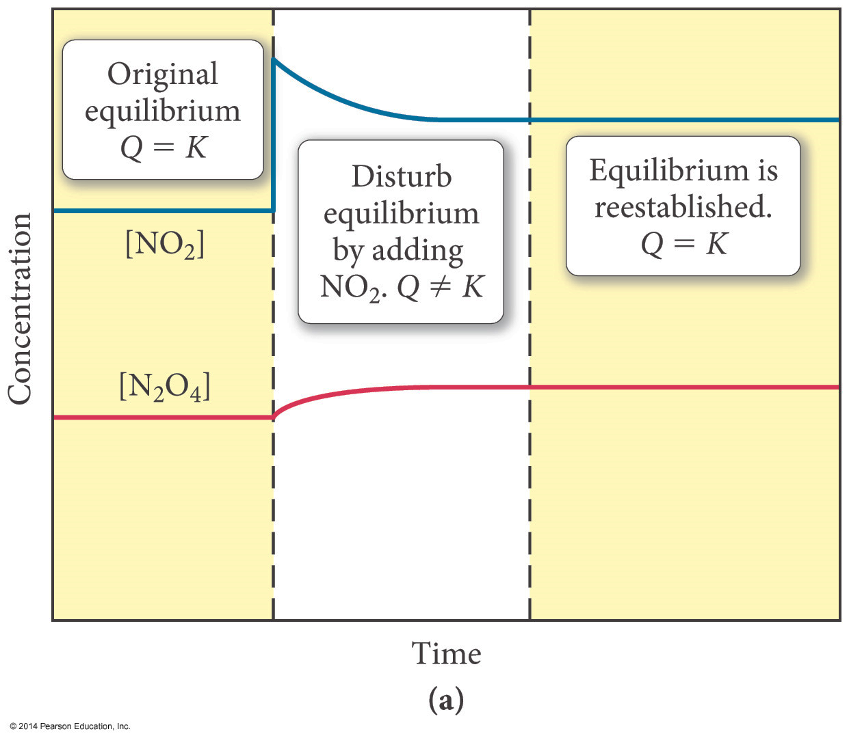
The Effect of [ ] Changes on Equilibrium
When NO₂ is added, some of it decomposes to make more N₂O₄ .

Slide 18
The Effect of [ ] Changes on Equilibrium
When NO₂ is added, some of it decomposes to make more N₂O₄ .

Slide 19
The Effect of [ ] Changes on Equilibrium
Notice how it is at a NEW equilibrium?
When NO₂ is added, some of it decomposes to make more N₂O₄ .

Slide 20
The Effects of Catalysts – Careful!
Provide an alternative, more efficient mechanism.
Works for both forward and reverse reactions.
Affect the rate of the forward and reverse reactions by the same factor.
Therefore, catalysts do not affect the position of equilibrium.
They do not change the position of equilibrium…
You just get to equilibrium faster!

Slide 21
The Effects of Catalysts
They do not change the position of equilibrium…
You just get to equilibrium faster!

Slide 22
Sometimes there are REALLY tricky ones ☹
Adding a (l) doesn’t affect the equilibrium position right???
BUT...
What if you add water as your liquid???
It changes the CONCENTRATION of what you have...
Does that affect Q ???
YES! Q changes! K stays the same!
So you will end up making more reactants or products depending on the equation. SO tricky! Have to be careful...not everything is tricky, but sometimes they are!

Slide 23
Things that Make a Good Equilibrium Answer
IDENTIFY the stressor
WHAT will change because of that stressor?
WHY will things change?
HOW does the change happen?
IMPACT on [ ] , Partial Pressures, K_{eq} etc
(We will do a warmup where we use this as our format!)

Slide 24
Link to YouTube Presentation
https://youtu.be/lUdunOfj-OE

