Slide 1
Atomic Structure and Periodicity Shielding and Such

Slide 2
Shielding
In a multielectron system, electrons are simultaneously attracted to the nucleus and repelled by each other.
Outer electrons are shielded from the nucleus by the core electrons.
Shielding effect
Outer electrons do not effectively screen for each other.
The shielding causes the outer electrons to not experience the full strength of the nuclear charge.

Slide 3
Effective Nuclear Charge
The effective nuclear charge is a net positive charge that is attracting a particular electron.
Z is the nuclear charge, and S is the number of electrons in lower energy levels.
Electrons in the same energy level contribute to screening but since their contribution is so small they are not part of the calculation.
Trend is s > p > d > f.
Z_{effective} = Z − S

Slide 4
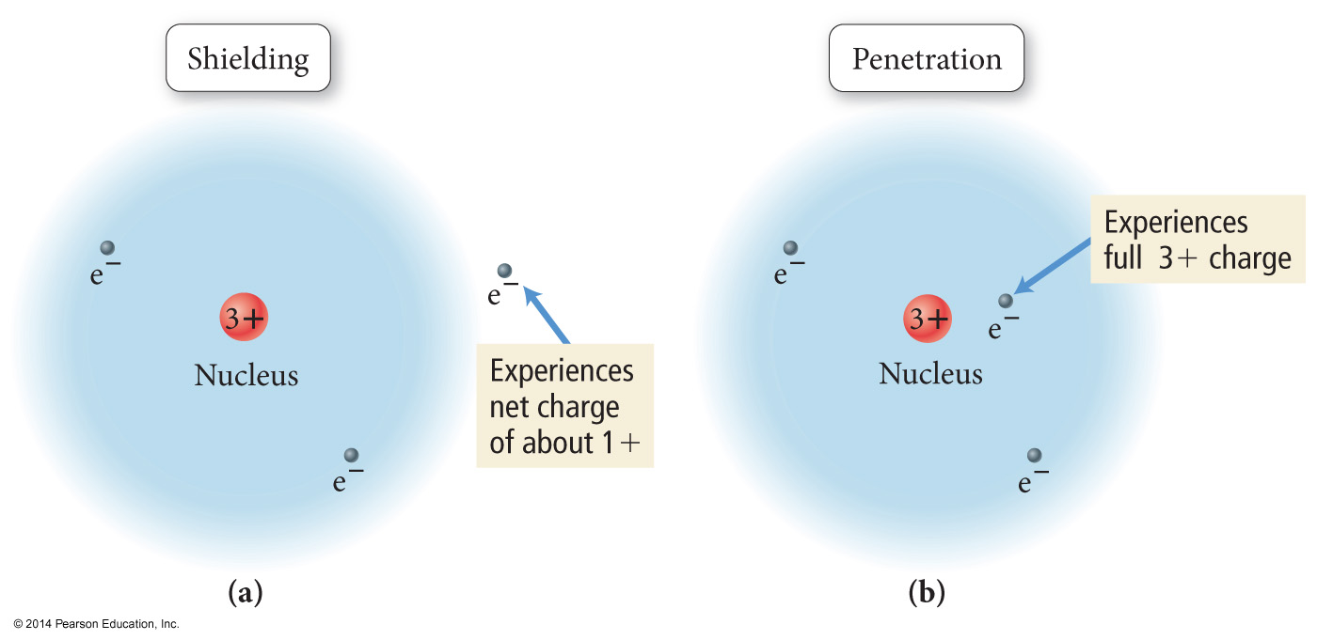
Shielding and Penetration

Slide 5
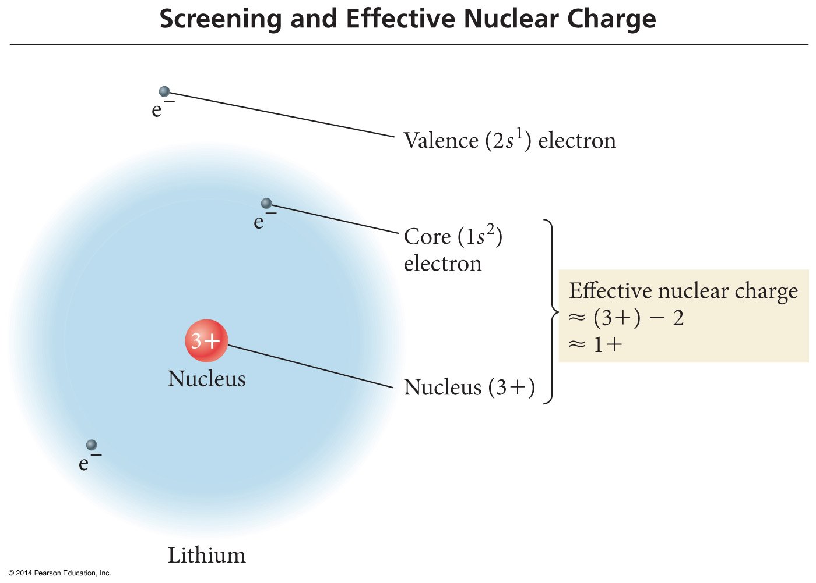
Shielding and Effective Nuclear Charge

Slide 6
An orbital is a region within an atom where there is a probability of finding an electron. This is a probability diagram for the s orbital in the first energy level…
Orbital shapes are defined as the surface that
contains 90% of the total electron probability.

Slide 7
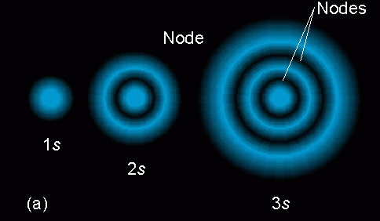
Sizes of s orbitals
Orbitals of the same shape (s, for instance) grow
larger as n increases…
Nodes are regions of low probability within an
orbital.

Slide 8
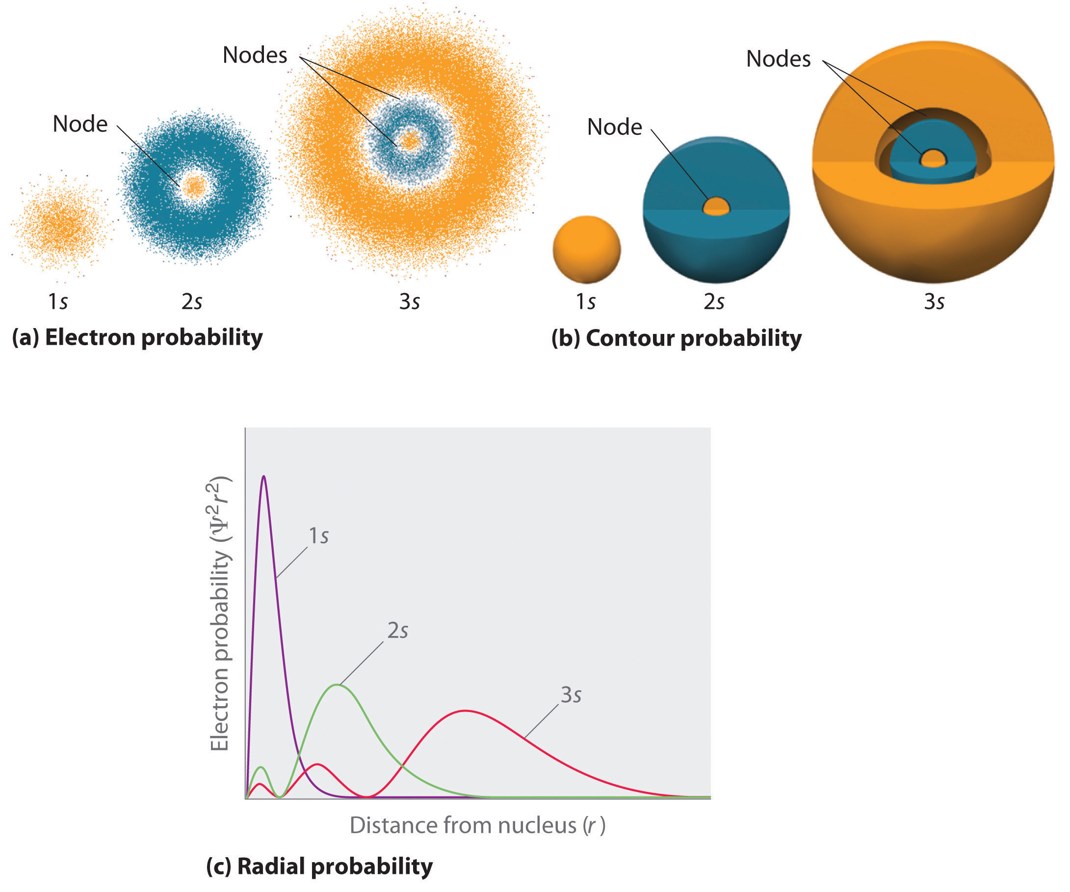

Slide 9
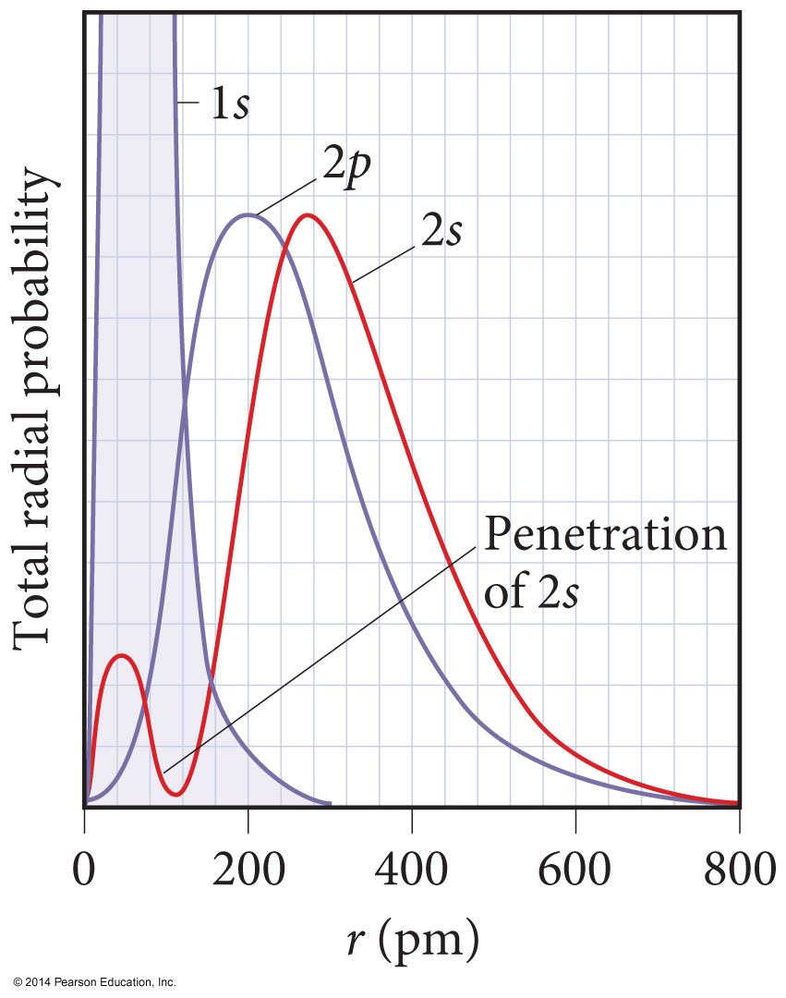
Penetration and Shielding
The radial distribution function shows that the 2s orbital penetrates more deeply into the 1s orbital than does the 2p.
The weaker penetration of the 2p sublevel means that electrons in the 2p sublevel experience more repulsive force; they are more shielded from the attractive force of the nucleus.
The deeper penetration of the 2s electrons means electrons in the 2s sublevel experience a greater attractive force to the nucleus and are not shielded as effectively.

Slide 10
Penetration
The closer an electron is to the nucleus, the more attraction it experiences.
The better an outer electron is at penetrating through the electron cloud of inner electrons, the more attraction it will have for the nucleus.
The degree of penetration is related to the orbital’s radial distribution function.
In particular, the distance the maxima of the function are from the nucleus

Slide 11
Penetration #1
Orbitals in outer energy levels DO penetrate into
lower energy levels.
This is a probability
Distribution for a
3s orbital.
What parts of the
diagram correspond
to “nodes” – regions
of zero probability?

Slide 12
Probability distribution

Slide 13
Probability distribution

