Slide 1
Photoelectron Spectroscopy
(PES)

Slide 2
Spectroscopy
Method of analyzing matter using electromagnetic radiation.

Slide 3
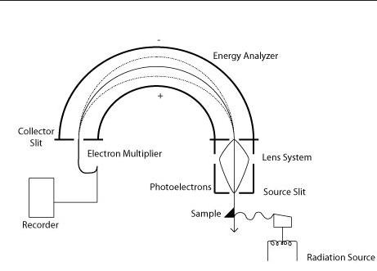
Photoelectron Spectroscopy
How it works:
Sample is exposed to EM radiation
Electrons jump out of sample and go through analyzer
http://chemwiki.ucdavis.edu

Slide 4
PES Data
Electrons generally farther from the nucleus
Electrons
generally closer to the nucleus
Each peak represents the electrons in a single sublevel in the atom
The bigger the peak – the more electrons
Number of electrons #
Energy to remove an electron
(binding energy)
(increases to the left!)
←

Slide 5
Hydrogen vs. Helium
Helium
Hydrogen
#e⁻
#e⁻
← energy
← energy
1 electron in 1s
2 electrons in 1s
The helium peak is twice as tall because there are twice as many electrons in the 1s sublevel

Slide 6
Hydrogen vs. Helium
Helium
Hydrogen
#e⁻
#e⁻
← energy
← energy
1 electron in 1s
2 electrons in 1s
The helium peak is farther to the left (higher energy) thus more energy is needed to remove
the 1s electrons in helium. They must be held more tightly because there is a higher effective
nuclear charge. (Helium has 2 protons pulling on 1s but hydrogen only has 1)

Slide 7
Oxygen (1s²2s²2p⁴)
Number of electrons #
2 electrons in 1s
2 electrons in 2s
4 electrons in 2p
Energy to remove an electron
(binding energy)
(increases to the left!)
←

Slide 8
Scandium (1s²2s²2p⁶3s²3p⁶4s²3d¹)
Number of electrons
*Notice that it takes more
energy to remove an electron from
3d than from 4s.
This is because as electrons are
added to 3d they shield 4s thus it’s
easier (takes less energy) to
remove 4s electrons compared to
3d electrons.
Remember when transition metals make
positive ions - it’s the s electrons that are
lost first!
2 in1s
2 in 3s
2 in 4s
1 in 3d
2 in 2s
6 in 2p
6 in 2p
Energy to remove an electron
(binding energy)
(increases to the left!)
←

Slide 9
Example 1:
Number of electrons
Identify the element whose
PES data is shown to the right.
Sodium
Why is one peak much larger
Than the others?
This peak represents 6 electrons
In the 2p sublevel the other
Peaks represent only 1 or 2
electrons
In which sublevel are the electrons
Represented by peak A
3s
A
Energy
←

Slide 10
Example 2:
Oxygen
Nitrogen
#e⁻
#e⁻
← energy
← energy
The PES data above shows only the peak for the 1s electrons. Why is the peak for
Nitrogen farther to the right?
It takes less energy to remove a 1s electron from nitrogen because it has a lower
Effective nuclear charge (less protons) than oxygen

Slide 11
Example 3:
Number of electrons
Draw the expected PES
Spectrum for the element boron
Energy
←

