Slide 1
Atomic Structure and Periodicity

Slide 2
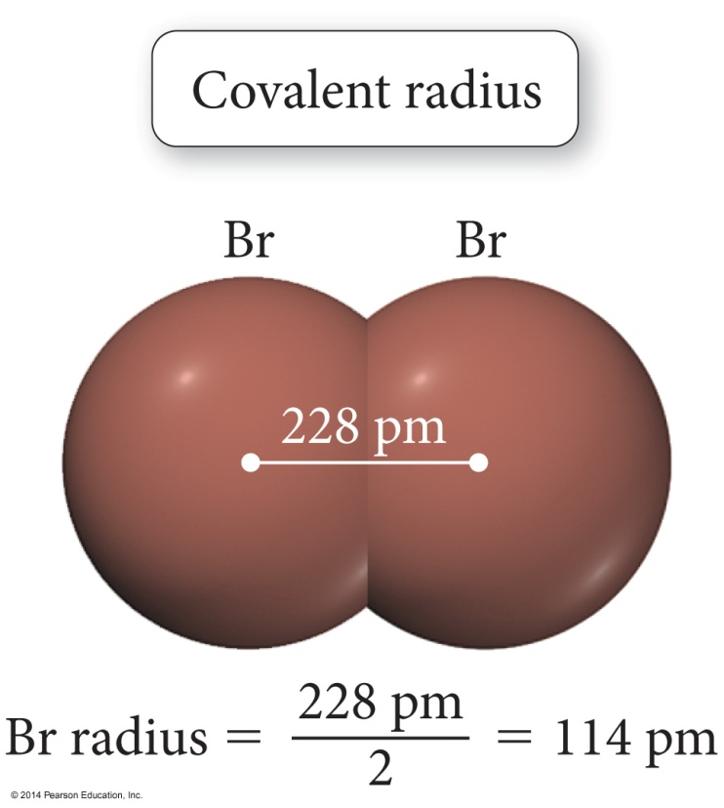
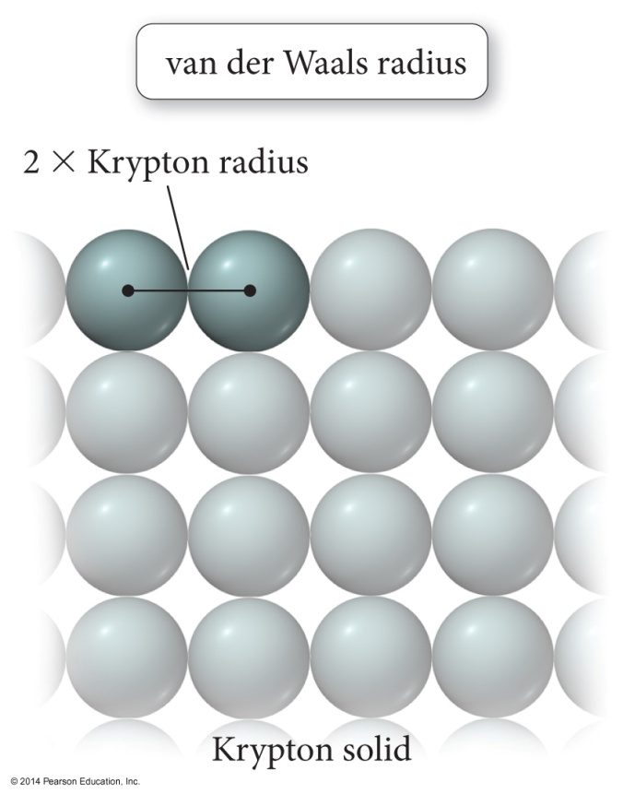
Trend in Atomic Radius – Main Group
There are several methods for measuring the radius of an atom, and they give slightly different numbers.
Van der Waals radius = nonbonding
Covalent radius = bonding radius
Atomic radius is an average radius of an atom based on measuring large numbers of elements and compounds.

Slide 3
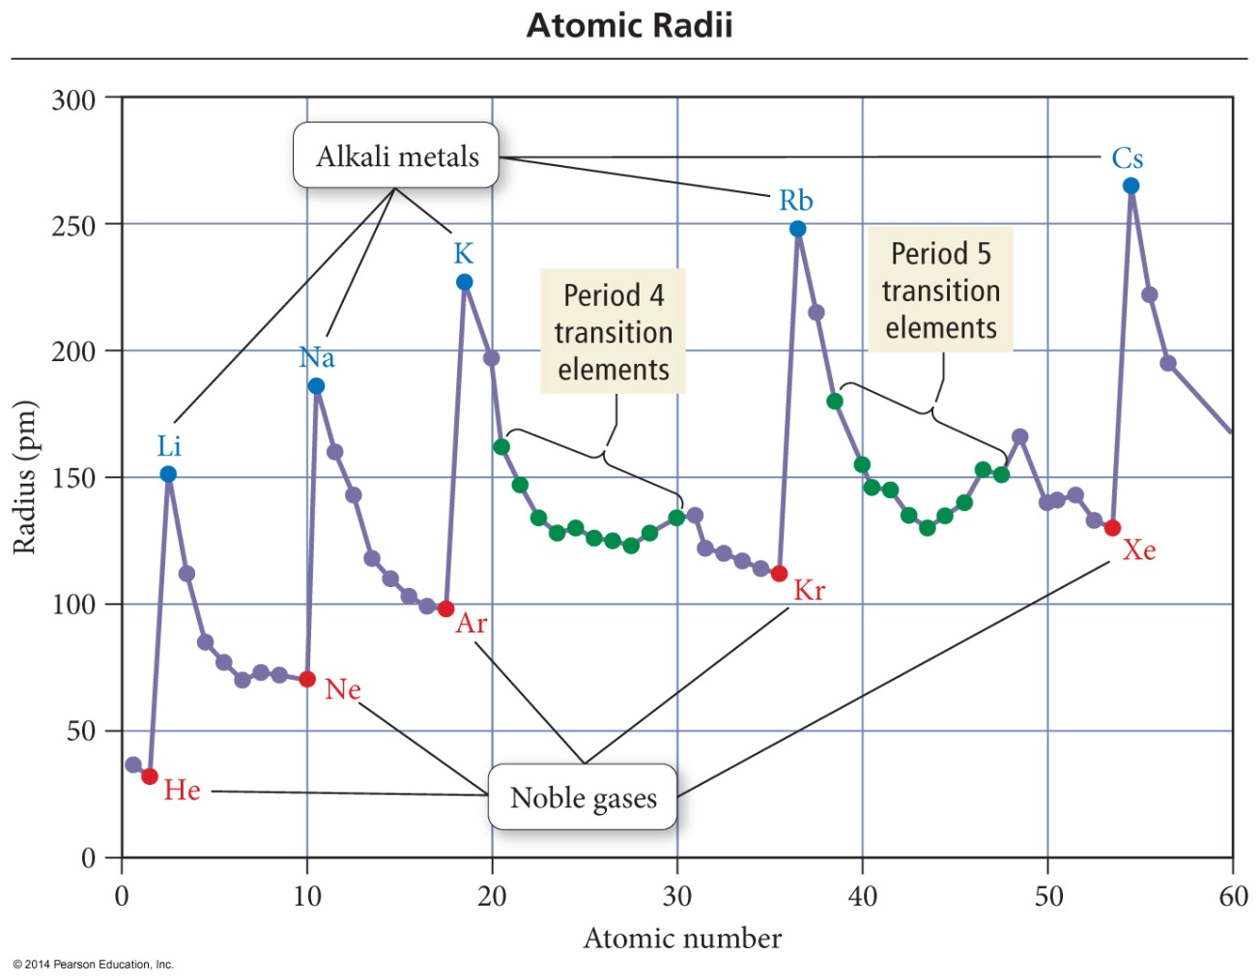
Trend in Atomic Radius – Main Group
Atomic radius decreases across period (left to right)
Adding electrons to same valence shell
Effective nuclear charge increases
Valence shell held closer

Slide 4
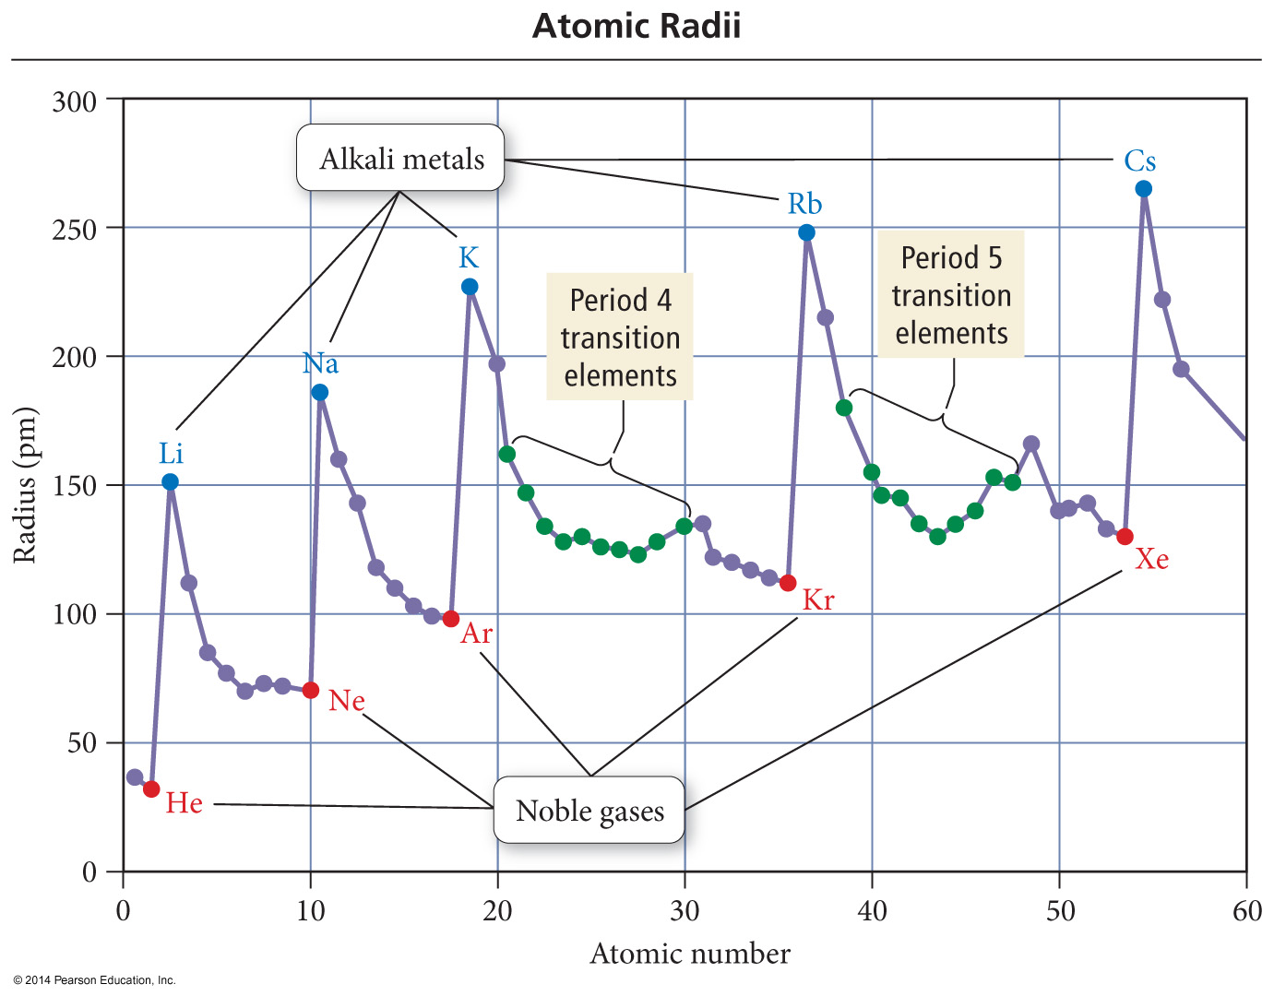
Trend in Atomic Radius – Main Group
Atomic radius increases down group
Valence shell farther from nucleus
Effective nuclear charge fairly close

Slide 5
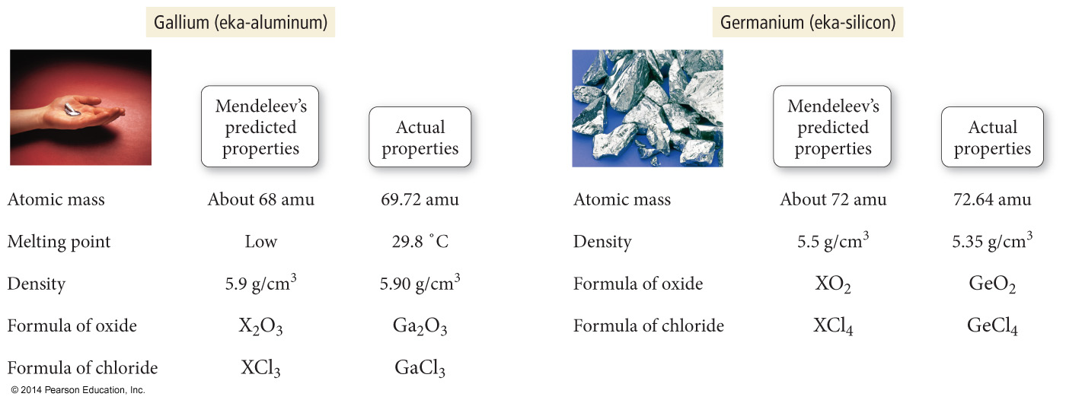
Periodic Trends in Atomic Radius

Slide 6
Quantum-Mechanical Explanation for the Group Trend in Atomic Radius
The size of an atom is related to the distance the valence electrons are from the nucleus.

Slide 7
Quantum-Mechanical Explanation for the Group Trend in Atomic Radius
The larger the orbital an electron is in, the farther its most probable distance will be from the nucleus, and the less attraction it will have for the nucleus.

Slide 8
Quantum-Mechanical Explanation for the Group Trend in Atomic Radius
Traversing down a group adds a principal energy level.

Slide 9
Quantum-Mechanical Explanation for the Group Trend in Atomic Radius
The larger the principal energy level an orbital is in, the larger its volume.

Slide 10
Quantum-Mechanical Explanation for the Group Trend in Atomic Radius
Quantum-mechanics predicts the atoms should get larger down a column.

Slide 11
Quantum-Mechanical Explanation for the Period Trend in Atomic Radius
The larger the effective nuclear charge an electron experiences, the stronger the attraction it will have for the nucleus.

Slide 12
Quantum-Mechanical Explanation for the Period Trend in Atomic Radius
The stronger the attraction the valence electrons have for the nucleus, the closer their average distance will be to the nucleus.

Slide 13
Quantum-Mechanical Explanation for the Period Trend in Atomic Radius
Traversing across a period increases the effective nuclear charge on the valence electrons.

Slide 14
Quantum-Mechanical Explanation for the Period Trend in Atomic Radius
Quantum-mechanics predicts the atoms should get smaller across a period.

Slide 15
Trends in Ionic Radius
Ions in the same group have the same charge.
Ion size increases down the column.
Higher valence shell, larger
Cations are smaller than neutral atoms; anions are larger than neutral atoms.
Cations are smaller than anions.
Except Rb⁺ and Cs⁺ bigger or same size as F⁻ and O²⁻.
Larger positive charge = smaller cation
For isoelectronic species
Isoelectronic = same electron configuration
Larger negative charge = larger anion
For isoelectronic species

Slide 16
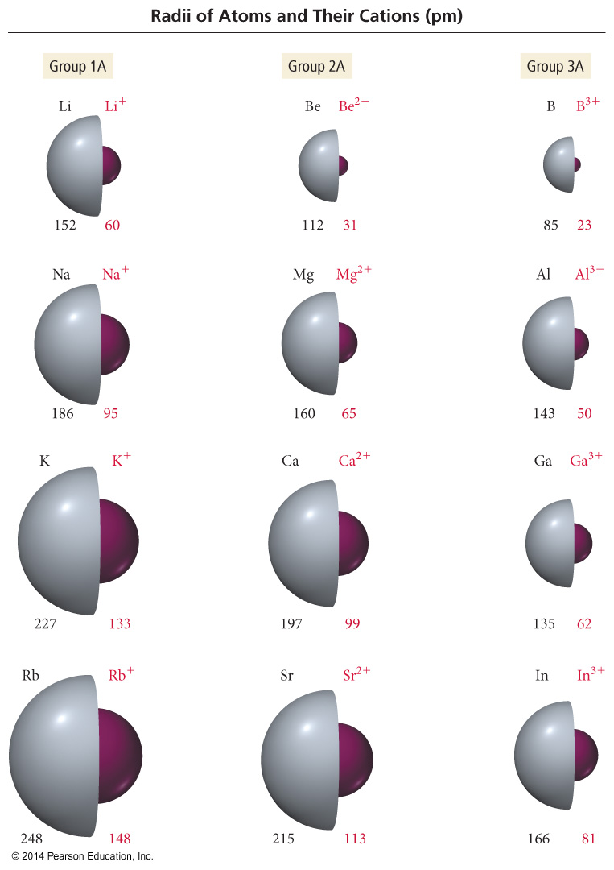
Periodic Trends in Ionic Radius

Slide 17
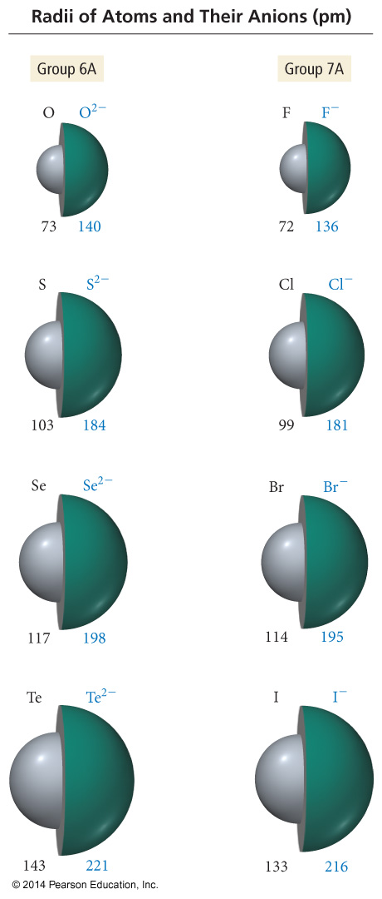
Periodic Trends in Ionic Radius

Slide 18
Ionization Energy (IE)
Minimum energy needed to remove an electron from an atom or ion
Gas state
Endothermic process
Valence electron easiest to remove, lowest IE
M(g) + IE₁ → M¹⁺(g) + 1 e–
M⁺¹(g) + IE₂ → M²⁺(g) + 1 e–
First ionization energy = energy to remove electron from neutral atom, second IE = energy to remove from 1+ ion, etc.

Slide 19
Ionization Energy: the energy required to remove an electron from an atom
Increases for successive electrons taken from the same atom
Tends to increase across a period
Electrons in the same quantum level do not shield as effectively as electrons in inner levels, ↑ protons, ↑ Energy required
Irregularities at half filled and filled sublevels due to extra repulsion of electrons paired in orbitals, making them easier to remove
Tends to decrease down a group
Outer electrons are farther from the
Nucleus, more shielding effect

Slide 20
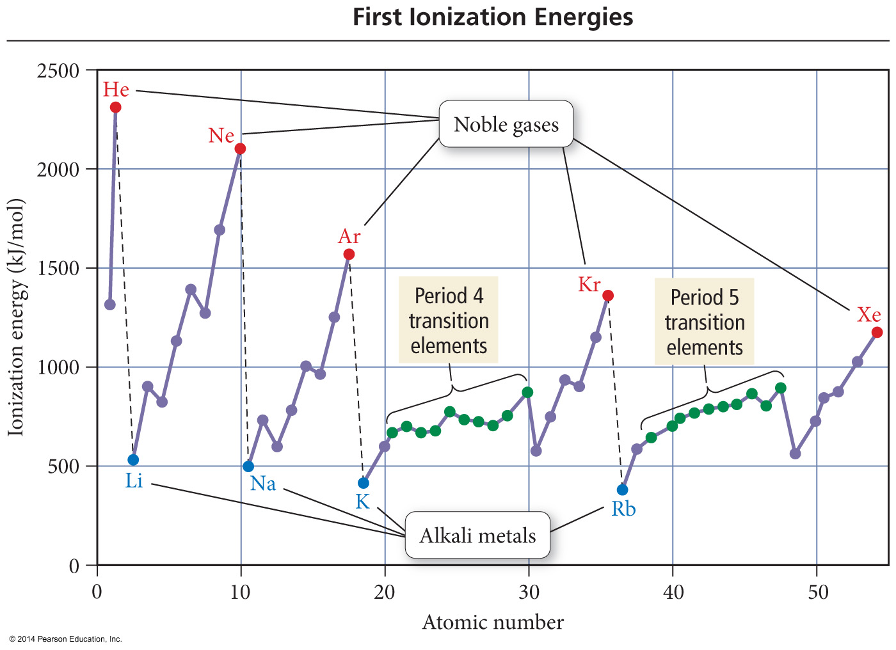

Slide 21
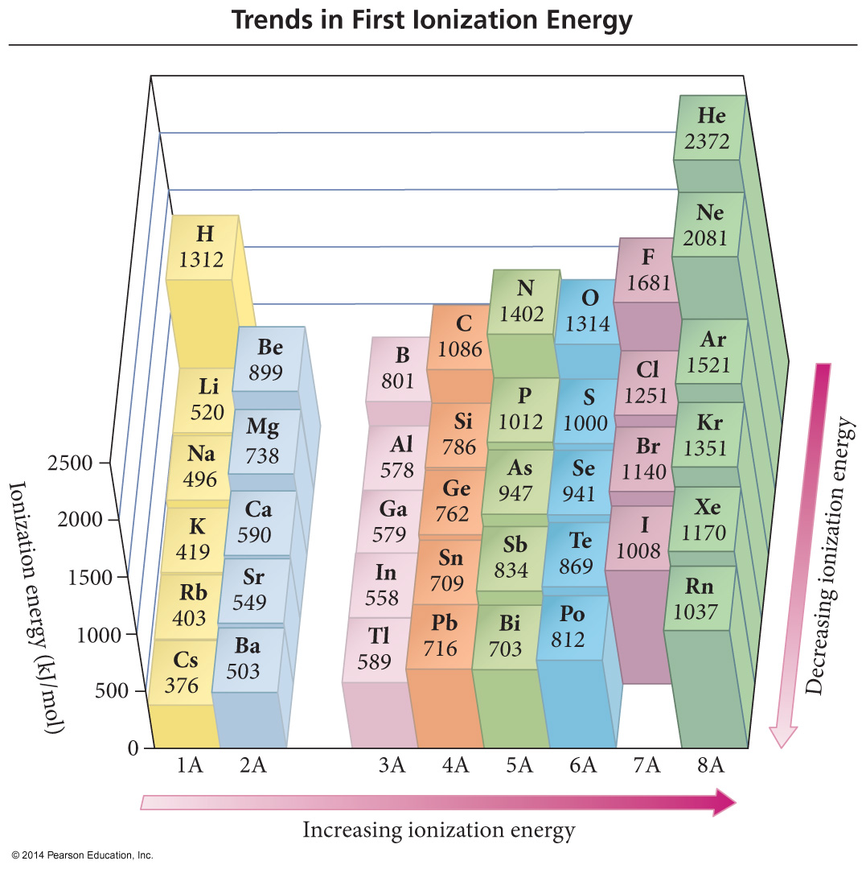

Slide 22
Quantum-Mechanical Explanation for the Trends in First Ionization Energy
The strength of attraction is related to the most probable distance the valence electrons are from the nucleus and the effective nuclear charge the valence electrons experience.

Slide 23
Quantum-Mechanical Explanation for the Trends in First Ionization Energy
The larger the orbital an electron is in, the farther its most probable distance will be from the nucleus and the less attraction it will have for the nucleus.

Slide 24
Quantum-Mechanical Explanation for the Trends in First Ionization Energy
Quantum-mechanics predicts the atom’s first ionization energy should get lower down a column.

Slide 25
Quantum-Mechanical Explanation for the Trends in First Ionization Energy
Traversing across a period increases the effective nuclear charge on the valence electrons.

Slide 26
Quantum-Mechanical Explanation for the Trends in First Ionization Energy
Quantum-mechanics predicts the atom’s first ionization energy should get larger across a period.

Slide 27
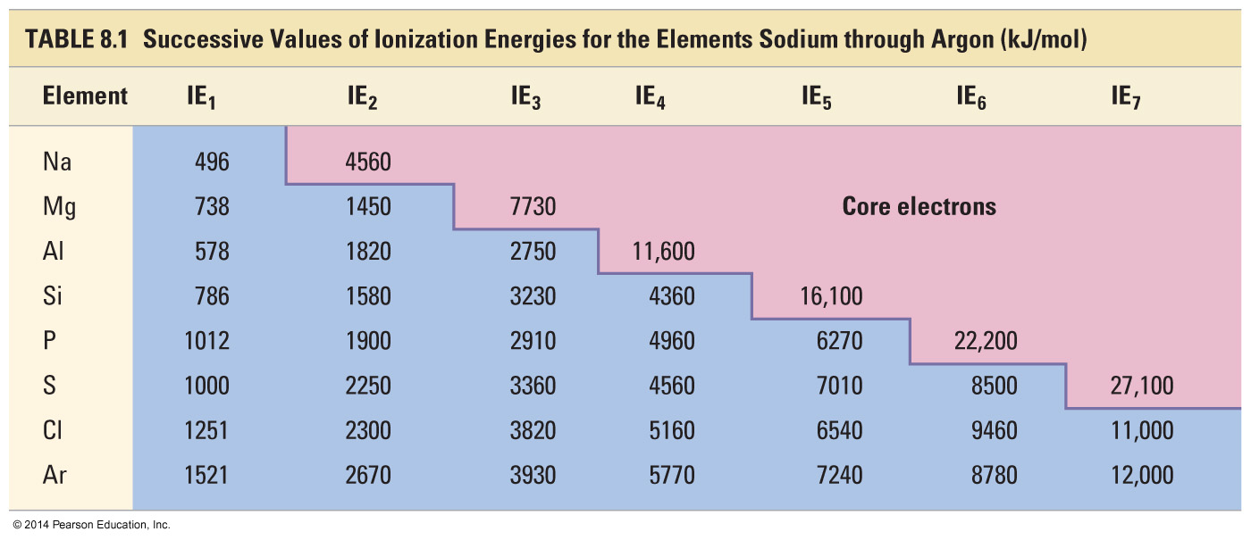
Trends in Second and Successive Ionization Energies

Slide 28
Electron Affinity
Energy is released when an neutral atom gains an electron. CHANGE in ENERGY
Gas state
M(g) + 1e⁻ → M¹⁻(g) + EA
Electron affinity is defined as exothermic (−), but may actually be endothermic (+).
Some alkali earth metals and all noble gases are endothermic. Why?
The more energy that is released, the larger the electron affinity.
The more negative the number, the larger the EA.

Slide 29
Trends in Electron Affinity
Alkali metals decrease electron affinity down the column.
But not all groups do
Generally irregular increase in EA from second period to third period
“Generally” increases across period
Becomes more negative from left to right
Not absolute
Group 5A generally lower EA than expected because extra electron must pair
Groups 2A and 8A generally very low EA because added electron goes into higher energy level or sublevel
Highest EA in any period = halogen

Slide 30
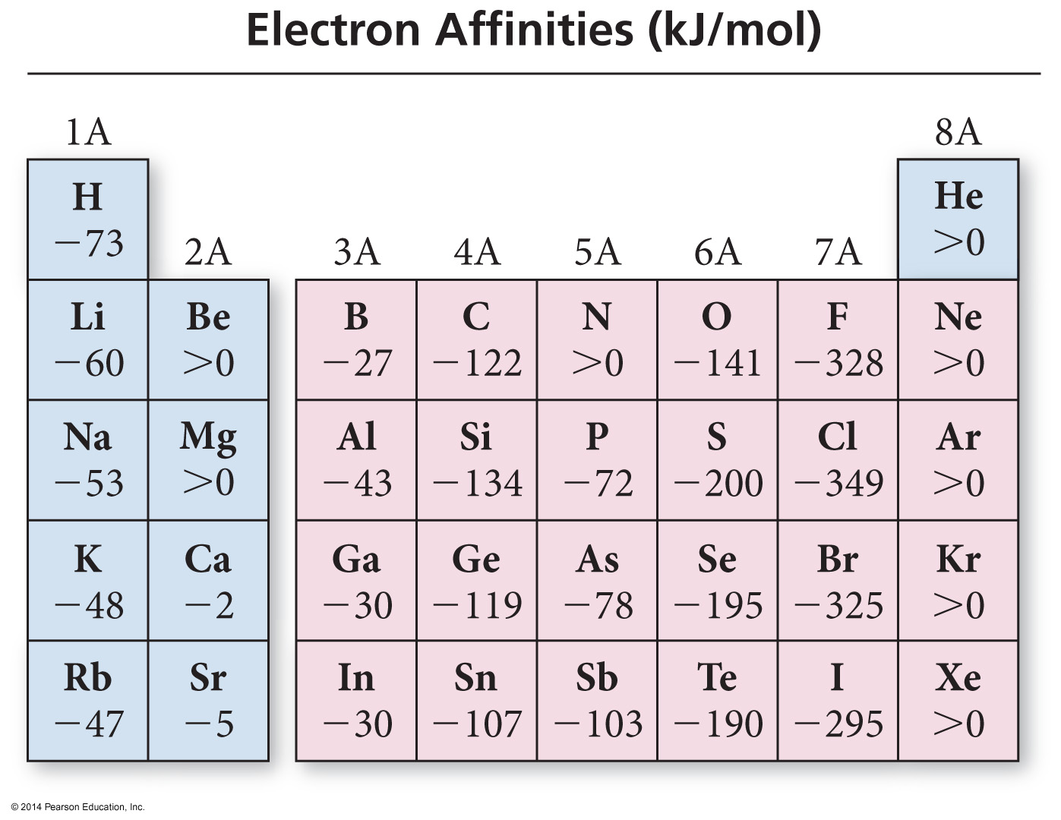

Slide 31
Table of Electron Affinities

Slide 32
Electronegativity
The ability of an atom to attract bonding electrons to itself is called electronegativity.
Increases across period (left to right) and decreases down group (top to bottom)
Fluorine is the most electronegative element.
Francium is the least electronegative element.
Noble gas atoms are not assigned values.
Opposite of atomic size trend.
The larger the difference in electronegativity, the more polar the bond.
Negative end toward more electronegative atom.

Slide 33
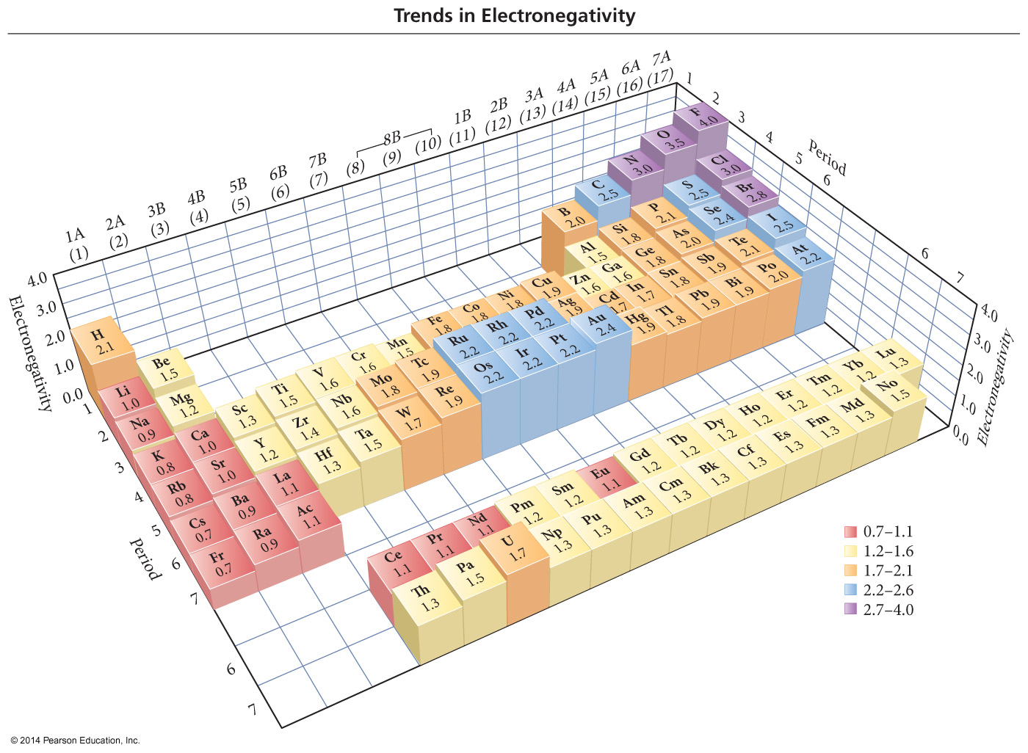
Electronegativity Scale

Slide 34
Electronegativity Difference and Bond Type
If the difference in electronegativity between bonded atoms is 0, the bond is pure covalent.
Equal sharing
If the difference in electronegativity between bonded atoms is 0.1 to 0.4, the bond is nonpolar covalent.
If the difference in electronegativity between bonded atoms is 0.5 to 1.9, the bond is polar covalent.
If difference in electronegativity between bonded atoms is larger than or equal to 2.0, the bond is ionic.
“100%”

Slide 35
Summary of Periodic Trends In the locker

Slide 36
Bond Polarity

Slide 37
Bond Dipole Moments
Dipole moment, μ, is a measure of bond polarity.
A dipole is a material with a + and − end.
it is directly proportional to the size of the partial charges and directly proportional to the distance between them.
μ = (q)(r)
Not Coulomb’s law
Measured in Debyes, D
Generally, the more electrons two atoms share and the larger the atoms are, the larger the dipole moment.

Slide 38
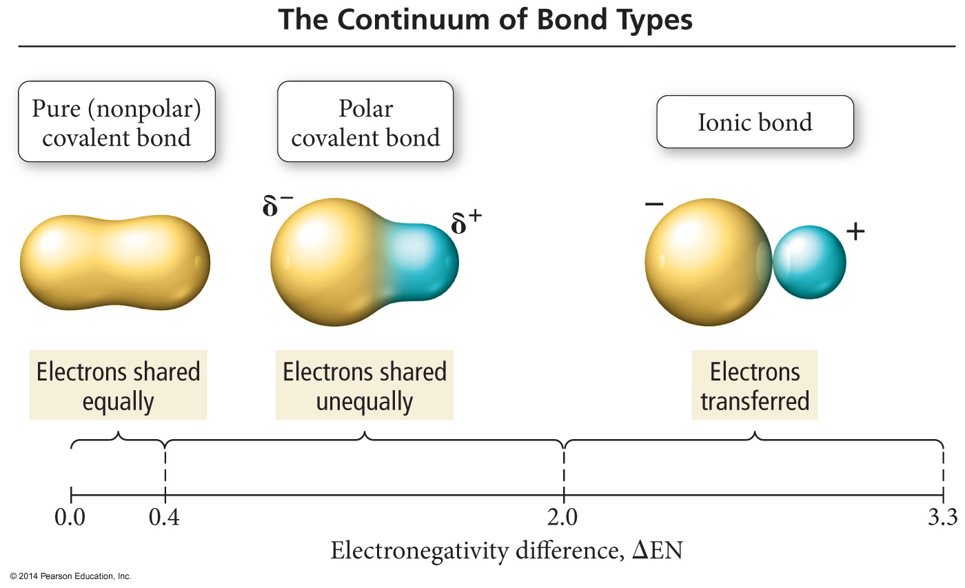

Slide 39
Magnetic Properties of Transition Metal Atoms and Ions
Electron configurations that result in unpaired electrons mean that the atom or ion will have a net magnetic field; this is called paramagnetism.
Will be attracted to a magnetic field

Slide 40
Magnetic Properties of Transition Metal Atoms and Ions
Electron configurations that result in all paired electrons mean that the atom or ion will have no magnetic field; this is called diamagnetism.
Slightly repelled by a magnetic field

