Slide 1
Atomic Structure and Periodicity Wave Partilce Duality ** Not Part of class**

Slide 2
The Puzzle of the Atom
Protons and electrons are attracted to each other because of opposite charges
Electrically charged particles moving in a curved path give off energy
Despite these facts, atoms don’t collapse

Slide 3
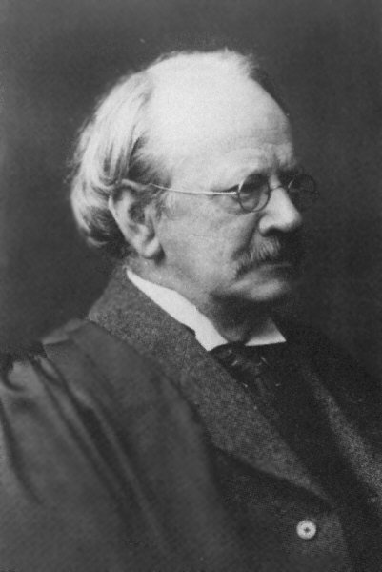
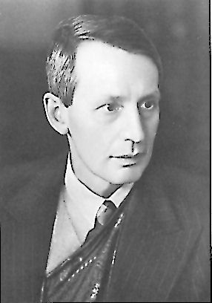
Wave-Particle Duality
JJ Thomson won the Nobel prize for describing the electron as a particle.
His son, George Thomson won the Nobel prize for describing the wave-like nature of the electron.
The electron is a particle!
The electron is an energy wave!

Slide 4
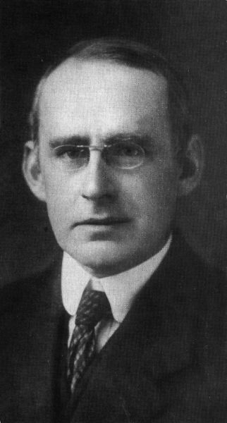
Confused??? You’ve Got Company!
“No familiar conceptions can be woven around the electron; something unknown is doing we don’t know what.”
Physicist Sir Arthur Eddington
The Nature of the Physical World
1934

Slide 5
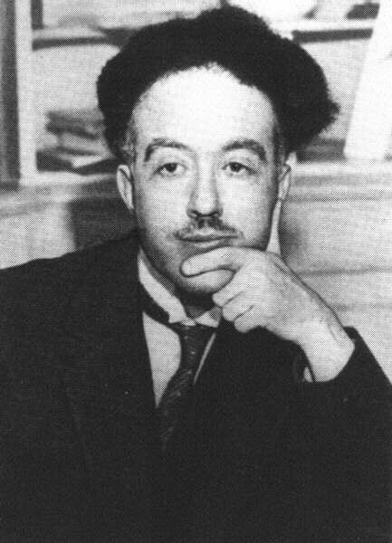
The Wave-like Electron
The electron propagates through space as an energy wave. To understand the atom, one must understand the behavior of electromagnetic waves.
Louis deBroglie
Light Travels through
space as a wave
Light transmits energy as a particle
Particles have wavelength, exhibited by diffraction patterns
Large particles have very short wavelength
All Matter exhibits both particle and wave properties

Slide 6
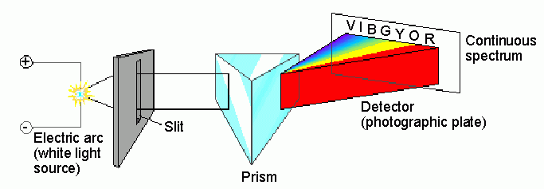
Spectroscopic analysis of the visible spectrum…
…produces all of the colors in a continuous spectrum

Slide 7
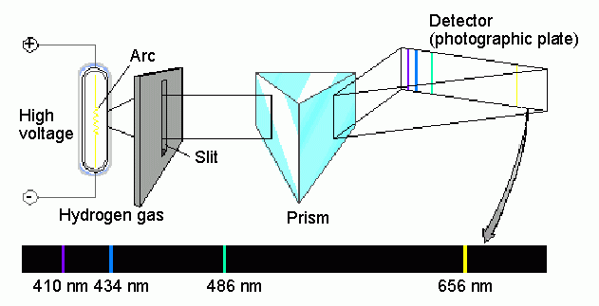
Spectroscopic analysis of the hydrogen spectrum…
…produces a “bright line” spectrum

Slide 8
Electron Energy in Hydrogen The Bohr Model
Bohr Model
The electron moves around the nucleus only in certain allowed circular orbits
Bright line spectra confirms that only certain energies exist in the atom, and atom emits photons with definite wavelengths when the electron returns to a lower energy state
Energy levels available to the electron in the hydrogen atom

Slide 9
Shortcomings of Bohr Model…
Bohr's model does not work for atoms other than hydrogen
2. Electron's do not move in circular orbits

Slide 10
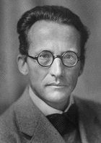
Schrodinger Wave Equation
Equation for probability of a single electron being found along a single axis (x-axis)
Erwin Schrodinger

Slide 11
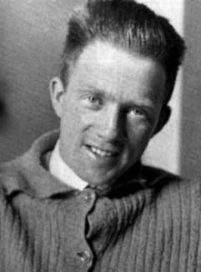
Heisenberg Uncertainty Principle
“One cannot simultaneously determine both the position and momentum of an electron.”
You can find out where the electron is, but not where it is going.
OR…
You can find out where the electron is going, but not where it is!
Werner
Heisenberg

Slide 12
Penetration #2
Which of the orbital types in the 3rd energy level
does not seem to have a “node”?
WHY NOT?

Slide 13
Quantum Numbers
Each electron in an atom has a unique set of 4 quantum numbers which describe it.
Principal quantum number, n
Angular momentum quantum number, l
Magnetic quantum number, m or m_{l}
Spin quantum number, s or m_{s}

Slide 14
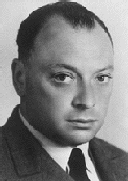
Pauli Exclusion Principle
No two electrons in an atom can have the same four quantum numbers.
Wolfgang
Pauli

Slide 15
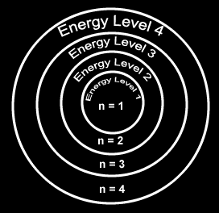
Principal Quantum Number
Generally symbolized by n, it denotes the shell (energy level) in which the electron is located.
Number of electrons that can fit in a shell:
2n²

Slide 16
Angular Momentum Quantum Number
The angular momentum quantum number, generally symbolized by l, denotes the orbital (subshell) in which the electron is located.

Slide 17
Magnetic Quantum Number
The magnetic quantum number, generally symbolized by m, denotes the orientation of the electron’s orbital with respect to the three axes in space.

Slide 18
Spin Quantum Number
Spin quantum number denotes the behavior (direction of spin) of an electron within a magnetic field.
Possibilities for electron spin:

Slide 19
Assigning the Numbers
The three quantum numbers (n, l, and m) are integers.
The principal quantum number (n) cannot be zero.
n must be 1, 2, 3, etc.
The angular momentum quantum number (l ) can be any integer between 0 and n - 1.
For n = 3, l can be either 0, 1, or 2.
The magnetic quantum number (m_{l}) can be any integer between -l and +l.
For l = 2, m can be either -2, -1, 0, +1, +2.

Slide 20
Principle, angular momentum, and magnetic quantum numbers: n, l, and m_{l}

Slide 21
s orbital shape
The s orbital has a spherical shape centered around
the origin of the three axes in space.

Slide 22
P orbital shape
There are three dumbbell-shaped p orbitals in
each energy level above n = 1, each assigned to
its own axis (x, y and z) in space.

Slide 23
d orbital shapes
Things get a bit more complicated with the five d orbitals that are found in the d sublevels beginning with n = 3. To remember the shapes, think of:
“double dumbells”
…and a “dumbell
with a donut”!

Slide 24
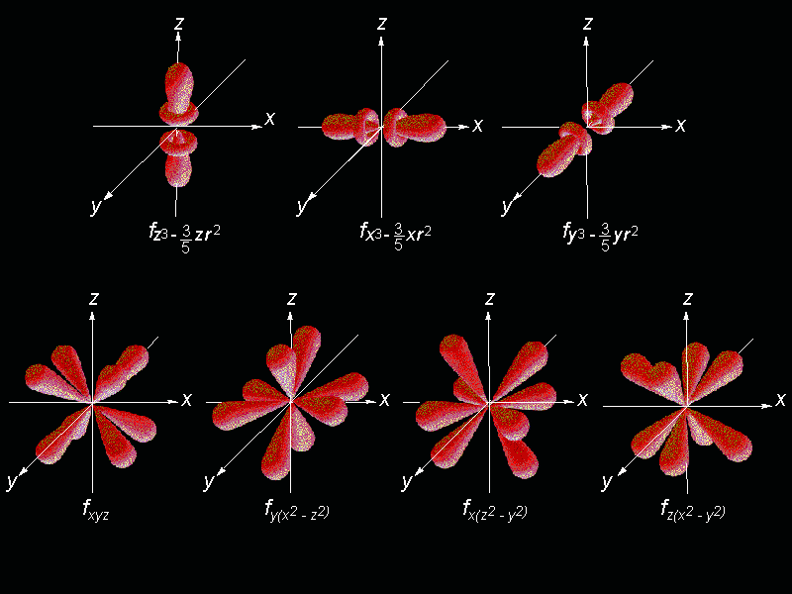
Shape of f orbitals

Slide 25
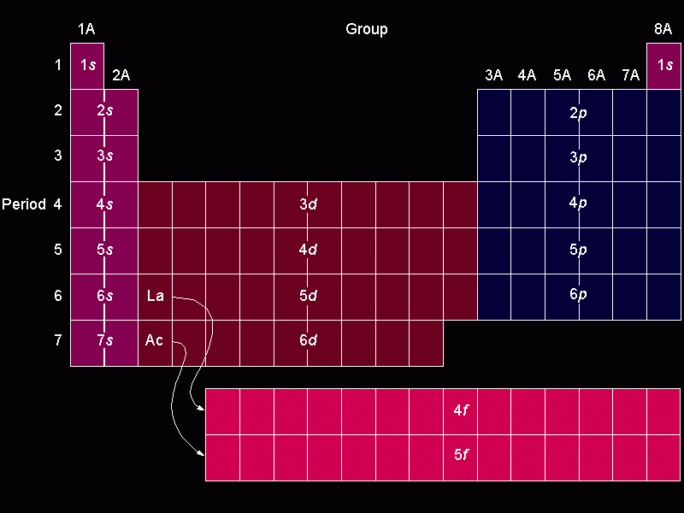
Orbital filling table

Slide 26
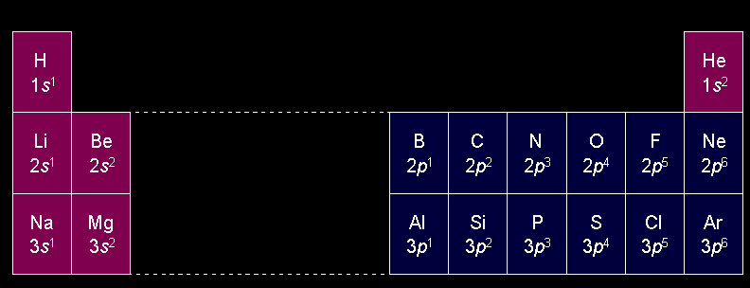
Electron configuration of the elements of the first three series

Slide 27
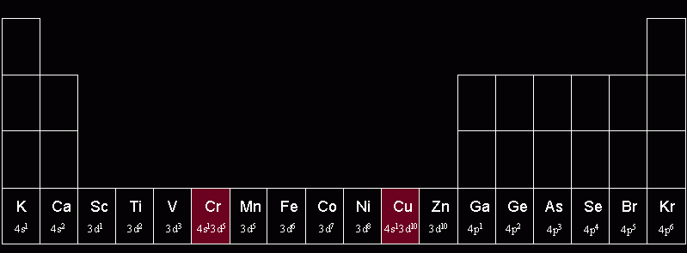
Irregular confirmations of Cr and Cu
Chromium steals a 4s electron to half fill its 3d sublevel, no longer part of this class…
Copper steals a 4s electron to FILL
its 3d sublevel

Slide 28
Quantum Number Practice
Ex #1: phosphorus
P
Rule 1: identify the principle energy level, n (same as period)
In period 3
In the p-block
3rd one in ∴ 1
Rule 2: identify the orbital type, l (block the e- is in)
Is 1st half of block, ∴ +1/2
Rule 3: identify the orientation (-l to l ).
Answer:
(3, 1, 1, +1/2)
Rule 4: 1st half have +1/2 spin, 2nd half have -1/2 spin

Slide 29
Quantum Number Practice
Ex #2: Iron
Fe
Rule 1: identify the principle energy level, n (same as period)
In period 3
In the d-block
6th one in ∴ -2
Rule 2: identify the orbital type, l (block the e- is in)
Is 2nd half of block, ∴ -1/2
Rule 3: identify the orientation (-l to l ).
Answer:
(3, 2, -2, -1/2)
Rule 4: 1st half have +1/2 spin, 2nd half have -1/2 spin

Slide 30
Quantum Number Practice
Ex #3: Barium
Ba
Rule 1: identify the principle energy level, n (same as period)
In period 6
In the s-block
2nd one in ∴ 0
Rule 2: identify the orbital type, l (block the e- is in)
Is 2nd half of block, ∴ -1/2
Rule 3: identify the orientation (-l to l ).
Answer:
(6, 0, 0, -1/2)
Rule 4: 1st half have +1/2 spin, 2nd half have -1/2 spin

Slide 31
Quantum Number Practice
Ex #4: Tin
Sn
Rule 1: identify the principle energy level, n (same as period)
In period 5
In the p-block
2nd one in ∴ 0
Rule 2: identify the orbital type, l (block the e- is in)
Is 1st half of block, ∴ +1/2
Rule 3: identify the orientation (-l to l ).
Answer:
(5, 1, 0, +1/2)
Rule 4: 1st half have +1/2 spin, 2nd half have -1/2 spin

Slide 32
Quantum Number Practice
Ex #5: Silver
Ag
Rule 1: identify the principle energy level, n (same as period)
In period 4
In the d-block
9th one in ∴ 1
Rule 2: identify the orbital type, l (block the e- is in)
Is 2nd half of block, ∴ -1/2
Rule 3: identify the orientation (-l to l ).
Answer:
(4, 2, 1, -1/2)
Rule 4: 1st half have +1/2 spin, 2nd half have -1/2 spin

Slide 33
Quantum Number Practice
Ex #6: Oxygen
O
Rule 1: identify the principle energy level, n (same as period)
In period 2
In the p-block
4th one in ∴ -1
Rule 2: identify the orbital type, l (block the e- is in)
Is 2nd half of block, ∴ -1/2
Rule 3: identify the orientation (-l to l ).
Answer:
(2, 1, -1, -1/2)
Rule 4: 1st half have +1/2 spin, 2nd half have -1/2 spin

Slide 34
Electron Energy in Hydrogen The Bohr Model
Z = nuclear charge (atomic number)
n = energy level
***Equation works only for atoms or ions with 1 electron (H, He⁺, Li²⁺, etc).

Slide 35
Calculating Energy Change, ΔE, for Electron Transitions
Energy must be absorbed from a photon (+ΔE) to move an electron away from the nucleus
Energy (a photon) must be given off (-ΔE) when an electron moves toward the nucleus

