Slide 1
Atomic Structure and Periodicity Waves & Math

Slide 2
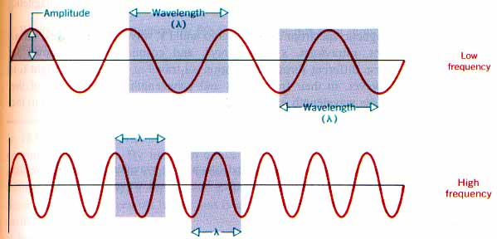
Electromagnetic radiation propagates through space as a wave moving at the speed of light.
c = νλ
C = speed of light, a constant (3.00 x 10⁸ m/s)
ν = frequency, in units of hertz (hz, sec⁻¹)
λ = wavelength, in meters

Slide 3
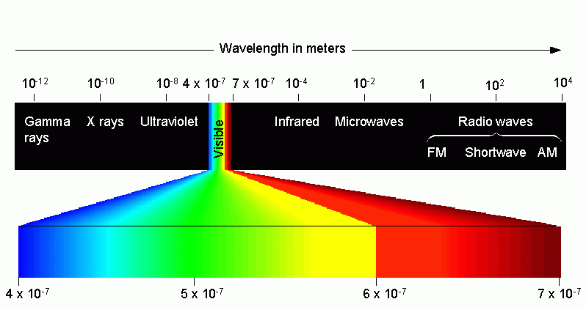
Types of electromagnetic radiation:

Slide 4
The energy (E ) of electromagnetic radiation is directly proportional to the frequency (ν) of the radiation.
E = hν
E = Energy, in units of Joules (kg·m²/s²)
h = Planck’s constant (6.626 x 10⁻³⁴ J·s)
ν = frequency, in units of hertz (hz, sec⁻¹)

Slide 5
Wavelength Table
Long
Wavelength
=
Low Frequency
=
Low ENERGY
Short
Wavelength
=
High Frequency
=
High ENERGY

Slide 6
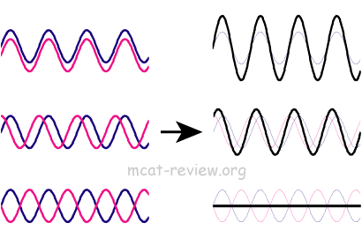
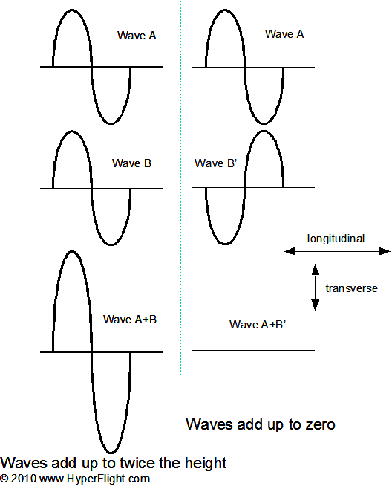
Wave properties

Slide 7
Relating Frequency, Wavelength and Energy
Common re-arrangements:

