Slide 1
Atomic Structure and Periodicity

Slide 2
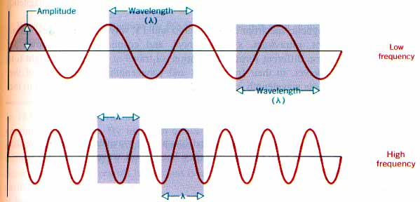
Electromagnetic radiation propagates through space as a wave moving at the speed of light.
c = νλ
C = speed of light, a constant (3.00 x 10⁸ m/s)
ν = frequency, in units of hertz (hz, sec⁻¹)
λ = wavelength, in meters

Slide 3
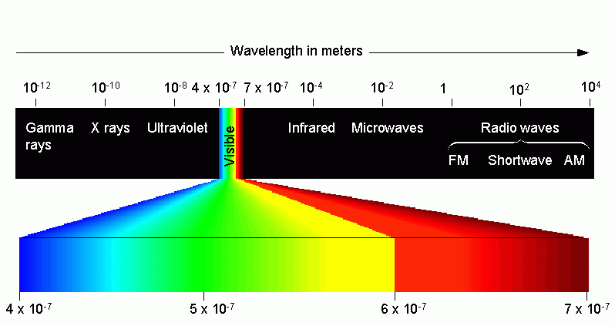
Types of electromagnetic radiation:

Slide 4
The energy (E ) of electromagnetic radiation is directly proportional to the frequency (ν) of the radiation.
E = hν
E = Energy, in units of Joules (kg·m²/s²)
h = Planck’s constant (6.626 x 10⁻³⁴ J·s)
ν = frequency, in units of hertz (hz, sec⁻¹)

Slide 5
Wavelength Table
Long
Wavelength
=
Low Frequency
=
Low ENERGY
Short
Wavelength
=
High Frequency
=
High ENERGY

Slide 6
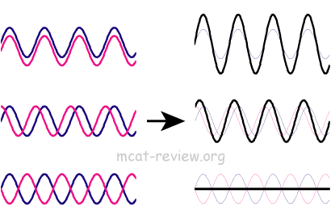
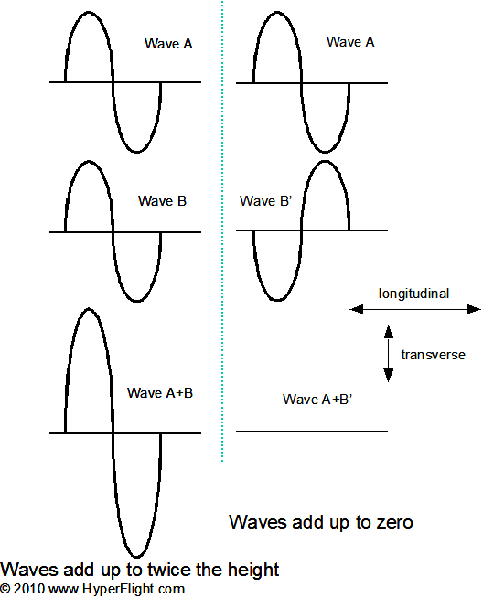
Wave properties

Slide 7
Relating Frequency, Wavelength and Energy
Common re-arrangements:

Slide 8
Shielding
In a multielectron system, electrons are simultaneously attracted to the nucleus and repelled by each other.
Outer electrons are shielded from the nucleus by the core electrons.
Shielding effect
Outer electrons do not effectively screen for each other.
The shielding causes the outer electrons to not experience the full strength of the nuclear charge.

Slide 9
Effective Nuclear Charge
The effective nuclear charge is a net positive charge that is attracting a particular electron.
Z is the nuclear charge, and S is the number of electrons in lower energy levels.
Electrons in the same energy level contribute to screening but since their contribution is so small they are not part of the calculation.
Trend is s > p > d > f.
Z_{effective} = Z − S

Slide 10
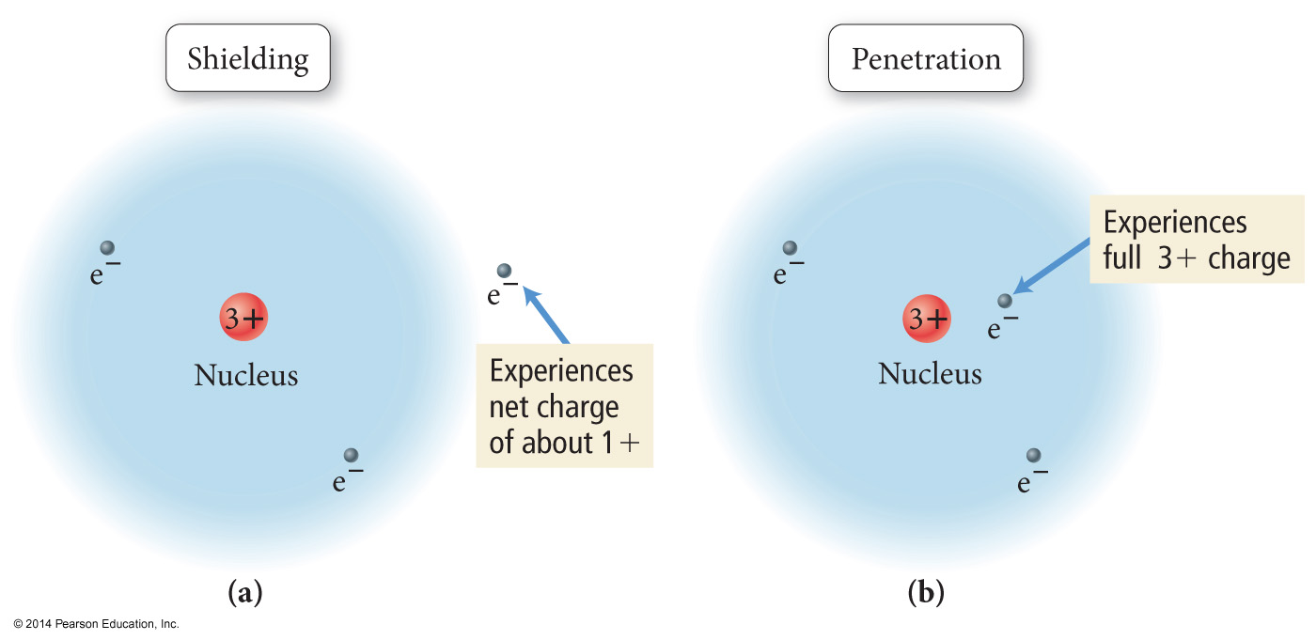
Shielding and Penetration

Slide 11
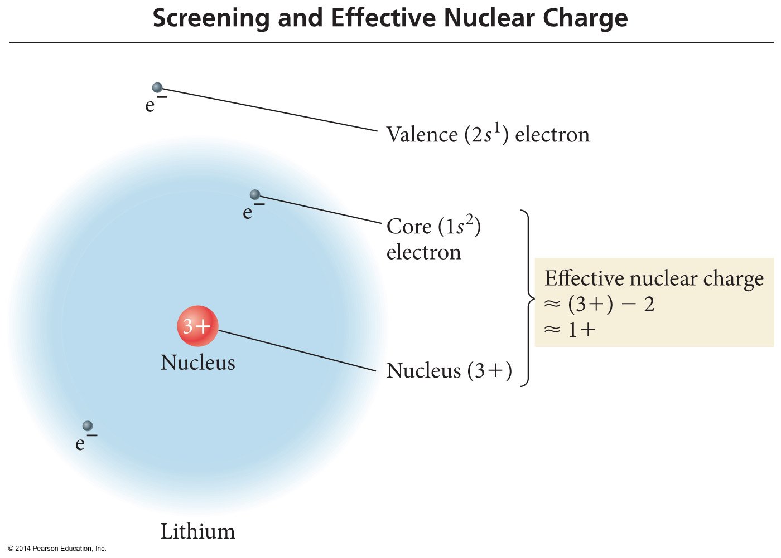
Shielding and Effective Nuclear Charge

Slide 12
An orbital is a region within an atom where there is a probability of finding an electron. This is a probability diagram for the s orbital in the first energy level…
Orbital shapes are defined as the surface that
contains 90% of the total electron probability.

Slide 13
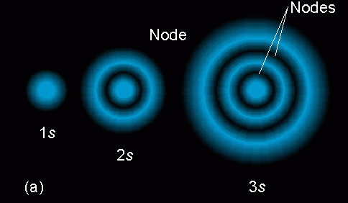
Sizes of s orbitals
Orbitals of the same shape (s, for instance) grow
larger as n increases…
Nodes are regions of low probability within an
orbital.

Slide 14
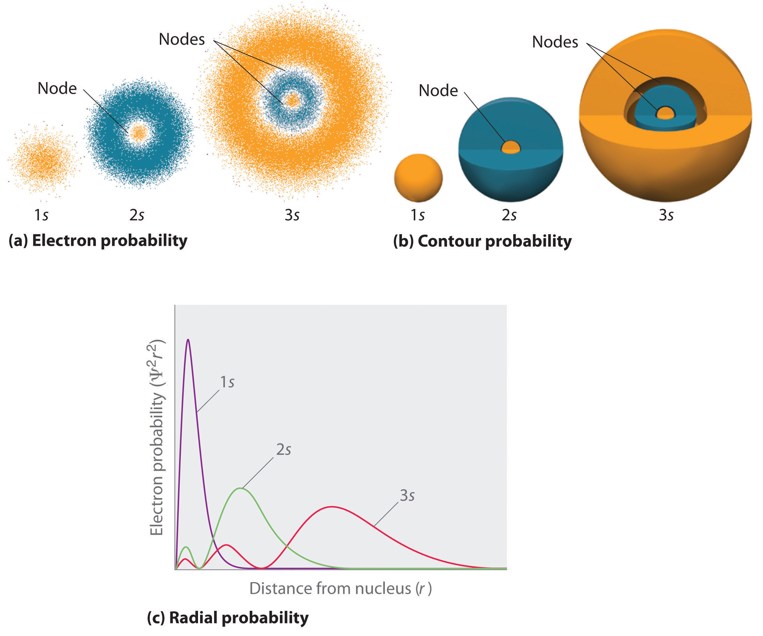

Slide 15
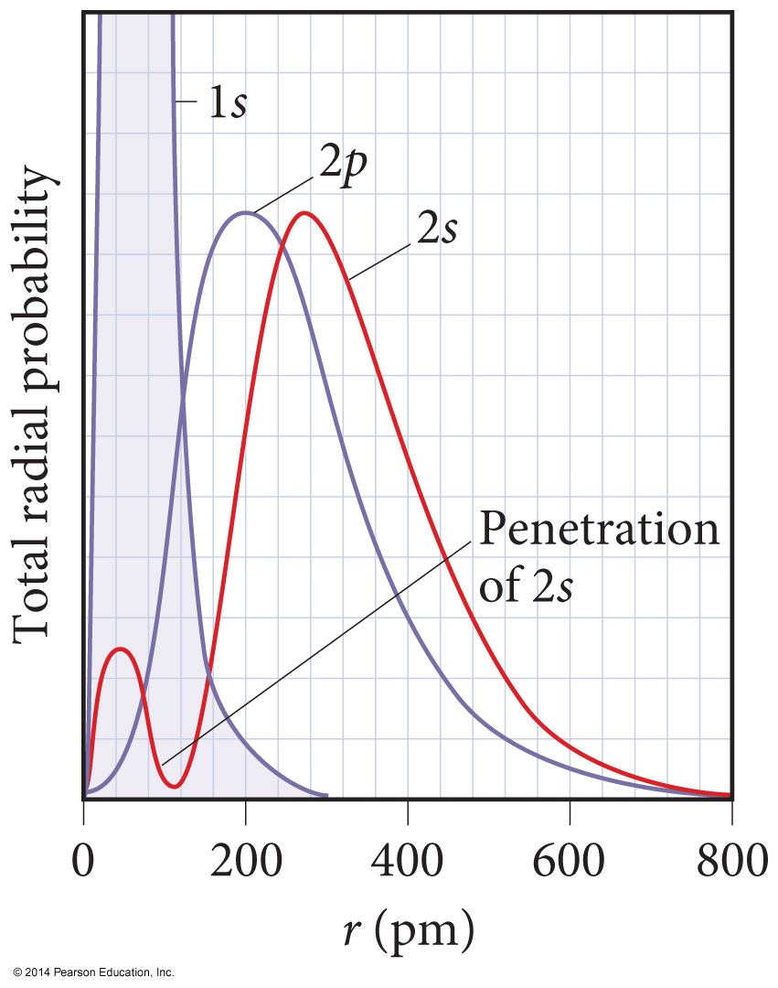
Penetration and Shielding
The radial distribution function shows that the 2s orbital penetrates more deeply into the 1s orbital than does the 2p.
The weaker penetration of the 2p sublevel means that electrons in the 2p sublevel experience more repulsive force; they are more shielded from the attractive force of the nucleus.
The deeper penetration of the 2s electrons means electrons in the 2s sublevel experience a greater attractive force to the nucleus and are not shielded as effectively.

Slide 16
Penetration
The closer an electron is to the nucleus, the more attraction it experiences.
The better an outer electron is at penetrating through the electron cloud of inner electrons, the more attraction it will have for the nucleus.
The degree of penetration is related to the orbital’s radial distribution function.
In particular, the distance the maxima of the function are from the nucleus

Slide 17
Penetration #1
Orbitals in outer energy levels DO penetrate into
lower energy levels.
This is a probability
Distribution for a
3s orbital.
What parts of the
diagram correspond
to “nodes” – regions
of zero probability?

Slide 18
Probability distribution

Slide 19
Probability distribution

Slide 20
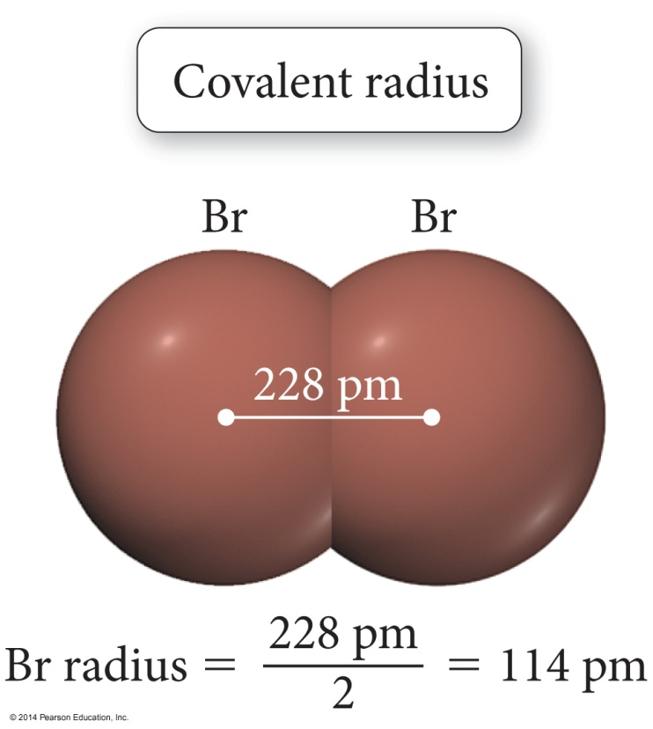
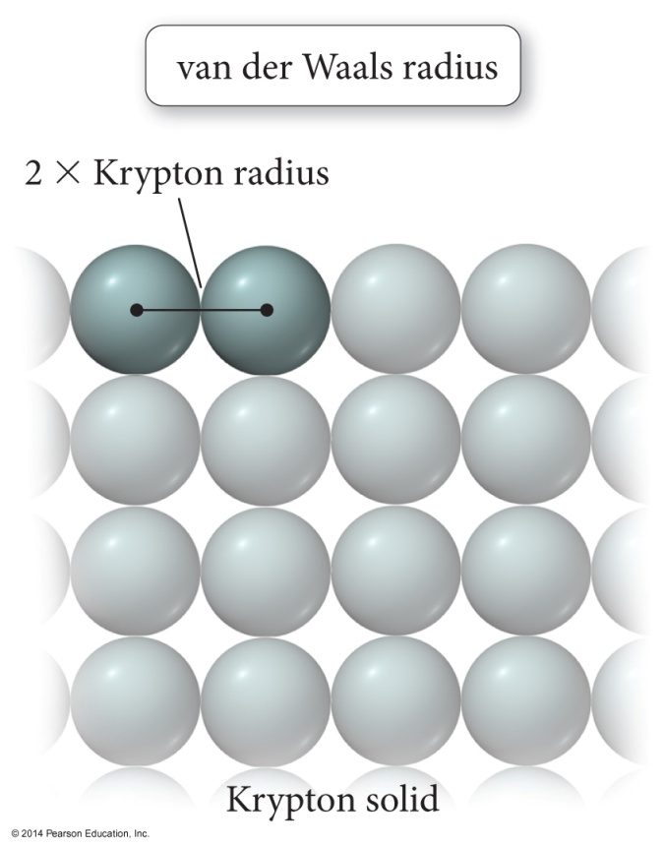
Trend in Atomic Radius – Main Group
There are several methods for measuring the radius of an atom, and they give slightly different numbers.
Van der Waals radius = nonbonding
Covalent radius = bonding radius
Atomic radius is an average radius of an atom based on measuring large numbers of elements and compounds.

Slide 21
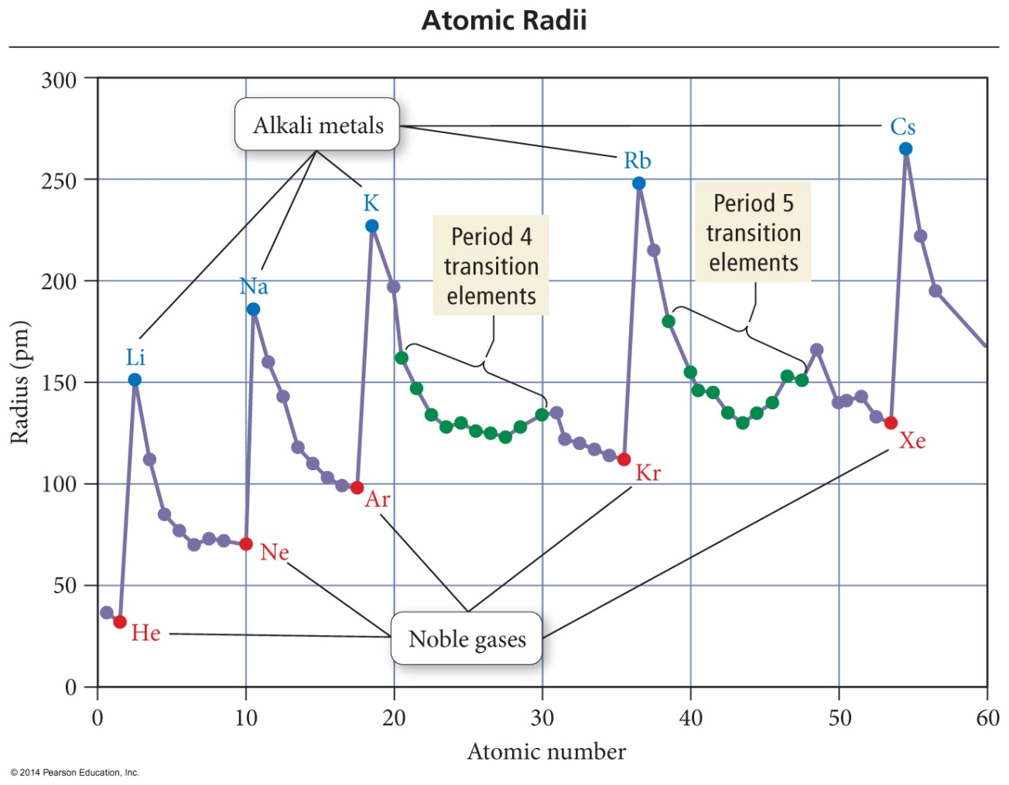
Trend in Atomic Radius – Main Group
Atomic radius decreases across period (left to right)
Adding electrons to same valence shell
Effective nuclear charge increases
Valence shell held closer

Slide 22
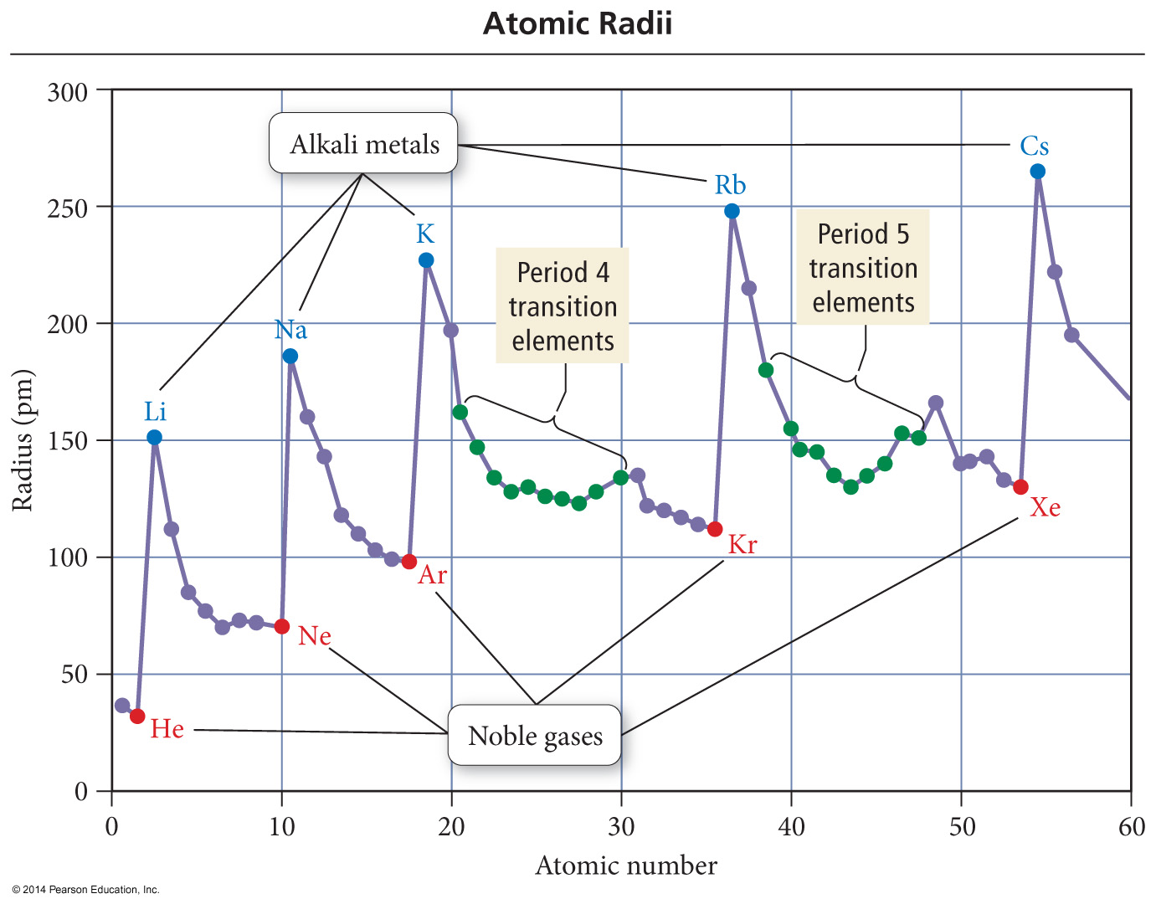
Trend in Atomic Radius – Main Group
Atomic radius increases down group
Valence shell farther from nucleus
Effective nuclear charge fairly close

Slide 23
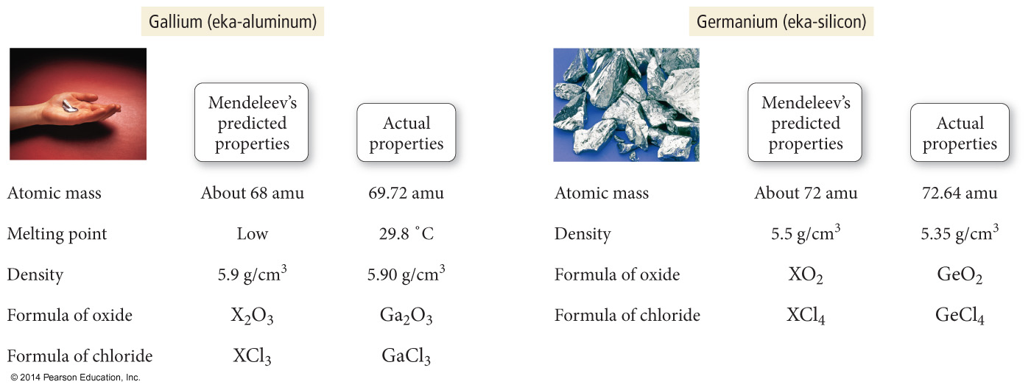
Periodic Trends in Atomic Radius

Slide 24
Quantum-Mechanical Explanation for the Group Trend in Atomic Radius
The size of an atom is related to the distance the valence electrons are from the nucleus.

Slide 25
Quantum-Mechanical Explanation for the Group Trend in Atomic Radius
The larger the orbital an electron is in, the farther its most probable distance will be from the nucleus, and the less attraction it will have for the nucleus.

Slide 26
Quantum-Mechanical Explanation for the Group Trend in Atomic Radius
Traversing down a group adds a principal energy level.

Slide 27
Quantum-Mechanical Explanation for the Group Trend in Atomic Radius
The larger the principal energy level an orbital is in, the larger its volume.

Slide 28
Quantum-Mechanical Explanation for the Group Trend in Atomic Radius
Quantum-mechanics predicts the atoms should get larger down a column.

Slide 29
Quantum-Mechanical Explanation for the Period Trend in Atomic Radius
The larger the effective nuclear charge an electron experiences, the stronger the attraction it will have for the nucleus.

Slide 30
Quantum-Mechanical Explanation for the Period Trend in Atomic Radius
The stronger the attraction the valence electrons have for the nucleus, the closer their average distance will be to the nucleus.

Slide 31
Quantum-Mechanical Explanation for the Period Trend in Atomic Radius
Traversing across a period increases the effective nuclear charge on the valence electrons.

Slide 32
Quantum-Mechanical Explanation for the Period Trend in Atomic Radius
Quantum-mechanics predicts the atoms should get smaller across a period.

Slide 33
Trends in Ionic Radius
Ions in the same group have the same charge.
Ion size increases down the column.
Higher valence shell, larger
Cations are smaller than neutral atoms; anions are larger than neutral atoms.
Cations are smaller than anions.
Except Rb⁺ and Cs⁺ bigger or same size as F⁻ and O²⁻.
Larger positive charge = smaller cation
For isoelectronic species
Isoelectronic = same electron configuration
Larger negative charge = larger anion
For isoelectronic species

Slide 34
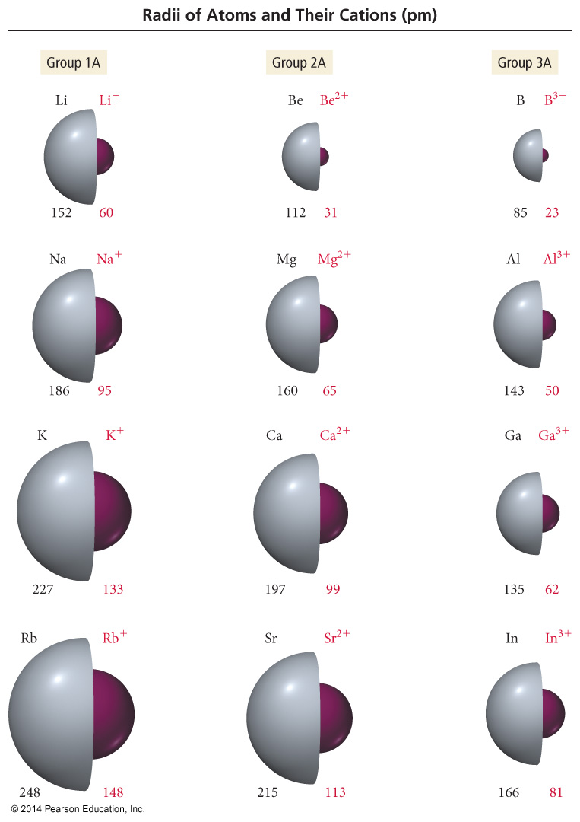
Periodic Trends in Ionic Radius

Slide 35
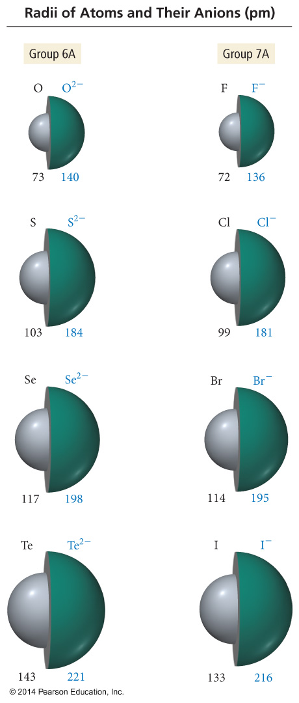
Periodic Trends in Ionic Radius

Slide 36
Ionization Energy (IE)
Minimum energy needed to remove an electron from an atom or ion
Gas state
Endothermic process
Valence electron easiest to remove, lowest IE
M(g) + IE₁ → M¹⁺(g) + 1 e–
M⁺¹(g) + IE₂ → M²⁺(g) + 1 e–
First ionization energy = energy to remove electron from neutral atom, second IE = energy to remove from 1+ ion, etc.

Slide 37
Ionization Energy: the energy required to remove an electron from an atom
Increases for successive electrons taken from
the same atom
Tends to increase across a period
Electrons in the same quantum level do
not shield as effectively as electrons in
inner levels, ↑ protons, ↑ Energy required
Irregularities at half filled and filled
sublevels due to extra repulsion of
electrons paired in orbitals, making them
easier to remove
Tends to decrease down a group
Outer electrons are farther from the
Nucleus, more shielding effect

Slide 38
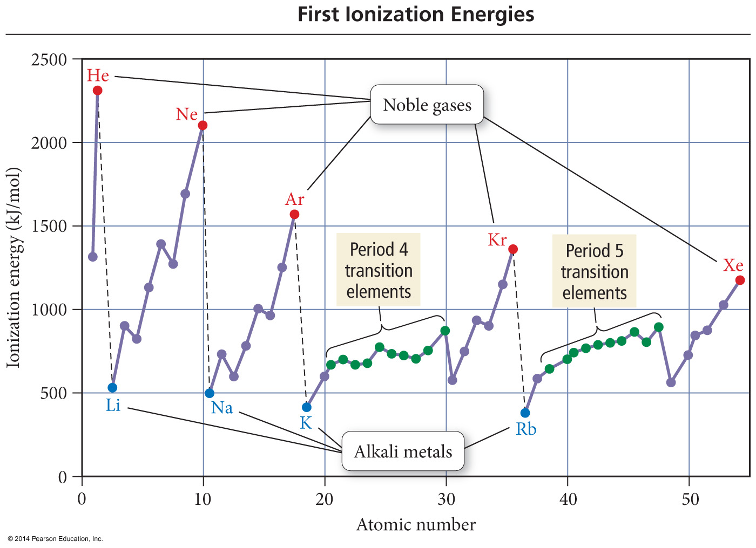

Slide 39
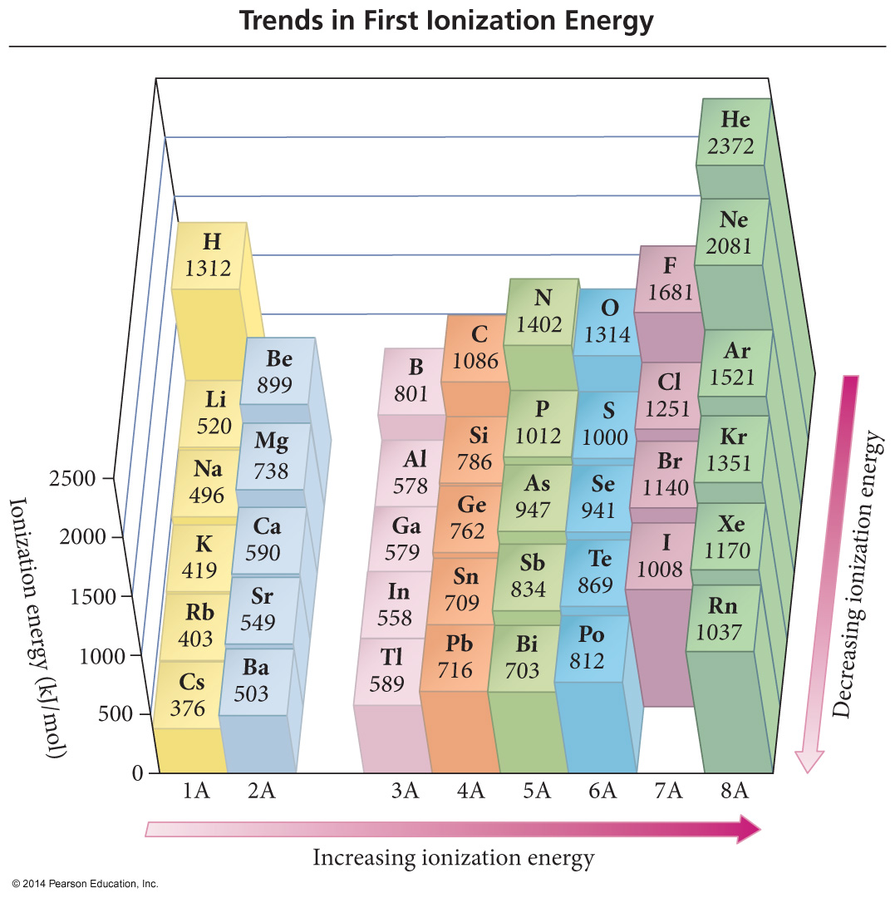

Slide 40
Quantum-Mechanical Explanation for the Trends in First Ionization Energy
The strength of attraction is related to the most probable distance the valence electrons are from the nucleus and the effective nuclear charge the valence electrons experience.

Slide 41
Quantum-Mechanical Explanation for the Trends in First Ionization Energy
The larger the orbital an electron is in, the farther its most probable distance will be from the nucleus and the less attraction it will have for the nucleus.

Slide 42
Quantum-Mechanical Explanation for the Trends in First Ionization Energy
Quantum-mechanics predicts the atom’s first ionization energy should get lower down a column.

Slide 43
Quantum-Mechanical Explanation for the Trends in First Ionization Energy
Traversing across a period increases the effective nuclear charge on the valence electrons.

Slide 44
Quantum-Mechanical Explanation for the Trends in First Ionization Energy
Quantum-mechanics predicts the atom’s first ionization energy should get larger across a period.

Slide 45
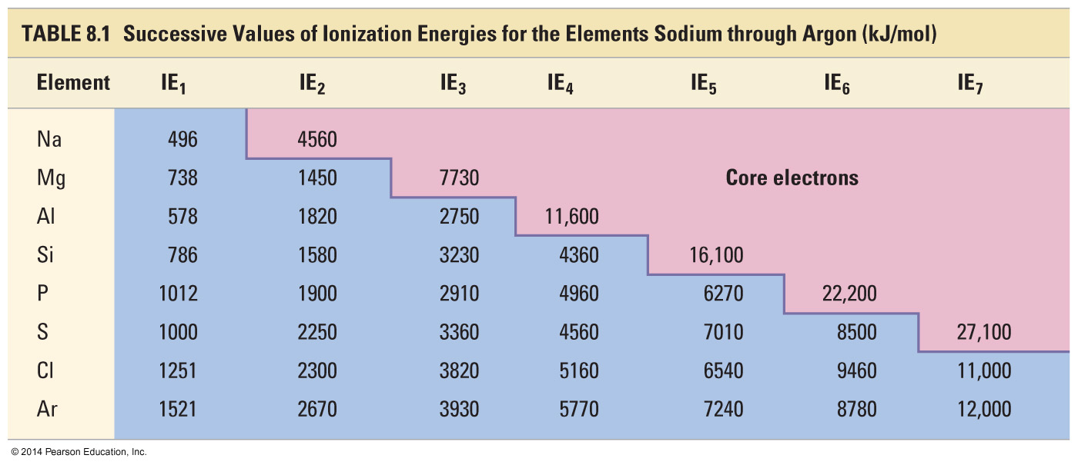
Trends in Second and Successive Ionization Energies

Slide 46
Electron Affinity
Energy is released when an neutral atom gains an electron. CHANGE in ENERGY
Gas state
M(g) + 1e⁻ → M¹⁻(g) + EA
Electron affinity is defined as exothermic (−), but may actually be endothermic (+).
Some alkali earth metals and all noble gases are endothermic. Why?
The more energy that is released, the larger the electron affinity.
The more negative the number, the larger the EA.

Slide 47
Trends in Electron Affinity
Alkali metals decrease electron affinity down the column.
But not all groups do
Generally irregular increase in EA from second period to third period
“Generally” increases across period
Becomes more negative from left to right
Not absolute
Group 5A generally lower EA than expected because extra electron must pair
Groups 2A and 8A generally very low EA because added electron goes into higher energy level or sublevel
Highest EA in any period = halogen

Slide 48
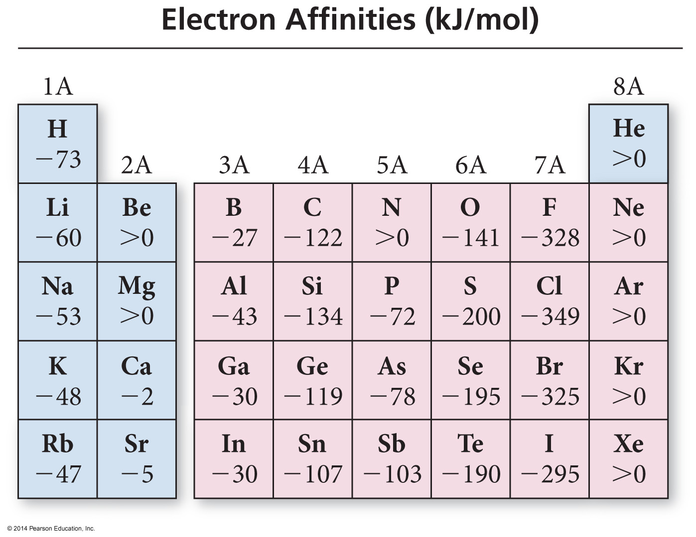

Slide 49
Table of Electron Affinities

Slide 50
Electronegativity
The ability of an atom to attract bonding electrons to itself is called electronegativity.
Increases across period (left to right) and decreases down group (top to bottom)
Fluorine is the most electronegative element.
Francium is the least electronegative element.
Noble gas atoms are not assigned values.
Opposite of atomic size trend.
The larger the difference in electronegativity, the more polar the bond.
Negative end toward more electronegative atom.

Slide 51
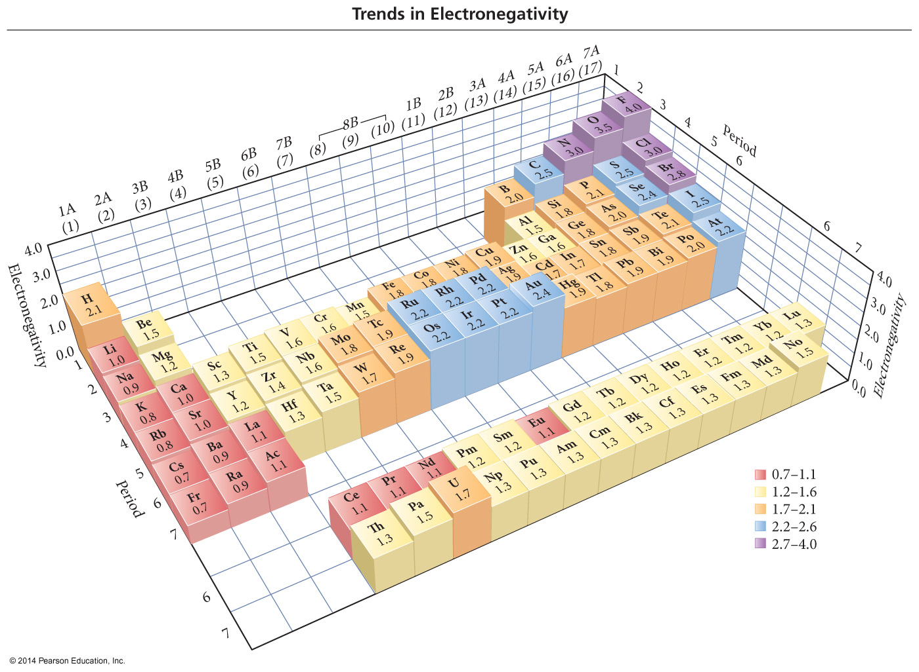
Electronegativity Scale

Slide 52
Electronegativity Difference and Bond Type
If the difference in electronegativity between bonded atoms is 0, the bond is pure covalent.
Equal sharing
If the difference in electronegativity between bonded atoms is 0.1 to 0.4, the bond is nonpolar covalent.
If the difference in electronegativity between bonded atoms is 0.5 to 1.9, the bond is polar covalent.
If difference in electronegativity between bonded atoms is larger than or equal to 2.0, the bond is ionic.
“100%”

Slide 53
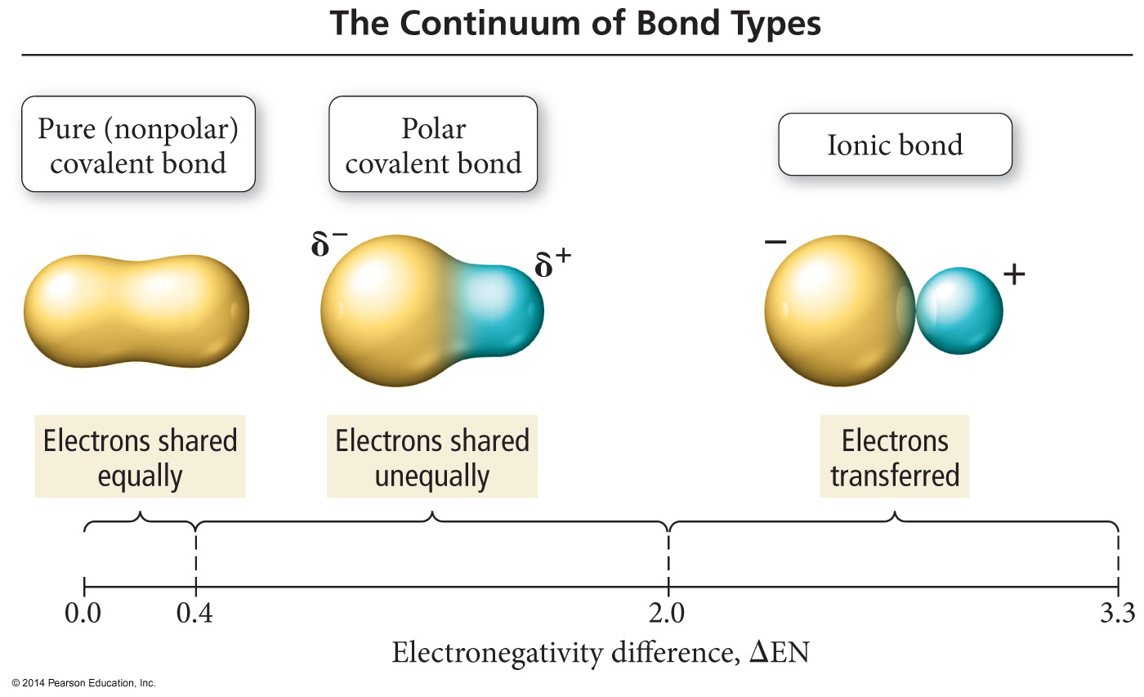

Slide 54
Bond Polarity

Slide 55
Bond Dipole Moments
Dipole moment, μ, is a measure of bond polarity.
A dipole is a material with a + and − end.
it is directly proportional to the size of the partial charges and directly proportional to the distance between them.
μ = (q)(r)
Not Coulomb’s law
Measured in Debyes, D
Generally, the more electrons two atoms share and the larger the atoms are, the larger the dipole moment.

Slide 56
Summary of Periodic Trends In the locker

Slide 57
Magnetic Properties of Transition Metal Atoms and Ions
Electron configurations that result in unpaired electrons mean that the atom or ion will have a net magnetic field; this is called paramagnetism.
Will be attracted to a magnetic field
Electron configurations that result in all paired electrons mean that the atom or ion will have no magnetic field; this is called diamagnetism.
Slightly repelled by a magnetic field
STOP

Slide 58
The Puzzle of the Atom
Protons and electrons are attracted to each other because of opposite charges
Electrically charged particles moving in a curved path give off energy
Despite these facts, atoms don’t collapse

Slide 59
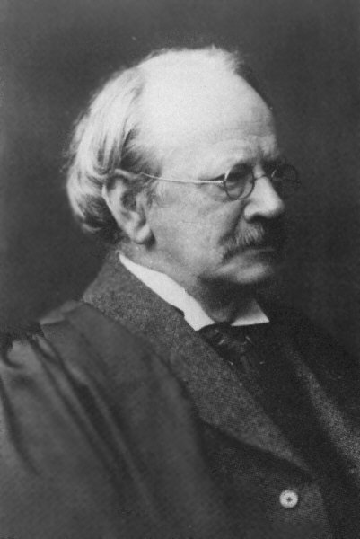
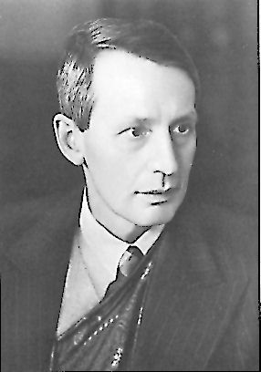
Wave-Particle Duality
JJ Thomson won the Nobel prize for describing the electron as a particle.
His son, George Thomson won the Nobel prize for describing the wave-like nature of the electron.
The electron is a particle!
The electron is an energy wave!

Slide 60
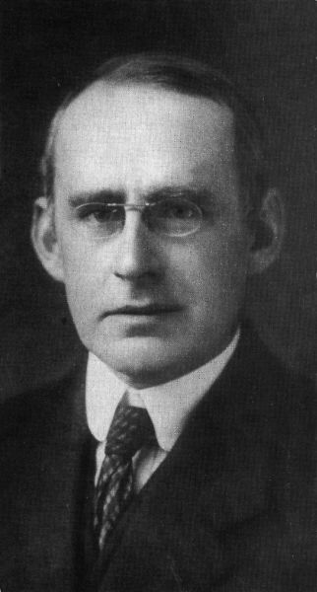
Confused??? You’ve Got Company!
“No familiar conceptions can be woven around the electron; something unknown is doing we don’t know what.”
Physicist Sir Arthur Eddington
The Nature of the Physical World
1934

Slide 61
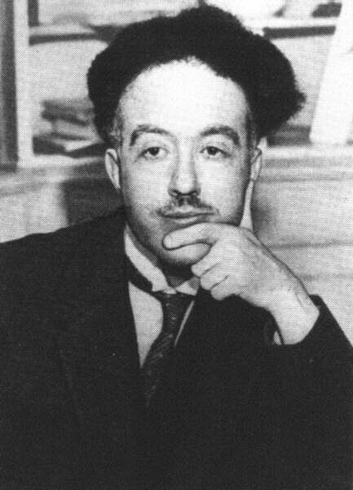
The Wave-like Electron
The electron propagates through space as an energy wave. To understand the atom, one must understand the behavior of electromagnetic waves.
Louis deBroglie
Light Travels through
space as a wave
Light transmits energy as a particle
Particles have wavelength, exhibited by diffraction patterns
Large particles have very short wavelength
All Matter exhibits both particle and wave properties

Slide 62
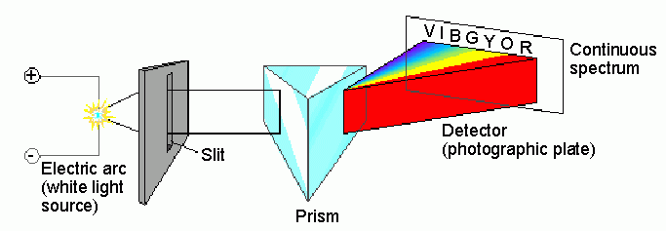
Spectroscopic analysis of the visible spectrum…
…produces all of the colors in a continuous spectrum

Slide 63
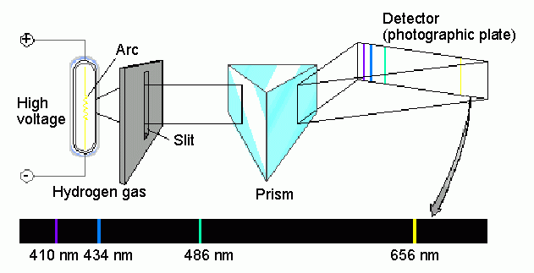
Spectroscopic analysis of the hydrogen spectrum…
…produces a “bright line” spectrum

Slide 64
Electron Energy in Hydrogen The Bohr Model
Bohr Model
The electron moves around the nucleus only in certain allowed circular orbits
Bright line spectra confirms that only certain energies exist in the atom, and atom emits photons with definite wavelengths when the electron returns to a lower energy state
Energy levels available to the electron in the hydrogen atom

Slide 65
Shortcomings of Bohr Model…
Bohr's model does not work for atoms other than hydrogen
2. Electron's do not move in circular orbits

Slide 66
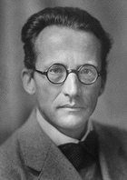
Schrodinger Wave Equation
Equation for probability of a single electron being found along a single axis (x-axis)
Erwin Schrodinger

Slide 67
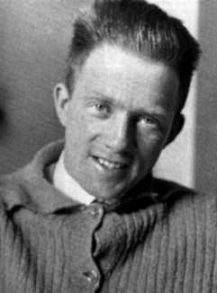
Heisenberg Uncertainty Principle
“One cannot simultaneously determine both the position and momentum of an electron.”
You can find out where the electron is, but not where it is going.
OR…
You can find out where the electron is going, but not where it is!
Werner
Heisenberg

Slide 68
Penetration #2
Which of the orbital types in the 3rd energy level
does not seem to have a “node”?
WHY NOT?

Slide 69
Quantum Numbers
Each electron in an atom has a unique set of 4 quantum numbers which describe it.
Principal quantum number, n
Angular momentum quantum number, l
Magnetic quantum number, m or m_{l}
Spin quantum number, s or m_{s}

Slide 70
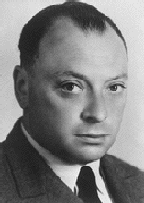
Pauli Exclusion Principle
No two electrons in an atom can have the same four quantum numbers.
Wolfgang
Pauli

Slide 71
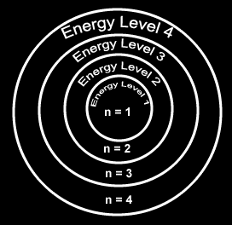
Principal Quantum Number
Generally symbolized by n, it denotes the shell (energy level) in which the electron is located.
Number of electrons that can fit in a shell:
2n²

Slide 72
Angular Momentum Quantum Number
The angular momentum quantum number, generally symbolized by l, denotes the orbital (subshell) in which the electron is located.

Slide 73
Magnetic Quantum Number
The magnetic quantum number, generally symbolized by m, denotes the orientation of the electron’s orbital with respect to the three axes in space.

Slide 74
Spin Quantum Number
Spin quantum number denotes the behavior (direction of spin) of an electron within a magnetic field.
Possibilities for electron spin:

Slide 75
Assigning the Numbers
The three quantum numbers (n, l, and m) are integers.
The principal quantum number (n) cannot be zero.
n must be 1, 2, 3, etc.
The angular momentum quantum number (l ) can be any integer between 0 and n - 1.
For n = 3, l can be either 0, 1, or 2.
The magnetic quantum number (m_{l}) can be any integer between -l and +l.
For l = 2, m can be either -2, -1, 0, +1, +2.

Slide 76
Principle, angular momentum, and magnetic quantum numbers: n, l, and m_{l}

Slide 77
s orbital shape
The s orbital has a spherical shape centered around
the origin of the three axes in space.

Slide 78
P orbital shape
There are three dumbbell-shaped p orbitals in
each energy level above n = 1, each assigned to
its own axis (x, y and z) in space.

Slide 79
d orbital shapes
Things get a bit more complicated with the five d orbitals that are found in the d sublevels beginning with n = 3. To remember the shapes, think of:
“double dumbells”
…and a “dumbell
with a donut”!

Slide 80
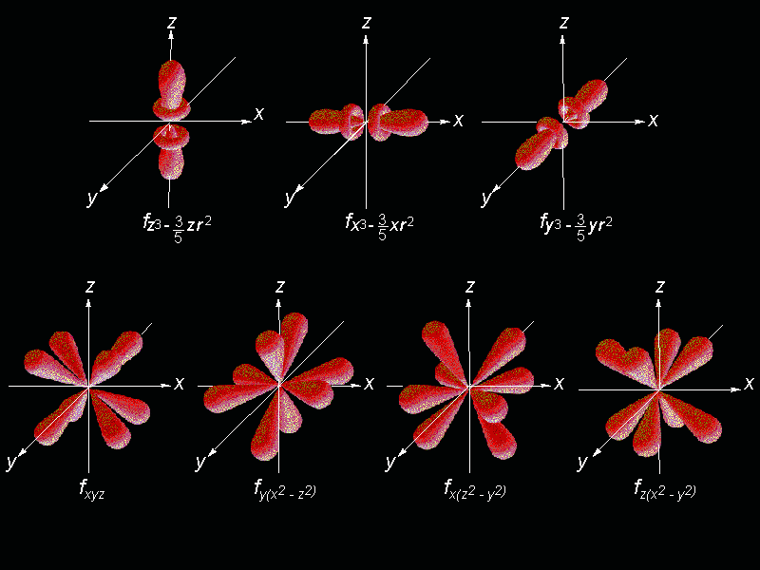
Shape of f orbitals

Slide 81
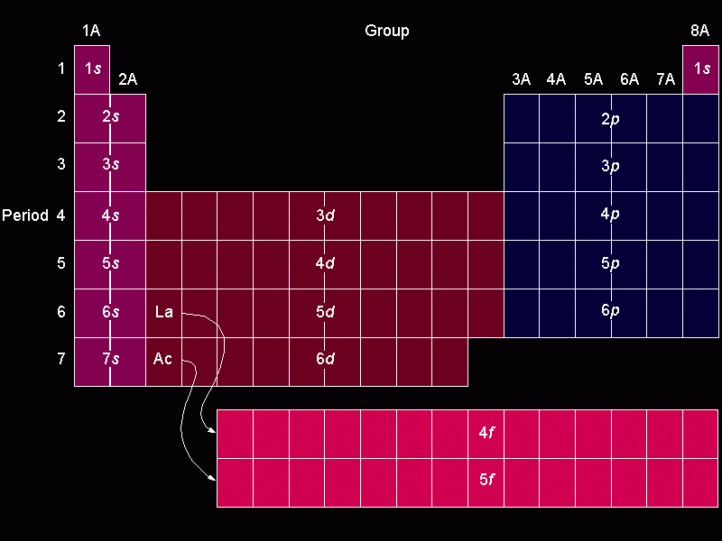
Orbital filling table

Slide 82
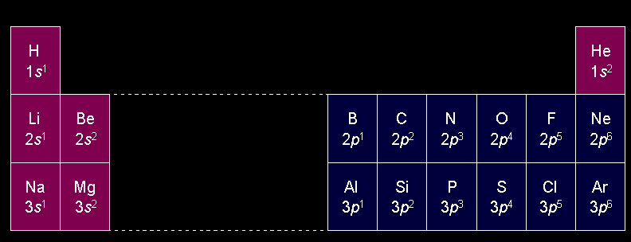
Electron configuration of the elements of the first three series

Slide 83
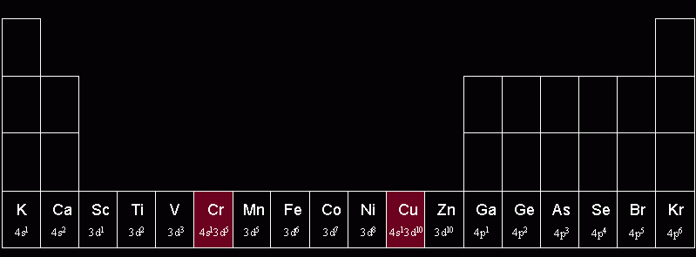
Irregular confirmations of Cr and Cu
Chromium steals a 4s electron to half fill its 3d sublevel, no longer part of this class…
Copper steals a 4s electron to FILL
its 3d sublevel

Slide 84
Quantum Number Practice
Ex #1: phosphorus
P
Rule 1: identify the principle energy level, n (same as period)
In period 3
In the p-block
3rd one in ∴ 1
Rule 2: identify the orbital type, l (block the e- is in)
Is 1st half of block, ∴ +1/2
Rule 3: identify the orientation (-l to l ).
Answer:
(3, 1, 1, +1/2)
Rule 4: 1st half have +1/2 spin, 2nd half have -1/2 spin

Slide 85
Quantum Number Practice
Ex #2: Iron
Fe
Rule 1: identify the principle energy level, n (same as period)
In period 3
In the d-block
6th one in ∴ -2
Rule 2: identify the orbital type, l (block the e- is in)
Is 2nd half of block, ∴ -1/2
Rule 3: identify the orientation (-l to l ).
Answer:
(3, 2, -2, -1/2)
Rule 4: 1st half have +1/2 spin, 2nd half have -1/2 spin

Slide 86
Quantum Number Practice
Ex #3: Barium
Ba
Rule 1: identify the principle energy level, n (same as period)
In period 6
In the s-block
2nd one in ∴ 0
Rule 2: identify the orbital type, l (block the e- is in)
Is 2nd half of block, ∴ -1/2
Rule 3: identify the orientation (-l to l ).
Answer:
(6, 0, 0, -1/2)
Rule 4: 1st half have +1/2 spin, 2nd half have -1/2 spin

Slide 87
Quantum Number Practice
Ex #4: Tin
Sn
Rule 1: identify the principle energy level, n (same as period)
In period 5
In the p-block
2nd one in ∴ 0
Rule 2: identify the orbital type, l (block the e- is in)
Is 1st half of block, ∴ +1/2
Rule 3: identify the orientation (-l to l ).
Answer:
(5, 1, 0, +1/2)
Rule 4: 1st half have +1/2 spin, 2nd half have -1/2 spin

Slide 88
Quantum Number Practice
Ex #5: Silver
Ag
Rule 1: identify the principle energy level, n (same as period)
In period 4
In the d-block
9th one in ∴ 1
Rule 2: identify the orbital type, l (block the e- is in)
Is 2nd half of block, ∴ -1/2
Rule 3: identify the orientation (-l to l ).
Answer:
(4, 2, 1, -1/2)
Rule 4: 1st half have +1/2 spin, 2nd half have -1/2 spin

Slide 89
Quantum Number Practice
Ex #6: Oxygen
O
Rule 1: identify the principle energy level, n (same as period)
In period 2
In the p-block
4th one in ∴ -1
Rule 2: identify the orbital type, l (block the e- is in)
Is 2nd half of block, ∴ -1/2
Rule 3: identify the orientation (-l to l ).
Answer:
(2, 1, -1, -1/2)
Rule 4: 1st half have +1/2 spin, 2nd half have -1/2 spin

Slide 90
Electron Energy in Hydrogen The Bohr Model
Z = nuclear charge (atomic number)
n = energy level
***Equation works only for atoms or ions with 1 electron (H, He⁺, Li²⁺, etc).

Slide 91
Calculating Energy Change, ΔE, for Electron Transitions
Energy must be absorbed from a photon (+ΔE) to move an electron away from the nucleus
Energy (a photon) must be given off (-ΔE) when an electron moves toward the nucleus

