Slide 1
N16 – Atomic Structure and Periodicity
Waves and Math
Link to YouTube Presentation: https://youtu.be/SWV-OEPv3R4

Slide 2
N16 – Atomic Structure and Periodicity
Waves and Math
Target: I can calculate things related to energy waves such as wavelength, frequency, and energy as they relate to chemistry concepts.

Slide 3
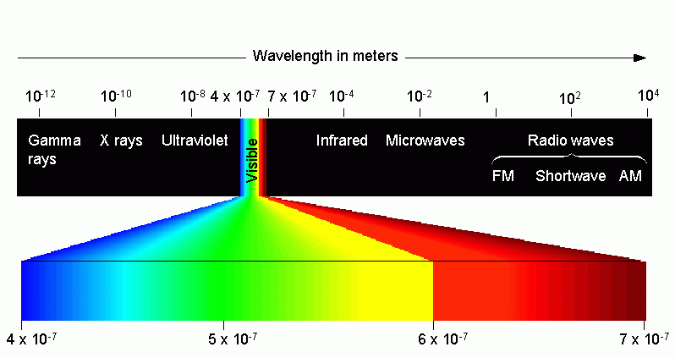
Types of Electromagnetic Radiation

Slide 4
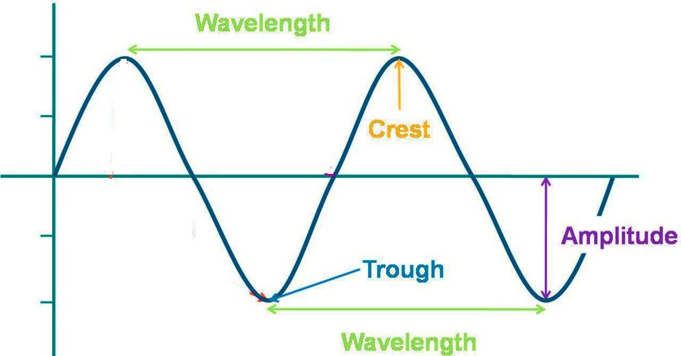
Parts of a Wave

Slide 5
Relationship between λ , ν and E
Long
Wavelength
=
Low Frequency
=
Low ENERGY
Short
Wavelength
=
High Frequency
=
High ENERGY

Slide 6
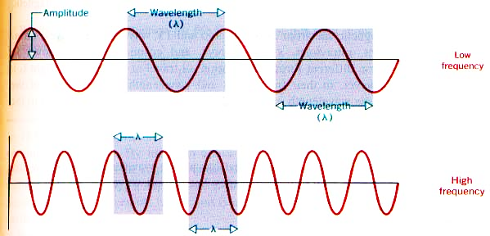
Electromagnetic Radiation
Propagates through space as a wave – moving at the speed of light
c = νλ
c = speed of light, a constant (3.00 x 10⁸ m/s)
ν = frequency, in units of hertz (hz, sec⁻¹)
Careful! Sometimes in MHz = x 10⁶ Hz
λ = wavelength (meters)
Careful! Sometimes in nm = x 10⁻⁹ m

Slide 7
Energy of EMR
Energy (E) is directly proportional to the frequency (ν) of the radiation
E = hν
E = Energy, in units of Joules (kg·m²/s²)
h = Planck’s constant (6.626 x 10⁻³⁴ J·s)
ν = frequency, in units of hertz (hz, sec⁻¹)

Slide 8
Game of Rearranging and Substitution!
Common Arrangements:

Slide 9
Wave Interference
Linear Superposition – when waves come together the result is the sum of the waves
In Phase
Constructive Interference
Additive
Out of Phase
Destructive Interference
Cancellation

Slide 10
Game of Rearranging and Substitution!
Other Useful Equations:
de Broglie Equation
Bohr Equation
$$E=−2.178 x {10}^{−18}J\left(\frac{Z^{2}}{n^{2}}\right)$$
$$λ= \frac{h}{mv}$$
Z = nuclear charge (atomic #)
n = energy level
m = particle mass
Energy Change Between Two Energy Levels
$$E=−2.178 x {10}^{−18}J\left(\frac{Z^{2}}{n_{final}^{2}} − \frac{Z^{2}}{n_{initial}^{2}}\right)$$

Slide 11
Link to YouTube Presentation
https://youtu.be/SWV-OEPv3R4

