Slide 1
N17 – Atomic Structure and Periodicity
Shielding and Such
Link to YouTube Presentation: https://youtu.be/paSLdnz8rE0

Slide 2
N17 – Atomic Structure and Periodicity
Shielding and Such
Target: I can keep nuclear attractions and electron repulsions in mind when explaining periodic trends.

Slide 3
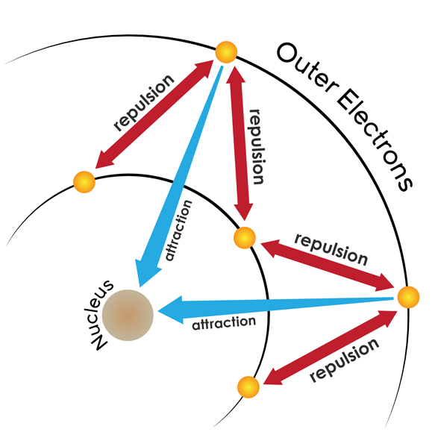
EVERYTHING is about…
ATTRACTIONS
Electrons attracted to protons in the nucleus
REPULSIONS
Electrons repelled by each other

Slide 4
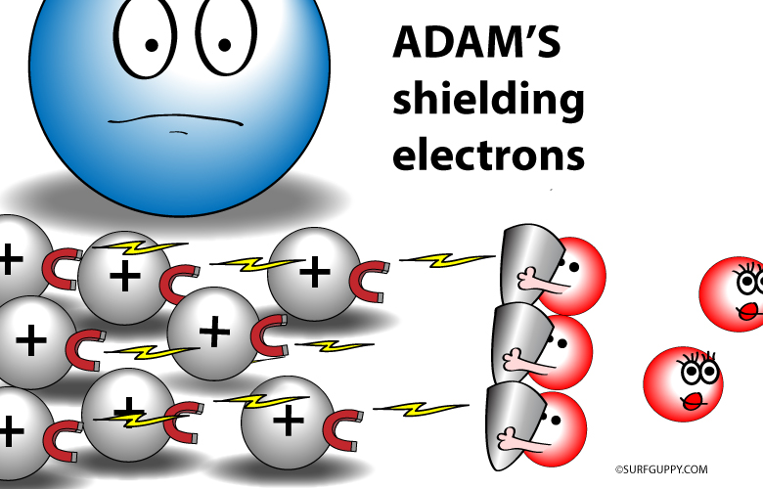
Shielding
Outer electrons are shielded from nucleus by the core electrons.
Shielding effect
Outer electrons do not effectively screen for each other.
Shielding causes outer electrons to not experience the full strength of the nuclear charge.
The electrons would be more attracted to the nucleus if the core electrons were not there!

Slide 5
Effective Nuclear Charge
The effective nuclear charge is a net positive charge that is attracting a particular electron.
Z_{effective} = Z − S
Z = nuclear charge
S = number of electrons in lower energy levels.
Electrons in the same energy level contribute to screening but their contribution is so small they are not part of the calculation.
Trend in Shielding strength: s > p > d > f.

Slide 6
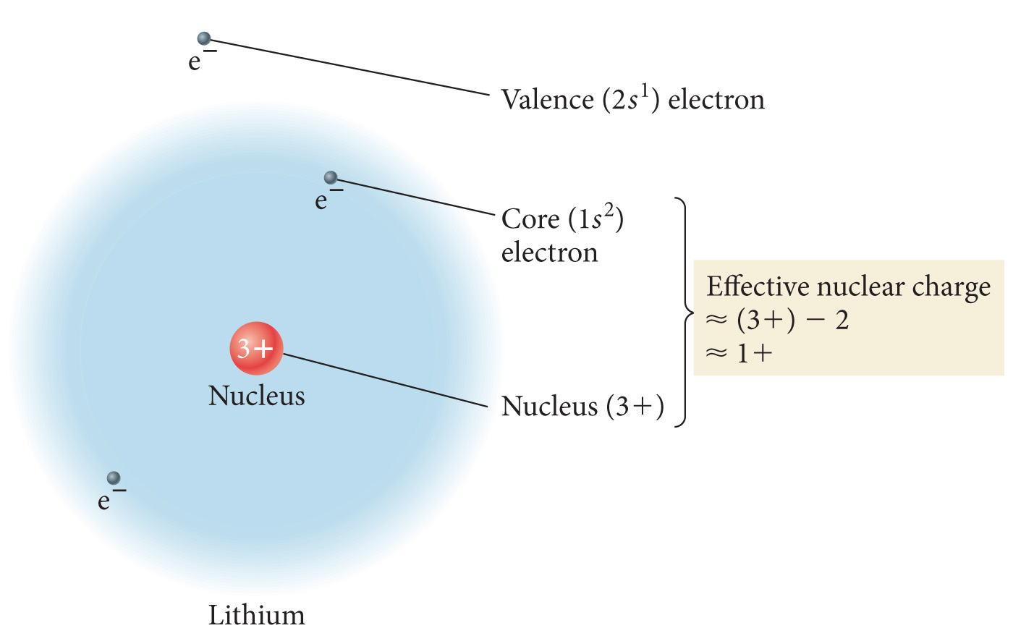
Effective Nuclear Charge
The valence e- is NOT feeling the full +3 charge of the nucleus!

Slide 7
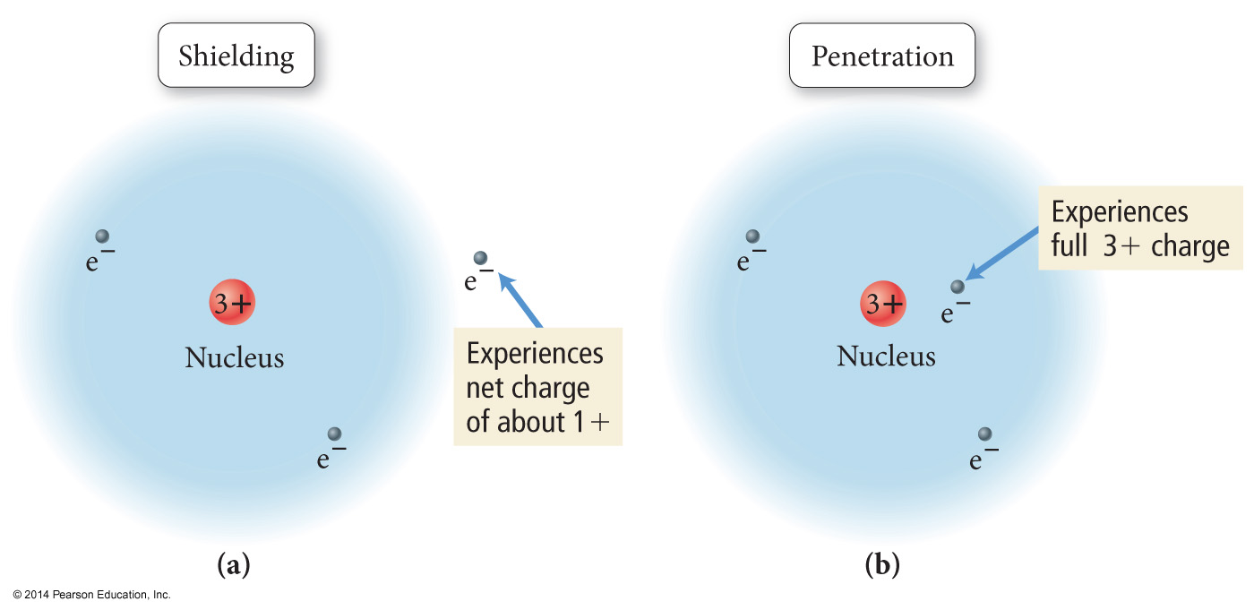
Penetration
Penetration is when an electron spends time closer to the nucleus than it’s outer boundary distance.
Remember - there are different orbital shapes
Some will have some electron density in closer to the nucleus than others

Slide 8
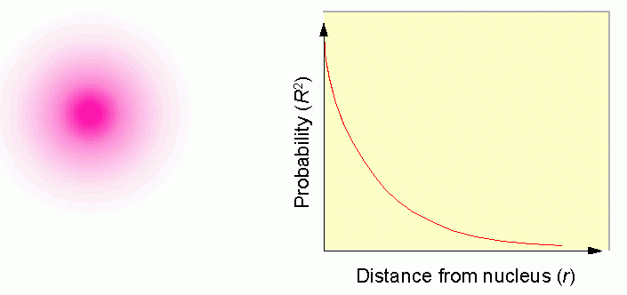
Remember…
An orbital is a region within an atom where there is a probability of finding an electron. Orbital shapes are defined as the surface that contains 90% of the total electron probability.
This is a probability diagram for the s orbital in the first energy level…

Slide 9
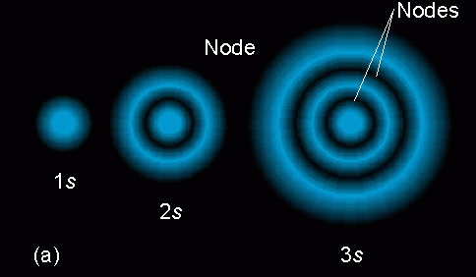
s Orbitals – not just a solid sphere!
s orbitals have areas of low probability inside them called nodes.

Slide 10
Penetration
Even larger s orbitals have some electron density near the nucleus!
Which s orbital is this?
What parts correspond to the “nodes” – areas with zero probability?
3s orbital

Slide 11
Penetration
Even larger s orbitals have some electron density near the nucleus!
Penetration of the 2s electrons and the 3s electrons!

Slide 12
Penetration
The closer an electron is to the nucleus, the more attraction it experiences.
The better an outer electron is at penetrating through the electron cloud of inner electrons, the more attraction it will have for the nucleus.
The degree of penetration is related to the orbital’s “radial distribution function” – tells us the probability of finding the electron at certain distances.

Slide 13
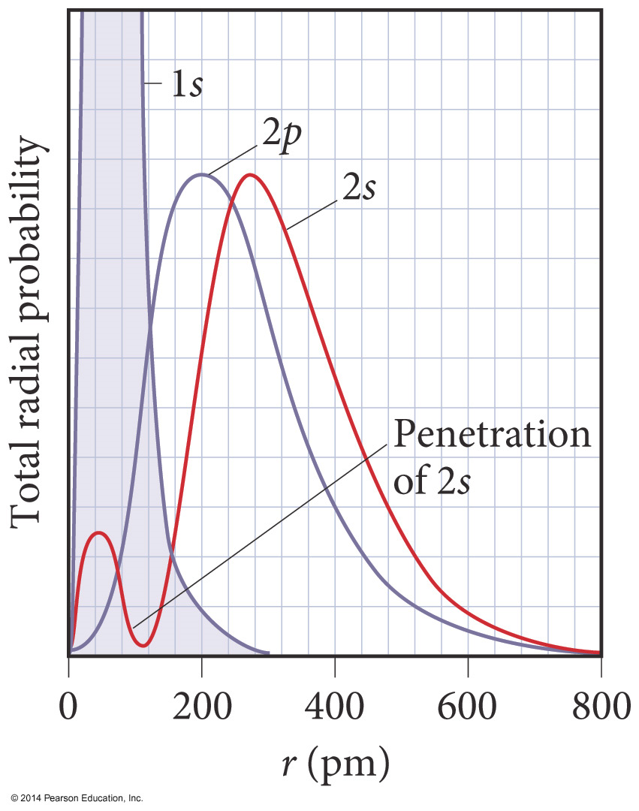
Penetration and Shielding
2s orbital – penetrates more deeply into the 1s orbital, towards the nucleus than the 2p orbital does
The weaker penetration of the 2p orbital means the 2p electrons experience LESS attractive force from the nucleus. They are more shielded from the nucleus.
The greater penetration of the 2s means electrons in the 2s orbital experience MORE attractive force from the nucleus. They are less shielded from the nucleus.

Slide 14
Penetration, Attraction, Shielding
Penetration towards the nucleus:
s > p > d > f
Attraction for nucleus:
s > p > d > f
Shielding they contribute for valence electrons:
s > p > d > f

Slide 15
Careful…
You need to be VERY careful with your phrasing!
Do not use generic or nonspecific terms – be specific.
BAD: It is shielded more
BETTER: Calcium’s valence electrons experience more shielding
You MUST reference BOTH atoms being compared.
BAD: Calcium’s valence electrons experience more shielding
BETTER: Calcium’s valence electrons experience more shielding than Sodium’s valence electrons

Slide 16
Careful…
You need to be VERY careful with your phrasing!
You MUST give REASONS.
BAD: Calcium’s valence electrons experience more shielding than Sodium’s valence electrons
BEST! Calcium’s valence electrons experience more shielding than Sodium’s valence electrons, because Calcium’s valence electrons are in energy level 4, while Sodium’s are in energy level 3. Therefore, Calcium’s valence electrons are shielded from 3 levels of core electrons, while sodium’s are shielded from only 2 levels of core electrons.

Slide 17
Last few suggestions…
Be succinct!
Do not ramble!
Bullet points are your friend!
Keep the grading rubric in mind – what key things are we looking to check off that you addressed????
Attraction to the nucleus
Repulsions between the electrons
Do not vocab drop!
Can't just say “shielding” or “effective nuclear charge”
Read as many AP Chem rubrics as possible for this topic! Internalize their phrasing (not necessarily “memorize”)

Slide 18
Why care about shielding & penetration?
Helps explain periodic trends!
Z_{eff}
Radius, Ionization energy, Electronegativity
A lot of “exceptions” to the periodic trends patterns that we glossed over in Honors Chem

Slide 19
Link to YouTube Presentations
https://youtu.be/paSLdnz8rE0

