Slide 1
N18 – Atomic Structure and Periodicity
Periodic Trends
Link to YouTube Presentation: https://youtu.be/RwCDvBtAGbo

Slide 2
N18 – Atomic Structure and Periodicity
Periodic Trends
Target: I can describe and explain various patterns/ trends visible on the periodic table by using concepts such as shielding and nuclear attraction.

Slide 3
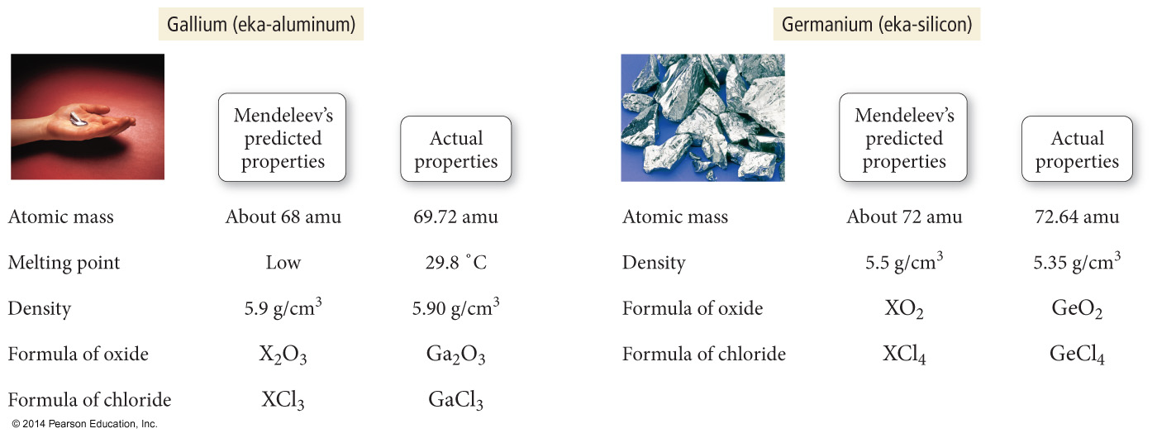
Patterns work really well!
Mendeleev predicted the properties of lots of elements!

Slide 4
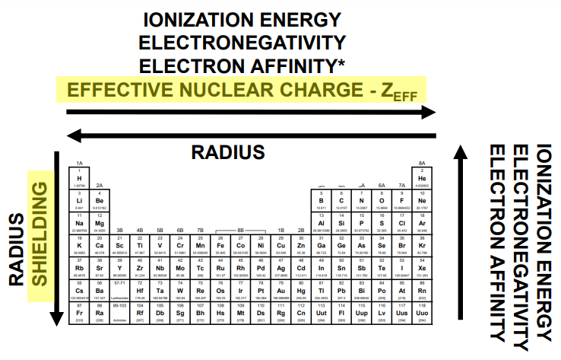
Summary of Periodic Trends

Slide 5
Summary of Periodic Trends

Slide 6
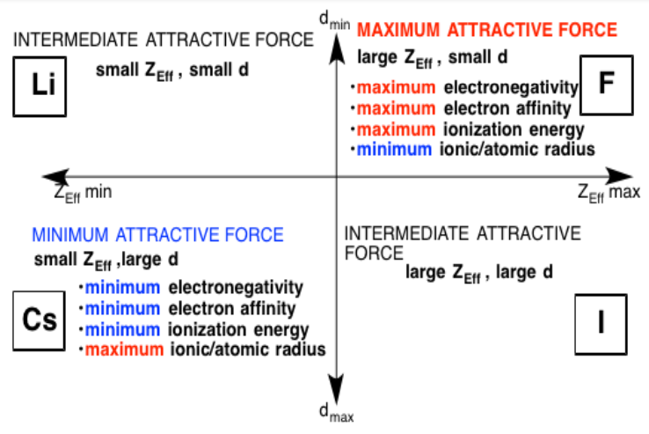
Summary of Periodic Trends

Slide 7
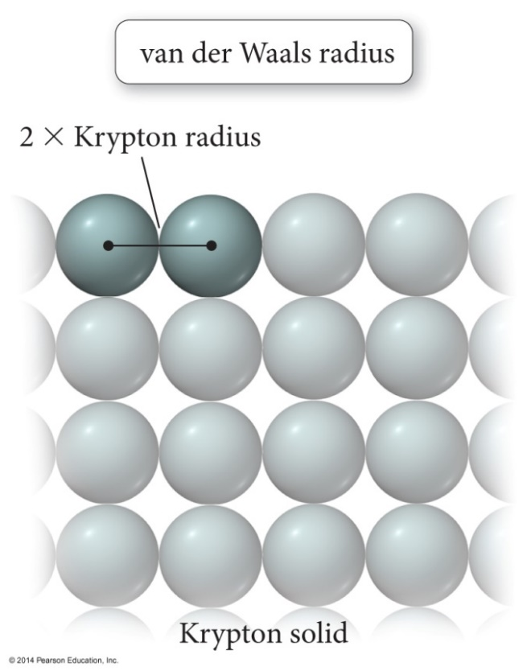
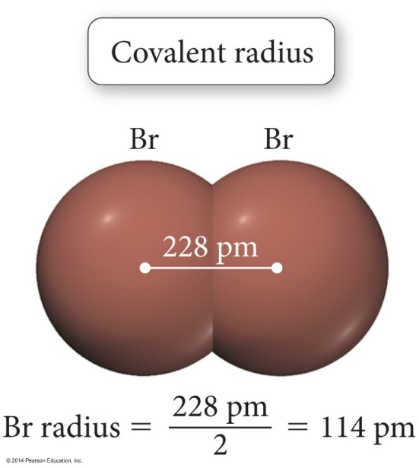
Atomic Radius
Several ways to measure
Van der Waals radius = nonbonding
Covalent radius = bonding radius
All give slightly different values
Atomic radius is an average radius of an atom based on measuring large numbers of elements and compounds.

Slide 8
Atomic Radius

Slide 9
Atomic Radius Trend
KEY POINTS TO DESCRIBE GOING DOWN A GROUP:
Can NOT just say “because there is more shielding” – no vocab dropping!
The size of an atom is related to the distance the valence electrons are from the nucleus and the attractive forces.
You must specifically mention that the higher energy level is bigger volume and further away from nucleus. – yes this seems obvious… but if you want points be careful!

Slide 10
Radius – Reasoning
Increases down a group (top to bottom)
Moving down a group:
Adds a (principal) energy level.
The larger the principal energy level an orbital is in:
The larger its volume.
The farther the e⁻ (most probable distance) is from nucleus.
The less attraction it will have for the nucleus.
The more shielding the valence electrons experience from inner core electrons.
Therefore: The larger the radius

Slide 11
Atomic Radius Trend
KEY POINTS TO DESCRIBE GOING ACROSS A PERIOD:
Can NOT just say “because there is greater effective nuclear charge” – no vocab dropping!
The size of an atom is related to the distance the valence electrons are from the nucleus and the attractive forces.
As you go to the right there are more protons added BUT shielding doesn’t increase since the e’s are added to the same energy level.
You must specifically mention that this results in greater nuclear attraction due to increased # of protons (nuclear charge) and therefore a smaller radius – yes this seems obvious… but if you want points be careful!

Slide 12
Radius – Reasoning
Decreases Across a Period (Left to Right)
Going to the right:
Adds a proton each time
No addition of shielding (adding e- to same energy level)
Adding a proton with no increased shielding:
Increases effective nuclear charge on the valence e’s
The stronger the attraction it will have for the nucleus.
The stronger the nuclear attraction:
The closer they are to the nucleus
Therefore: smaller radius

Slide 13
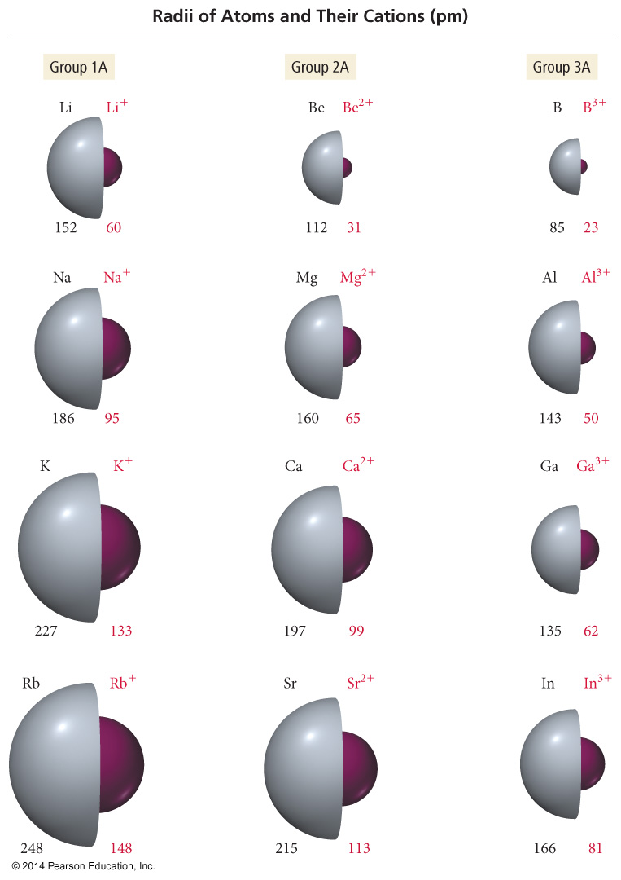
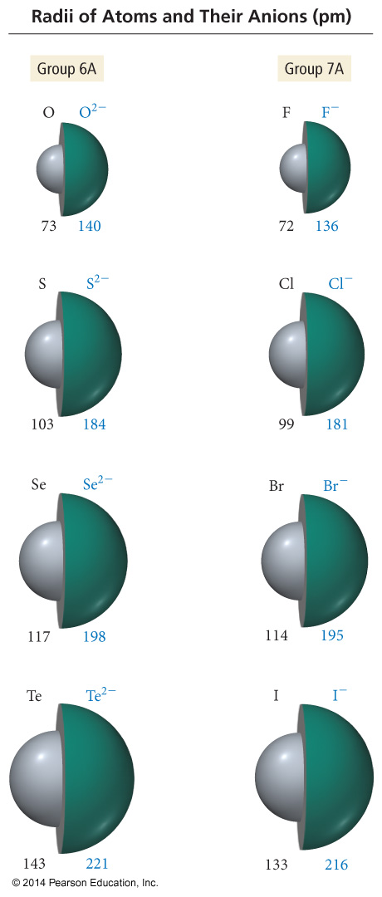
Ionic Radius Trend
Ions in same group have the same charge.
Ion size increases down column.
Higher valence shell, larger radius
Cations < neutral atoms
Anion > neutral atoms.
Neutral Cation Anion

Slide 14
Ionic Radius Trend
Neutral Cation Anion
Cations
Higher (+) charge, smaller radius
Mg⁺ radius > Mg²⁺ radius
Anion
Higher (-) charge, larger radius
O⁻ radius < O²⁻ radius

Slide 15
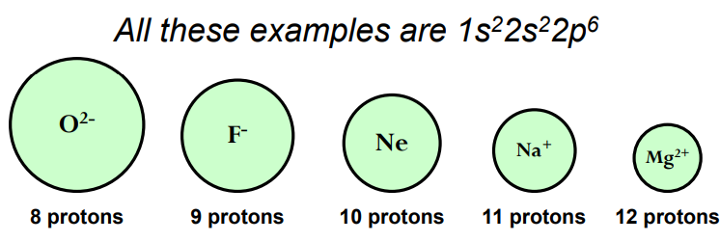
Ionic Radius Trend
Isoelectronic = same electron configuration
For isoelectronic species compare the # of protons to # e-
More protons, more attraction, smaller radius

Slide 16
Radius
Irregularities
Radius doesn’t change very much going across d-block
New electrons are being added to an INNER (core) energy level
Yes you are adding an extra proton to shrink radius
BUT you are also adding shielding!
Result is yes radius will decrease but not by as much as you might expect.

Slide 17
Ionization Energy

Slide 18
Ionization Energy (IE)
Ionization Energy is the minimum energy needed to remove an electron from an atom or ion
In the gas state
Endothermic process – takes energy
Valence electron easiest to remove, lowest IE
1st Ionization Energy – Energy to remove e⁻ from neutral atom
M_{(g)} + IE₁ → M¹⁺_{(g)} + 1 e-
2nd Ionization – Energy to remove e⁻ from 1+ ion
M¹⁺_{(g)} + IE₂ → M²⁺_{(g)} + 1e-

Slide 19
Ionization Energy (IE)
Decreases down a group
Each time you go down you have another energy level
Inner core electrons shield outer electrons
Increased radius
Decreased nuclear attraction
Easier to take away an electron
Decreased IE

Slide 20
Ionization Energy (IE)
Increases across a period (left to right)
Each time you go to the right you add a proton
No significant increase in shielding b/c adding e- to same energy level – they do not shield as well as inner levels
Therefore, the radius decreases
Increase in nuclear attraction
Harder to take one away
Increased IE

Slide 21
Ionization Energy (IE)
Irregularities
Half filled and totally filled sublevels (orbital set)
Extra repulsions of electrons in paired orbitals
Makes it easier to remove an electron
Lower IE than expected
Moving to a p orbital (Mg → Al)
p orbital does not penetrate as much as an s orbital
Less nuclear attraction
Lower IE than expected

Slide 22
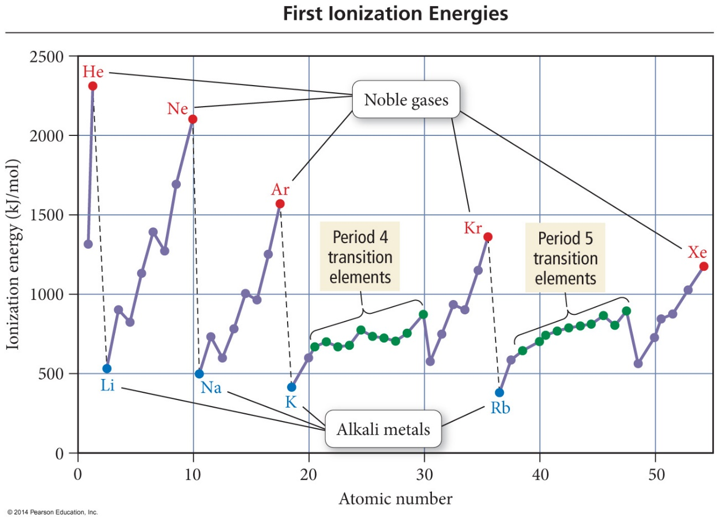
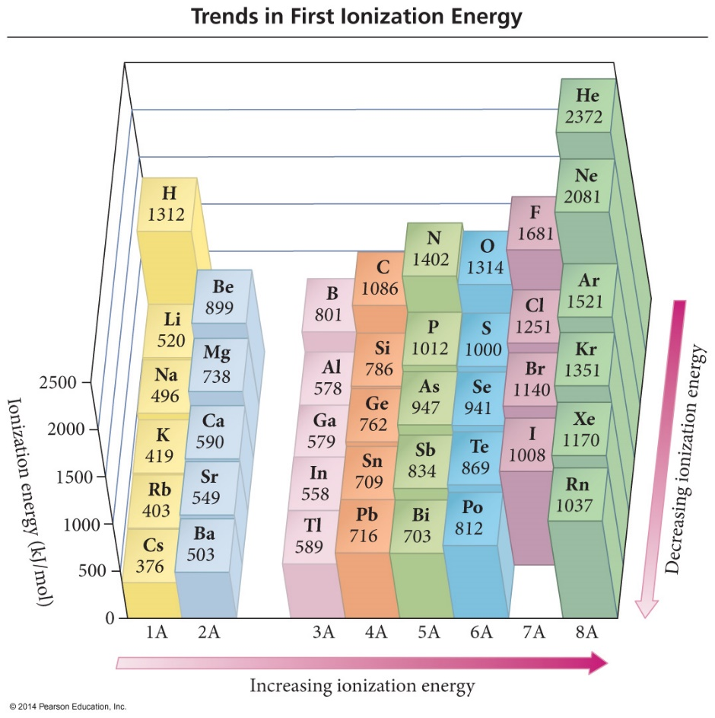
Ionization Energy (IE)

Slide 23
Ionization Energy (IE)
Increases for successive e⁻’s taken from same atom
Each time you take one away, atom gets smaller.
Smaller atom means greater nuclear attraction to valence e-
Harder to take away another e-
Increases IE

Slide 24
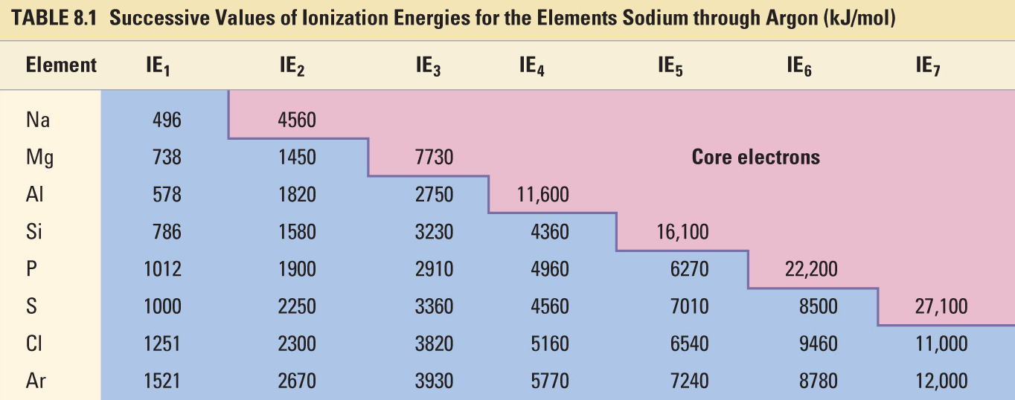
Successive Ionization Energies
Large jump in IE shows when you begin removing core e^{-’}s
Helps you figure out most likely charge on element
The charge is the number of ionizations that happened BEFORE the large jump

Slide 25
Electron Affinity

Slide 26
Electron Affinity
Electron Affinity – ∆ in energy when neutral atom gains e⁻
Gas state
Usually energy is released (exothermic, negative value)
M_{(g)} + 1e⁻ → M¹⁻_{(g)} + EA
Some alkali metals and all noble gases are endothermic
More energy released, the larger the electron affinity (larger negative = larger EA)

Slide 27
Electron Affinity
Alkali metals decrease electron affinity down the column.
But not all groups do
Generally irregular increase in EA from second period to third period
“Generally” increases across period
Becomes more negative from left to right
Not absolute
Group 5A often lower EA than expected - extra electron must pair
Groups 2A and 8A generally very low EA because added electron goes into higher energy level or sublevel
Highest EA in any period = halogen
Very irregular pattern compared to other PT Trends

Slide 28
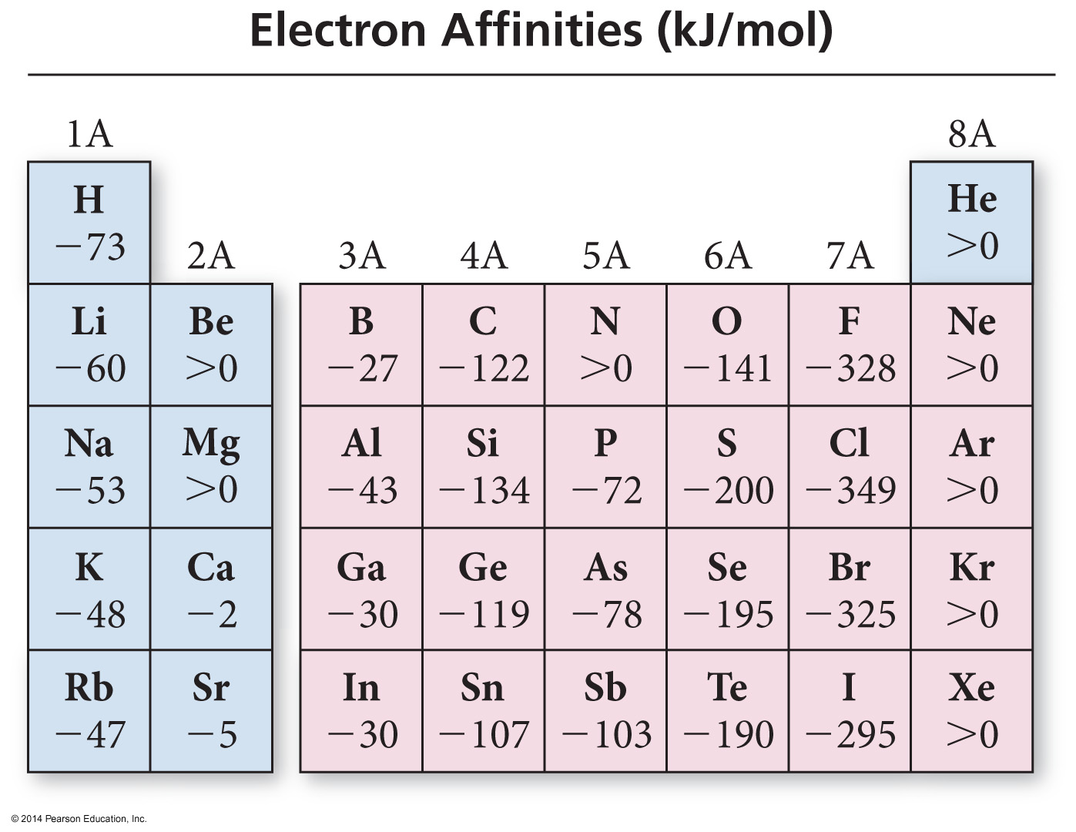
Electron Affinity

Slide 29
Electron Affinity

Slide 30
Electronegativity and Polarity

Slide 31
Electronegativity
The ability of an atom to attract bonding electrons to itself is called electronegativity.
Increases across period (left to right)
Decreases down group (top to bottom)
Fluorine - most electronegative
Francium - least electronegative
Noble gas atoms are not assigned values.
Opposite of atomic size trend.
The larger the difference in electronegativity, the more polar the bond.
Negative end toward more electronegative atom.

Slide 32
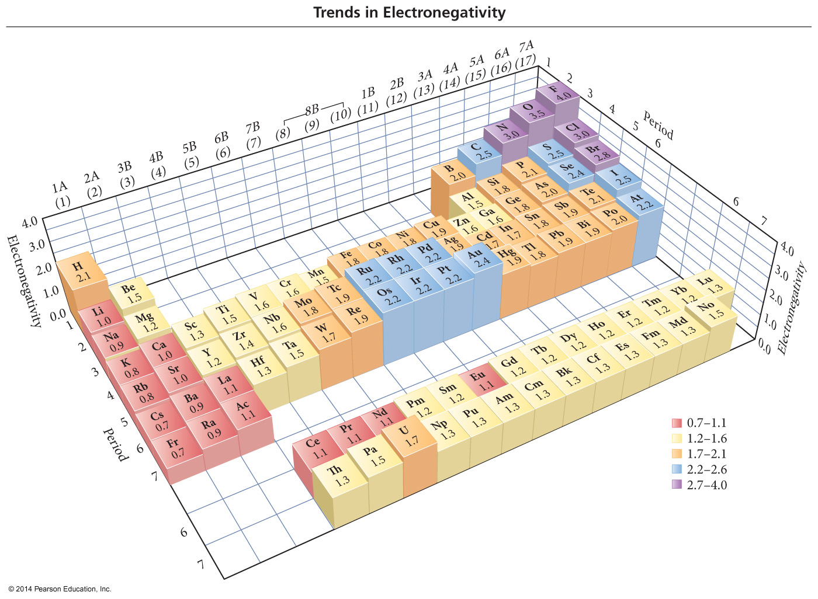
Electronegativity

Slide 33
Electronegativity Difference & Bond Type
Pure Covalent
Difference in electronegativity between bonded atoms is 0
Equal sharing
Nonpolar Covalent
Difference in electronegativity is 0.1 to 0.4
Polar Covalent
Difference in electronegativity is 0.5 to 1.9
Ionic
Difference in electronegativity is larger than or equal to 2.0

Slide 34
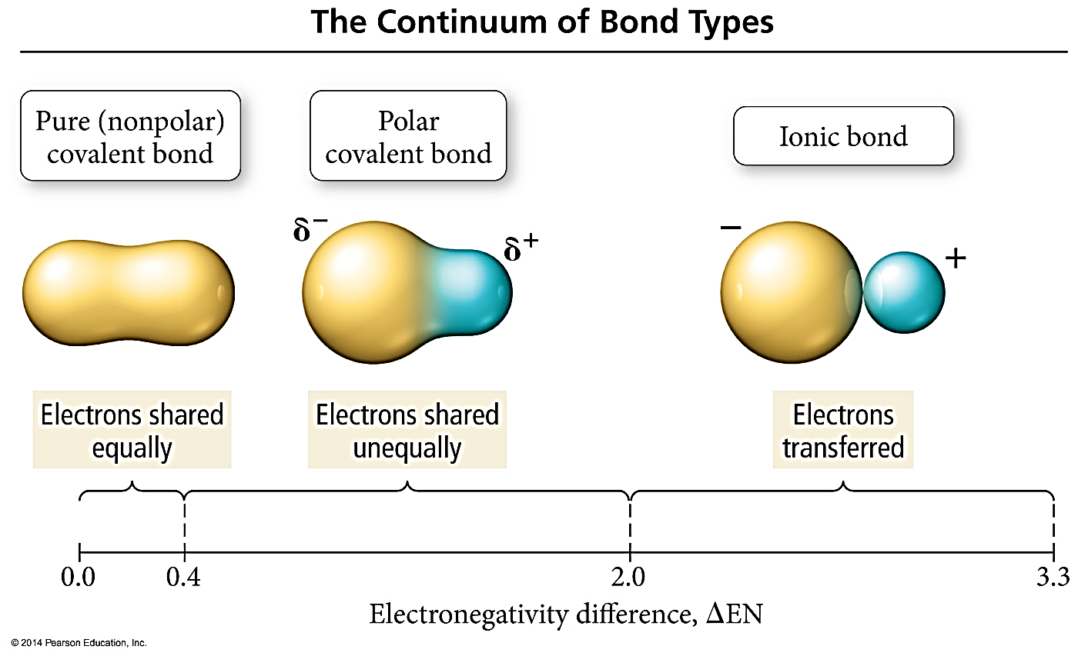
Electronegativity Difference & Bond Type

Slide 35
Electronegativity Difference & Bond Type

Slide 36
Bond Dipole Moments
Dipole – A substance with a partial (+) and partial (-) end
Dipole moment - μ, - a measure of bond polarity.
Directly proportional to the size of the partial charges and directly proportional to the distance between them.
μ = (q)(r)

Slide 37
Magnetic Properties
Paramagnetic – Atom or ion with a net magnetic field
Result of unpaired electrons in orbitals
Will be weakly attracted to a magnetic field
Diamagnetic – Atom or ion with no magnetic field
Result of all paired electrons in orbitals
Slightly repelled by a magnetic field
Ferromagnetic – Group of atoms in a solid crystal or lattice that keeps its magnetism even when there is no magnetic field applied

Slide 38
Electron Configuration and Magnetism

Slide 39
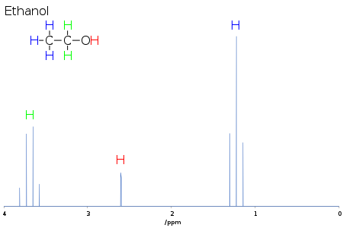
Why care about Paramagnetism?
NMR Machine – Helps determine the structure of molecules
MRI – Applied to images of the body

Slide 40
Why care about Paramagnetism?
NMR Machine – Helps determine the structure of molecules
MRI – Applied to images of the body

Slide 41
Link to YouTube Presentation
https://youtu.be/RwCDvBtAGbo

