Slide 1
Bonding – General Concepts Coulomb’s Law, Lattice Energy, Bond E

Slide 2
Electronegativity: The ability of an atom in a molecule to attract shared electrons to itself.

Slide 3
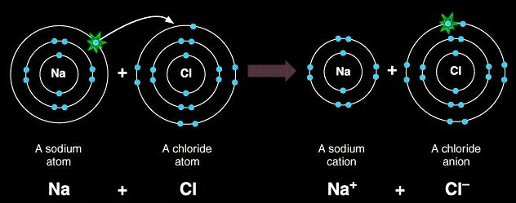
Ionic Bonds
Electrons are transferred
Electronegativity differences are
generally greater than 1.7
The formation of ionic bonds is
always exothermic!

Slide 4
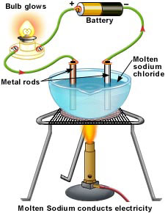
Determination of Ionic Character
Electronegativity difference is not the final determination of ionic character
Compounds are ionic if they conduct electricity in their molten state

Slide 5
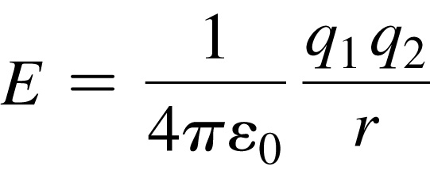
Coulomb’s Law
Coulomb’s law describes the attractions and repulsions between charged particles.
For like charges, the potential energy (E) is positive and decreases as the particles get farther apart as r increases. r should be squared
For opposite charges, the potential energy is negative and becomes more negative as the particles get closer together.
The strength of the interaction increases as the size of the charges increases.
Electrons are more strongly attracted to a nucleus with a 2+ charge than a nucleus with a 1+ charge.

Slide 6
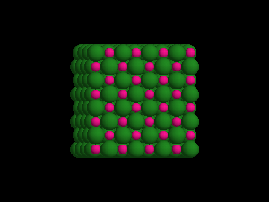
Sodium Chloride Crystal Lattice
Ionic compounds form solids at ordinary temperatures.
Ionic compounds organize in a characteristic crystal lattice of alternating positive and negative ions.

Slide 7
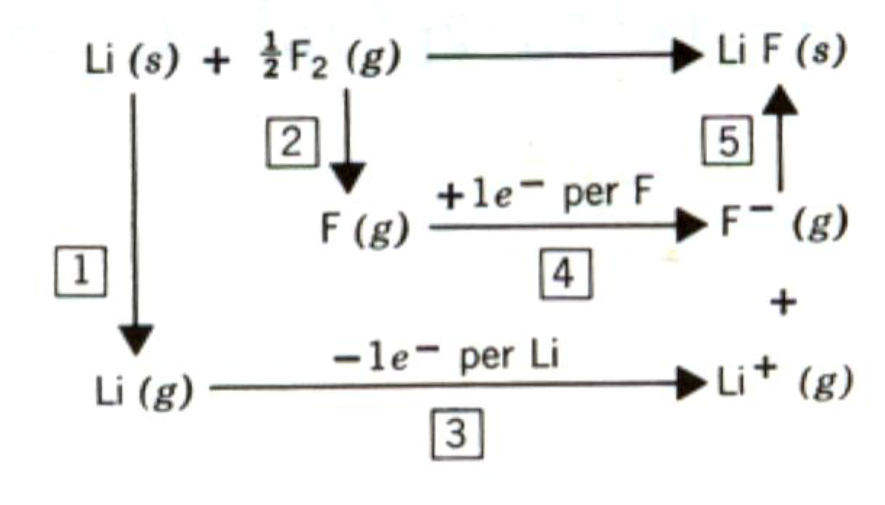
Lattice Energy Steps

Slide 8
Lattice Energy cont…
Lattice energy can be represented by a modified form of Coulomb’s Law: k is a
proportionality constant that depends on the structure of the solid and the electron configurations of the ions.
k is not the rate constant from this point of view

Slide 9
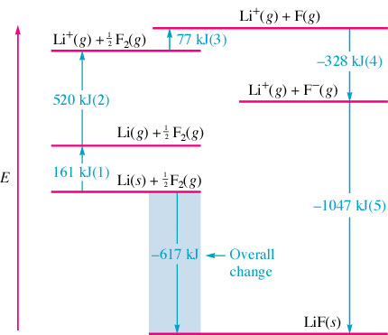
Enthalpy of dissociation --energy required to decompose an ion pair (from a lattice) into ions ∴ a measure of the strength of the ionic bond
Reminder: Q are the ion charges

Slide 10
Estimate ΔH_{f} for Sodium Chloride
Na(s) + ½ Cl₂(g) → NaCl(s)
Lattice Energy | -786 kJ/mol
Ionization Energy for Na | 495 kJ/mol
Electron Affinity for Cl | -349 kJ/mol
Bond energy of Cl₂ | 239 kJ/mol
Enthalpy of sublimation for Na | 109 kJ/mol
Na(s) → Na(g) + 109 kJ
Na(g) → Na⁺(g) + e⁻ + 495 kJ
½ Cl₂(g) → Cl(g) + ½(239 kJ)
Cl(g) + e⁻ → Cl⁻(g) - 349 kJ
Na⁺(g) + Cl⁻(g) → NaCl(s) -786 kJ
Na(s) + ½ Cl₂(g) → NaCl(s) -412 kJ/mol

Slide 11
Covalent Bonds
Polar-Covalent bonds
Electrons are unequally shared
Electronegativity difference between .3 and 1.7
Nonpolar-Covalent bonds
Electrons are equally shared
Electronegativity difference of 0 to 0.3

Slide 12
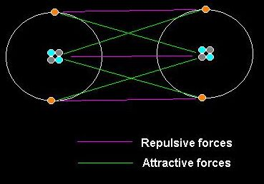
Covalent Bonding Forces
Electron – electron
repulsive forces = Bad
Proton – proton
repulsive forces = bad
Electron – proton
attractive forces = good

Slide 13
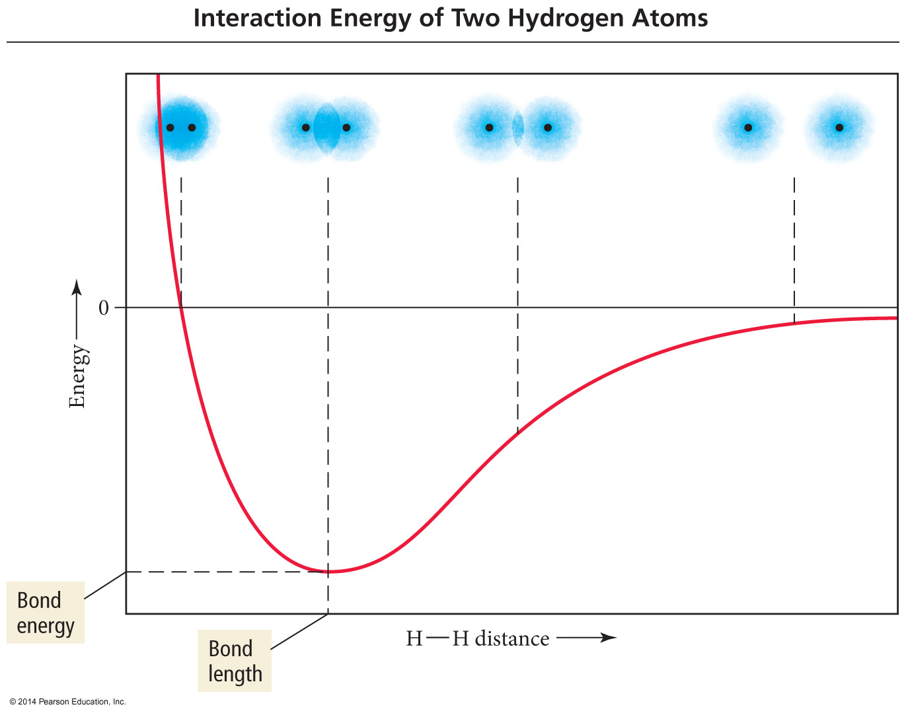

Slide 14
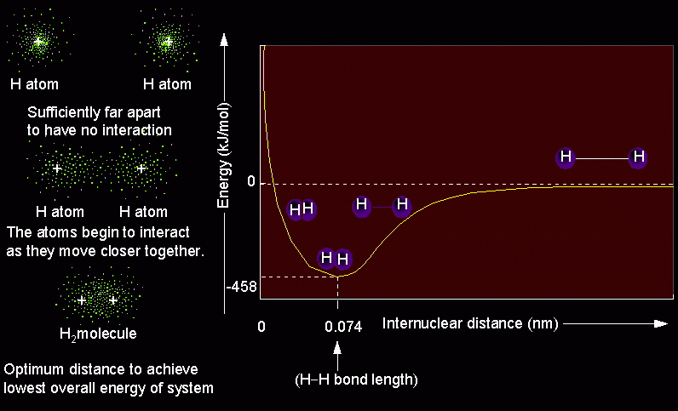
Bond Length Diagram

Slide 15
Bond Length and Energy
Bond | Bond type | Bond length (pm) | Bond Energy (kJ/mol)
C - C | Single | 154 | 347
C = C | Double | 134 | 614
C ≡ C | Triple | 120 | 839
C - O | Single | 143 | 358
C = O | Double | 123 | 745
C - N | Single | 143 | 305
C = N | Double | 138 | 615
C ≡ N | Triple | 116 | 891
Bonds between elements become shorter and stronger as multiplicity increases.

Slide 16
Bond Energy and Enthalpy
Energy required
Energy released
D = Bond energy per mole of bonds
Breaking bonds always requires energy
Breaking = endothermic
Forming bonds always releases energy
Forming = exothermic

