Slide 1
Bonding – General Concepts FC, VSEPR

Slide 2
Resonance
Resonance is invoked when more than one valid Lewis structure can be written for a particular molecule.
Benzene, C₆H₆
The actual structure is an average of the resonance
structures.
The bond lengths in the ring are identical, and
between those of single and double bonds.

Slide 3
Resonance Bond Length and Bond Energy
Resonance bonds are shorter and stronger than single bonds.
Resonance bonds are longer and weaker than double
bonds.

Slide 4
Resonance in Ozone, O₃
Neither structure is correct.
Oxygen bond lengths are identical, and intermediate to single and double bonds

Slide 5
Resonance in Polyatomic Ions
Resonance in a carbonate ion:
Resonance in an acetate ion:

Slide 6
Resonance with FORMAL CHARGES
Equation:
To evaluate a Lewis Structure:
Atoms in molecules try to achieve FC as close to zero as possible
Any negative FC’s are expected to be on the most electronegative atoms
The Σ of the FC of all atoms must = the overall charge of the ion or molecule
Example of Sulfate ion:

Slide 7
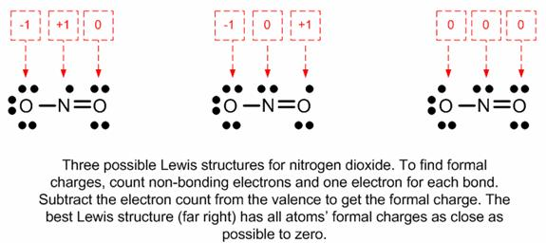
Carbonate Ion
Nitrogen Dioxide

Slide 8
Localized Electron Model
Lewis structures are an application of the “Localized Electron Model”
L.E.M. says: Electron pairs can be thought of as “belonging” to pairs of atoms when bonding using atomic orbitals. Lone pairs belong to only one atom
Resonance points out a weakness in the Localized Electron Model.
What about Delocalized electrons?

Slide 9
VSEPR Model
(Valence Shell Electron Pair Repulsion)
The structure around a given atom is determined principally by minimizing electron pair repulsions.

Slide 10
Predicting a VSEPR Structure
Draw Lewis structure.
Put pairs as far apart as possible.
Determine positions of atoms from the way electron pairs are shared
Determine the name of molecular structure from positions of the atoms using the AXE formula (next slide).

Slide 11
VSEPR – AXE Method
The A represents the central atom.
The X represents how many sigma bonds are formed between the central atoms and outside atoms. Multiple covalent bonds (π, double or triple) count as one X.
The E represents the number of lone electron pairs present on the central atom.
The sum of X and E, sometimes known as the steric number.

Slide 12
VSEPR – Valence Shell Electron Pair Repulsion
X + E | Overall Structure (Electronic Geometry) | Forms
2 | Linear | AX₂
3 | Trigonal Planar | AX₃, AX₂E
4 | Tetrahedral | AX₄, AX₃E, AX₂E₂
5 | Trigonal bipyramidal | AX₅, AX₄E, AX₃E₂, AX₂E₃
6 | Octahedral | AX₆, AX₅E, AX₄E₂
A = central atom
X = atoms bonded to A
E = nonbonding electron pairs on A

Slide 13
VSEPR: Linear (180°)
AX₂
CO₂

Slide 14
VSEPR: Trigonal Planar (120°)
AX₃
BF₃
AX₂E (Bent)
SnCl₂
RED = Molecular Geo.

Slide 15
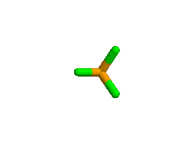
VSEPR: Tetrahedral (109.5°)
AX₄
CCl₄
RED = Molecular Geo.
AX₃E (107.5°)
(Trigonal Pyramidal)
PCl₃
AX₂E₂(104.5°)
(Bent)
Cl₂O

Slide 16
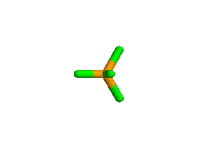
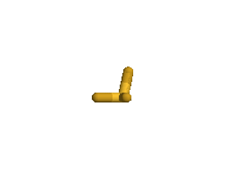
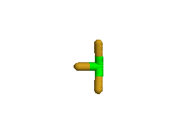
VSEPR: Trigonal Bi-pyramidal (90°,120°)
AX₅
PCl₅
AX₄E (See saw)
(180°, 120°)
SF₄
AX₃E₂ (T-shape)
(90°, 180°)
ClF₃
AX₂E₃ (Linear)
I₃⁻
RED = Molecular Geo.

Slide 17
VSEPR: Octahedral (90°)
AX₆
SF₆
AX₅E (< 90°)
(Square pyramidal)
BrF₅
AX₄E₂ (90°)
(Square Planar)
ICl₄-
RED = Molecular Geo.

Slide 18
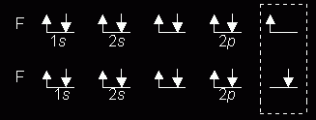
REMINDER: The Octet Rule
Combinations of elements tend to form so that each atom, by gaining, losing, or sharing electrons, has an octet of electrons in its highest occupied energy level.
Diatomic Fluorine

Slide 19
Comments About the Octet Rule
2nd period elements C, N, O, F observe the octet rule (HONC rule as well).

Slide 20
Comments About the Octet Rule
2nd period elements B and Be often have fewer than 8 electrons around themselves - they are very reactive.

Slide 21
Comments About the Octet Rule
3rd period and heavier elements CAN exceed the octet rule having expanded octets (using ?).

Slide 22
Comments About the Octet Rule
When writing Lewis structures, satisfy octets first, then place extra electrons around central element if needed

Slide 23
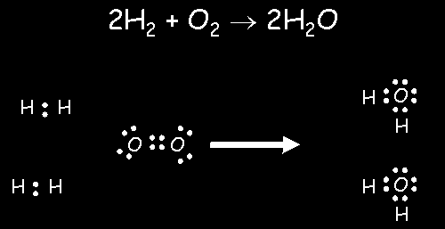
Formation of Water by the Octet Rule

Slide 24
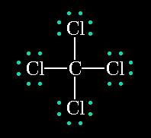
Lewis Structures
Shows how valence electrons are arranged among atoms in a molecule.
Reflects central idea that stability of a compound relates to noble gas electron configuration.

Slide 25
Rules for Drawing Lewis Structures
Add up total number of Ve⁻ and divide by 2 (this =s the number of pairs)
The least electronegative atom tends to be your “central” atom
Place all other atoms around your central atom
H are always terminal
Halogens tend to be terminal
Place a pair of e- or a “−” between the central atom and all other atoms obeying the OCTET rules (some exceptions: H(2), Be(4), B(6))
Distribute ALL remaining pairs of e- on the terminal atoms to fill to an octet (H is a duet – 2).
If any pairs of e- remain, then place them on the central atom.
If after all pairs are placed and the octet rule is not satisfied, then make double or triple bonds

Slide 26
Multiple Covalent Bonds: Double bonds
Ethene
Two pairs of shared electrons

Slide 27
Multiple Covalent Bonds: Triple bonds
Ethyne
Three pairs of shared electrons

