Slide 1
Covalent Bonding VSEPR Shapes, Effects of Lone Pairs, Polarity

Slide 2
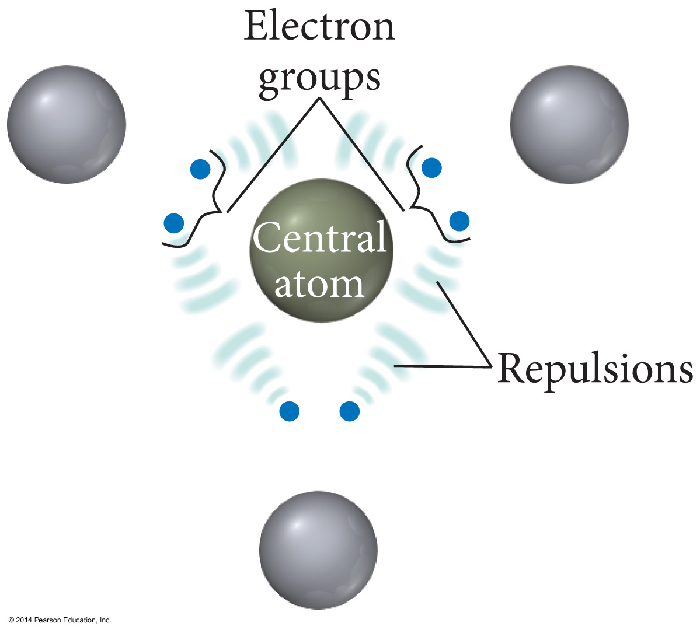

Slide 3
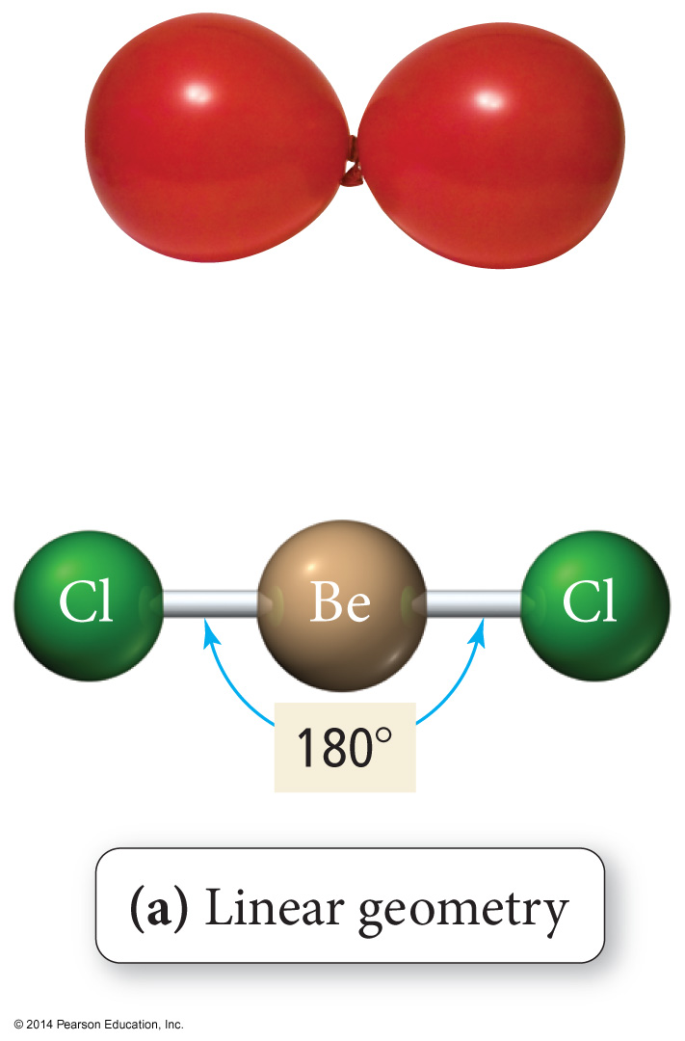
Linear Geometry

Slide 4
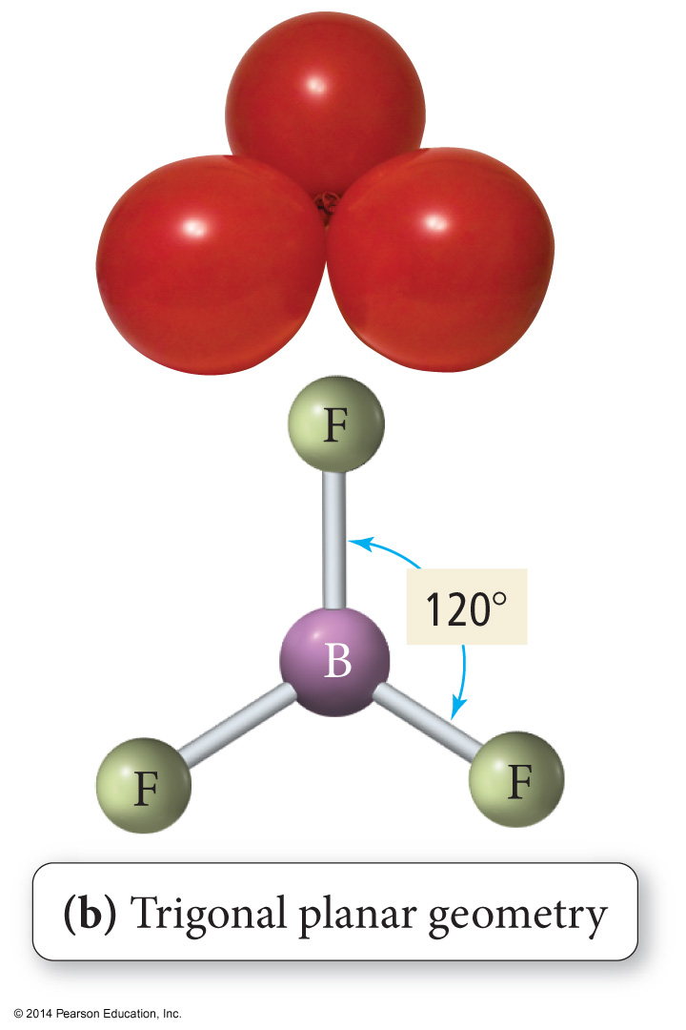
Trigonal Planar Geometry

Slide 5
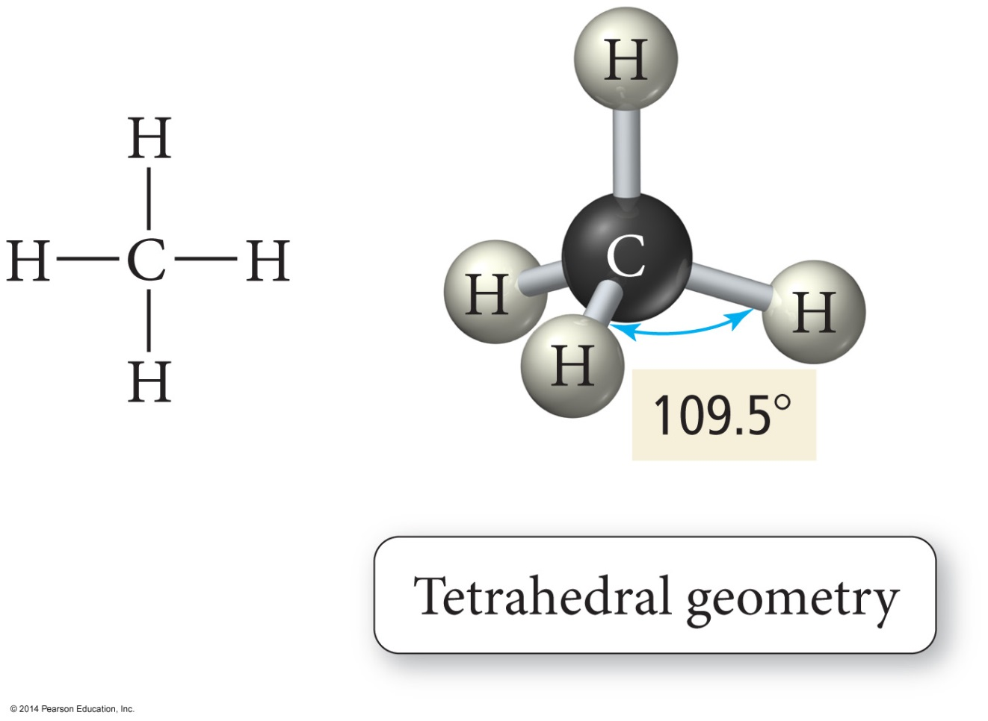
Tetrahedral Geometry

Slide 6
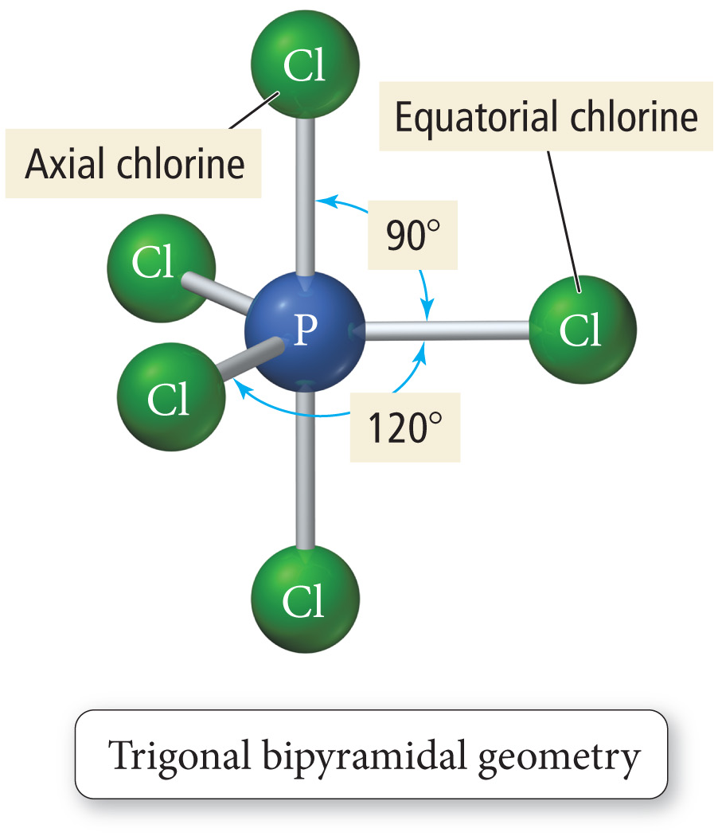
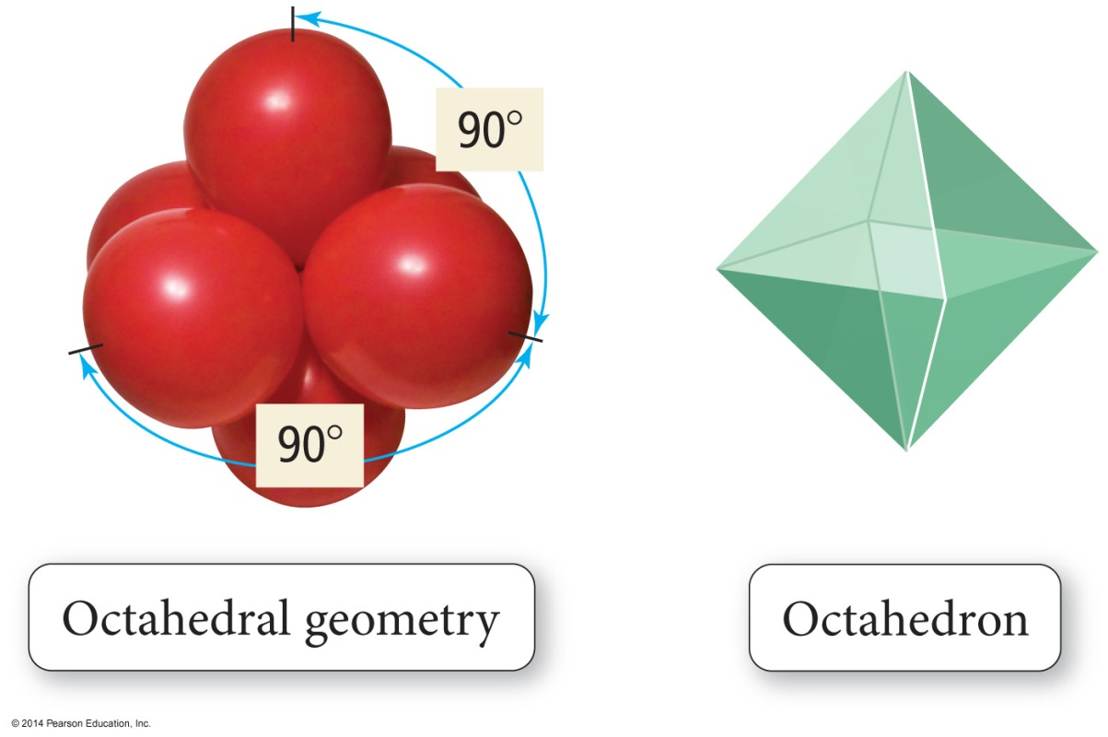
Trigonal Bipyramid

Slide 7
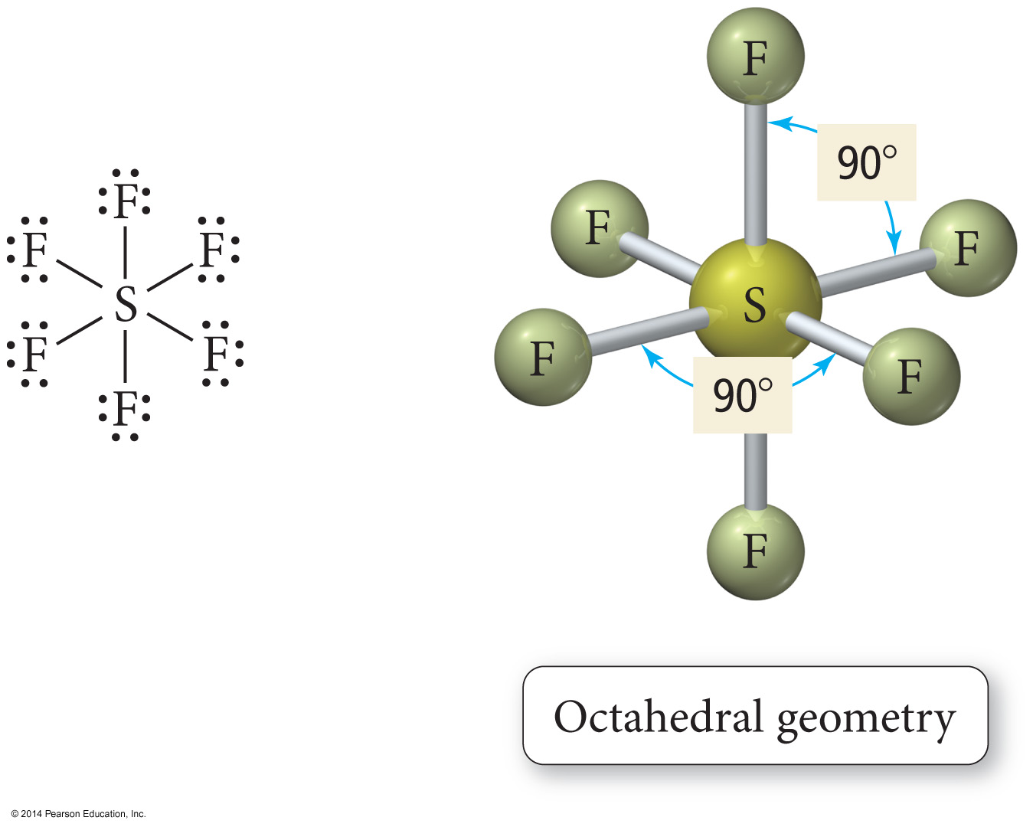
Octahedral Geometry

Slide 8
Octahedral Geometry

Slide 9
The Effect of Lone Pairs
Lone pair groups “occupy more space” on the central atom because their electron density is exclusively on the central atom, rather than shared like bonding electron groups.
Relative sizes of repulsive force interactions is as follows:
This affects the bond angles, making the bonding pair angles smaller than expected.
Lone Pair – Lone Pair > Lone Pair – Bonding Pair > Bonding Pair – Bonding Pair

Slide 10
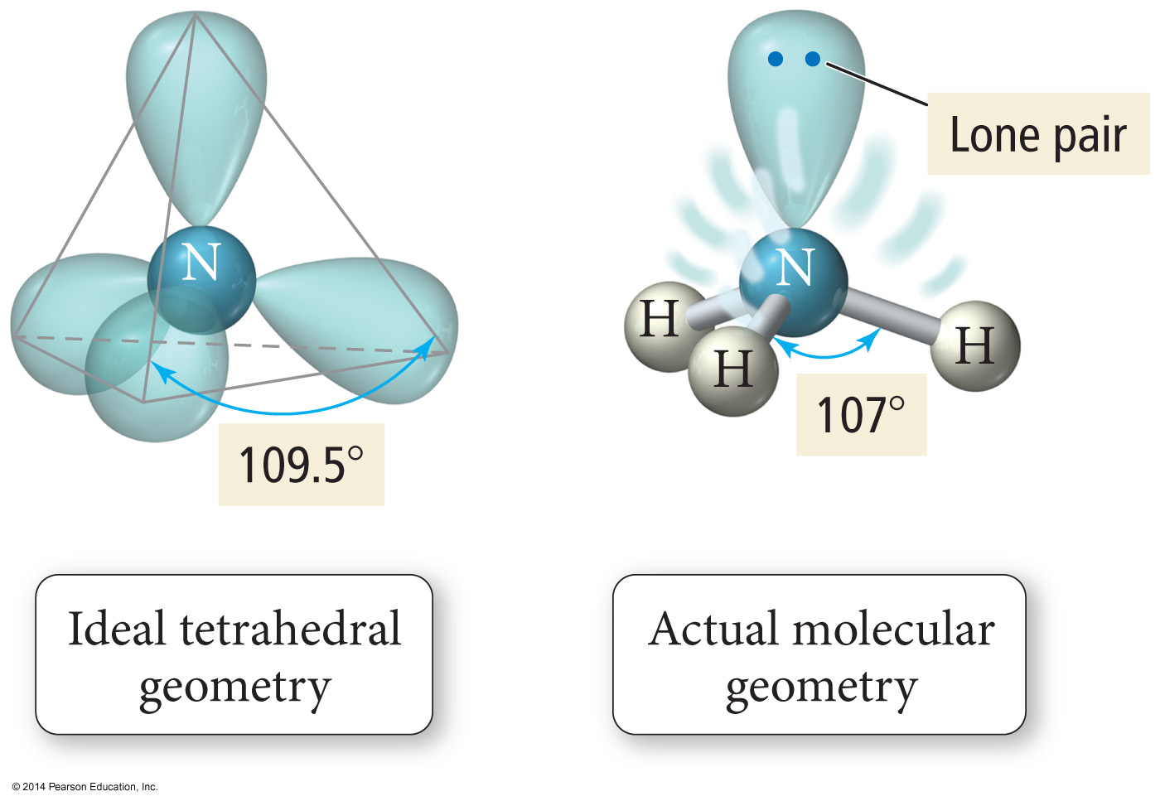
Bond Angle Distortion from Lone Pairs

Slide 11
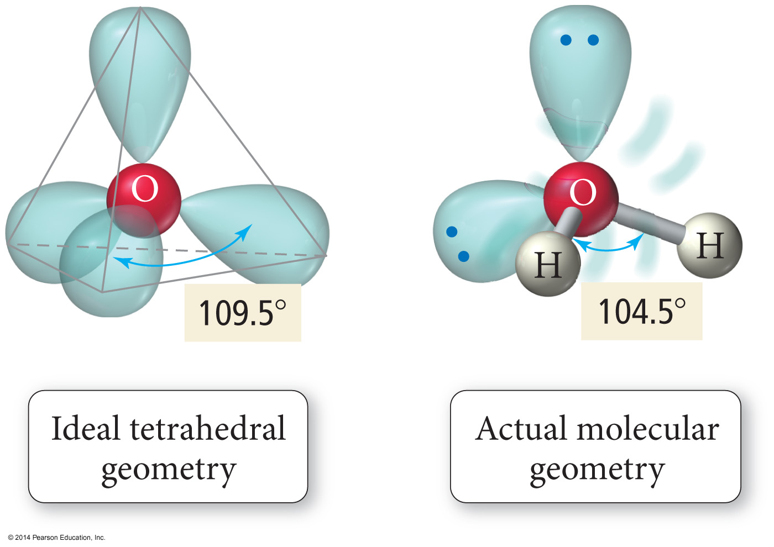
Bond Angle Distortion from Lone Pairs

Slide 12
Polarity of Molecules
For a molecule to be polar it must
have polar bonds.
Electronegativity difference – theory
Bond dipole moments – measured
have an asymmetrical shape.
Vector addition
Polarity affects the intermolecular forces of attraction.
Therefore, boiling points and solubility’s
Like dissolves like
Non-bonding pairs affect molecular polarity, strong pull in its direction.

