Slide 1
Covalent Bonding Hybridization

Slide 2
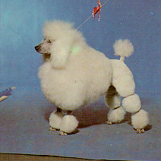
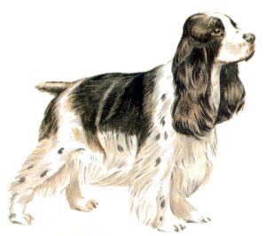
Hybridization - The Blending of Orbitals
+
=
Poodle
+
Cocker Spaniel
=
Cockapoo
+
=
s orbital
+
p orbital
=
sp orbital

Slide 3
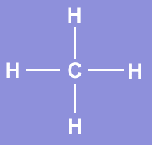
What Proof Exists for Hybridization?
We have studied electron configuration notation and
the sharing of electrons in the formation of covalent
bonds.
Lets look at a molecule of methane, CH₄.
Methane is a simple natural gas. Its molecule has a
carbon atom at the center with four hydrogen atoms covalently bonded around it.

Slide 4
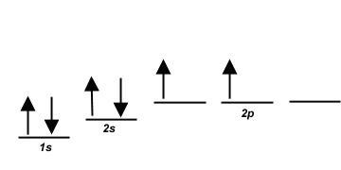
Carbon ground state configuration
What is the expected orbital notation of carbon
in its ground state?
Can you see a problem with this?
(Hint: How many unpaired electrons does this
carbon atom have available for bonding?)

Slide 5
Carbon’s Bonding Problem
You should conclude that carbon only has TWO
electrons available for bonding. That is not not enough!
How does carbon overcome this problem so that
it may form four bonds?

Slide 6
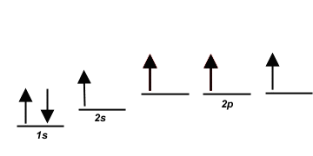
Carbon’s Empty Orbital
The first thought that chemists had was that carbon promotes one of its 2s electrons…
…to the empty 2p orbital.

Slide 7
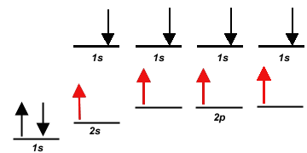
However, they quickly recognized a problem with such
an arrangement…
Three of the carbon-hydrogen bonds would involve
an electron pair in which the carbon electron was a 2p, matched with the lone 1s electron from a hydrogen atom.

Slide 8
This would mean that three of the bonds in a methane
molecule would be identical, because they would involve
electron pairs of equal energy.
But what about the fourth bond…?

Slide 9
The fourth bond is between a 2s electron from the
carbon and the lone 1s hydrogen electron.
Such a bond would have slightly less energy than the other bonds in a methane molecule.

Slide 10
This bond would be slightly different in character than
the other three bonds in methane.
This difference would be measurable to a chemist
by determining the bond length and bond energy.
But is this what they observe?

Slide 11
The simple answer is, “No”.
Measurements show that
all four bonds in methane
are equal. Thus, we need
a new explanation for the
bonding in methane.
Chemists have proposed an explanation – they call it
Hybridization.
Hybridization is the combining of two or more orbitals
of nearly equal energy within the same atom into
orbitals of equal energy.

Slide 12
In the case of methane, they call the hybridization
sp³, meaning that an s orbital is combined with three
p orbitals to create four equal hybrid orbitals.
These new orbitals have slightly MORE energy than
the 2s orbital…
… and slightly LESS energy than the 2p orbitals.

Slide 13
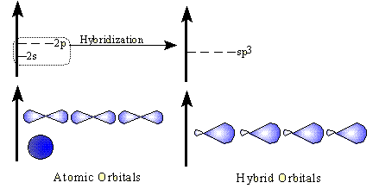
sp³ Hybrid Orbitals
Here is another way to look at the sp³ hybridization
and energy profile…

Slide 14
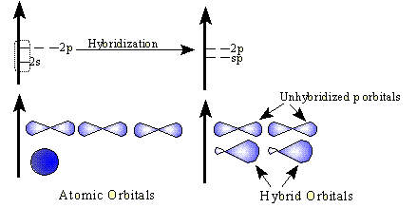
sp Hybrid Orbitals
While sp³ is the hybridization observed in methane,
there are other types of hybridization that atoms
undergo.
These include sp hybridization, in which one s
orbital combines with a single p orbital.
This produces two hybrid orbitals, while leaving two normal p orbitals

Slide 15
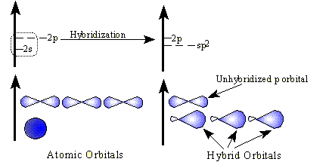
sp² Hybrid Orbitals
Another hybrid is the sp², which combines two orbitals from a p sublevel with one orbital from an s sublevel.
One p orbital remains unchanged.

Slide 16
Hybridization and Molecular Geometry
Forms | Overall Structure (electronic geometry) | Hybridization of “A”
AX₂ | Linear | sp
AX₃, AX₂E | Trigonal Planar | sp²
AX₄, AX₃E, AX₂E₂ | Tetrahedral | sp³
AX₅, AX₄E, AX₃E₂, AX₂E₃ | Trigonal bipyramidal | ??
AX₆, AX₅E, AX₄E₂ | Octahedral | ??
A = central atom
X = atoms bonded to A
E = nonbonding electron pairs on A

