Slide 1
Covalent Bonding Sigma and Pi Bonds

Slide 2
Types of Bonds
A sigma (σ) bond results when the interacting atomic orbitals point along the axis connecting the two bonding nuclei.
Either standard atomic orbitals or hybrids
s to s, p to p, hybrid to hybrid, s to hybrid, etc.
A pi (π) bond results when the bonding atomic orbitals are parallel to each other and perpendicular to the axis connecting the two bonding nuclei.
Between unhybridized parallel p orbitals
The interaction between parallel orbitals is not as strong as between orbitals that point at each other; therefore, σ bonds are stronger than π bonds.

Slide 3
Sigma and Pi Bonds
Sigma (σ) bonds exist in the region directly between two bonded atoms.
Pi (π) bonds exist in the region above and below a line drawn between two bonded atoms.
Single bond | 1 sigma bond
Double Bond | 1 sigma, 1 pi bond
Triple Bond | 1 sigma, 2 pi bonds

Slide 4
Sigma and Pi Bonds Single Bonds
1 σ bond
Ethane

Slide 5
Sigma and Pi Bonds: Double bonds
1 π bond
Ethene
1 σ bond

Slide 6
Sigma and Pi Bonds Triple Bonds
1 π bond
Ethyne
1 π bond
1 σ bond

Slide 7
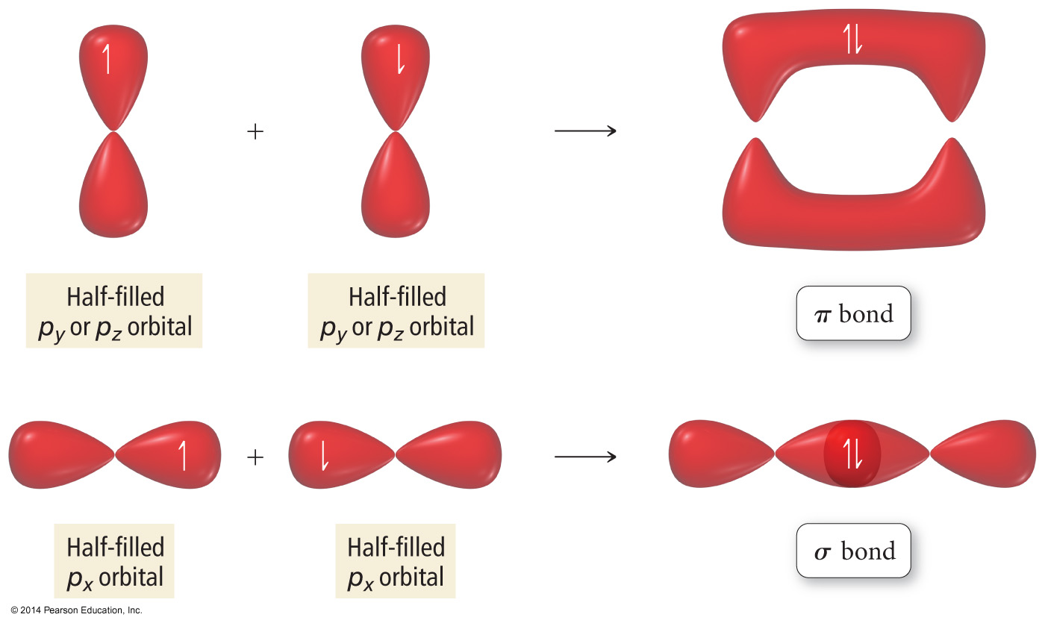

Slide 8
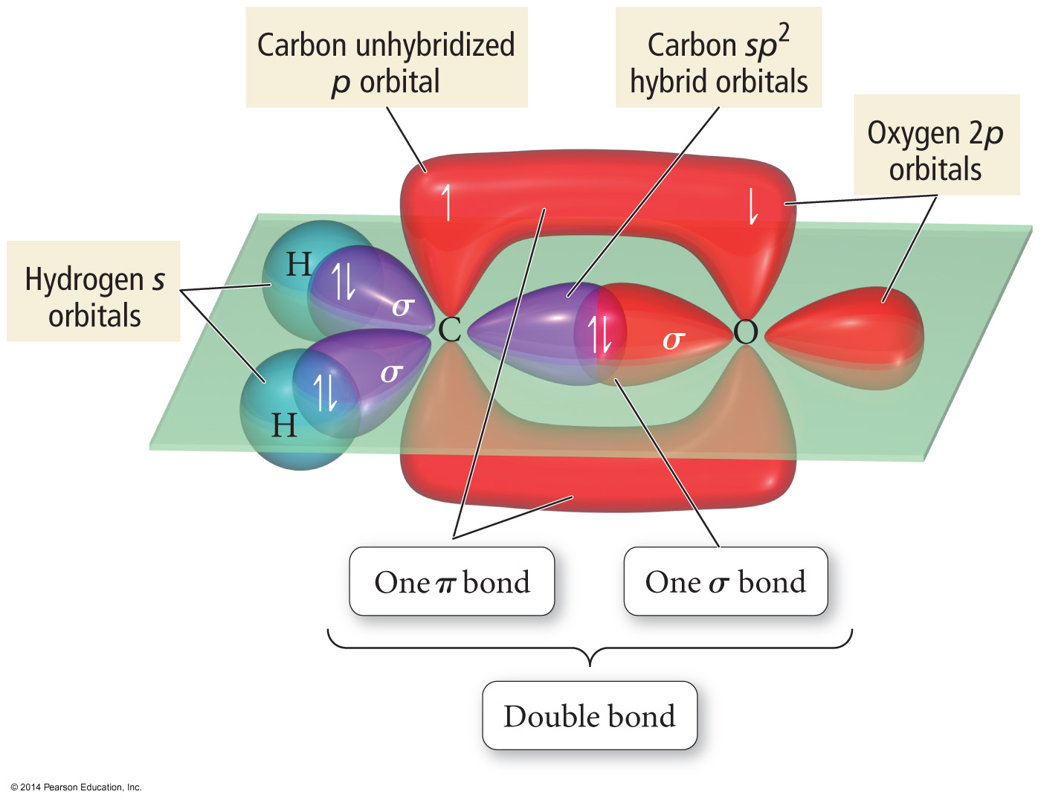

Slide 9
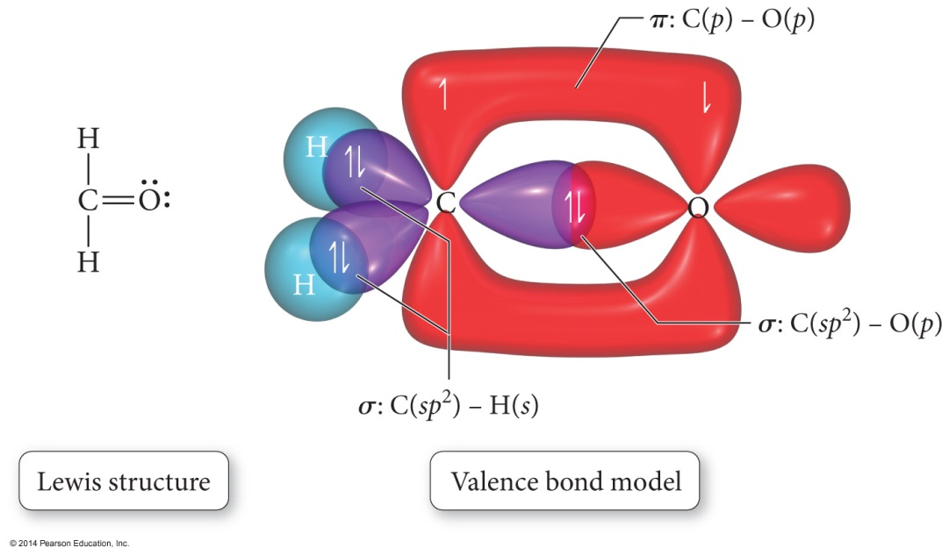
Orbital Diagrams of Bonding
“Overlap” between a hybrid orbital on one atom with a hybrid or nonhybridized orbital on another atom results in a σ bond.
“Overlap” between unhybridized p orbitals on bonded atoms results in a π bond.

Slide 10
Orbital Diagrams of Bonding cont.
Hybrid orbitals overlap to form a σ bond. Unhybridized p orbitals overlap to form a π bond.

Slide 11
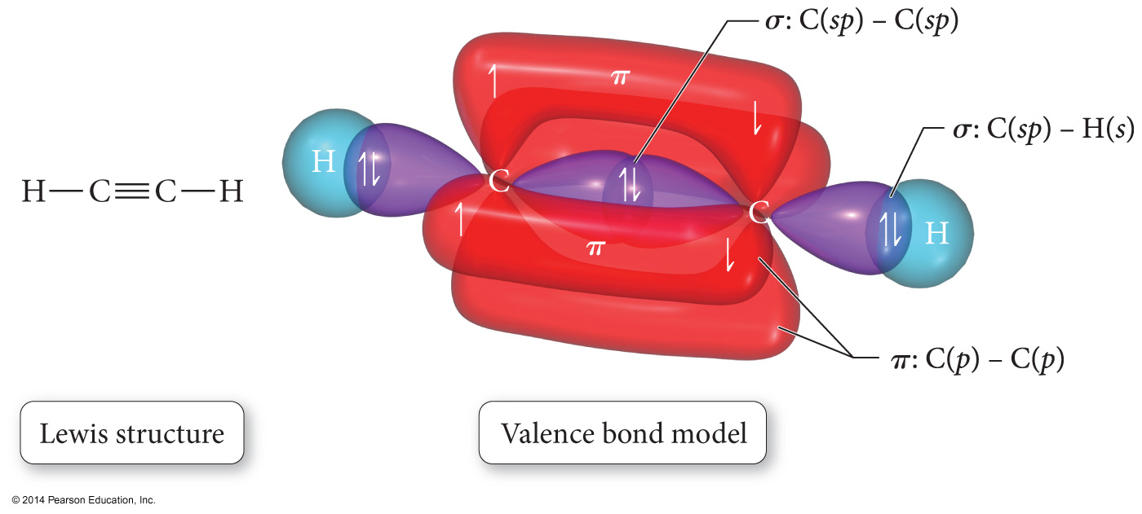

Slide 12
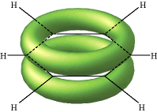
The De-Localized Electron Model
Pi bonds (π) contribute to the delocalized model of electrons in bonding, and help explain resonance
Electron density from π bonds can be distributed symmetrically all around the ring, above and below the plane.

