Slide 1
Covalent Bonding Molecular Orbital Theory

Slide 2
Molecular Orbital (MO) Theory
In MO theory, we apply Schrödinger’s wave equation to the molecule to calculate a set of molecular orbitals.
In practice, the equation solution is estimated.
We start with good guesses from our experience as to what the orbital should look like.
Then we test and tweak the estimate until the energy of the orbital is minimized.
In this treatment, the electrons belong to the whole molecule, so the orbitals belong to the whole molecule.
Delocalization

Slide 3
LCAO
The simplest guess starts with the atomic orbitals of the atoms adding together to make molecular orbitals; this is called the linear combination of atomic orbitals (LCAO) method.
Weighted sum
Because the orbitals are wave functions, the waves can combine either constructively or destructively.

Slide 4
Molecular Orbitals
When the wave functions combine constructively, the resulting molecular orbital has less energy than the original atomic orbitals; it is called a bonding molecular orbital.
σ, π
Most of the electron density between the nuclei
When the wave functions combine destructively, the resulting molecular orbital has more energy than the original atomic orbitals; it is called an antibonding molecular orbital.
σ*, π*
Most of the electron density outside the nuclei
Nodes between nuclei

Slide 5
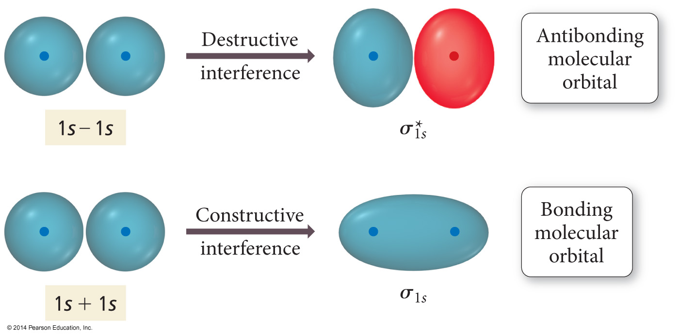
Interaction of 1s Orbitals

Slide 6
Molecular Orbital Theory
Electrons in bonding MOs are stabilizing.
Lower energy than the atomic orbitals
Electrons in antibonding MOs are destabilizing.
Higher in energy than atomic orbitals
Electron density located outside the internuclear axis
Electrons in antibonding orbitals cancel stability gained by electrons in bonding orbitals.

Slide 7
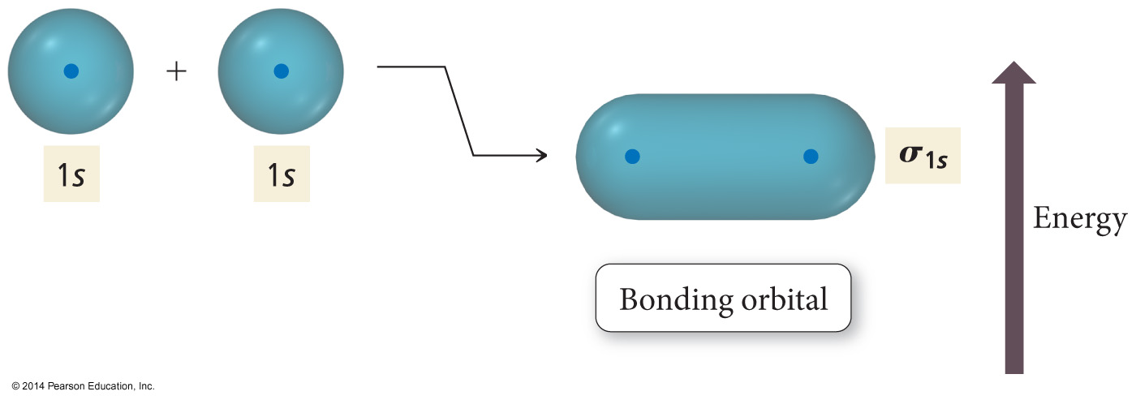
Energy Comparisons of Atomic Orbitals to Molecular Orbitals

Slide 8
MO and Properties
Bond order = difference between number of electrons in bonding and antibonding orbitals
Only need to consider valence electrons
May be a fraction
Higher bond order = stronger and shorter bonds
If bond order = 0, then bond is unstable compared to individual atoms and no bond will form.
A substance will be paramagnetic if its MO diagram has unpaired electrons.
If all electrons paired, it is diamagnetic

Slide 9
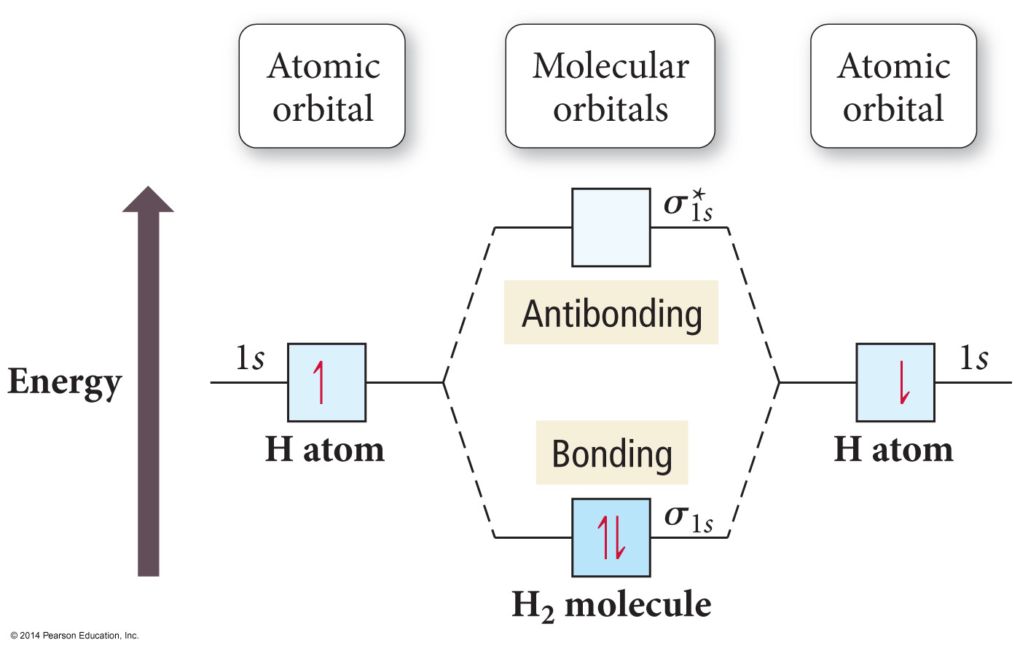

Slide 10
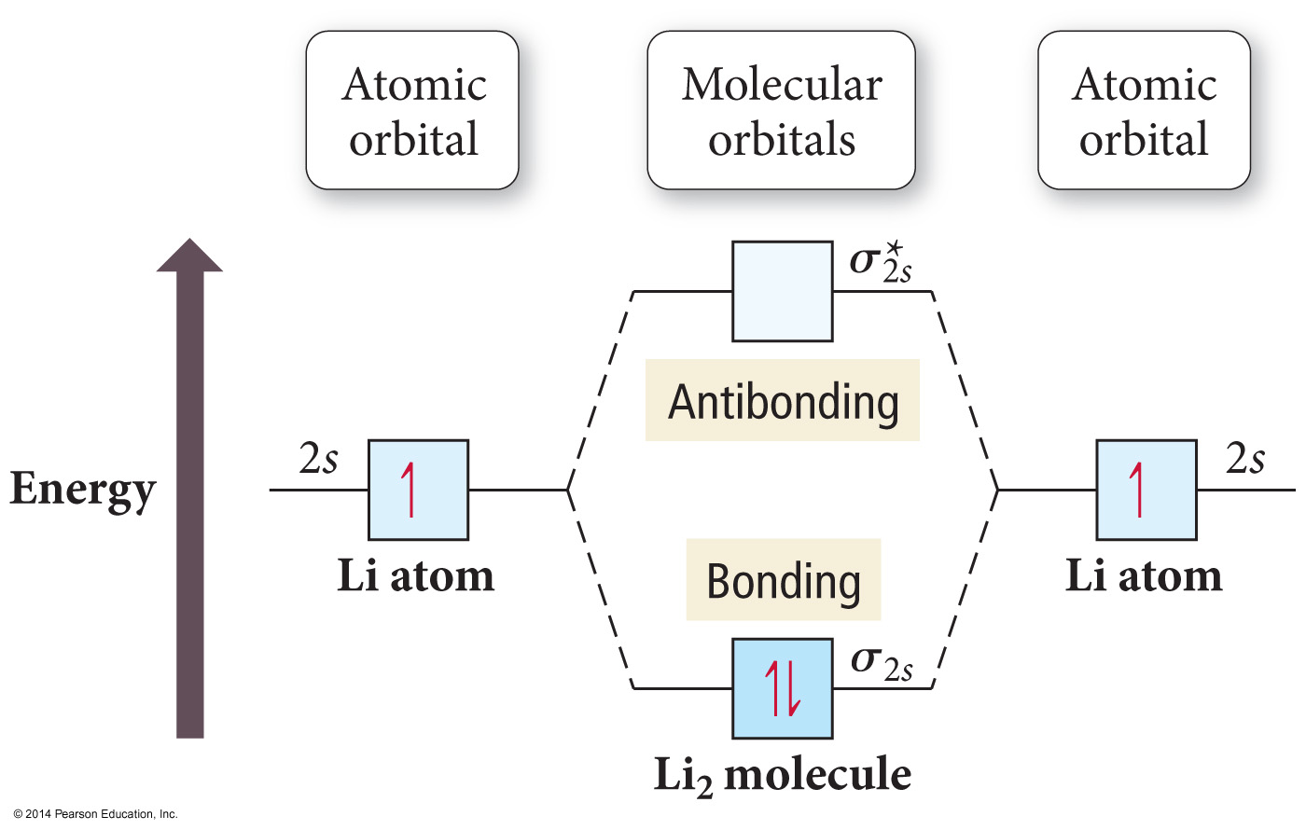
Period Two Homonuclear Diatomic Molecules

Slide 11
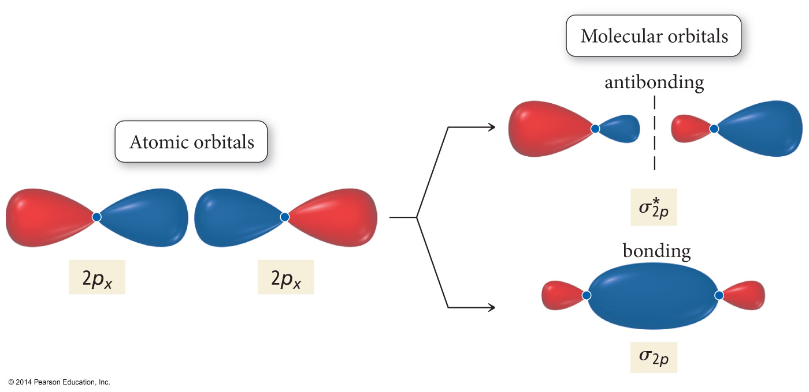
Interaction of p Orbitals

Slide 12
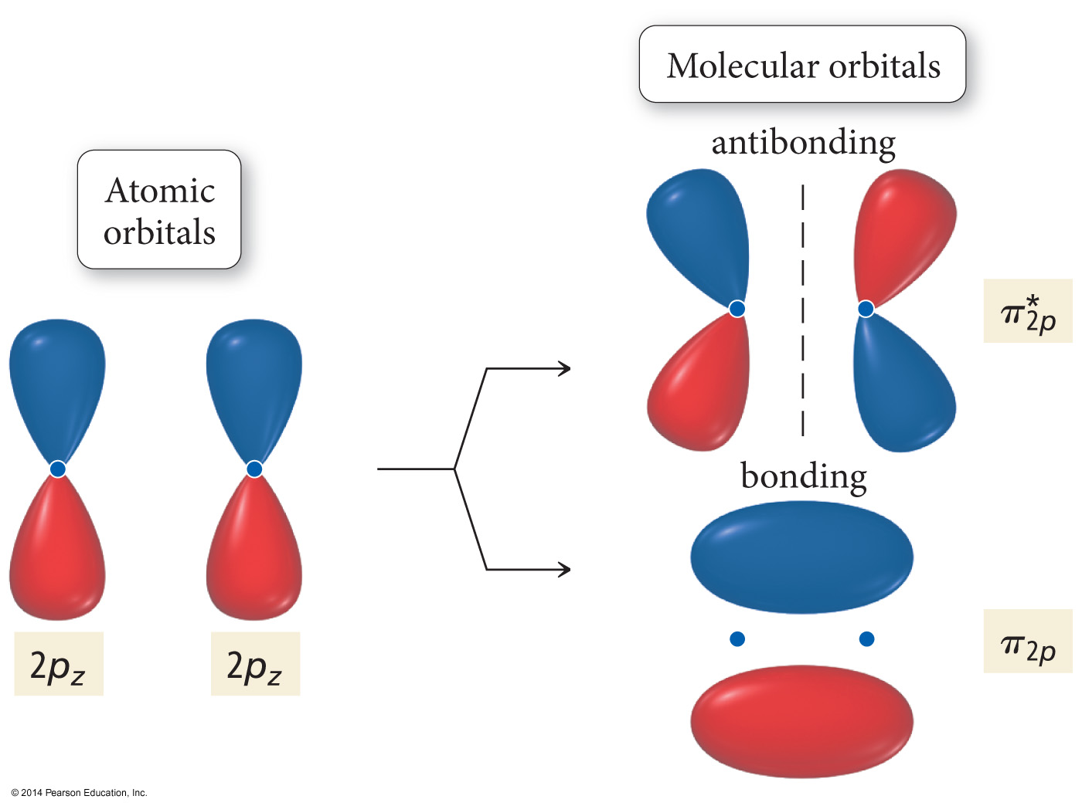
Interaction of p Orbitals

Slide 13
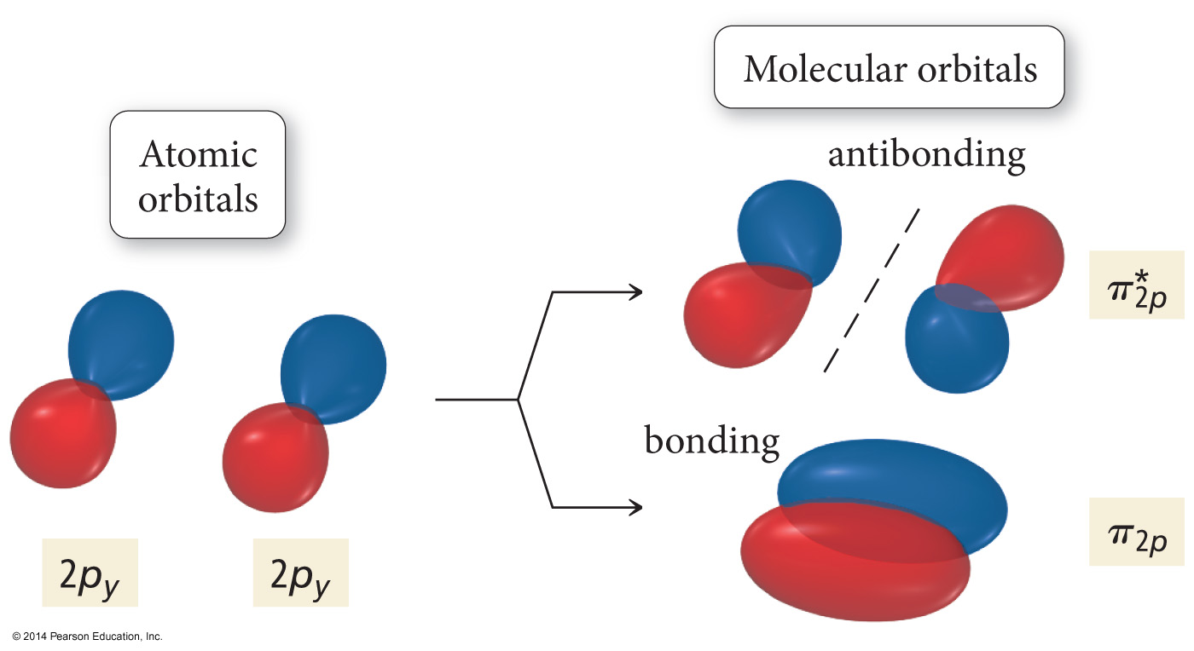
Interaction of p Orbitals

Slide 14
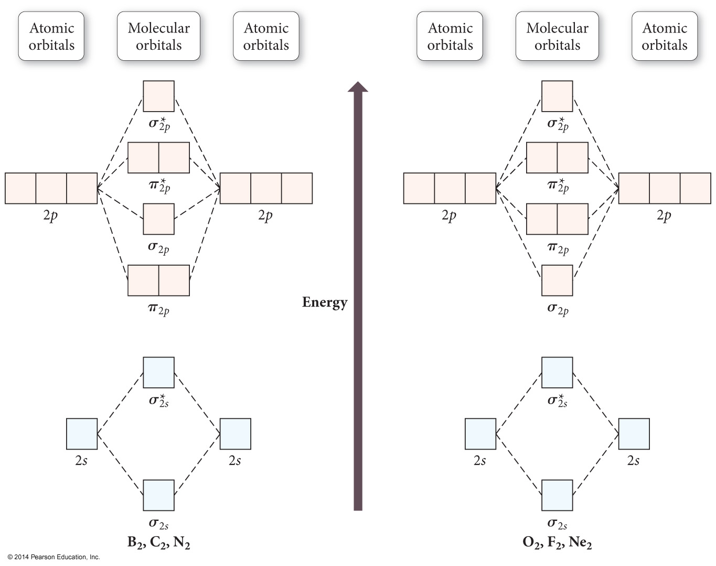

Slide 15
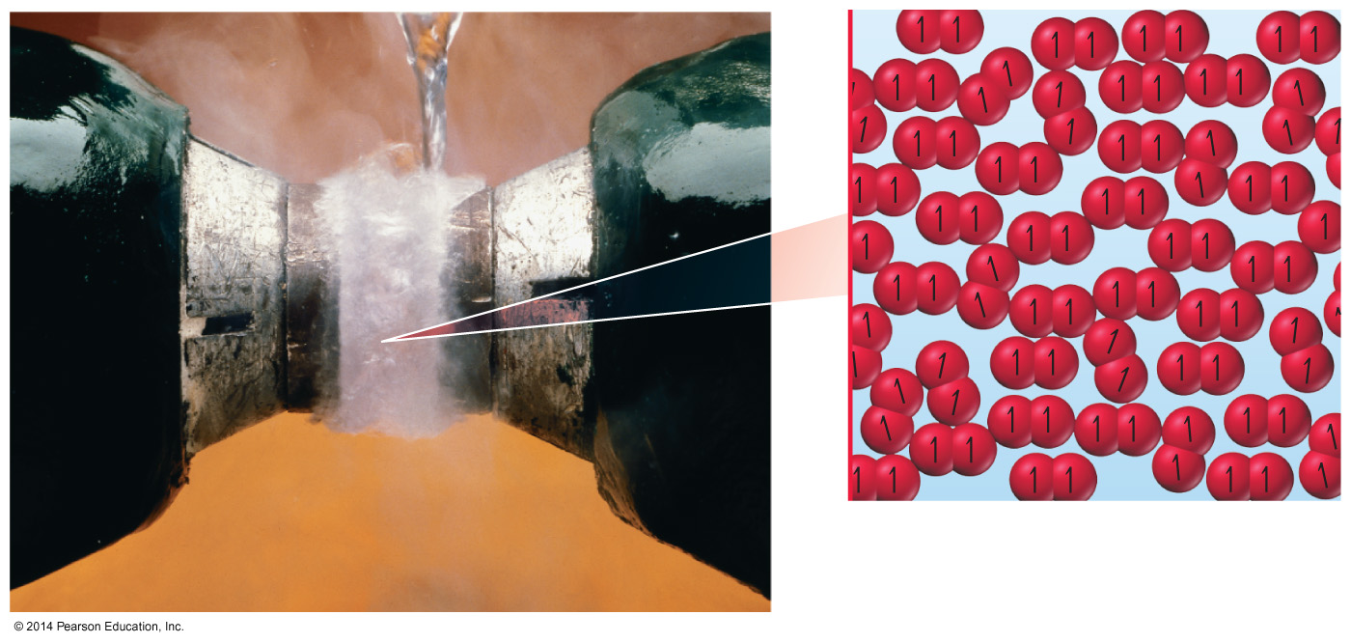
O₂
Dioxygen is paramagnetic.
Paramagnetic material has unpaired electrons.
Neither Lewis theory nor valence bond theory predict this result.

Slide 16
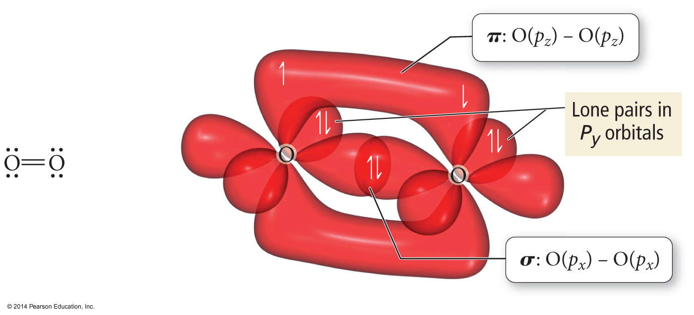
O₂ as Described by Lewis and VB Theory

Slide 17
Heteronuclear Diatomic Molecules and Ions
When the combining atomic orbitals are identical and of equal energy, the contribution of each atomic orbital to the molecular orbital is equal.
When the combining atomic orbitals are different types and energies, the atomic orbital closest in energy to the molecular orbital contributes more to the molecular orbital.

Slide 18
Heteronuclear Diatomic Molecules and Ions
The more electronegative an atom is, the lower in energy are its orbitals.
Lower energy atomic orbitals contribute more to the bonding MOs.
Higher energy atomic orbitals contribute more to the antibonding MOs.
Nonbonding MOs remain localized on the atom donating its atomic orbitals.

Slide 19
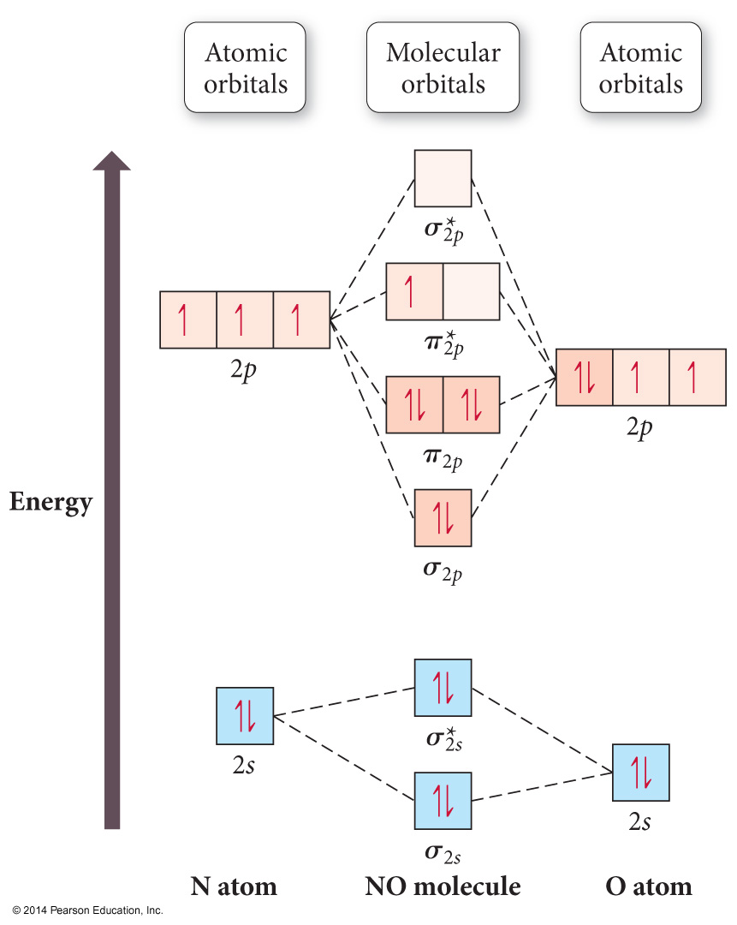
Second-Period Heteronuclear Diatomic Molecules

Slide 20
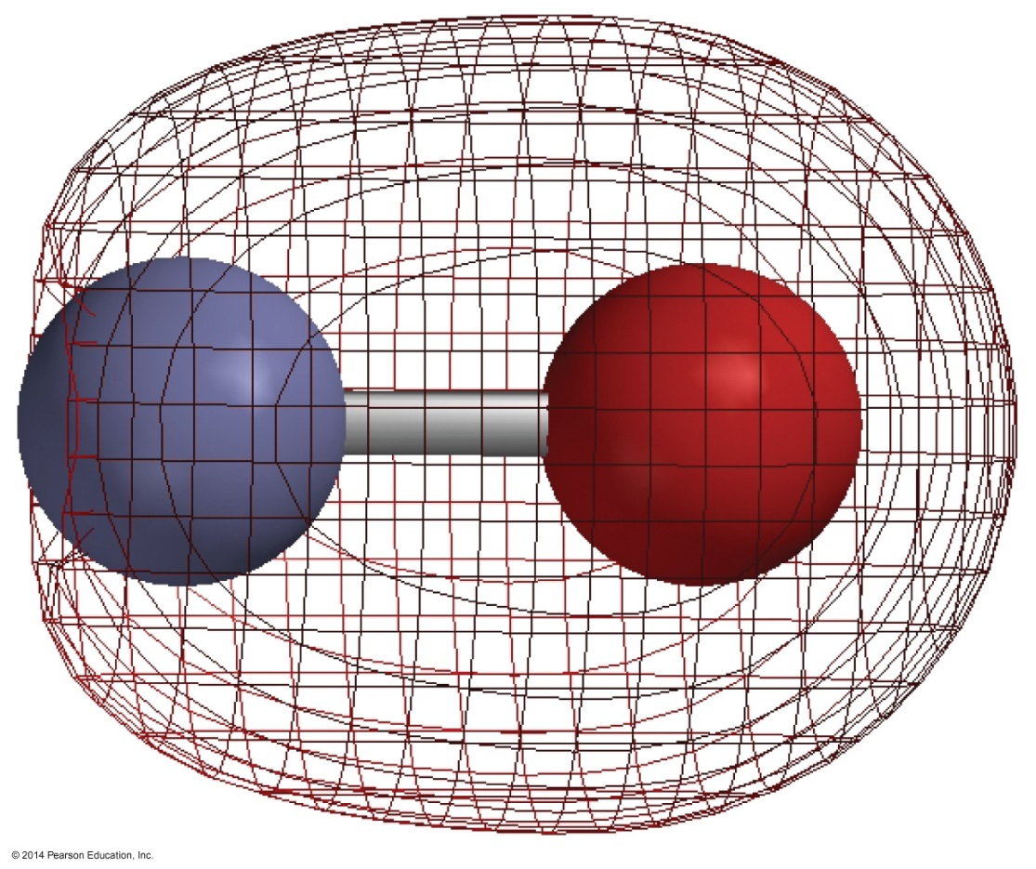
NO
σ_{2s} bonding MO
shows more electron density near O because it is mostly O’s 2s atomic orbital.

Slide 21
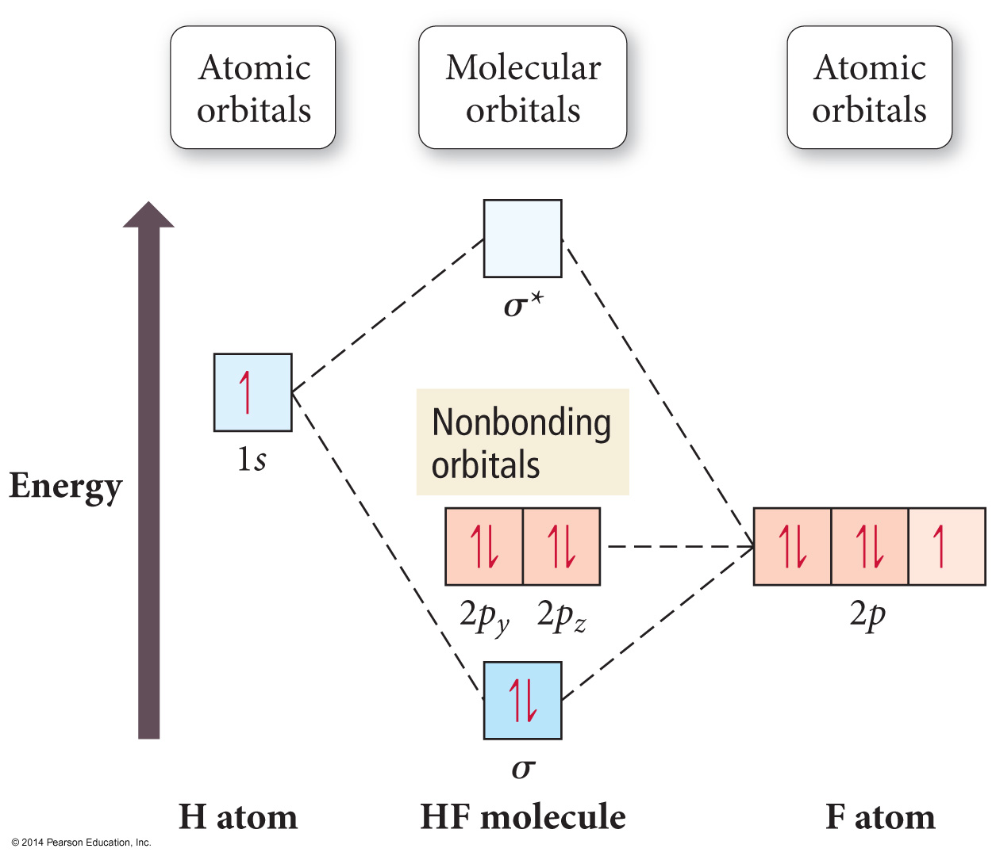
HF

Slide 22
Polyatomic Molecules
When many atoms are combined together, the atomic orbitals of all the atoms are combined to make a set of molecular orbitals, which are delocalized over the entire molecule.
Gives results that better match real molecule properties than either Lewis or valence bond theories.

Slide 23
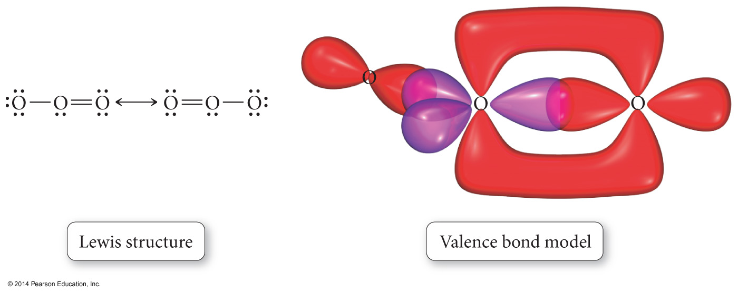
Ozone, O₃

Slide 24
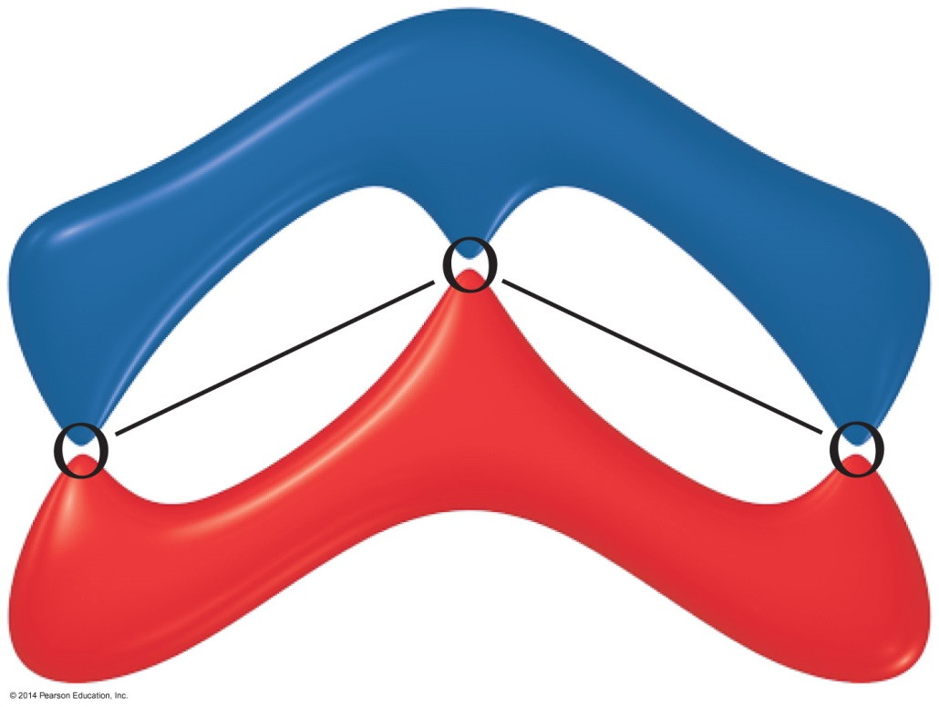
Ozone, O₃

Slide 25
Hybridization Involving “d” Orbitals
Beginning with elements in the third row, “d” orbitals may also hybridize
sp³d = five hybrid orbitals of equal energy
sp³d ² = six hybrid orbitals of equal energy

