Slide 1
Welcome to APTeach:
Coulomb’s Law in AP Chemistry
AP TEACH
Thursday, September 21, 2023

Slide 2
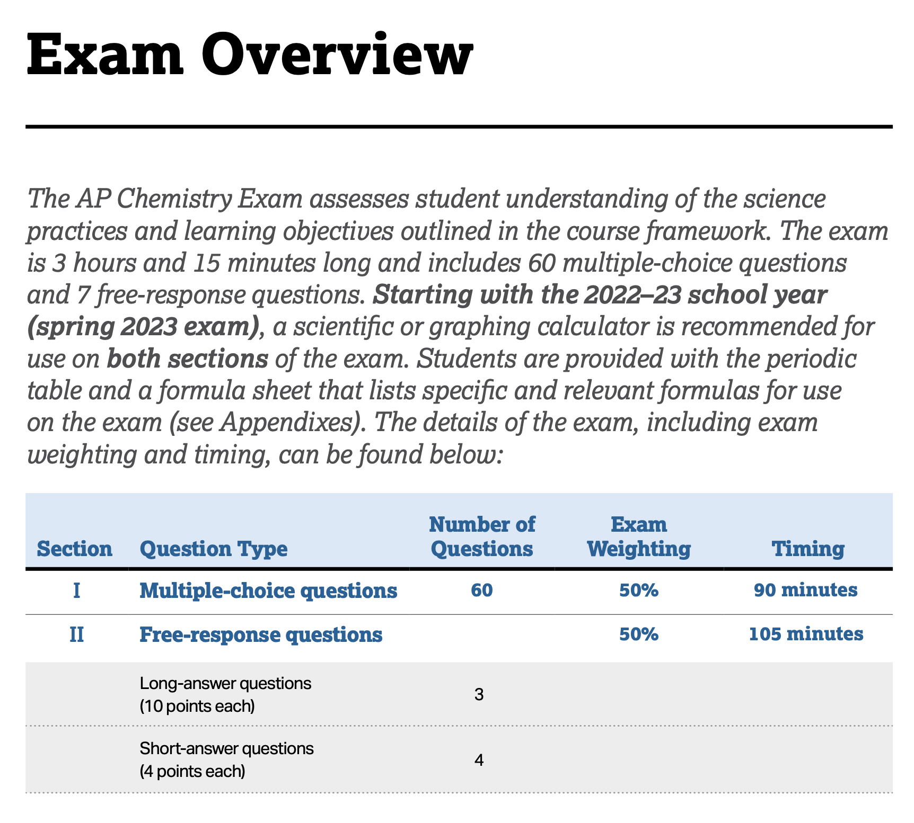
College Board
Course Exam & Description (CED): Calculators!

Slide 3
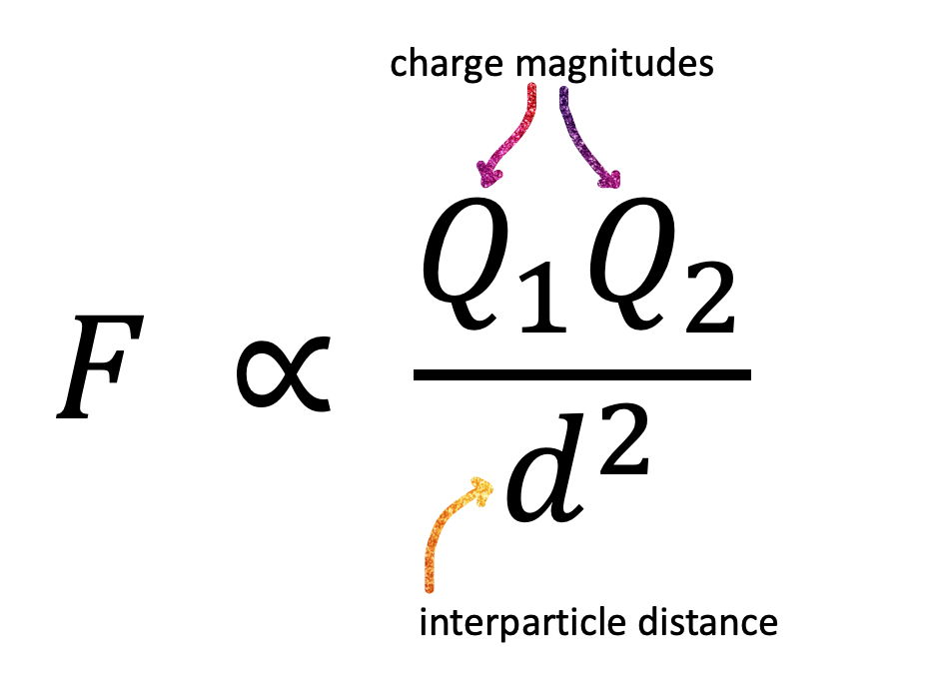
Coulomb’s Law in AP Chemistry
These relationships show up in several different units
No calculations required
Focus is on conceptual explanations

Slide 4
Coulomb’s Law overview
What affects the magnitude of the attractive force?
Charge magnitude has a more dramatic effect on the attractive force than the interparticle distance

Slide 5
Coulomb’s Law: Writing high quality FRQ responses
First compare charges,
then consider interparticle distance
Specify what particles are interacting
Electrons and protons
Two ions
Two polar molecules
An ion and a polar molecule

Slide 6
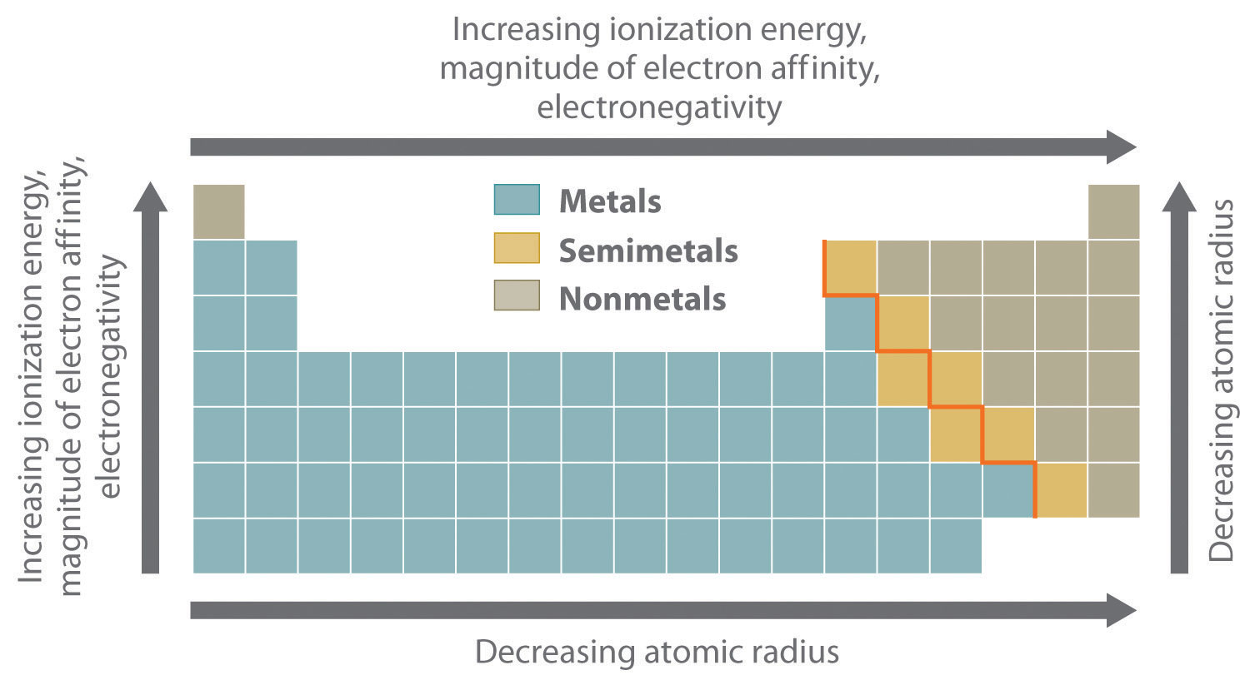
Periodic Trends:
Asked to explain a trend in terms of atomic structure?
Focus on either
changes in nuclear charge (for period trends) OR
the number of occupied energy levels (for group trends)
Image source

Slide 7
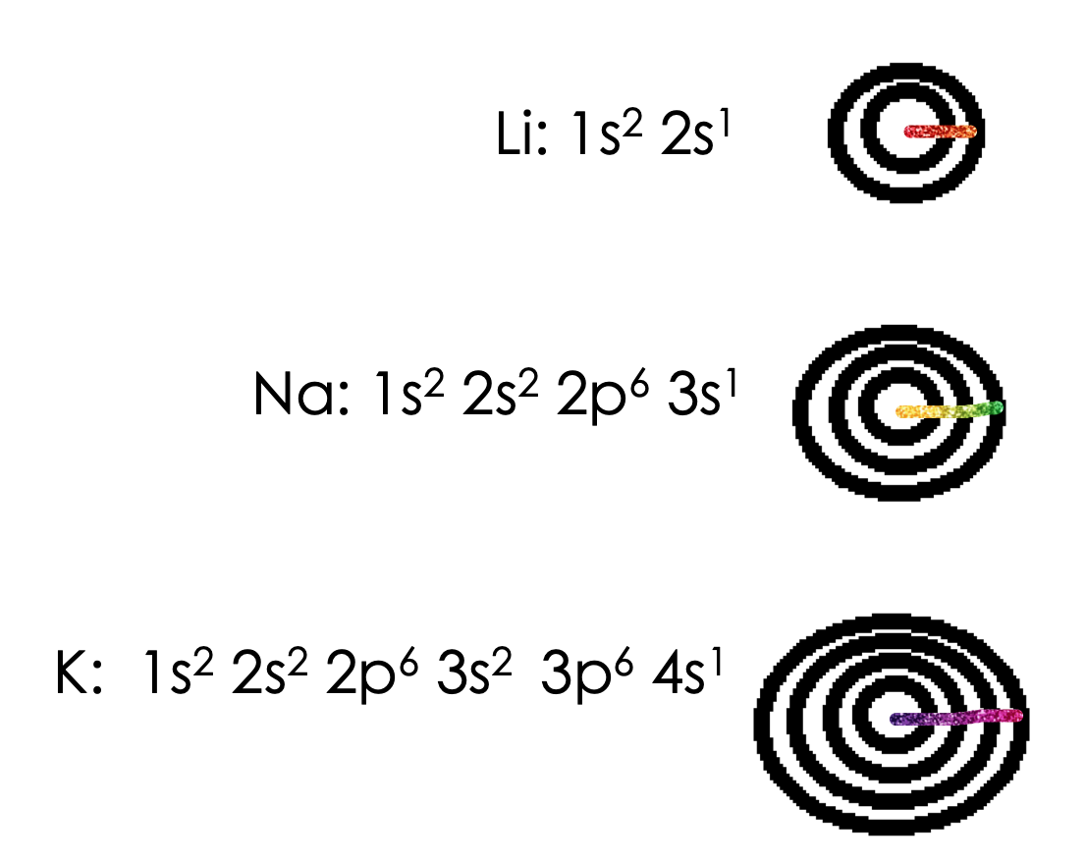
Explaining group trends with Coulomb’s Law
Group trend: valence electrons occupy higher energy levels that are further from the nucleus
As the distance between the valence electrons and the nucleus increases, the coulombic attraction between the nucleus and the valence electrons decreases

Slide 8
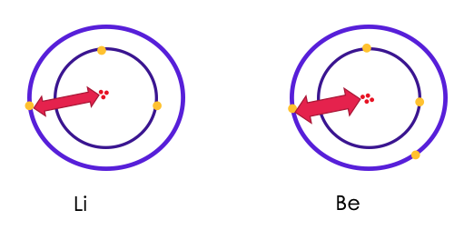
Explaining trends across a period with Coulomb’s Law
Period trend: valence electrons occupy the same energy level
As the number of protons increases, the coulombic attraction between the nucleus and the valence electrons increases

Slide 9
2021 #2 part h

Slide 10
2021 #2h
Students needed to include 3 statements to get the point

Slide 11
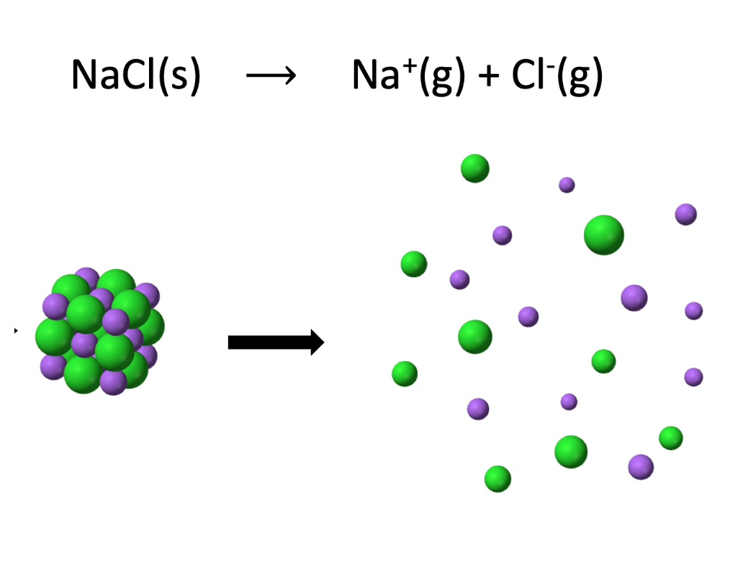
Lattice energy/melting points of ionic compounds
aka lattice dissociation energy
the energy required to completely separate a mole of a solid ionic compound into its gaseous ions

Slide 12
Lattice Energy/MP of ionic compounds
2017 6b
Both cations have the same charge
The difference in lattice energy must be due to different cation radii

Slide 13
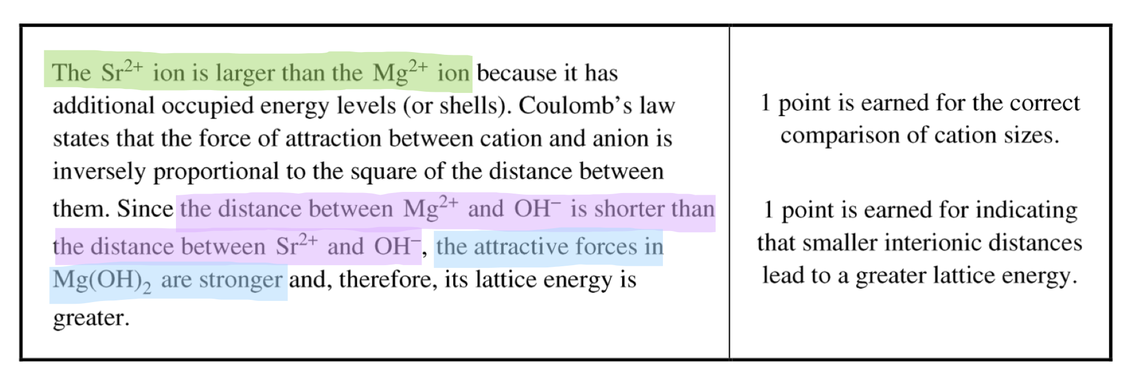
2017 6b
First compare ion charges: both cations are +2, same anion

Slide 14
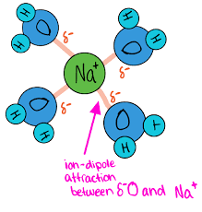
Strength of IMFs
Ion-dipole attractions
Dipole-dipole attractions
London dispersion forces
Image source

Slide 15
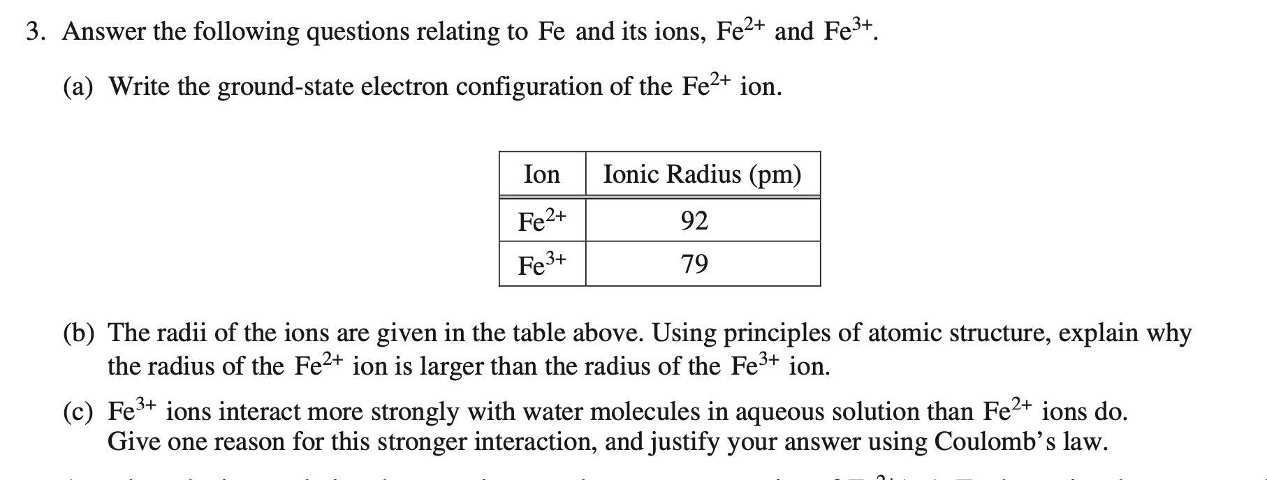
2018 3b-c

Slide 16
2018 3b
Notes:
To summarize:
•nucleus:valence electron attractions are the same in both ions
•More electrons overall in Fe²⁺ than in Fe³⁺ leads to more electron:electron
•repulsions for Fe²⁺ and therefore a larger ionic radius for Fe²⁺

Slide 17
2018 3c

