Slide 1
Bonding – General Concepts

Slide 2
Electronegativity: The ability of an atom in a molecule to attract shared electrons to itself.

Slide 3
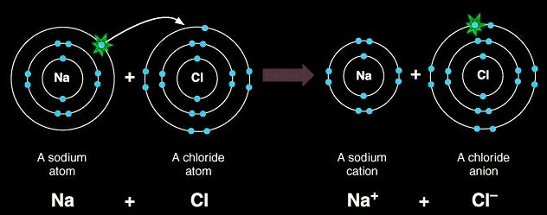
Ionic Bonds
Electrons are transferred
Electronegativity differences are
generally greater than 1.7
The formation of ionic bonds is
always exothermic!

Slide 4
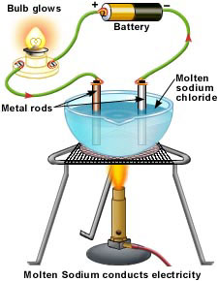
Determination of Ionic Character
Electronegativity difference is not the final determination of ionic character
Compounds are ionic if they conduct electricity in their molten state

Slide 5
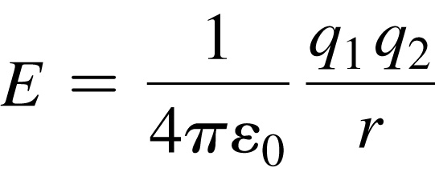
Coulomb’s Law
Coulomb’s law describes the attractions and repulsions between charged particles.
For like charges, the potential energy (E) is positive and decreases as the particles get farther apart as r increases. r should be squared
For opposite charges, the potential energy is negative and becomes more negative as the particles get closer together.
The strength of the interaction increases as the size of the charges increases.
Electrons are more strongly attracted to a nucleus with a 2+ charge than a nucleus with a 1+ charge.

Slide 6
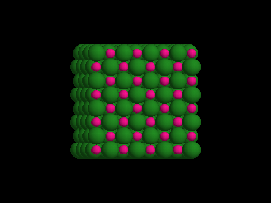
Sodium Chloride Crystal Lattice
Ionic compounds form solids at ordinary temperatures.
Ionic compounds organize in a characteristic crystal lattice of alternating positive and negative ions.

Slide 7
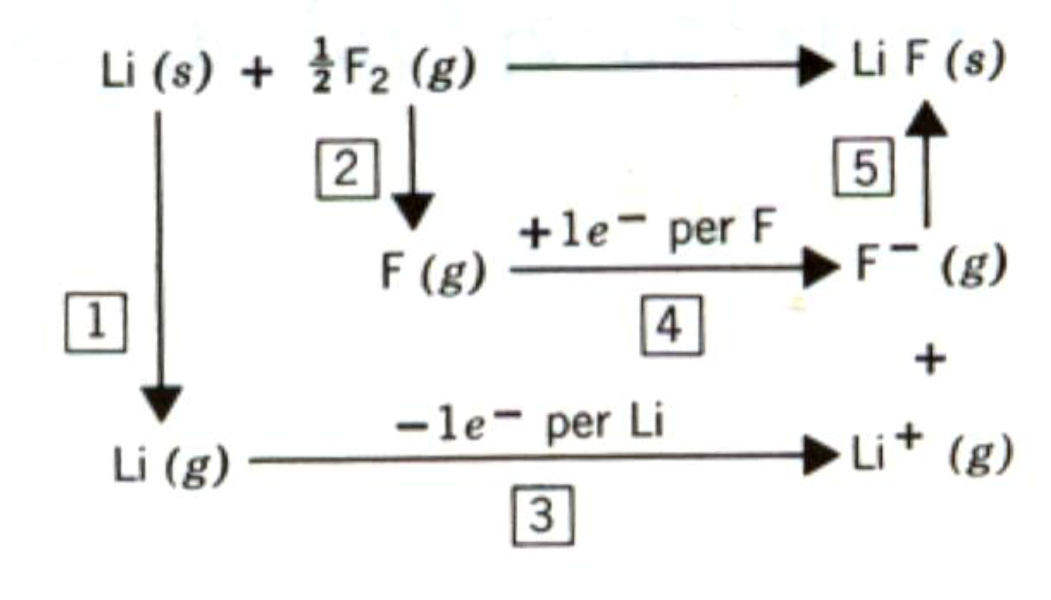
Lattice Energy Steps

Slide 8
Lattice Energy cont…
Lattice energy can be represented by a modified form of Coulomb’s Law: k is a
proportionality constant that depends on the structure of the solid and the electron configurations of the ions.
k is not the rate constant from this point of view

Slide 9
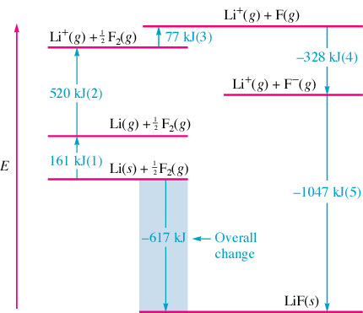
Enthalpy of dissociation --energy required to decompose an ion pair (from a lattice) into ions ∴ a measure of the strength of the ionic bond
Reminder: Q are the ion charges

Slide 10
Estimate ΔH_{f} for Sodium Chloride
Na(s) + ½ Cl₂(g) → NaCl(s)
Lattice Energy | -786 kJ/mol
Ionization Energy for Na | 495 kJ/mol
Electron Affinity for Cl | -349 kJ/mol
Bond energy of Cl₂ | 239 kJ/mol
Enthalpy of sublimation for Na | 109 kJ/mol
Na(s) → Na(g) + 109 kJ
Na(g) → Na⁺(g) + e⁻ + 495 kJ
½ Cl₂(g) → Cl(g) + ½(239 kJ)
Cl(g) + e⁻ → Cl⁻(g) - 349 kJ
Na⁺(g) + Cl⁻(g) → NaCl(s) -786 kJ
Na(s) + ½ Cl₂(g) → NaCl(s) -412 kJ/mol

Slide 11
Covalent Bonds
Polar-Covalent bonds
Electrons are unequally shared
Electronegativity difference between .3 and 1.7
Nonpolar-Covalent bonds
Electrons are equally shared
Electronegativity difference of 0 to 0.3

Slide 12
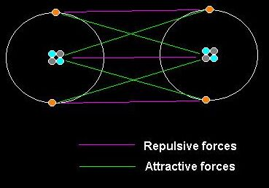
Covalent Bonding Forces
Electron – electron
repulsive forces = Bad
Proton – proton
repulsive forces = bad
Electron – proton
attractive forces = good

Slide 13
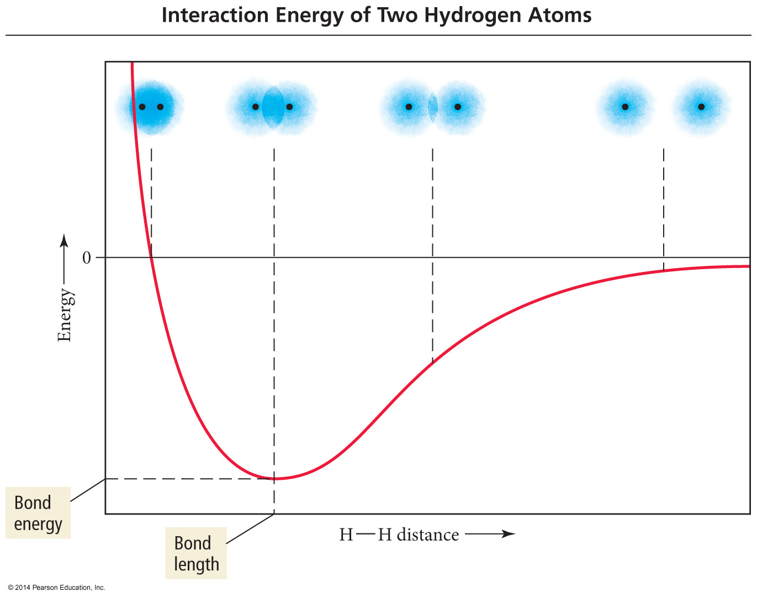

Slide 14
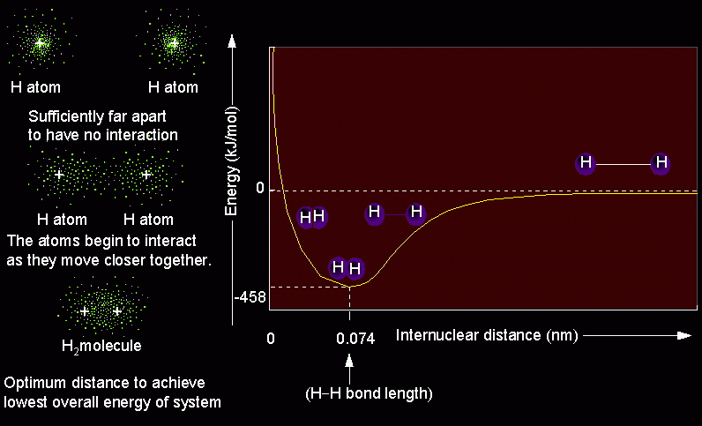
Bond Length Diagram

Slide 15
Bond Length and Energy
Bond | Bond type | Bond length (pm) | Bond Energy (kJ/mol)
C - C | Single | 154 | 347
C = C | Double | 134 | 614
C ≡ C | Triple | 120 | 839
C - O | Single | 143 | 358
C = O | Double | 123 | 745
C - N | Single | 143 | 305
C = N | Double | 138 | 615
C ≡ N | Triple | 116 | 891
Bonds between elements become shorter and stronger as multiplicity increases.

Slide 16
Bond Energy and Enthalpy
Energy required
Energy released
D = Bond energy per mole of bonds
Breaking bonds always requires energy
Breaking = endothermic
Forming bonds always releases energy
Forming = exothermic

Slide 17
Resonance with FORMAL CHARGES
Equation:
To evaluate a Lewis Structure:
Atoms in molecules try to achieve FC as close to zero as possible
Any negative FC’s are expected to be on the most electronegative atoms
The Σ of the FC of all atoms must = the overall charge of the ion or molecule
Example of Sulfate ion:

Slide 18
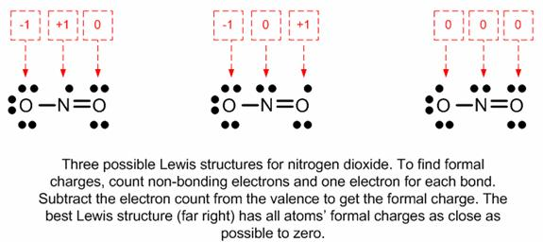
Carbonate Ion
Nitrogen Dioxide

Slide 19
Localized Electron Model
Lewis structures are an application of the “Localized Electron Model”
L.E.M. says: Electron pairs can be thought of as “belonging” to pairs of atoms when bonding using atomic orbitals. Lone pairs belong to only one atom
Resonance points out a weakness in the Localized Electron Model.
What about Delocalized electrons?

Slide 20
VSEPR Model
(Valence Shell Electron Pair Repulsion)
The structure around a given atom is determined principally by minimizing electron pair repulsions.

Slide 21
Predicting a VSEPR Structure
Draw Lewis structure.
Put pairs as far apart as possible.
Determine positions of atoms from the way electron pairs are shared
Determine the name of molecular structure from positions of the atoms using the AXE formula (next slide).

Slide 22
VSEPR – AXE Method
The A represents the central atom.
The X represents how many sigma bonds are formed between the central atoms and outside atoms. Multiple covalent bonds (π, double or triple) count as one X.
The E represents the number of lone electron pairs present on the central atom.
The sum of X and E, sometimes known as the steric number.

Slide 23
VSEPR – Valence Shell Electron Pair Repulsion
X + E | Overall Structure (Electronic Geometry) | Forms
2 | Linear | AX₂
3 | Trigonal Planar | AX₃, AX₂E
4 | Tetrahedral | AX₄, AX₃E, AX₂E₂
5 | Trigonal bipyramidal | AX₅, AX₄E, AX₃E₂, AX₂E₃
6 | Octahedral | AX₆, AX₅E, AX₄E₂
A = central atom
X = atoms bonded to A
E = nonbonding electron pairs on A

Slide 24
VSEPR: Linear (180°)
AX₂
CO₂

Slide 25
VSEPR: Trigonal Planar (120°)
AX₃
BF₃
AX₂E (Bent)
SnCl₂
RED = Molecular Geo.

Slide 26
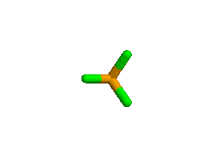
VSEPR: Tetrahedral (109.5°)
AX₄
CCl₄
RED = Molecular Geo.
AX₃E (107.5°)
(Trigonal Pyramidal)
PCl₃
AX₂E₂(104.5°)
(Bent)
Cl₂O

Slide 27
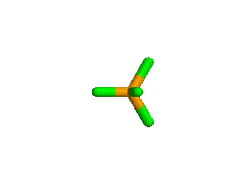
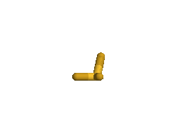
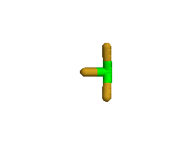
VSEPR: Trigonal Bi-pyramidal (90°,120°)
AX₅
PCl₅
AX₄E (See saw)
(180°, 120°)
SF₄
AX₃E₂ (T-shape)
(90°, 180°)
ClF₃
AX₂E₃ (Linear)
I₃⁻
RED = Molecular Geo.

Slide 28
VSEPR: Octahedral (90°)
AX₆
SF₆
AX₅E (< 90°)
(Square pyramidal)
BrF₅
AX₄E₂ (90°)
(Square Planar)
ICl₄-
RED = Molecular Geo.

Slide 29
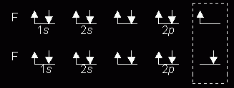
The Octet Rule
Combinations of elements tend to form so that each atom, by gaining, losing, or sharing electrons, has an octet of electrons in its highest occupied energy level.
Diatomic Fluorine

Slide 30
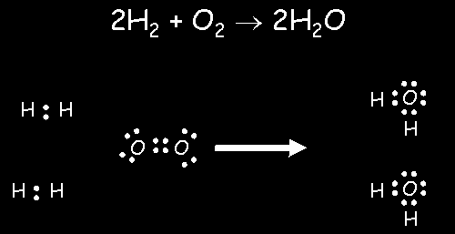
Formation of Water by the Octet Rule

Slide 31
Comments About the Octet Rule
2nd period elements C, N, O, F observe the octet rule (HONC rule as well).
2nd period elements B and Be often have fewer than 8 electrons around themselves - they are very reactive.
3rd period and heavier elements CAN exceed the octet rule having expanded octets (using ?).
When writing Lewis structures, satisfy octets first, then place electrons around elements having available d orbitals.

Slide 32
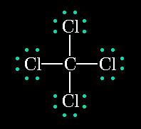
Lewis Structures
Shows how valence electrons are arranged among atoms in a molecule.
Reflects central idea that stability of a compound relates to noble gas electron configuration.

Slide 33
Rules for Drawing Lewis Structures
Add up total number of Ve⁻ and divide by 2 (this =s the number of pairs)
The least electronegative atom tends to be your “central” atom
Place all other atoms around your central atom
H are always terminal
Halogens tend to be terminal
Place a pair of e- or a “−” between the central atom and all other atoms obeying the OCTET rules (some exceptions: H(2), Be(4), B(6))
Distribute ALL remaining pairs of e- on the terminal atoms to fill to an octet (H is a duet – 2).
If any pairs of e- remain, then place them on the central atom.
If after all pairs are placed and the octet rule is not satisfied, then make double or triple bonds

Slide 34
Multiple Covalent Bonds: Double bonds
Ethene
Two pairs of shared electrons

Slide 35
Multiple Covalent Bonds: Triple bonds
Ethyne
Three pairs of shared electrons

Slide 36
Resonance
Resonance is invoked when more than one valid Lewis structure can be written for a particular molecule.
Benzene, C₆H₆
The actual structure is an average of the resonance
structures.
The bond lengths in the ring are identical, and
between those of single and double bonds.

Slide 37
Resonance Bond Length and Bond Energy
Resonance bonds are shorter and stronger than single bonds.
Resonance bonds are longer and weaker than double
bonds.

Slide 38
Resonance in Ozone, O₃
Neither structure is correct.
Oxygen bond lengths are identical, and intermediate to single and double bonds

Slide 39
Resonance in Polyatomic Ions
Resonance in a carbonate ion:
Resonance in an acetate ion:

