Slide 1
Covalent Bonding - Orbitals

Slide 2
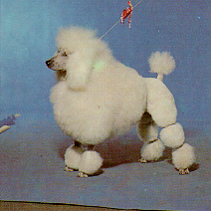
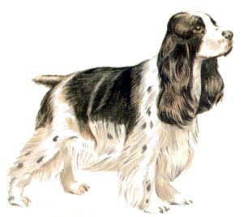
Hybridization - The Blending of Orbitals
+
=
Poodle
+
Cocker Spaniel
=
Cockapoo
+
=
s orbital
+
p orbital
=
sp orbital

Slide 3
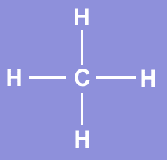
What Proof Exists for Hybridization?
We have studied electron configuration notation and
the sharing of electrons in the formation of covalent
bonds.
Lets look at a molecule of methane, CH₄.
Methane is a simple natural gas. Its molecule has a
carbon atom at the center with four hydrogen atoms covalently bonded around it.

Slide 4
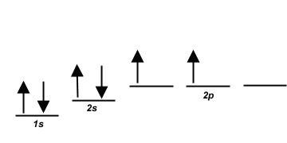
Carbon ground state configuration
What is the expected orbital notation of carbon
in its ground state?
Can you see a problem with this?
(Hint: How many unpaired electrons does this
carbon atom have available for bonding?)

Slide 5
Carbon’s Bonding Problem
You should conclude that carbon only has TWO
electrons available for bonding. That is not not enough!
How does carbon overcome this problem so that
it may form four bonds?

Slide 6
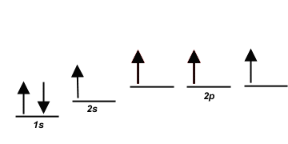
Carbon’s Empty Orbital
The first thought that chemists had was that carbon promotes one of its 2s electrons…
…to the empty 2p orbital.

Slide 7
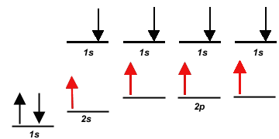
However, they quickly recognized a problem with such
an arrangement…
Three of the carbon-hydrogen bonds would involve
an electron pair in which the carbon electron was a 2p, matched with the lone 1s electron from a hydrogen atom.

Slide 8
This would mean that three of the bonds in a methane
molecule would be identical, because they would involve
electron pairs of equal energy.
But what about the fourth bond…?

Slide 9
The fourth bond is between a 2s electron from the
carbon and the lone 1s hydrogen electron.
Such a bond would have slightly less energy than the other bonds in a methane molecule.

Slide 10
This bond would be slightly different in character than
the other three bonds in methane.
This difference would be measurable to a chemist
by determining the bond length and bond energy.
But is this what they observe?

Slide 11
The simple answer is, “No”.
Measurements show that
all four bonds in methane
are equal. Thus, we need
a new explanation for the
bonding in methane.
Chemists have proposed an explanation – they call it
Hybridization.
Hybridization is the combining of two or more orbitals
of nearly equal energy within the same atom into
orbitals of equal energy.

Slide 12
In the case of methane, they call the hybridization
sp³, meaning that an s orbital is combined with three
p orbitals to create four equal hybrid orbitals.
These new orbitals have slightly MORE energy than
the 2s orbital…
… and slightly LESS energy than the 2p orbitals.

Slide 13
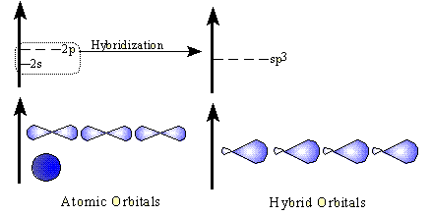
sp³ Hybrid Orbitals
Here is another way to look at the sp³ hybridization
and energy profile…

Slide 14
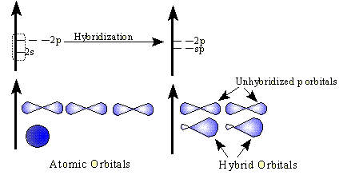
sp Hybrid Orbitals
While sp³ is the hybridization observed in methane,
there are other types of hybridization that atoms
undergo.
These include sp hybridization, in which one s
orbital combines with a single p orbital.
This produces two hybrid orbitals, while leaving two normal p orbitals

Slide 15
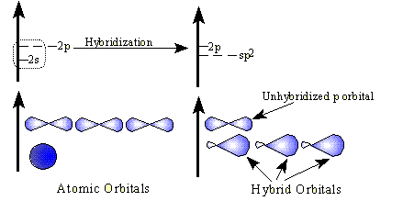
sp² Hybrid Orbitals
Another hybrid is the sp², which combines two orbitals from a p sublevel with one orbital from an s sublevel.
One p orbital remains unchanged.

Slide 16
Hybridization and Molecular Geometry
Forms | Overall Structure (electronic geometry) | Hybridization of “A”
AX₂ | Linear | sp
AX₃, AX₂E | Trigonal Planar | sp²
AX₄, AX₃E, AX₂E₂ | Tetrahedral | sp³
AX₅, AX₄E, AX₃E₂, AX₂E₃ | Trigonal bipyramidal | ??
AX₆, AX₅E, AX₄E₂ | Octahedral | ??
A = central atom
X = atoms bonded to A
E = nonbonding electron pairs on A

Slide 17
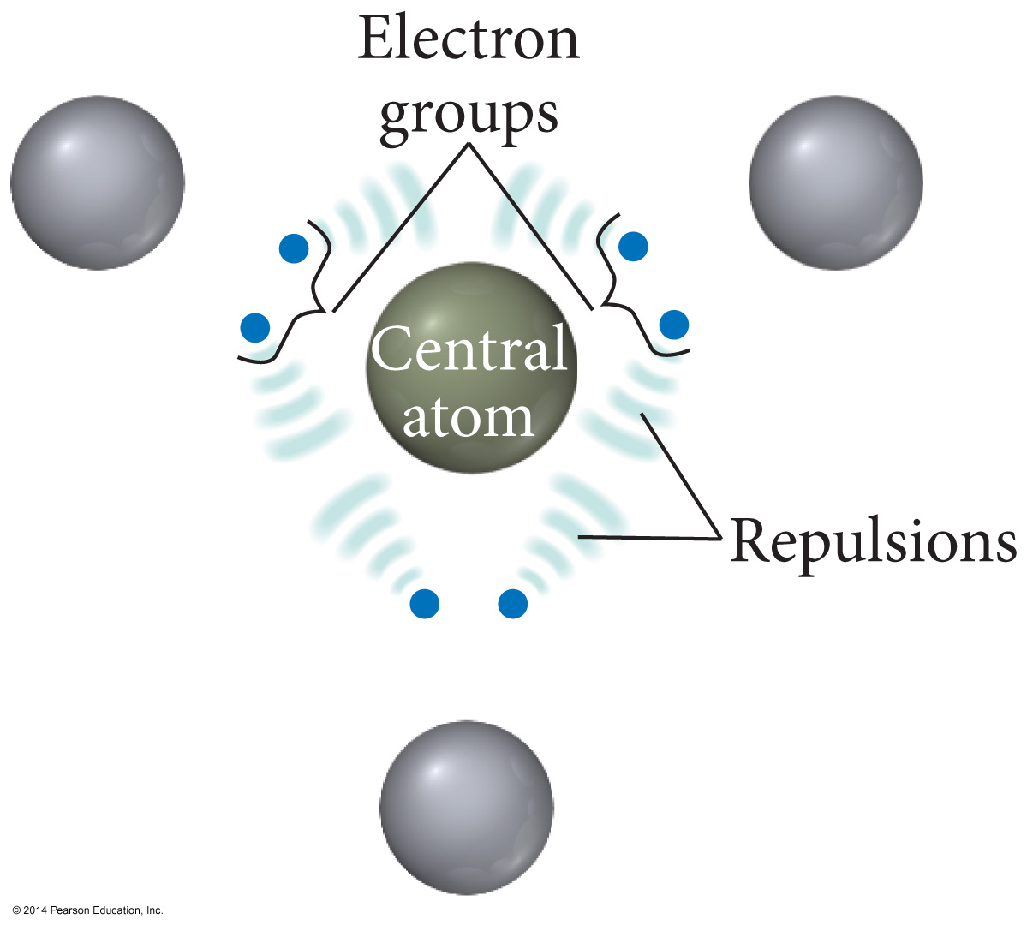

Slide 18
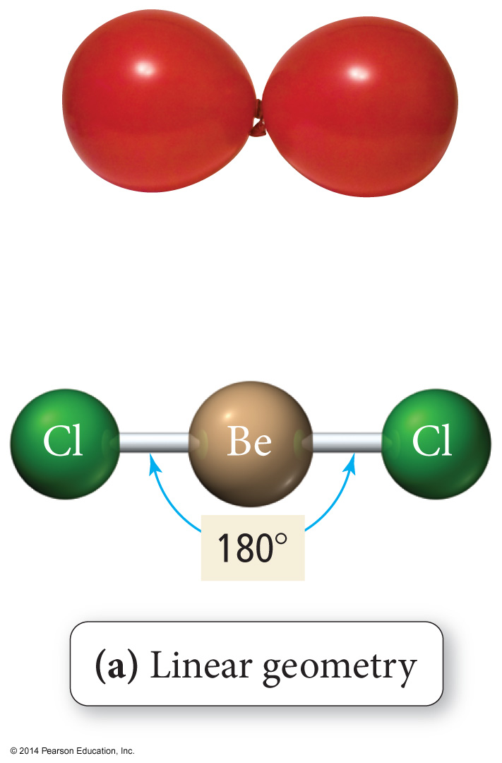
Linear Geometry

Slide 19
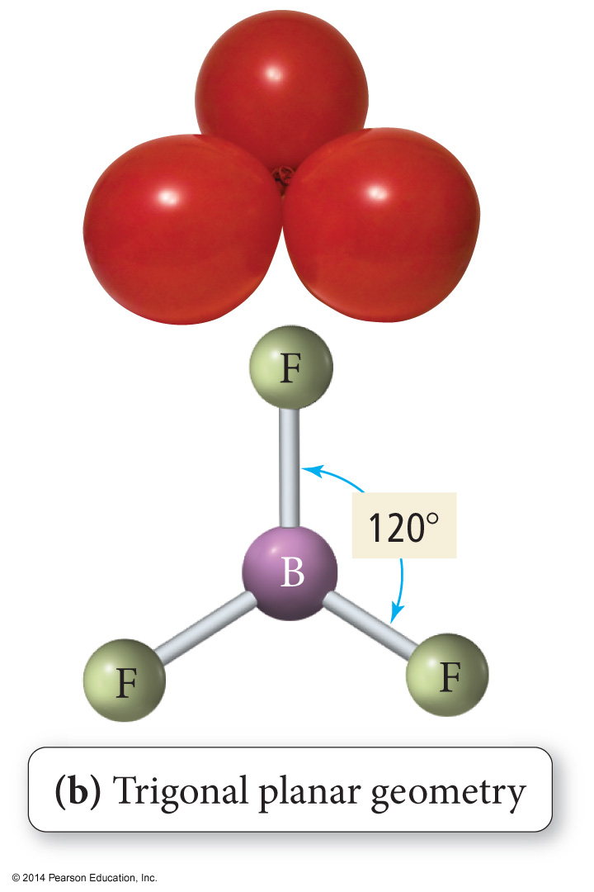
Trigonal Planar Geometry

Slide 20
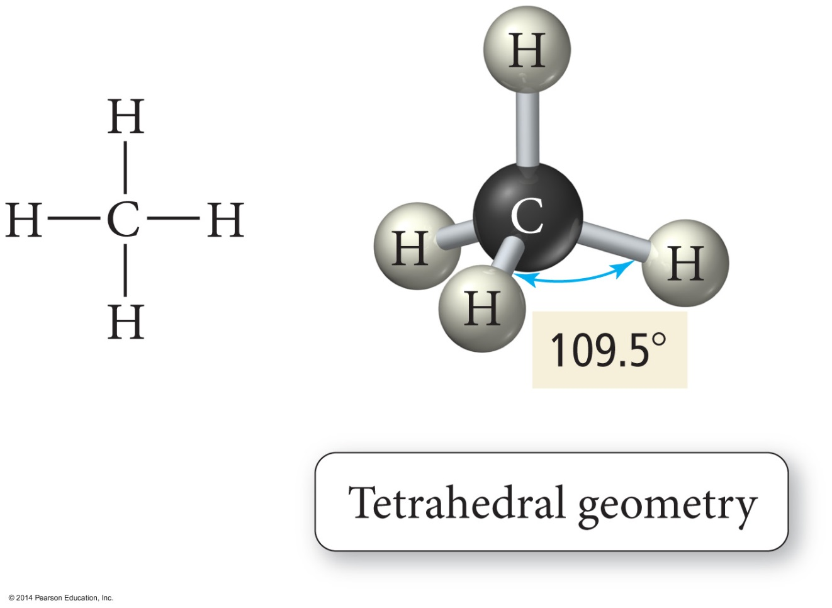
Tetrahedral Geometry

Slide 21
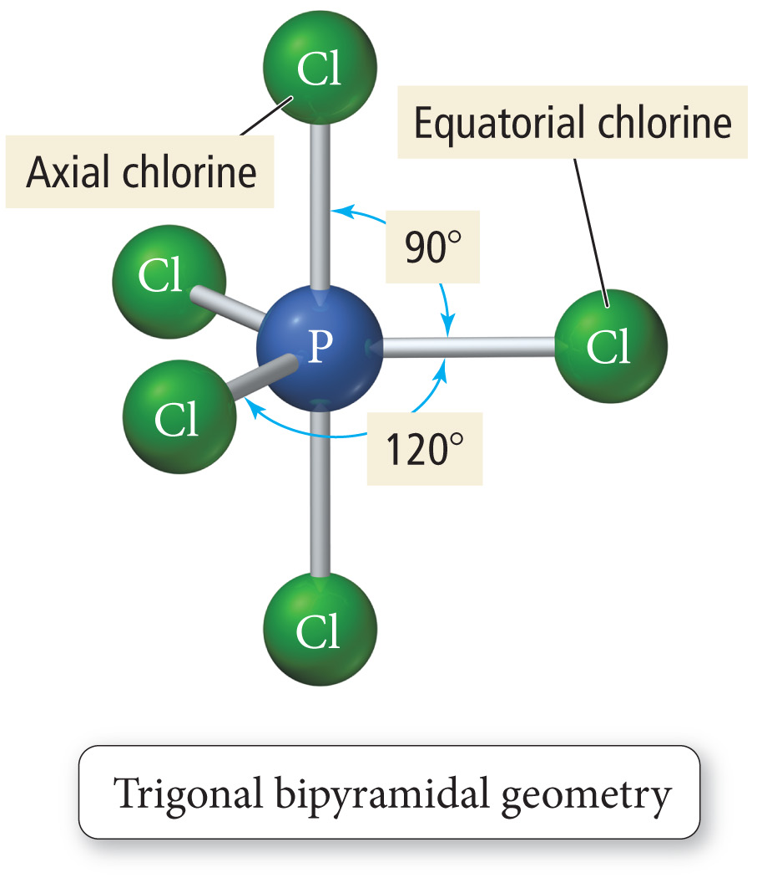
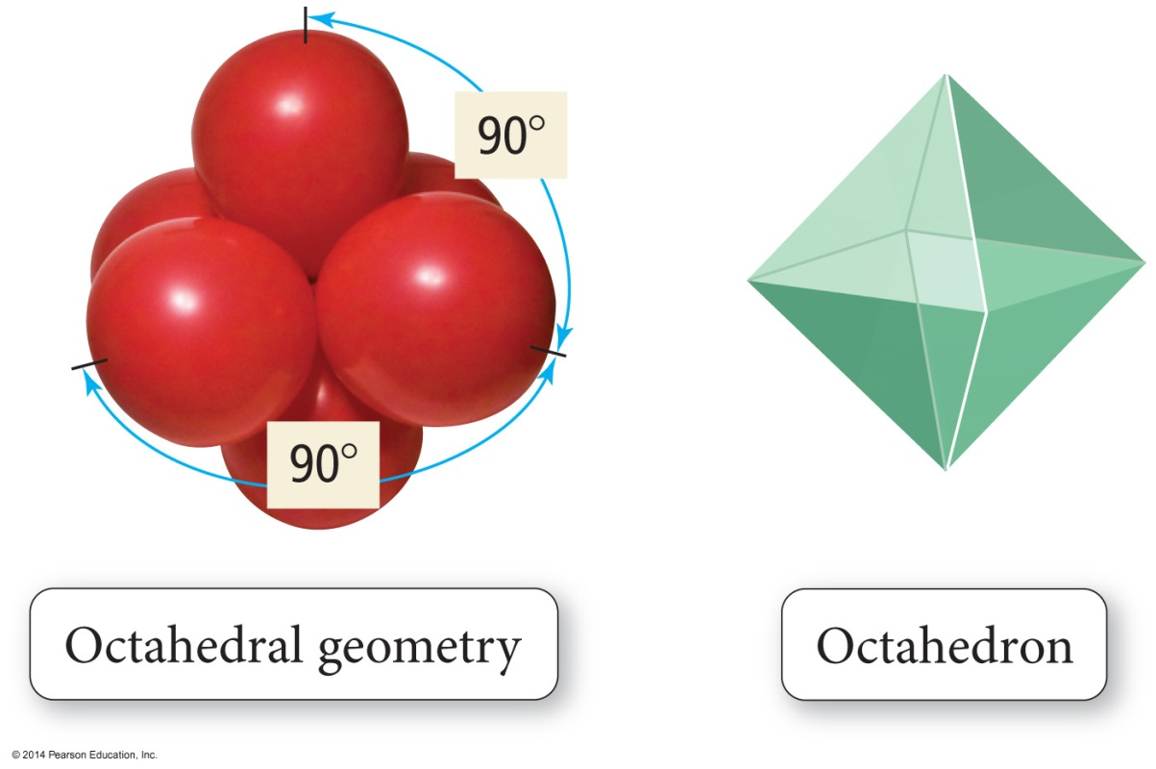
Trigonal Bipyramid

Slide 22
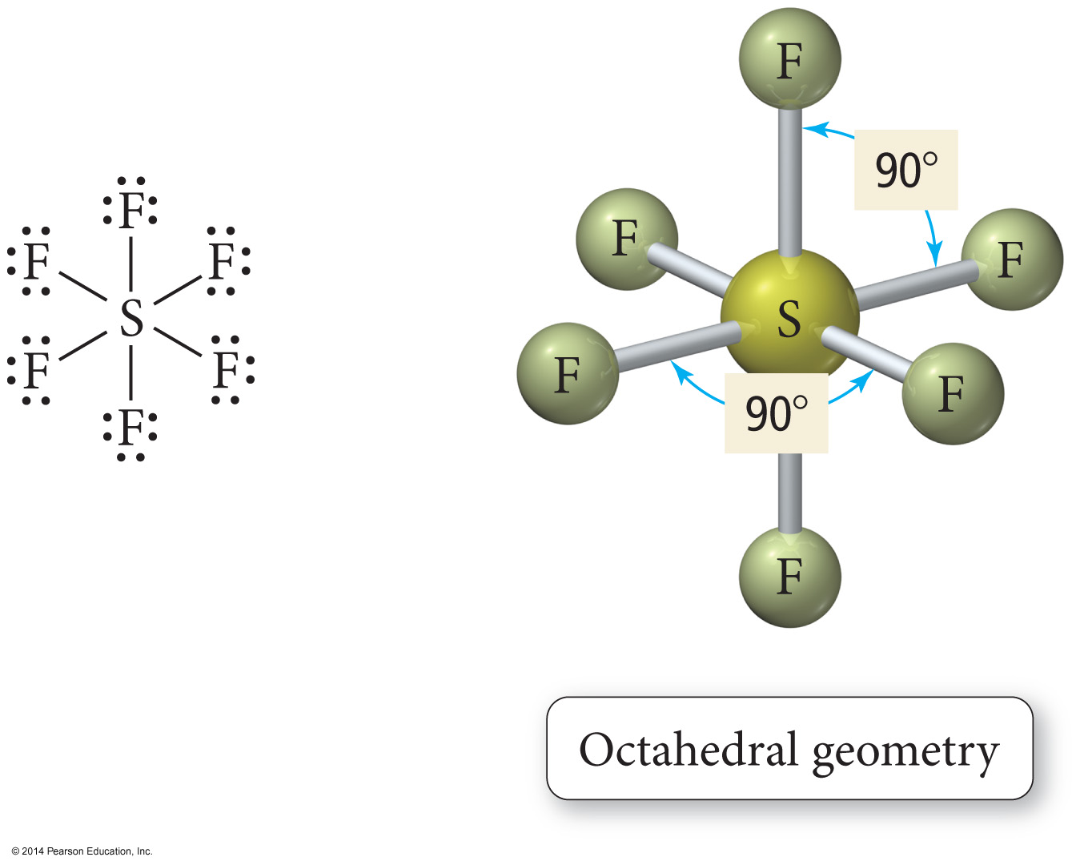
Octahedral Geometry

Slide 23
Octahedral Geometry

Slide 24
The Effect of Lone Pairs
Lone pair groups “occupy more space” on the central atom because their electron density is exclusively on the central atom, rather than shared like bonding electron groups.
Relative sizes of repulsive force interactions is as follows:
This affects the bond angles, making the bonding pair angles smaller than expected.
Lone Pair – Lone Pair > Lone Pair – Bonding Pair > Bonding Pair – Bonding Pair

Slide 25
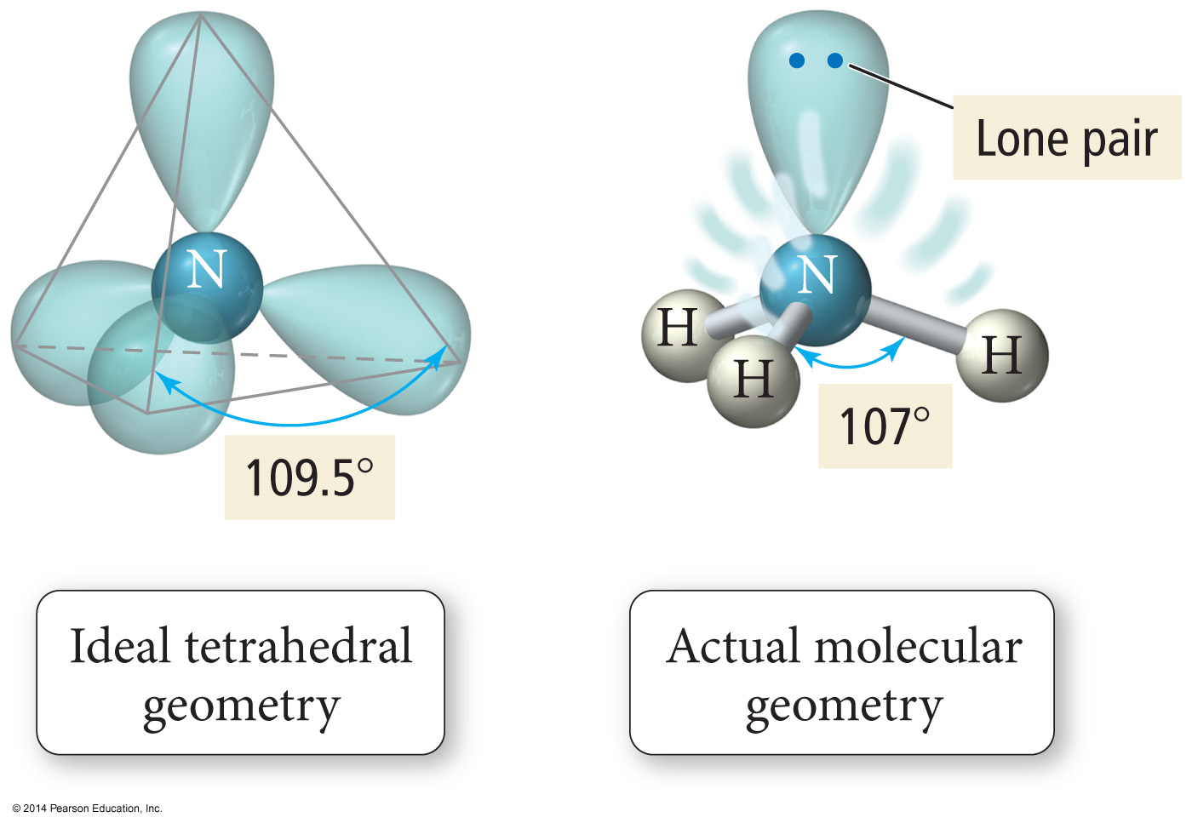
Bond Angle Distortion from Lone Pairs

Slide 26
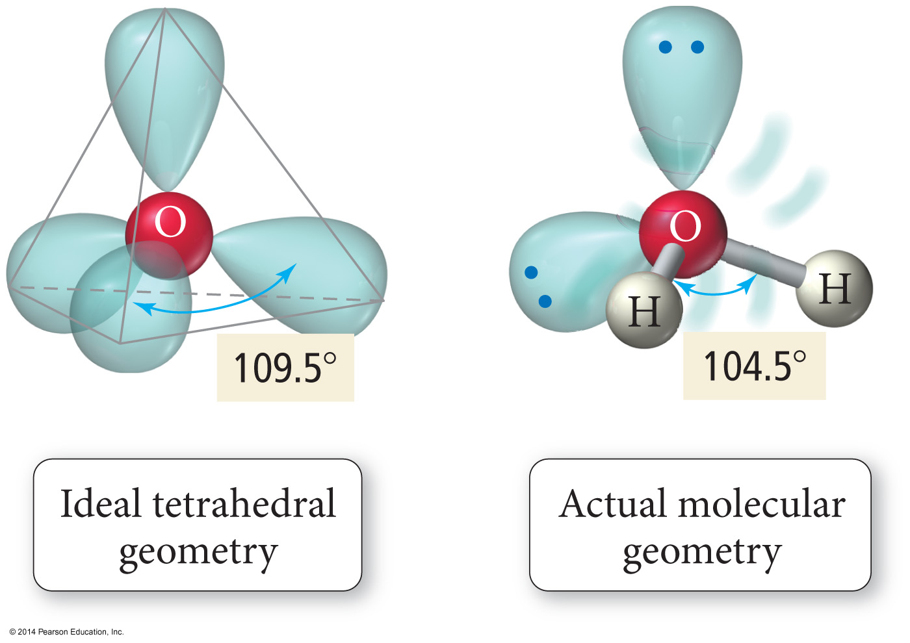
Bond Angle Distortion from Lone Pairs

Slide 27
Polarity of Molecules
For a molecule to be polar it must
have polar bonds.
Electronegativity difference – theory
Bond dipole moments – measured
have an asymmetrical shape.
Vector addition
Polarity affects the intermolecular forces of attraction.
Therefore, boiling points and solubility’s
Like dissolves like
Non-bonding pairs affect molecular polarity, strong pull in its direction.

Slide 28
Types of Bonds
A sigma (σ) bond results when the interacting atomic orbitals point along the axis connecting the two bonding nuclei.
Either standard atomic orbitals or hybrids
s to s, p to p, hybrid to hybrid, s to hybrid, etc.
A pi (π) bond results when the bonding atomic orbitals are parallel to each other and perpendicular to the axis connecting the two bonding nuclei.
Between unhybridized parallel p orbitals
The interaction between parallel orbitals is not as strong as between orbitals that point at each other; therefore, σ bonds are stronger than π bonds.

Slide 29
Sigma and Pi Bonds
Sigma (σ) bonds exist in the region directly between two bonded atoms.
Pi (π) bonds exist in the region above and below a line drawn between two bonded atoms.
Single bond | 1 sigma bond
Double Bond | 1 sigma, 1 pi bond
Triple Bond | 1 sigma, 2 pi bonds

Slide 30
Sigma and Pi Bonds Single Bonds
1 σ bond
Ethane

Slide 31
Sigma and Pi Bonds: Double bonds
1 π bond
Ethene
1 σ bond

Slide 32
Sigma and Pi Bonds Triple Bonds
1 π bond
Ethyne
1 π bond
1 σ bond

Slide 33
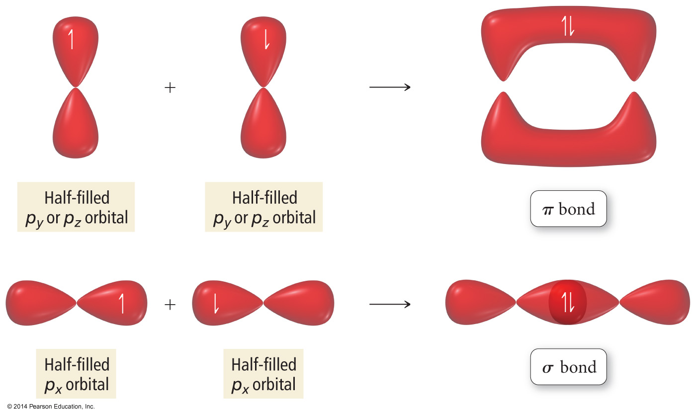

Slide 34
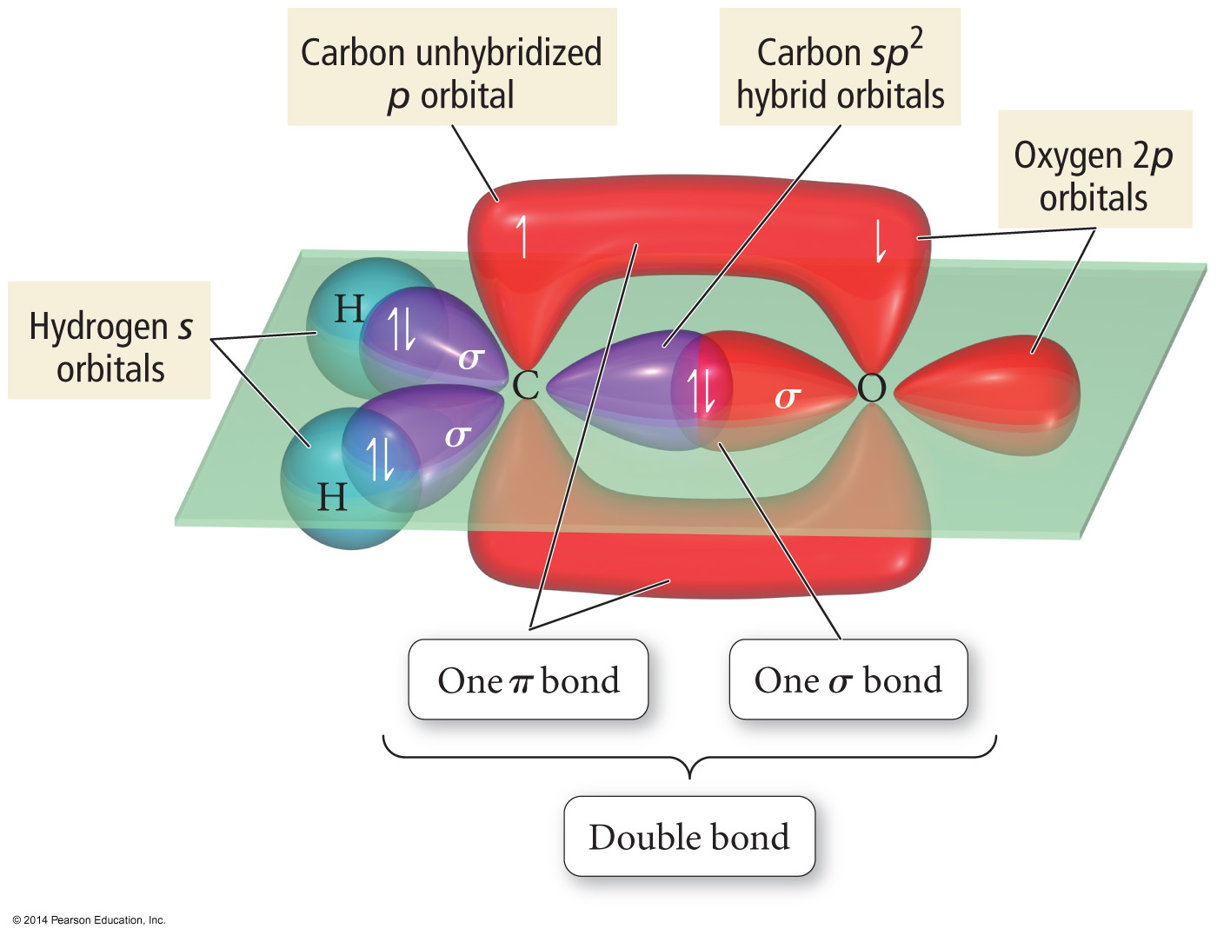

Slide 35
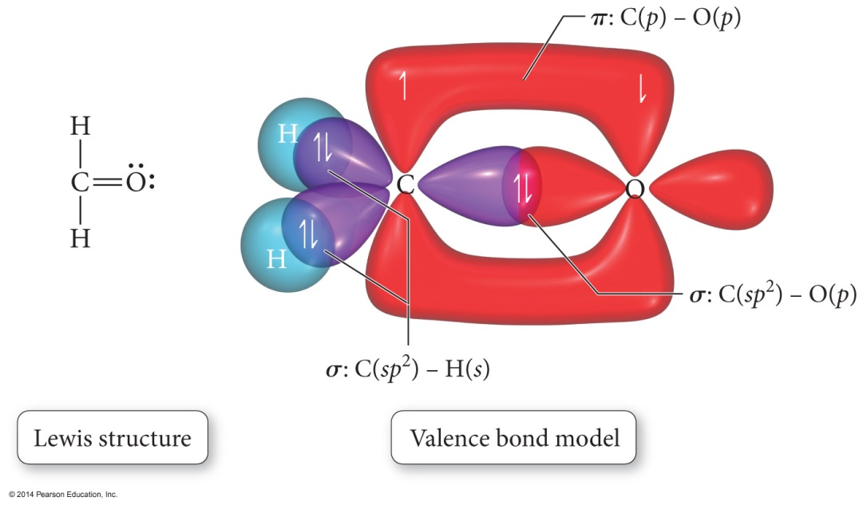
Orbital Diagrams of Bonding
“Overlap” between a hybrid orbital on one atom with a hybrid or nonhybridized orbital on another atom results in a σ bond.
“Overlap” between unhybridized p orbitals on bonded atoms results in a π bond.

Slide 36
Orbital Diagrams of Bonding cont.
Hybrid orbitals overlap to form a σ bond. Unhybridized p orbitals overlap to form a π bond.

Slide 37
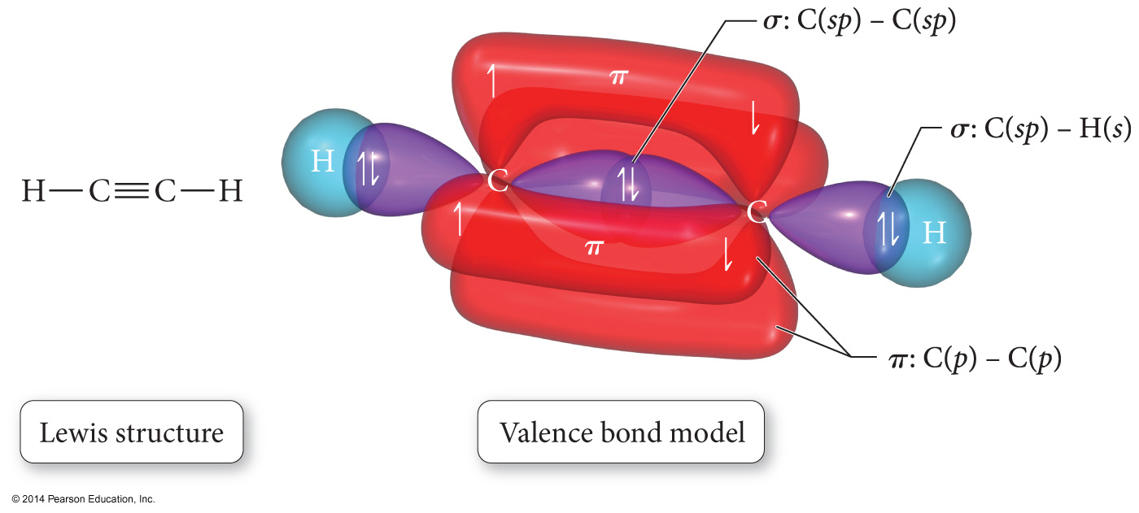

Slide 38
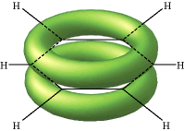
The De-Localized Electron Model
Pi bonds (π) contribute to the delocalized model of electrons in bonding, and help explain resonance
Electron density from π bonds can be distributed symmetrically all around the ring, above and below the plane.

Slide 39
STOP

Slide 40
Molecular Orbital (MO) Theory
In MO theory, we apply Schrödinger’s wave equation to the molecule to calculate a set of molecular orbitals.
In practice, the equation solution is estimated.
We start with good guesses from our experience as to what the orbital should look like.
Then we test and tweak the estimate until the energy of the orbital is minimized.
In this treatment, the electrons belong to the whole molecule, so the orbitals belong to the whole molecule.
Delocalization

Slide 41
LCAO
The simplest guess starts with the atomic orbitals of the atoms adding together to make molecular orbitals; this is called the linear combination of atomic orbitals (LCAO) method.
Weighted sum
Because the orbitals are wave functions, the waves can combine either constructively or destructively.

Slide 42
Molecular Orbitals
When the wave functions combine constructively, the resulting molecular orbital has less energy than the original atomic orbitals; it is called a bonding molecular orbital.
σ, π
Most of the electron density between the nuclei
When the wave functions combine destructively, the resulting molecular orbital has more energy than the original atomic orbitals; it is called an antibonding molecular orbital.
σ*, π*
Most of the electron density outside the nuclei
Nodes between nuclei

Slide 43
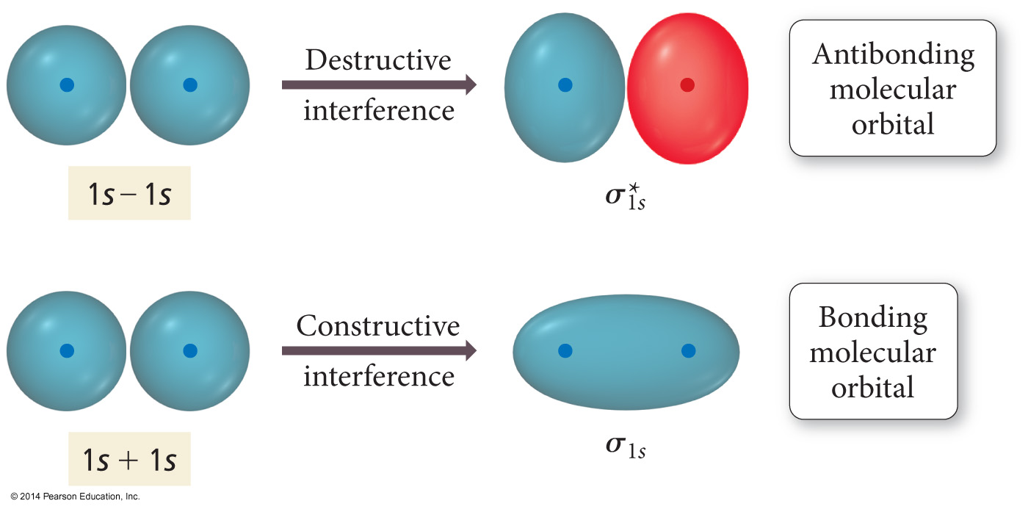
Interaction of 1s Orbitals

Slide 44
Molecular Orbital Theory
Electrons in bonding MOs are stabilizing.
Lower energy than the atomic orbitals
Electrons in antibonding MOs are destabilizing.
Higher in energy than atomic orbitals
Electron density located outside the internuclear axis
Electrons in antibonding orbitals cancel stability gained by electrons in bonding orbitals.

Slide 45
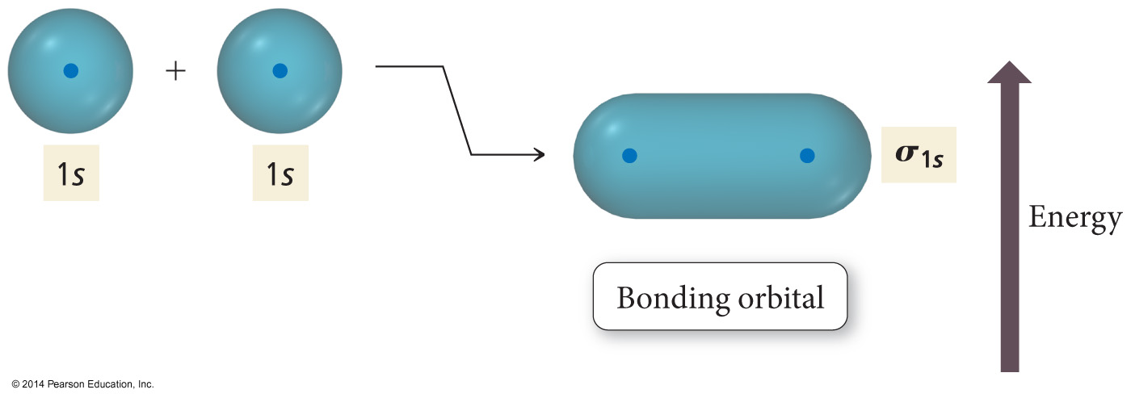
Energy Comparisons of Atomic Orbitals to Molecular Orbitals

Slide 46
MO and Properties
Bond order = difference between number of electrons in bonding and antibonding orbitals
Only need to consider valence electrons
May be a fraction
Higher bond order = stronger and shorter bonds
If bond order = 0, then bond is unstable compared to individual atoms and no bond will form.
A substance will be paramagnetic if its MO diagram has unpaired electrons.
If all electrons paired, it is diamagnetic

Slide 47
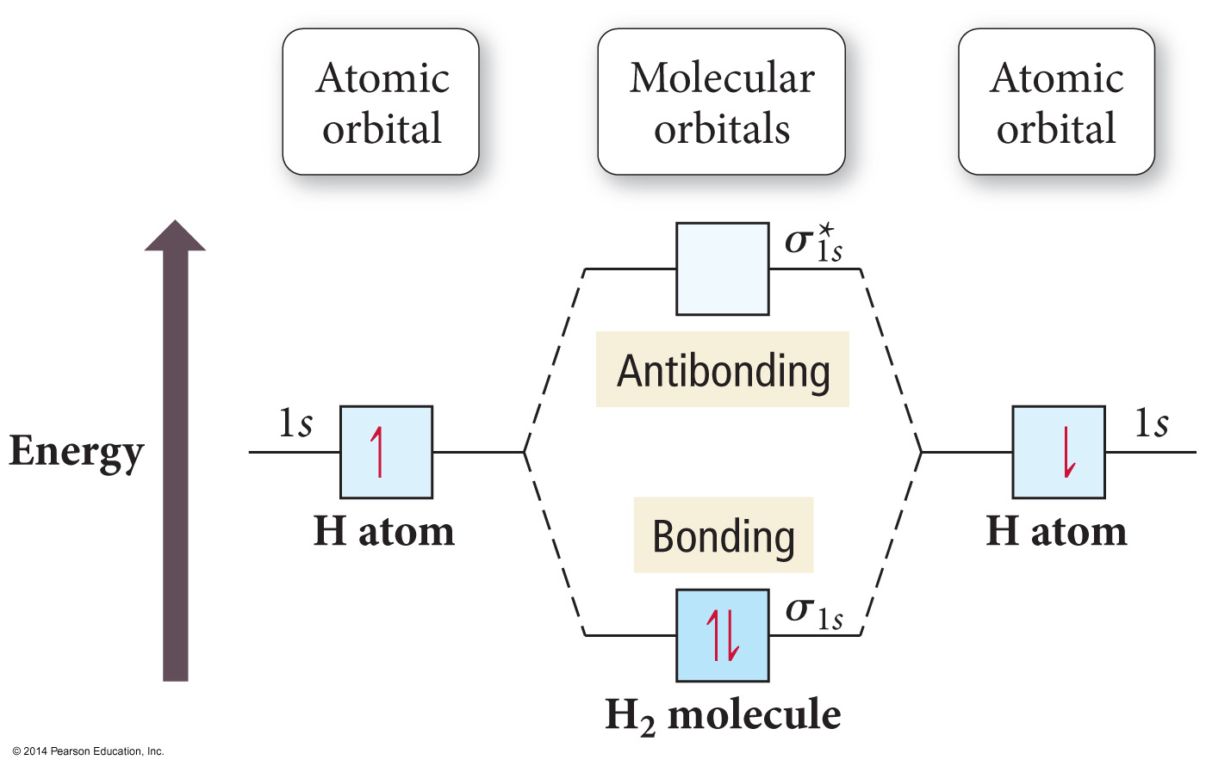

Slide 48
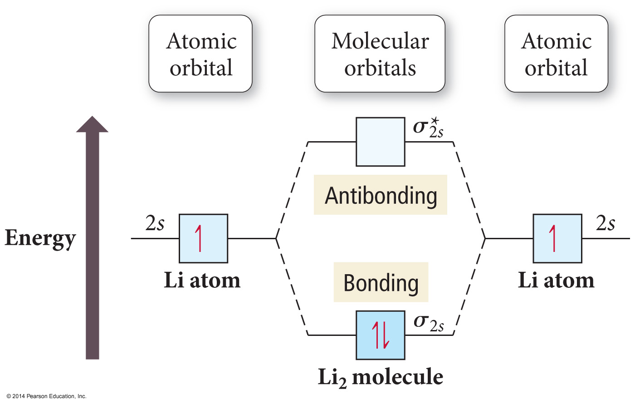
Period Two Homonuclear Diatomic Molecules

Slide 49
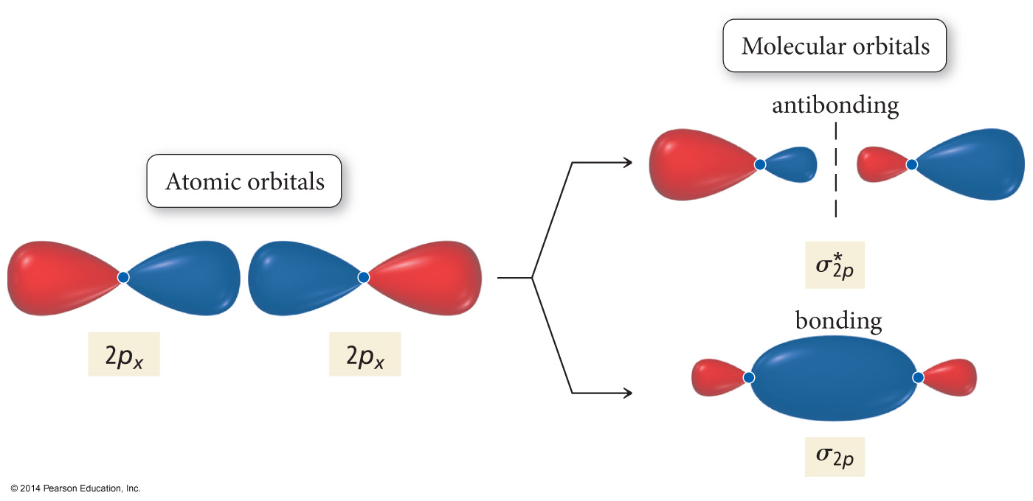
Interaction of p Orbitals

Slide 50
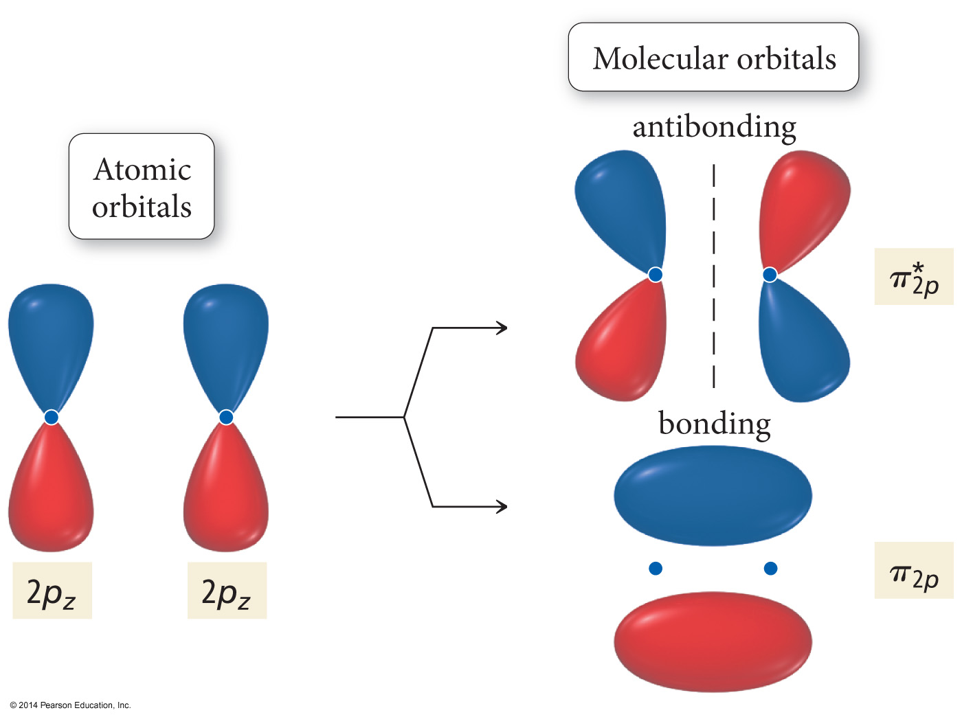
Interaction of p Orbitals

Slide 51
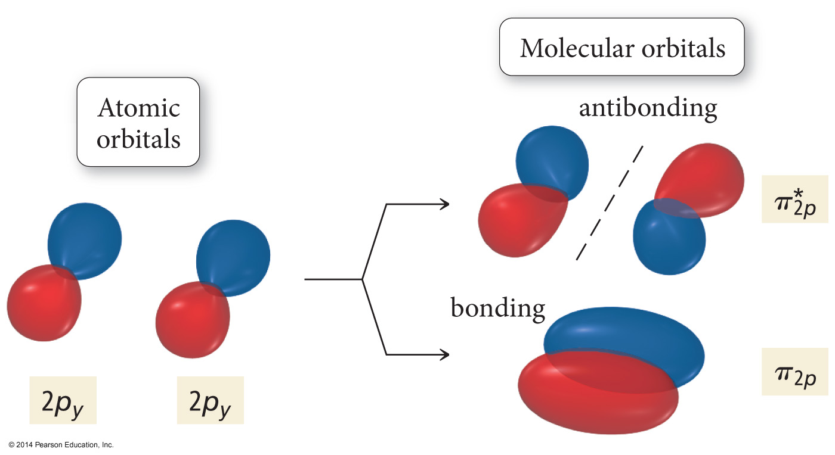
Interaction of p Orbitals

Slide 52
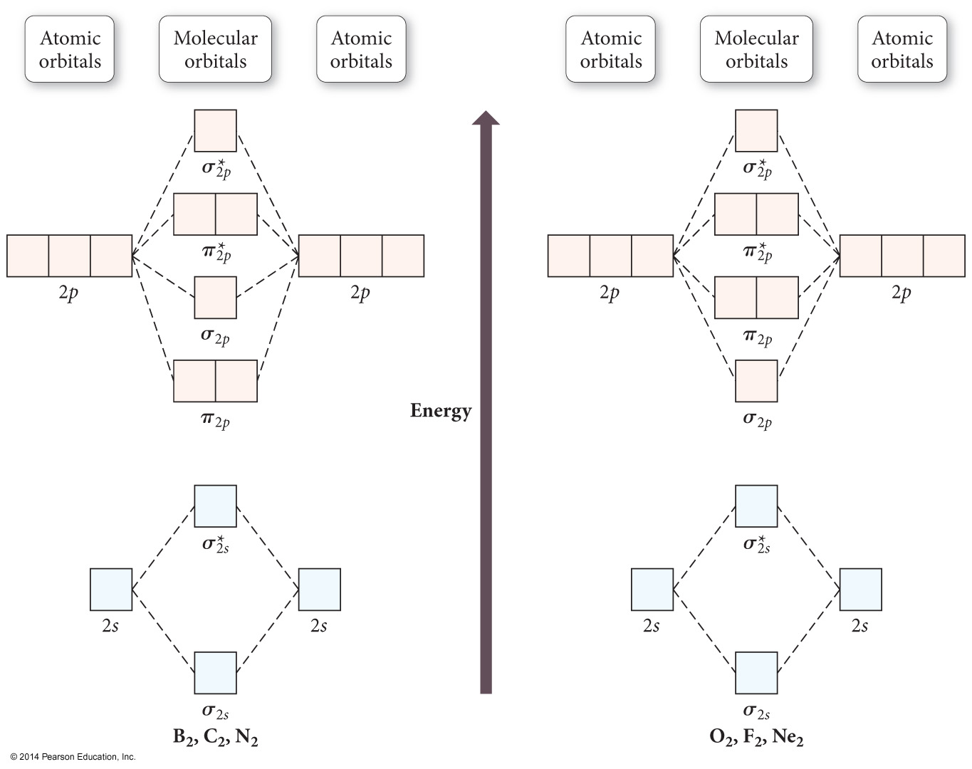

Slide 53
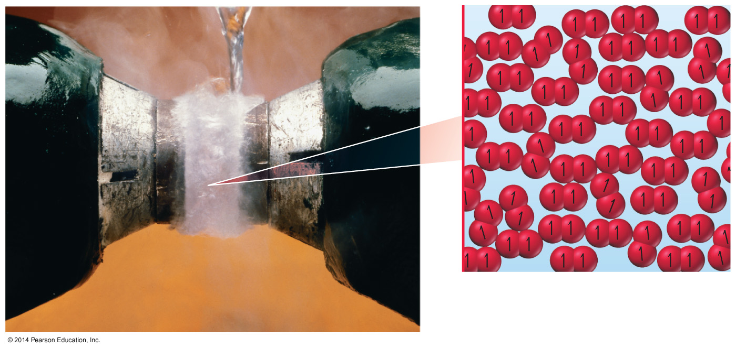
O₂
Dioxygen is paramagnetic.
Paramagnetic material has unpaired electrons.
Neither Lewis theory nor valence bond theory predict this result.

Slide 54
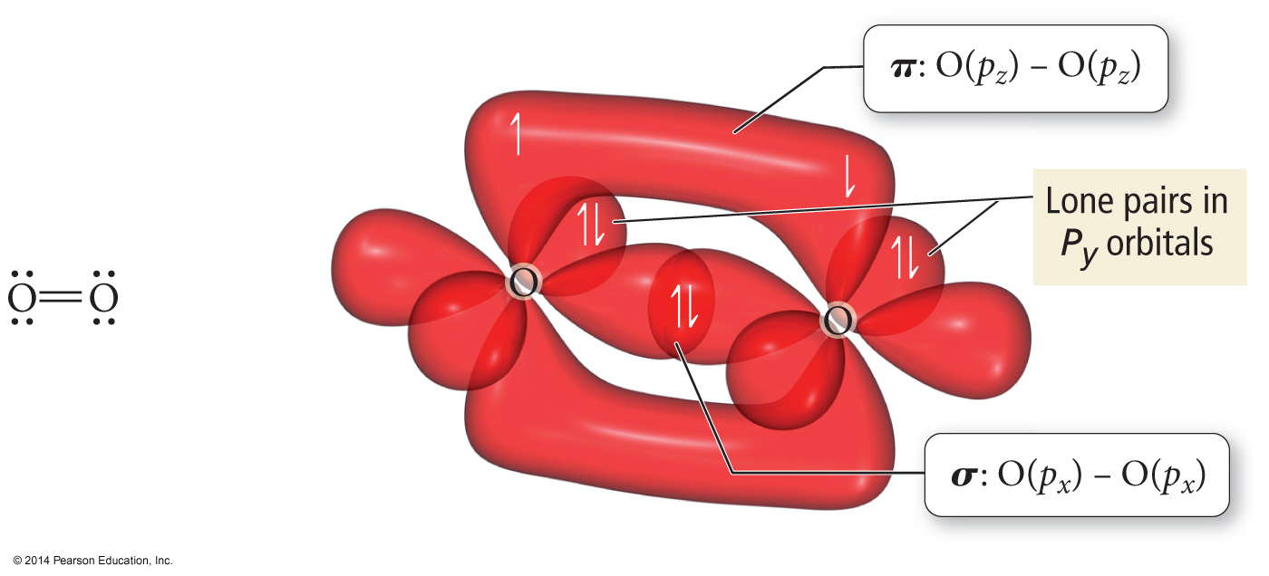
O₂ as Described by Lewis and VB Theory

Slide 55
Heteronuclear Diatomic Molecules and Ions
When the combining atomic orbitals are identical and of equal energy, the contribution of each atomic orbital to the molecular orbital is equal.
When the combining atomic orbitals are different types and energies, the atomic orbital closest in energy to the molecular orbital contributes more to the molecular orbital.

Slide 56
Heteronuclear Diatomic Molecules and Ions
The more electronegative an atom is, the lower in energy are its orbitals.
Lower energy atomic orbitals contribute more to the bonding MOs.
Higher energy atomic orbitals contribute more to the antibonding MOs.
Nonbonding MOs remain localized on the atom donating its atomic orbitals.

Slide 57
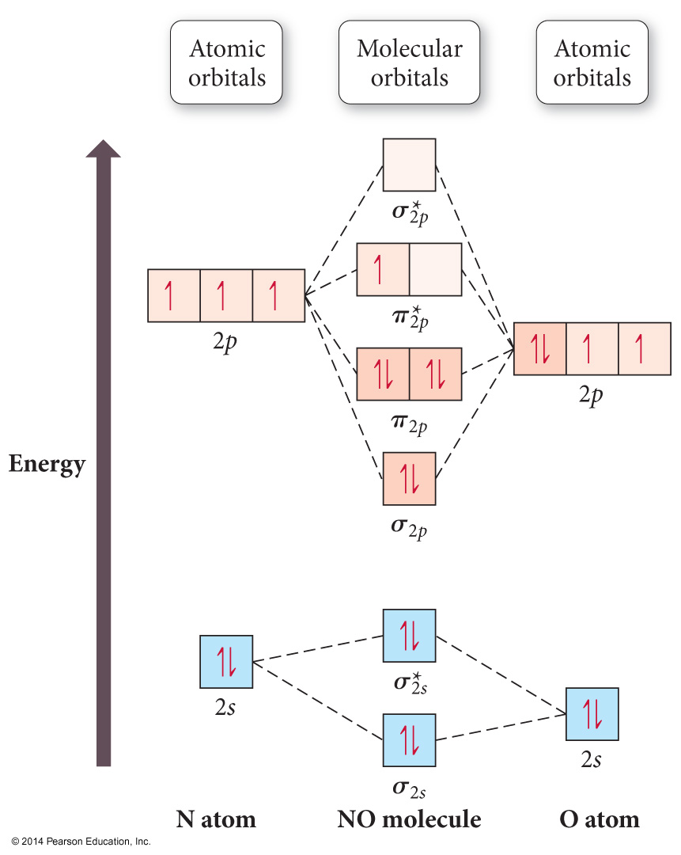
Second-Period Heteronuclear Diatomic Molecules

Slide 58
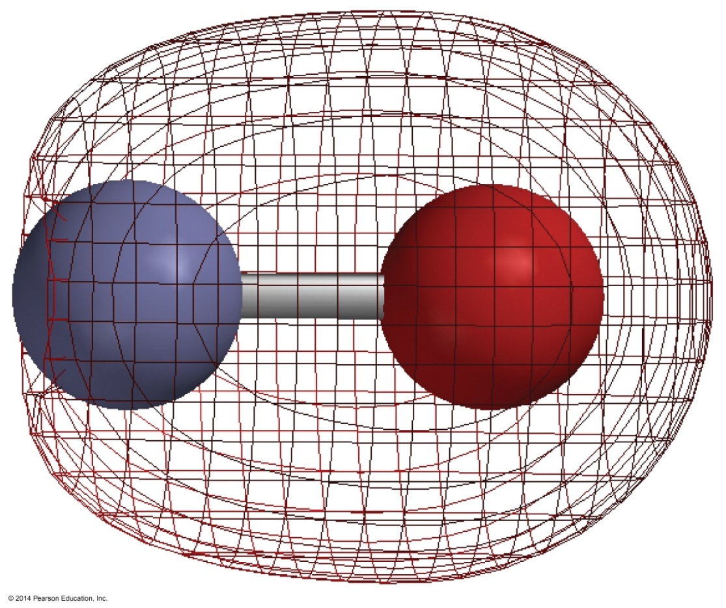
NO
σ_{2s} bonding MO
shows more electron density near O because it is mostly O’s 2s atomic orbital.

Slide 59
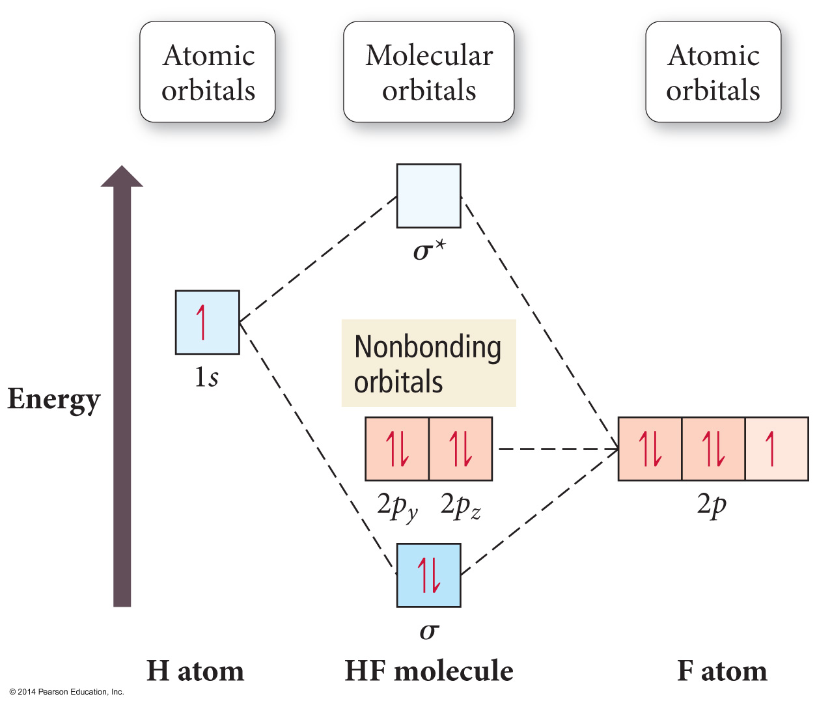
HF

Slide 60
Polyatomic Molecules
When many atoms are combined together, the atomic orbitals of all the atoms are combined to make a set of molecular orbitals, which are delocalized over the entire molecule.
Gives results that better match real molecule properties than either Lewis or valence bond theories.

Slide 61
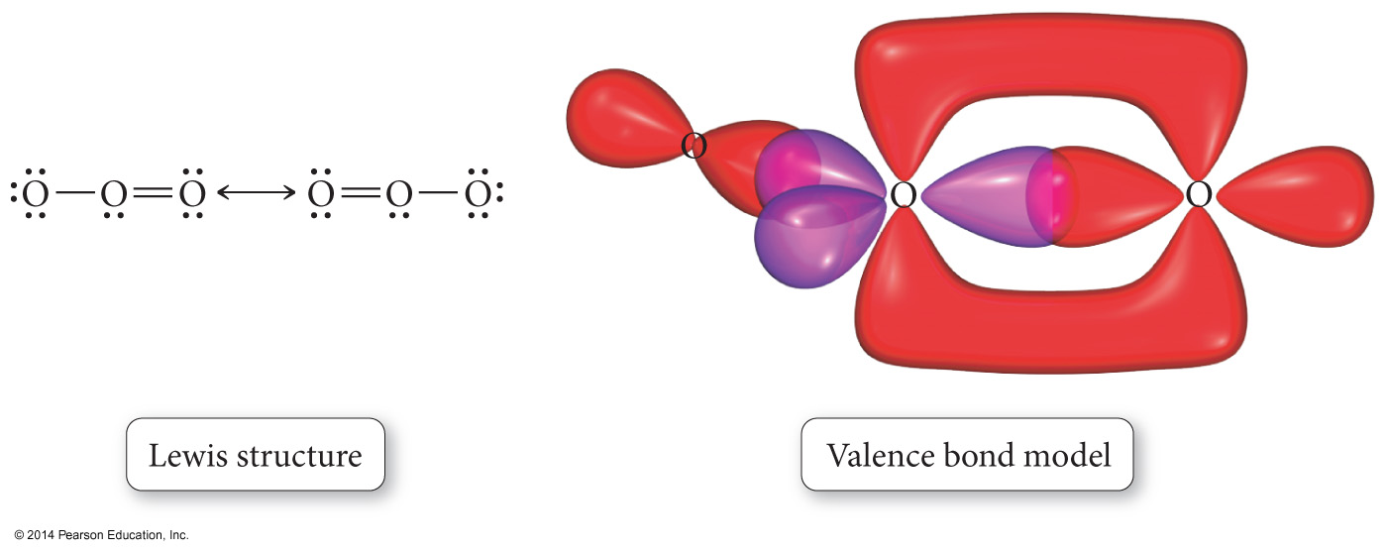
Ozone, O₃

Slide 62
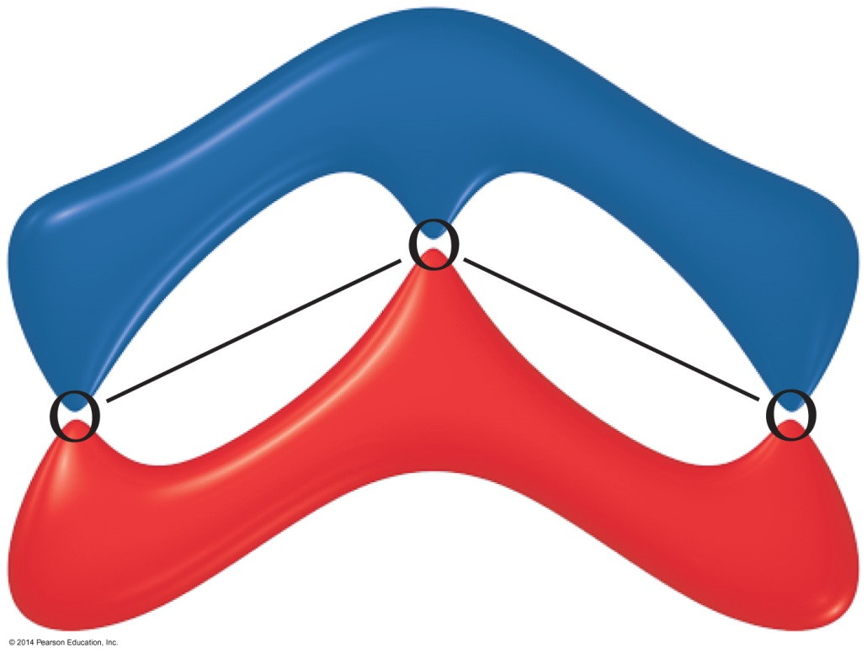
Ozone, O₃

Slide 63
Hybridization Involving “d” Orbitals
Beginning with elements in the third row, “d” orbitals may also hybridize
sp³d = five hybrid orbitals of equal energy
sp³d ² = six hybrid orbitals of equal energy

