Slide 1
N20 – Bonding
Energy of Bonding
Link to YouTube Presentation: https://youtu.be/bJm5LGLngfo

Slide 2
N20 – Bonding
Energy of Bonding
Target: I can perform calculations related to lattice energy and bond energy, and can explain the connection to Coulomb’s Law

Slide 3
Covalent

Slide 4
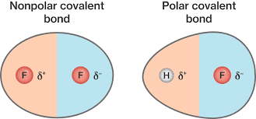
Covalent Bonds
Polar-Covalent bonds
Electrons are unequally shared
Electronegativity difference between 0.3 and 1.7
Nonpolar-Covalent bonds
Electrons are equally shared
Electronegativity difference between 0 to 0.3

Slide 5
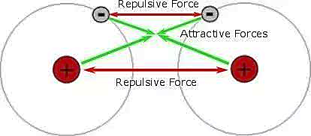
Covalent Bonding Forces
Electron – electron repulsive forces = Bad
Proton – proton repulsive forces = Bad
Electron – proton attractive forces = Good

Slide 6
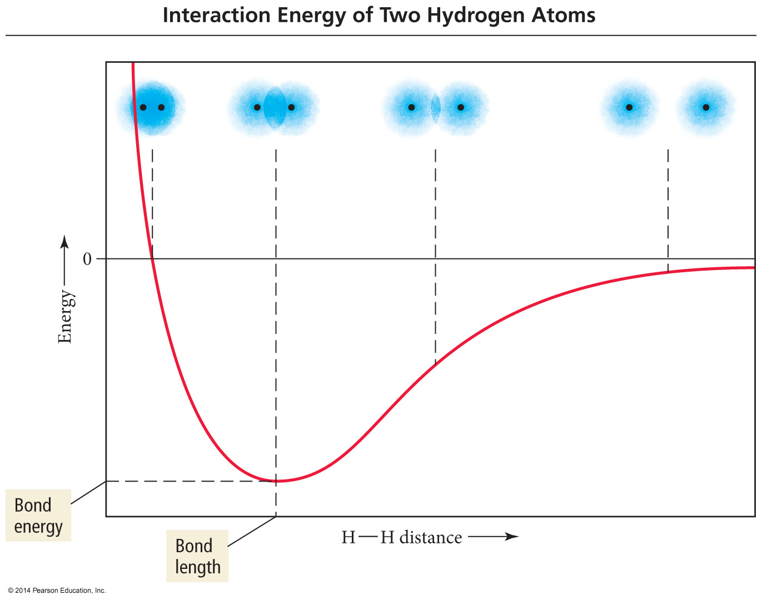
How Close Together Before “Bonded” ?
“Bonded” when at lowest, most stable energy.
Goldie Locks… Too far = bad Too close = bad You want it juuust right

Slide 7
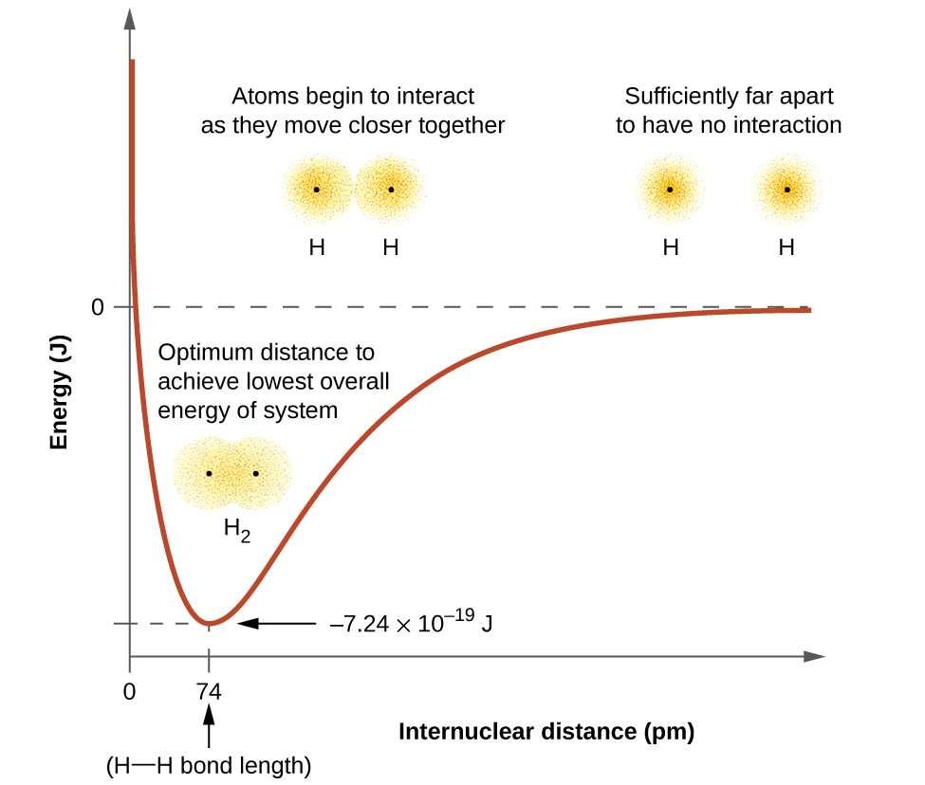
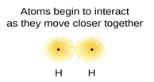
Bond Length Diagram
.
Too much overlap, repulsion between nuclei

Slide 8
Bond Length and Energy
Bonds between elements become shorter and stronger as multiplicity increases.
Bond | Bond type | Bond length (pm) | Bond Energy (kJ/mol)
C - C | Single | 154 | 347
C = C | Double | 134 | 614
C ≡ C | Triple | 120 | 839
C - O | Single | 143 | 358
C = O | Double | 123 | 745
C - N | Single | 143 | 305
C = N | Double | 138 | 615
C ≡ N | Triple | 116 | 891

Slide 9
Bond Energy and Enthalpy
D = Bond energy per mole of bonds
Breaking bonds always requires energy
Breaking = endothermic = ( + )
Forming bonds always releases energy
Forming = exothermic = ( - )

Slide 10
Bond Energy and Enthalpy
You will see numbers vary a decent amount from chart to chart. Use what is in the problem, otherwise look them up an don’t stress about slight differences.
“Takes to Break” = + endo
“Frees to Form” = - exo
How much energy does it take to break 2H₂O into 2H₂ and O₂? Bond energies: O-H 463 kJ/mol, H-H 436 kJ/mol, O=O 498 kJ/mol
Breaking: 4 O-H bonds → + values, absorbed, endo, +
Making: 2 H-H bonds, and 1 O=O bond → - values, released, exo, -
4 O-H 2 H-H 1 O=O
∆H = [ 4(463)] + [2(-436)+1(-498)] = 482 kJ/mol

Slide 11
Ionic

Slide 12
Remember these things?
Electronegativity, Atomic Radius, Ion Charge…
Why are these things important here?
Energy of bonding comes back to…
Attractions and Repulsions!

Slide 13
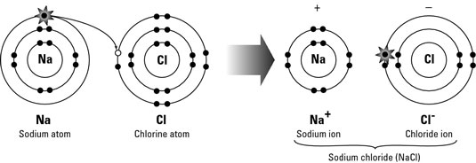
Ionic Bonds
e⁻’s transferred → makes ions
THEN ions are “electrostatically attracted” to each other
That attraction is the “bond”

Slide 14
Ionic Bonds
Electronegativity differences are generally greater than 1.7 – large difference
The last step in the formation of ionic bonds is the ions coming together - always exothermic!

Slide 15
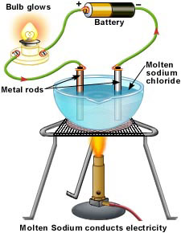
Determination of Ionic Character
Electronegativity difference is not the final determination of ionic character
Compounds are ionic if they conduct electricity in their molten state

Slide 16
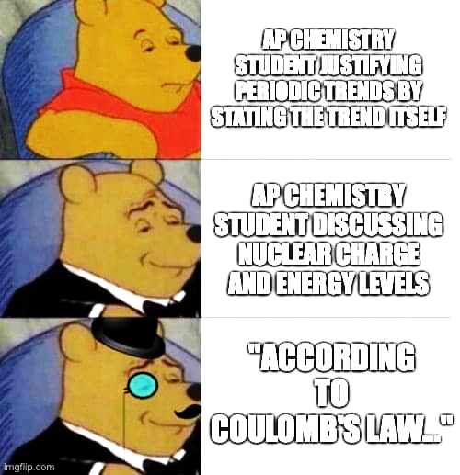
Coulomb’s Law and Periodic Trends

Slide 17
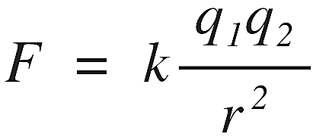
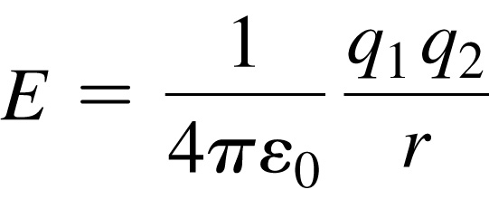
Coulomb’s Law
Describes the attractions and repulsions between charged particles.
Seen represented in various ways, no big deal!
$F∝$ $\frac{q_{1}q_{2}}{r^{2}}$
q = absolute value of charge on particles
r = distance btwn particles
k and the $\frac{1}{4πε_{0}}$ are Coulomb’s constant which varies based on what substance the objects are in. k is NOT the rate constant
2

Slide 18
Effect of Distance Between Particles ( r )
For like charges, (+ and +, or – and – )
Like charges repel. Takes Energy to push them close.
Potential energy (E) is positive.
E decreases as the particles get farther apart as r increases.
For opposite charges, (+ and – )
Opposite charges attract. More stable closer together.
Potential energy is negative. (Negative is good!)
E becomes more negative as the particles get closer together.

Slide 19
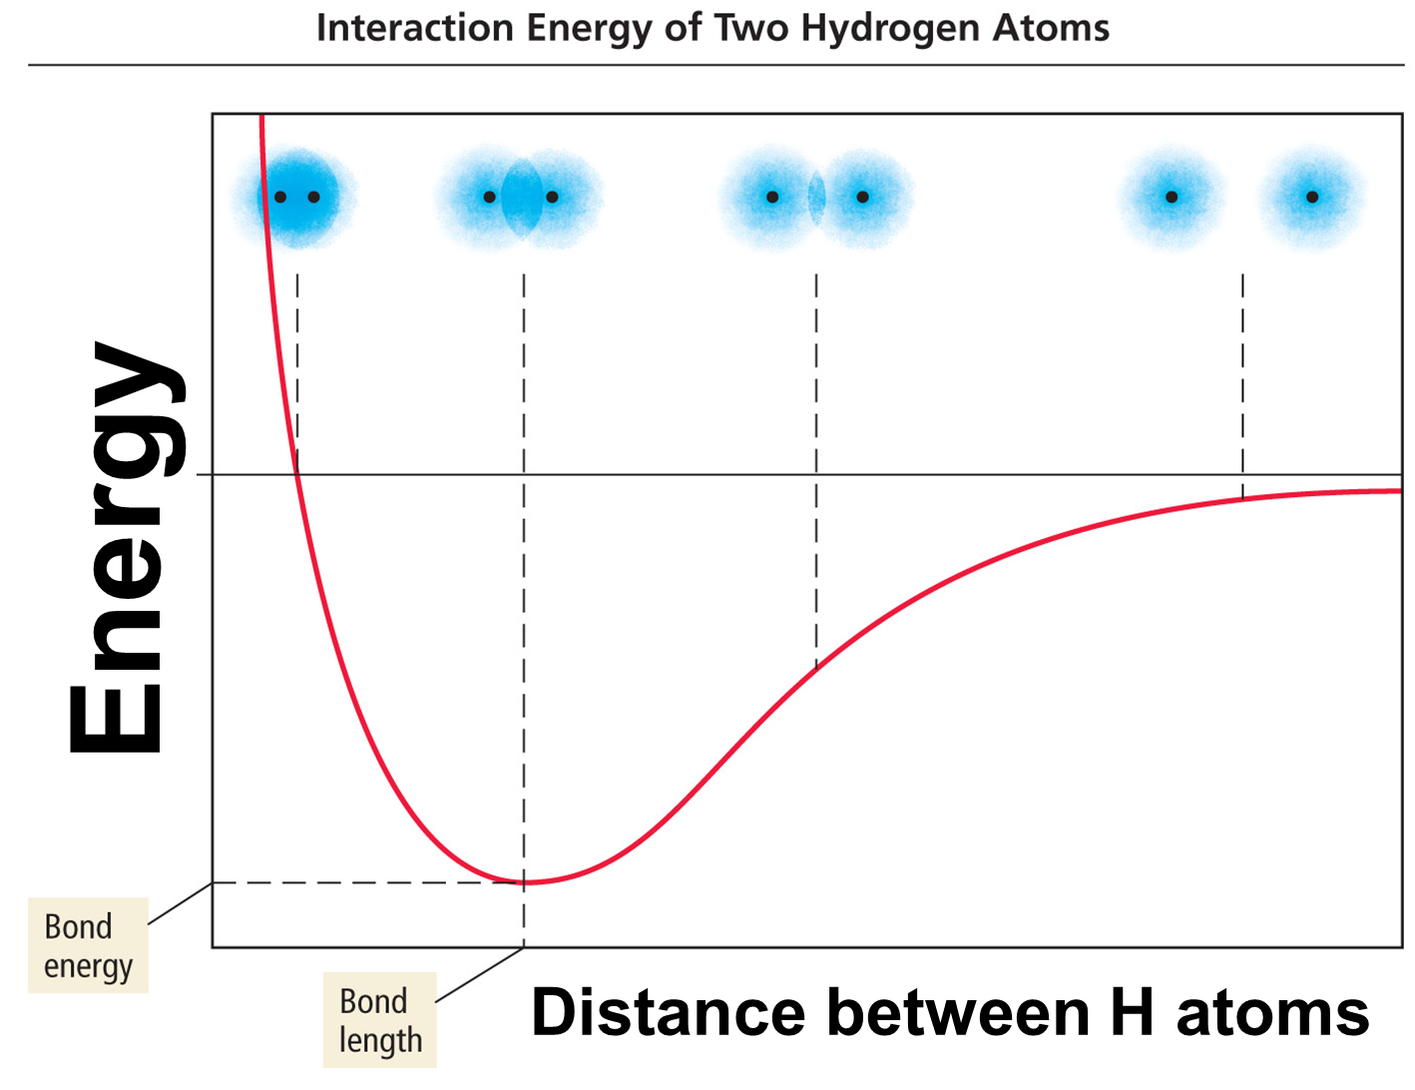
Effect of Distance Between Particles ( r )

Slide 20
Effect of Charge Magnitude ( q )
Strength of the interaction ↑ as size of the charges ↑
Electrons are more strongly attracted to a nucleus with a 2+ charge than a nucleus with a 1+ charge.
Therefore…
Strongest ionic bond would be:
Large charge magnitude (example: +2 versus +1, or -3 versus -2) AND
Small ionic radius (example: Li⁺ versus Cs⁺, or Cl⁻ versus I⁻ )

Slide 21
Which factor matters more?
Usually, the charge magnitude is a bigger impact than the radius. Check it first!
If things have the SAME charge magnitude, then check radius

Slide 22
How Strong is the Bond?
The more energy required to separate an ion pair (from a lattice) into ions the stronger the bond.
Usually simplified into “a modified form of Coulomb’s Law” with r instead of r²
$$Lattice Energy=k\left(\frac{Q_{1}Q_{2}}{r}\right)$$

Slide 23
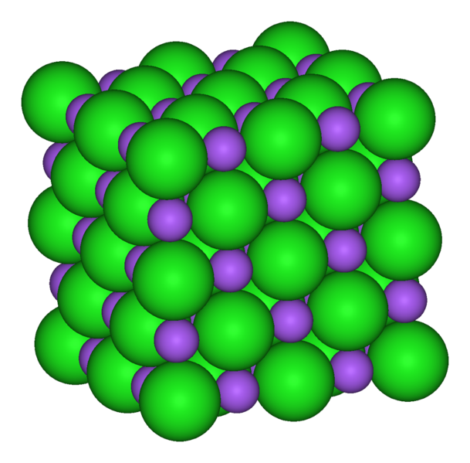
Sodium Chloride Crystal Lattice
Ionic compounds form solids at ordinary temperatures.
Organized in a characteristic crystal lattice of alternating positive and negative ions.

Slide 24
Lattice Dissociation Energy
The amount of energy absorbed to separate a mole of solid ionic compound into its gaseous ions
Often just called “The Lattice Energy”
ENDOTHERMIC PROCESS (+)
-
+
Pretend there is a mole of the solid here ☺

Slide 25
Lattice Formation Energy
The amount of energy released to form a mole of solid ionic compound from its gaseous ions
Often just called “The Lattice Energy”
EXOTHERMIC PROCESS (-)
-
+
Pretend there is a mole of the solid here ☺

Slide 26
Lattice Dissociation Energy

Slide 27
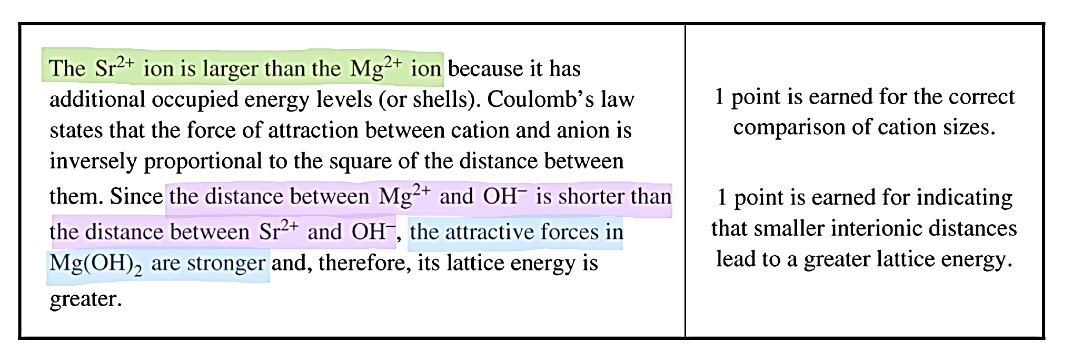

Slide 28
Lattice Energy vs. ∆H
Lattice Energy is just one step in an entire process.
It involves the elements already being ions in a gaseous state.
∆H is the TOTAL amount of energy needed for the ENTIRE process to happen if the elements are NOT already in their ionic and gaseous states.

Slide 29
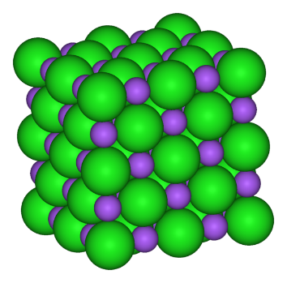
Example: Steps for Forming LiF
Turn solid Li into a gas
Sublimation
Break the F_{2 (g)} bond to get F_{(g)}
Bond energy
Ionize Li → Li⁺
Ionization energy
Add an electron to F → F⁻
Electron affinity
Form the ionic bond
Lattice energy
+
+ e-
+ e-
-
Pretend there is a mole of the solid here ☺
+
-
+

Slide 30
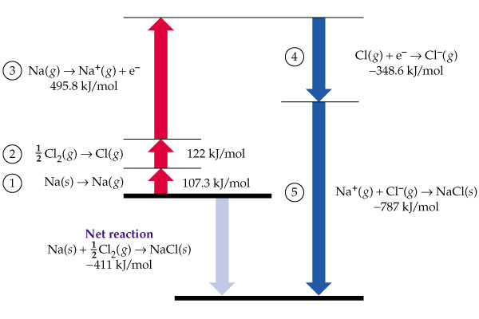
Often see diagrams similar to this
Ionization
Energy
( + )
Electron Affinity
( - )
Dissociation Energy
( + )
Enthalpy of sublimation
( + )
Lattice Energy
( - )
Enthalpy of Formation

Slide 31
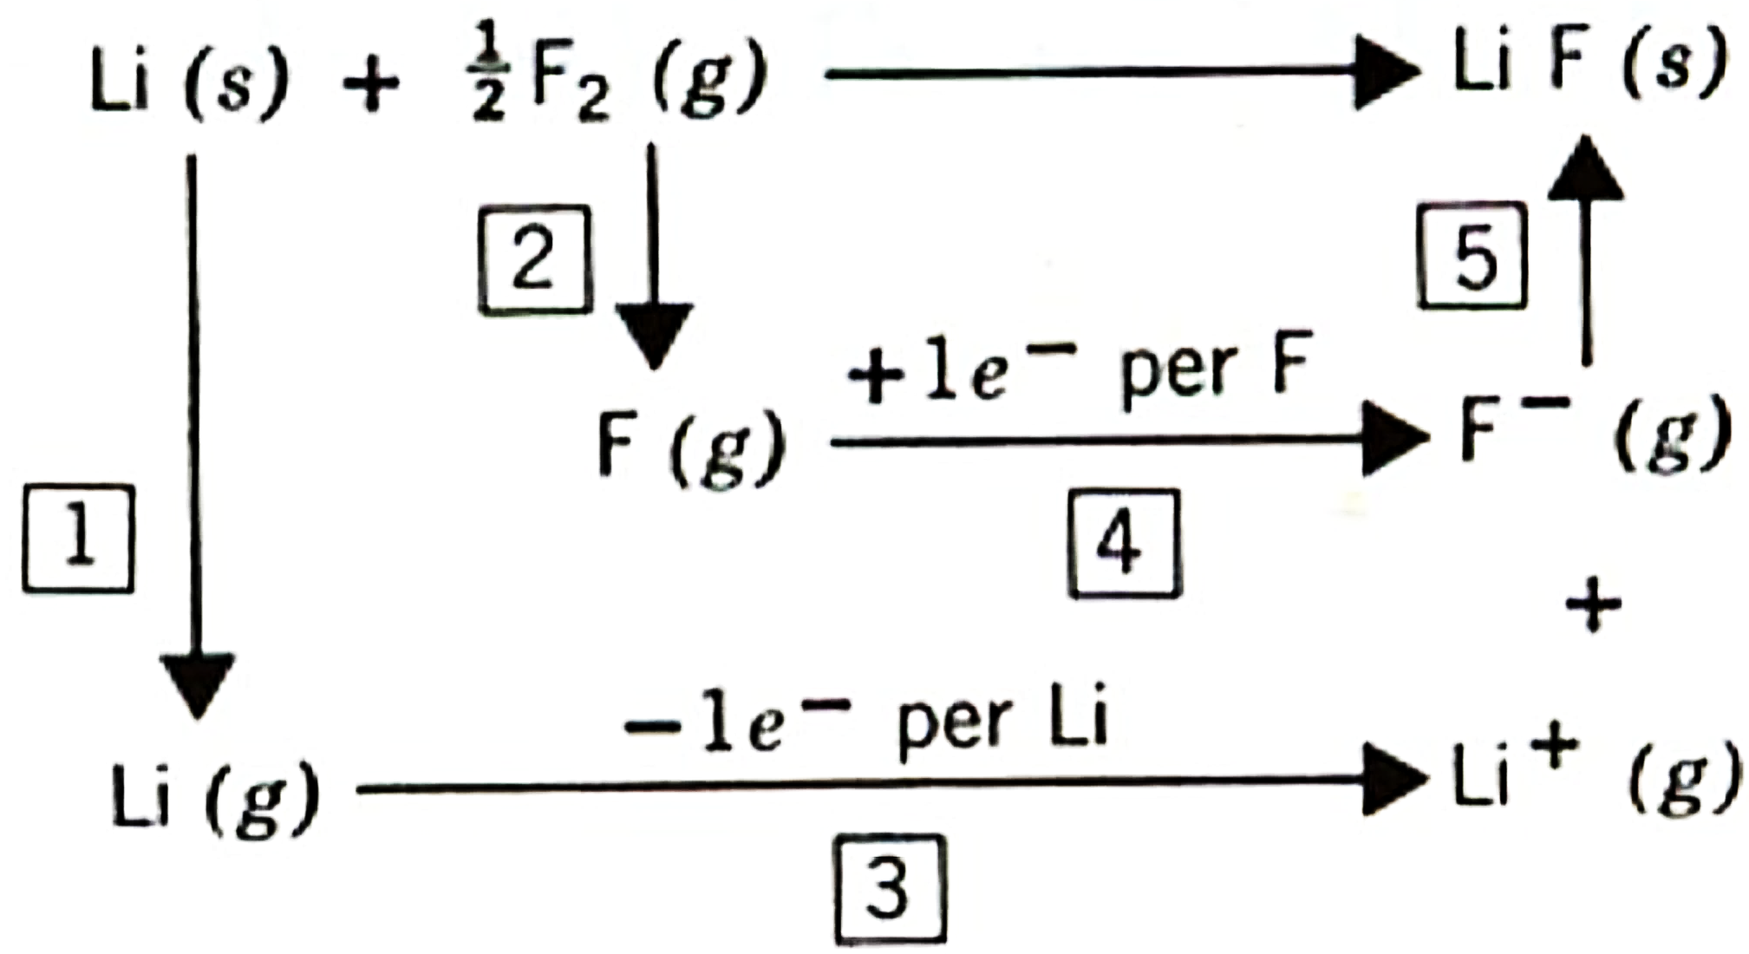
Often see diagrams similar to this
The overall enthalpy of formation can be + or –
depending on exact numbers for the rest of the steps!

Slide 32
ΔH_{f} for Sodium Chloride
Sodium needs to:
1. Sublimate (s → g)
2. Loose e- (Na → Na⁺)
Chlorine needs to:
1. Break apart (Cl₂ → Cl)
2. Gain e- (Cl → Cl⁻)
Ions need to:
1. Form Lattice (Na⁺ + Cl⁻ → NaCl)
Na(s) + ½ Cl₂(g) → NaCl(s)
Lattice Energy | -786 kJ/mol
Ionization Energy for Na | 495 kJ/mol
Electron Affinity for Cl | -349 kJ/mol
Bond energy of Cl₂ | 239 kJ/mol
Enthalpy of sublimation for Na | 109 kJ/mol
Na(s) → Na(g) + 109 kJ
Na(g) → Na⁺(g) + e⁻ + 495 kJ
½ Cl₂(g) → Cl(g) + ½(239 kJ)
Cl(g) + e⁻ → Cl⁻(g) - 349 kJ
Remember Hess’s Law!
Na⁺(g) + Cl⁻(g) → NaCl(s) -786 kJ
Na(s) + ½ Cl₂(g) → NaCl(s) -412 kJ/mol

Slide 33
YouTube Link to Presentation: https://youtu.be/bJm5LGLngfo

