Slide 1
N21 – Bonding
Formal Charge and VSEPR
Link to YouTube Presentation: https://youtu.be/KvJ2DPLVjfI

Slide 2
N21 – Bonding
Formal Charge and VSEPR
Target: I can draw more accurate and preferred Lewis Structures by considering Resonance Structures, Formal Charge, and VSEPR Theory

Slide 3
Resonance
When more than one valid Lewis structure can be written for a molecule.
Example: Benzene, C₆H₆
You would expect the single bonds to be longer than the double bonds.
BUT when measured the bond lengths in the ring are identical! The lengths of all the bonds are between a single and double bonds.
The actual structure is an average of the resonance structures.

Slide 4
Localized Electron Model
Lewis structures are an application of the “Localized Electron Model”
Electron pairs can be thought of as “belonging” to pairs of atoms when bonding using atomic orbitals. Lone pairs belong to only one atom.
Resonance points out a weakness in LEM! Other “better” models exist.
What about Delocalized electrons? Doesn’t work with LEM but we know it happens!

Slide 5
Resonance Bond Length and Energy
Resonance bonds are shorter and stronger than single bonds.
Resonance bonds are longer and weaker than double bonds.

Slide 6
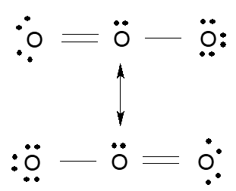
Resonance in Ozone, O₃
Neither structure is correct!
Oxygen bond lengths are identical, and intermediate to single and double bonds.
We know this from experimental data!

Slide 7
Resonance in Polyatomic Ions
Resonance in a carbonate ion:
Resonance in an acetate ion:
Use square brackets and double headed arrows between resonance structures!

Slide 8
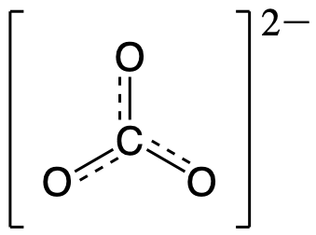
Resonance in Polyatomic Ions
Resonance in a carbonate ion:
Sometimes see it drawn with a dashed line to represent a combo of all the resonance structures.
*CAREFUL!* DO NOT DO THIS IF THEY ASK YOU TO DRAW THE RESONANCE STRUCTURES! NO POINTS FOR ONE STRUCTURE WITH DOTTED LINES!

Slide 9
Formal Charge
Some resonance structures are “better,” more stable, more common than others.
Formal Charge helps us figure out which is best
“The charge assigned to an atom in a molecule, assuming that the electrons in all chemical bonds are shared equally between atoms, regardless of relative electronegativities.”
Basically –
what charge would the atoms have if you divvied up the electrons equally and they were all separate atoms again.

Slide 10
How to Calculate Formal Charge
Formal Charge = Should - Has
( )
# lone pair e⁻’s on the atom
½ the # of bonded e-
# of Valence e-
-
+
From the periodic table!
Half because they are sharing with the other atom

Slide 11
How to Calculate Formal Charge
Formal Charge = Should - Has
( )
# lone pair e⁻’s on the atom
½ the # of bonded e-
# of Valence e-
-
+
Half because they are sharing with the other atom

Slide 12
Formal Charge
Which structure is preferred?
Minimizing the “formal charge” on the atoms,
AND
Having negative Formal Charge on the more electronegative elements

Slide 13
How to Calculate Formal Charge
Some guidelines:
Atoms would like a FC as close to 0 as possible.
Any negative FC should be on the most electronegative atoms.
AND
The sum of all FC must equal the overall charge on the ion or molecule.
- this is the one people forget about!

Slide 14
Ex: Sulfate Ion
FC =
# lone pair e⁻’s on the atom
½ the # of bonded e-
-
-
# of Valence e-
Each Oxygen: (6) – (6) – ½ (2) = -1
Sulfur:
(6) – (0) – ½ (8) = +2
Sum
4 (-1) + (+2) = -2 Good, that matches the charge on the sulfate ion!
Single Bonded Oxygens (6) – (6) – ½ (2) = -1
Double Bonded Oxygen: (6) – (4) – ½ (4) = 0
Sulfur:
(6) – (0) – ½ (10) = +1
Sum
3 (-1) + (0) + (+1) = -2
Single Bonded Oxygen: (6) – (6) – ½ (2) = -1
Double Bonded Oxygens: (6) – (4) – ½ (4) = 0
Sulfur:
(6) – (0) – ½ (12) = 0
Sum
2 (-1) + (0) + (0) = -2

Slide 15
Ex: Nitrogen Dioxide Use formal charges to decide which is the best resonance structure
-1
+1
0
-1
0
+1
0
0
0

Slide 16
Rest of this PowerPoint is review of VSEPR and Lewis Structures.
If you need a refresher then keep going, or even go watch the Honors Chem lecture videos on these topics!

Slide 17
VSEPR Model
Valence Shell Electron Pair Repulsion
The structure around a given atom is mostly determined by minimizing electron pair repulsions.
Repulsions minimized by being as far apart from each other as possible. In other words – largest bond angles possible
YOU CAN’T JUST LOOK AT ANGLES BETWEEN THE ATOMS! YOU HAVE TO INCLUDE THE LONE PAIRS TOO! THEY WANT A LOT OF “ELBOW ROOM”

Slide 18
Predicting a VSEPR Structure
Draw Lewis structure.
Put pairs as far apart as possible.
Determine positions of atoms from the way electron pairs are shared
Determine the name of molecular structure from positions of the atoms using the AXE formula
In reality…memorize it all using AXE formulas to help in the memorization process.

Slide 19
VSEPR – AXE Method
The A represents the central atom.
The X represents how many sigma bonds are formed between the central atoms and outside atoms. Multiple covalent bonds (π, double or triple) count as one X. Basically, how many atoms are bonded to the central A atom.
The E represents the number of lone electron pairs present on the central atom.
The sum of X and E known as the steric number.

Slide 20
VSEPR
X + E | Overall Structure (Electronic Geometry) | Forms
2 | Linear | AX₂
3 | Trigonal Planar | AX₃, AX₂E
4 | Tetrahedral | AX₄, AX₃E, AX₂E₂
5 | Trigonal bipyramidal | AX₅, AX₄E, AX₃E₂, AX₂E₃
6 | Octahedral | AX₆, AX₅E, AX₄E₂
A = central atom
X = atoms bonded to A
E = nonbonding electron pairs on A

Slide 21
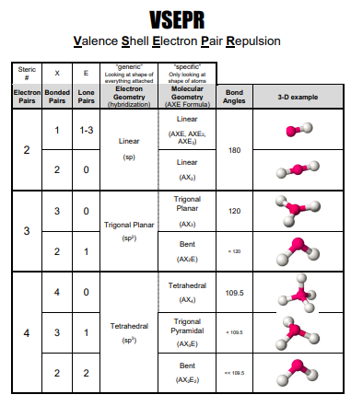
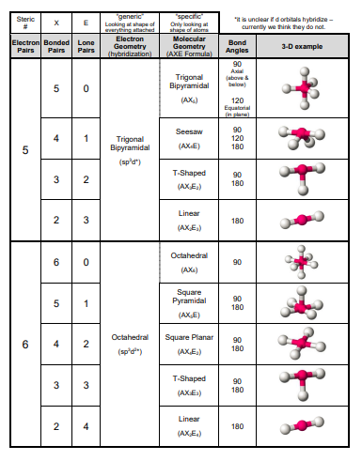
VSEPR

Slide 22
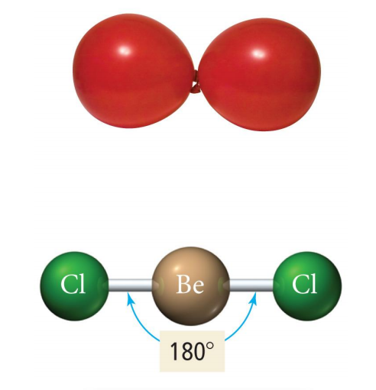
AX₂: Linear (180°)

Slide 23
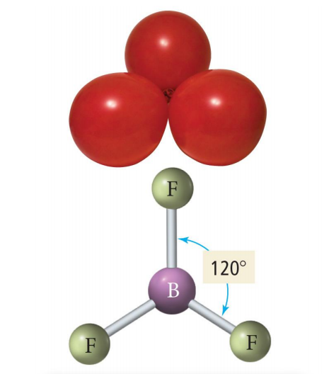
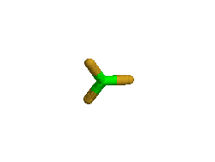
AX₃, AX₂E: Trigonal Planer (120°)
AX₃
BF₃
AX₂E
(Bent)
SnCl₂
RED = Molecular Geo.

Slide 24
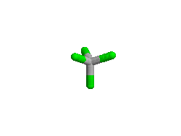
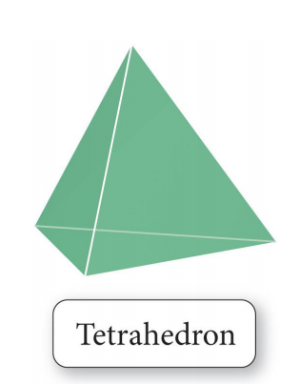
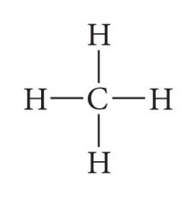
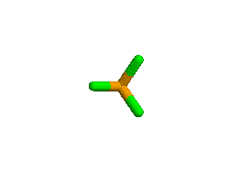
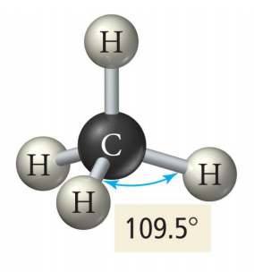
AX₄, AX₃E, AX₂E₂: Tetrahedral (109.5°)
AX₄
CCl₄
PCl₃
AX₃E (107.5°)
(Trigonal Pyramidal)
AX₂E₂ (104.5°)
(Bent)
Cl₂O

Slide 25
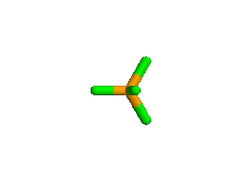
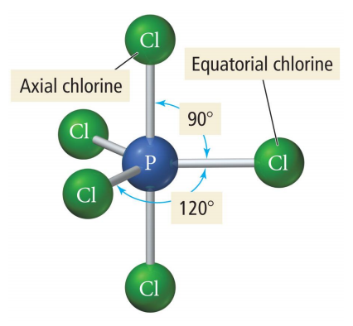
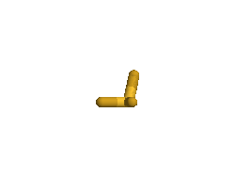
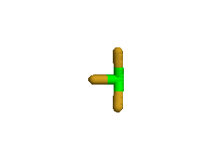
AX₅, AX₄E, AX₃E₂, AX₂E₃ : Trigonal Bipyramidal (120°, 90 °)
AX₅
PCl₅
AX₄E (See saw)
(180°, 120°)
SF₄
AX₃E₂ (T-shape)
(90°, 180°)
ClF₃
AX₂E₃ (Linear)
I₃⁻

Slide 26
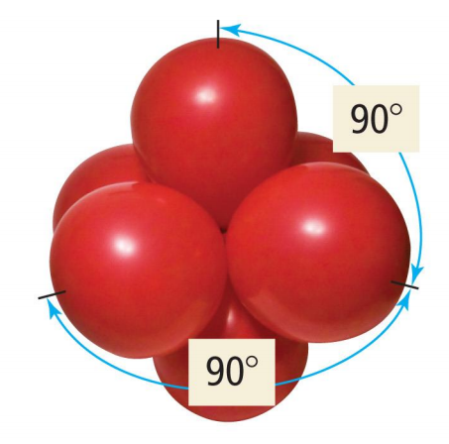
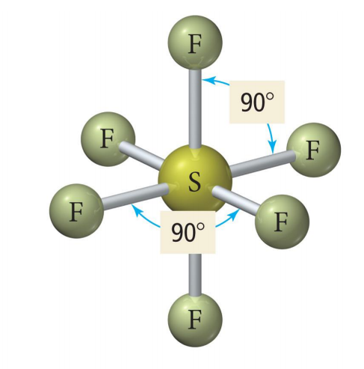
AX₆, AX₅E, AX₄E₂: Octahedral (90°)
AX₆
SF₆
AX₅E (< 90°)
(Square pyramidal)
BrF₅
AX₄E₂ (90°)
(Square Planar)
ICl₄-

Slide 27
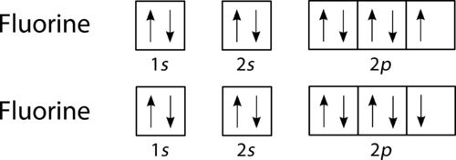
REMINDER: The Octet Rule
Combinations of elements tend to form so that each atom, by gaining, losing, or sharing electrons, has an octet of electrons in its highest occupied energy level.
Diatomic Fluorine

Slide 28
Comments About the Octet Rule
2nd period elements C, N, O, F observe the octet rule And the H O N C rule as well.
1 2 3 4 # of bonds each likes to make

Slide 29
Comments About the Octet Rule
2nd period elements B and Be often have fewer than 8 electrons around themselves - they are very reactive. They have “deficient octets.”

Slide 30
Comments About the Octet Rule
3rd period elements and beyond CAN exceed the octet rule to have expanded octets because those elements have access to…d orbitals! They can have “expanded octets”

Slide 31
Comments About the Octet Rule
Don’t forget just because an element CAN have an expanded octet (like S) doesn’t mean it HAS to. Also, don’t forget things like B and Be are fine with a deficient octet – they are fine with fewer electrons.

Slide 32
Comments About the Octet Rule
When writing Lewis Structures you should technically take into account Formal Charges, but typically a valid structure that follows the octet rule will be accepted unless it says something to allude to needing to take FC into account.

Slide 33
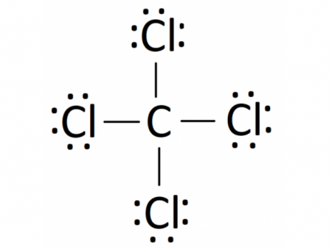
Lewis Structures
Shows how valence electrons are arranged among atoms in a molecule.
Reflects central idea that stability of a compound relates to noble gas electron configuration.
Do NOT just randomly throw dots all over your paper! Follow the steps and be thoughtful!

Slide 34
“Rules” for Drawing Lewis Structures
Count and sum valence electrons.
Place your atoms.
Bond all atoms w/ a single bond (try simplest way 1st).
Give all atoms a full shell.
Re-count the electrons you used.
Fix if needed
Used too few? Put extras on the central atom.
Used too many? Try double or triple bonds to fix.

Slide 35
Placement Suggestions

Slide 36
Placement Suggestions
4) Think about Formal Charges - Want lowest formal charges
- If drawing an ion, sum of formal charges should match the charge on the ions
- Negative FC on more electronegative elements

Slide 37
Multiple Covalent Bonds: Double bonds
Ethene
Two pairs of shared electrons
FOUR electrons being shared

Slide 38
Multiple Covalent Bonds: Triple bonds
Ethyne
Three pairs of shared electrons
SIX electrons being shared

Slide 39
YouTube Link to Presentation: https://youtu.be/KvJ2DPLVjfI

