Slide 1
N22 – Bonding
VSEPR Shapes, Effects of Lone Pairs, Polarity
Link to YouTube Presentation: https://youtu.be/xlo2xTQmrKQ

Slide 2
N22 – Bonding
Some reminders about: VSEPR Shapes, Effects of Lone Pairs, Polarity
Target: I can describe the importance of the VSEPR shape and presence of lone pairs on the polarity and behavior of molecules.

Slide 3
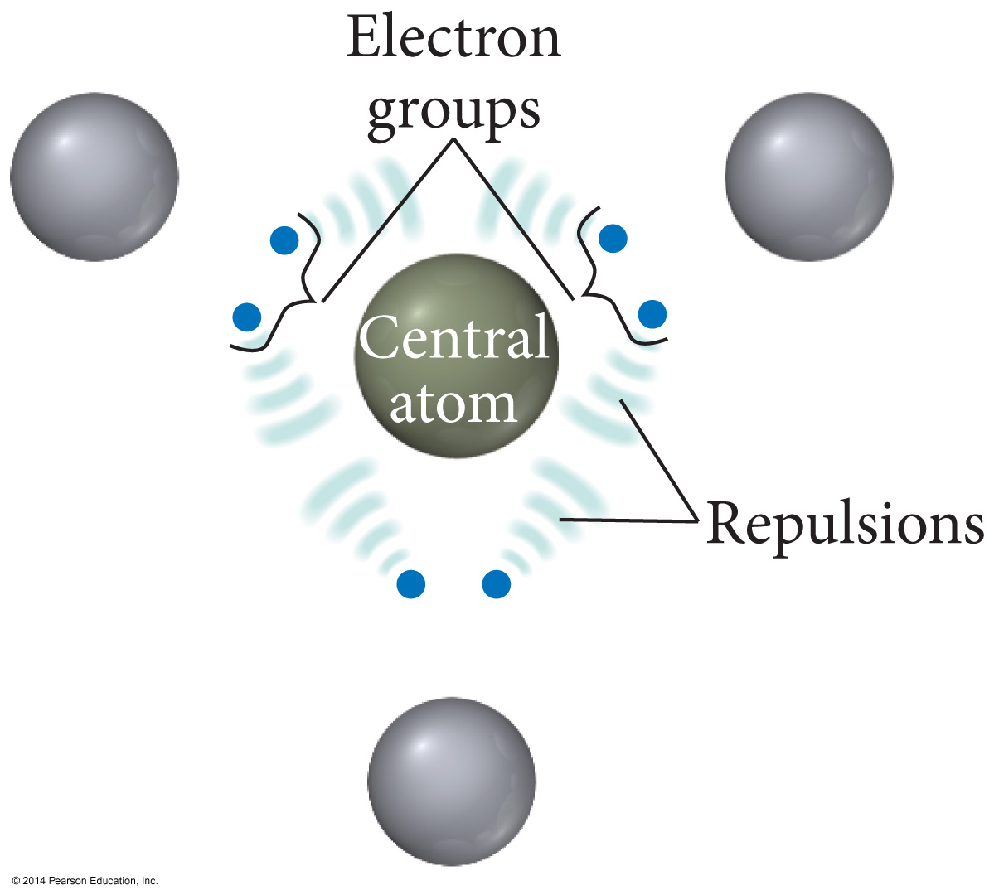
Electron Repulsions
Electron Repulsions help determine the shapes and bond angles in molecules.
Molecules take the shapes they do to minimize the repulsive forces!

Slide 4
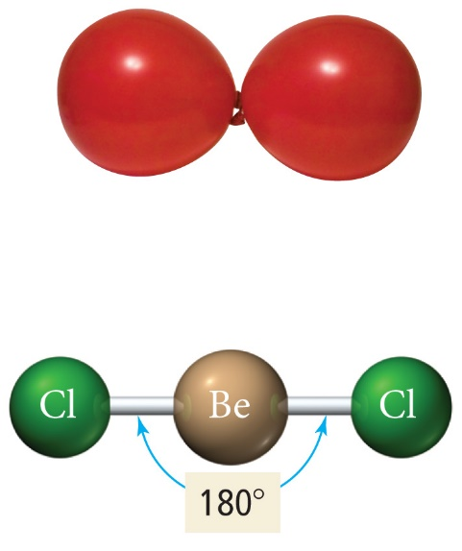
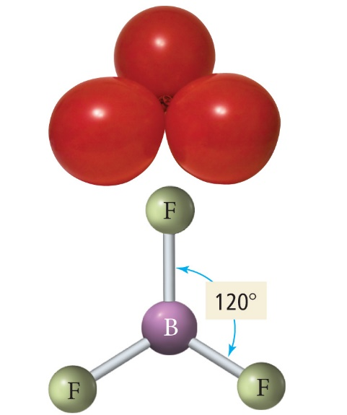
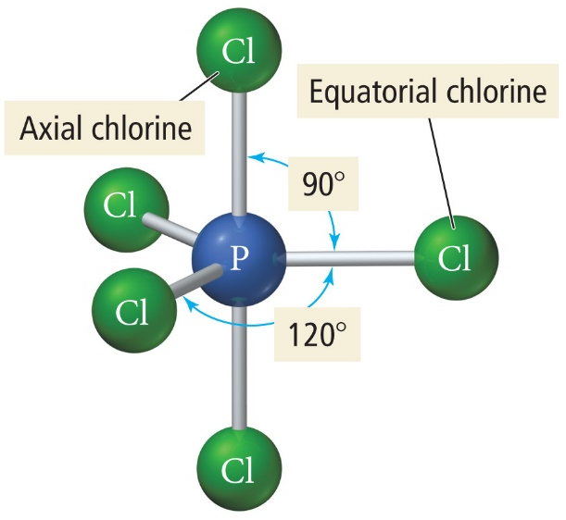
MEMORIZE YOUR VSEPR!!!

Slide 5
The Effect of Lone Pairs
Lone pair = “occupy more space”
Pushes the atoms out of the way
This affects the bond angles, making the bonding pair angles smaller than expected.
Relative sizes of repulsive force interactions:
Lowest: Bonding Pair – Bonding Pair
Medium: Lone Pair – Bonding Pair
Highest: Lone Pair – Lone Pair

Slide 6
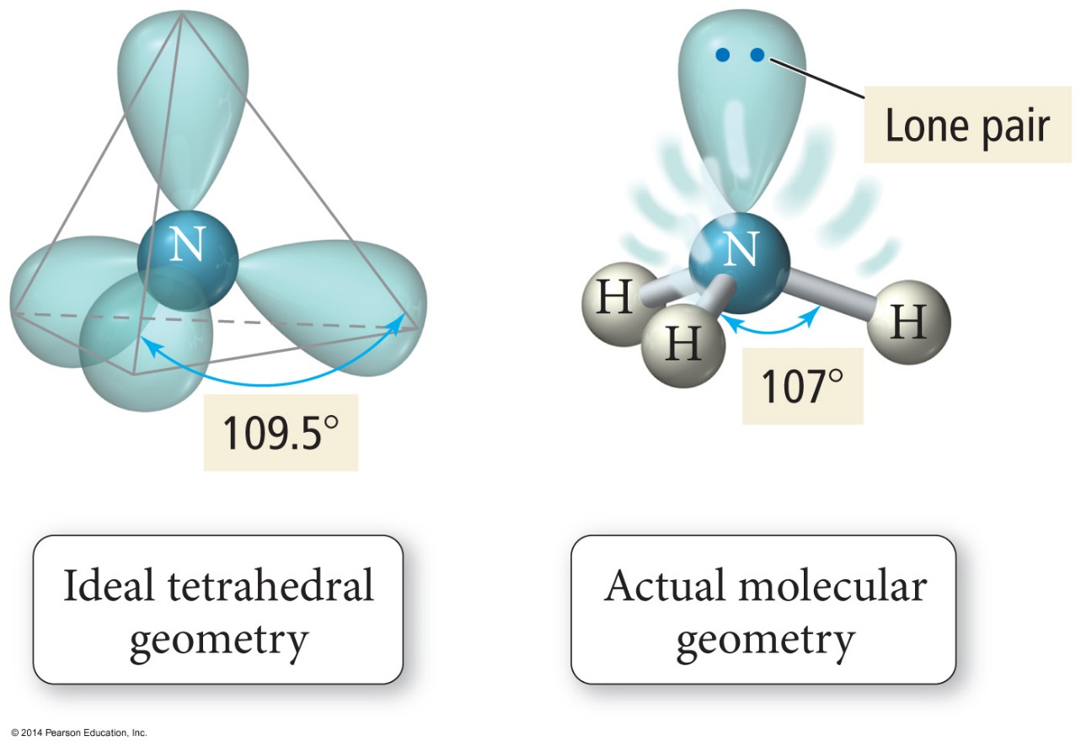
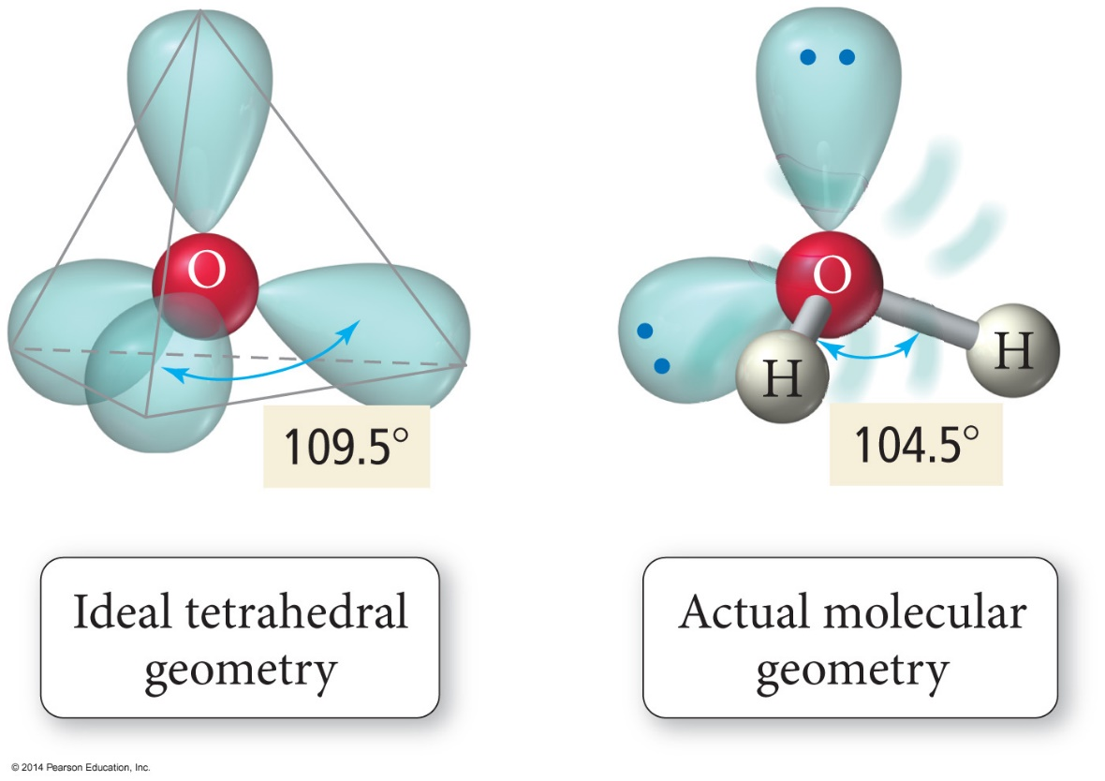
Bond Angle Distortion from Lone Pairs
< 109.5
<< 109.5

Slide 7
Polarity of Molecules
Sharing of electrons is a spectrum!

Slide 8
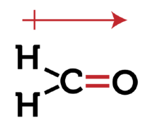
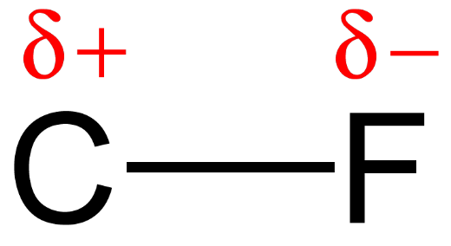
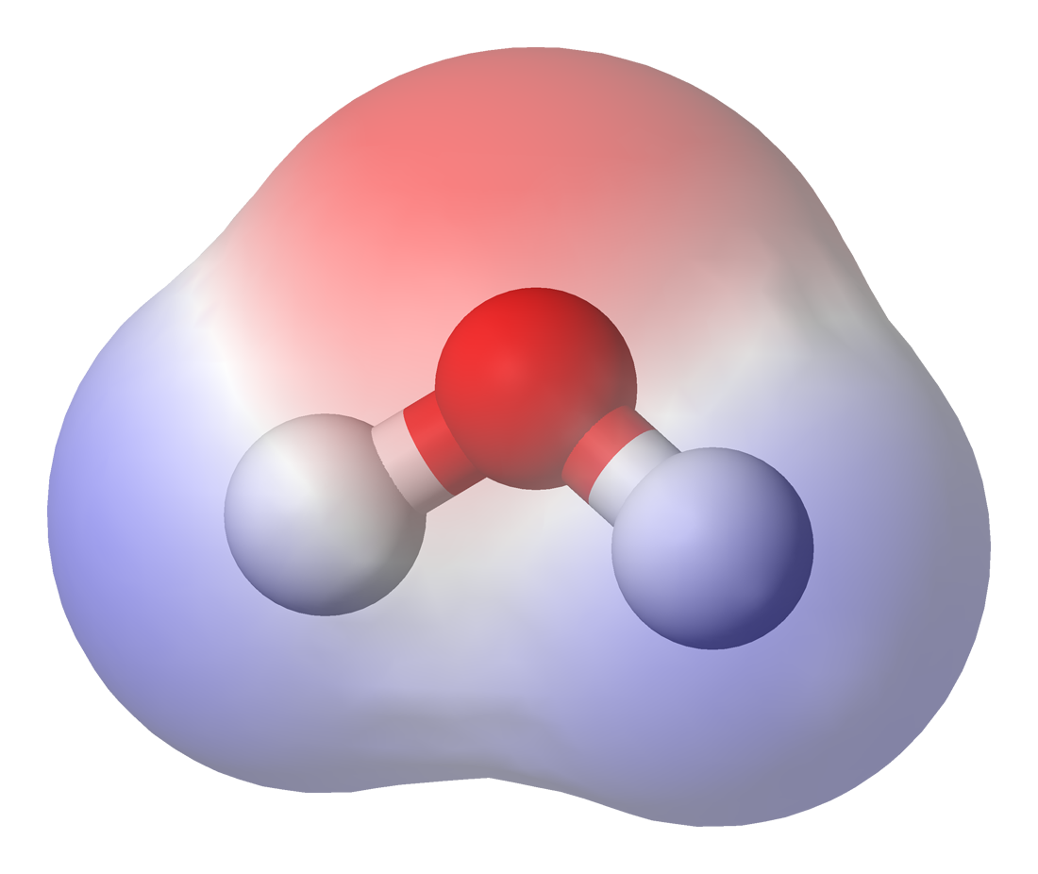
Three ways to diagram “dipoles”

Slide 9
Molecules become POLAR when electrons are not shared equally
Example: HF
HF is covalent but electrons are not shared equally
“partial positive”
“partial negative”
DO NOT REFRENCE POLAR BEARS AND PENGUINS IN YOUR FRQ ANSWERS!

Slide 10
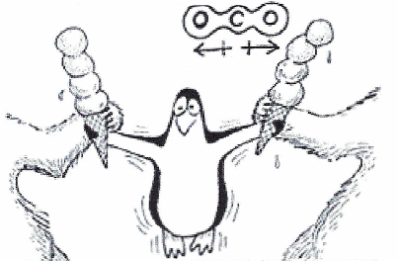
Symmetry…the pole destroyer!
CO₂
Has 1 carbon surrounded by 2 electronegative Oxygens, but is NOT polar?!?!
Electron density is still SYMETRICAL which makes it a non-polar molecule
THE SYMMETRY CANCELS OUT THE BOND DIPOLES SO THERE IS NO NET DIPOLE

Slide 11
Polarity of Molecules
For a molecule to be polar it must
Have polar bonds.
Electronegativity difference – theory
Bond dipole moments – measured
Have an asymmetrical shape.
“Vector addition” – if the polar bonds are equal but opposite direction they cancel out. SO THERE IS NO NET DIPOLE
MENTION BOTH!!!!!!!

Slide 12
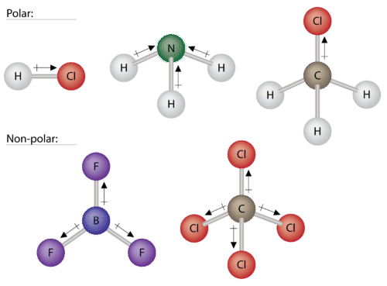
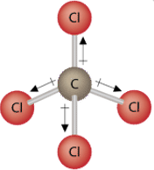
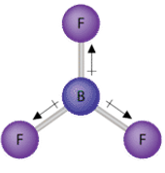
Careful about polar BOND versus polar MOLECULE
Polar bond AND Polar molecule
You need to talk about how the BOND dipoles do, or do not, cancel out due to the 3D VSEPR geometry of the molecule.
Is there a NET dipole or not????
Polar bond and NON-polar molecule

Slide 13
Careful about polar BOND versus polar MOLECULE
Polar bond AND Polar molecule
Polar bond AND Polar molecule
Polar bond and NON-polar molecule
Polar bond and NON-polar molecule

Slide 14
Polarity of Molecules
Polarity affects the intermolecular forces of attraction.
Therefore, boiling points and solubility
“Like dissolves like”
“Things with similar polarity and IMFs are miscible.”
Non-bonding pairs affect molecular polarity, strong pull in its direction.

Slide 15
YouTube Link to Presentation:
https://youtu.be/xlo2xTQmrKQ

