Slide 1
N23 – Bonding
Hybridization
Link to YouTube Presentation: https://youtu.be/9p9wnazGp9I

Slide 2
N23 – Bonding
Hybridization
Target: I can describe what hybridization is, and how it helps to account for experimentally determined bond angles and lengths.

Slide 3
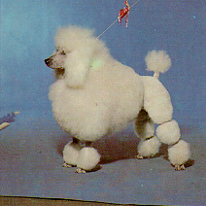
Hybridization- the blending of orbitals
Poodle
+
Labrador
=
Labradoodle
Hybridization is the combining of two or more orbitals of nearby equal energy within the same atom into orbitals of equal energy.

Slide 4
Hybridization- the blending of orbitals
Poodle
+
Labrador
=
Labradoodle
Labradoodle
Hybridization is the combining of two or more orbitals of nearby equal energy within the same atom into orbitals of equal energy.

Slide 5
Hybridization- the blending of orbitals
Poodle
+
Labrador
Labradoodle
Labradoodle
Hybridization is the combining of two or more orbitals of nearby equal energy within the same atom into orbitals of equal energy.

Slide 6
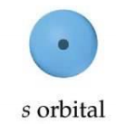
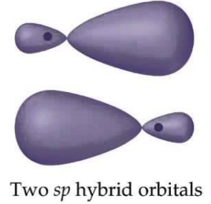
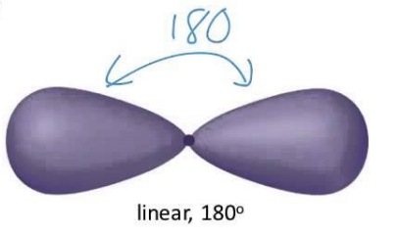
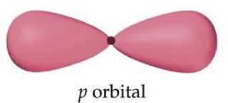
sp Hybridization
An s orbital and a p orbital turn into two new orbitals with slightly different shapes, the new orbitals have combined s and p character.
Overlap to look like this
Hybridize
This is TWO “sp” orbitals! NOT a p orbital.

Slide 7
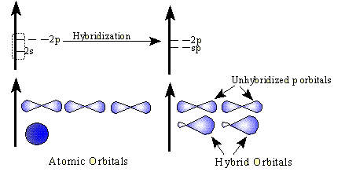
sp Hybrid Orbitals
There are other types of hybrid orbitals. Depends on which ones are combining!
Before
After
sp hybrid means an s and p combine. You have 2 leftover p orbitals

Slide 8
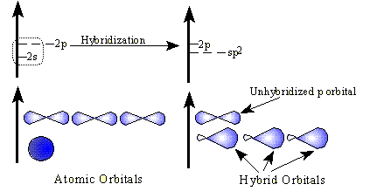
sp² Hybrid Orbitals
There are other types of hybrid orbitals. Depends on which ones are combining!
Before
After
sp² hybrid means an s and 2 p orbitals combine. You have 1 leftover p orbital

Slide 9
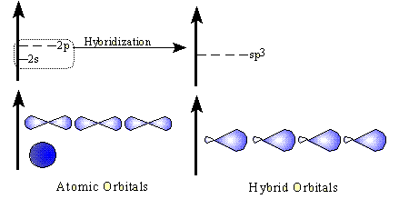
sp³ Hybrid Orbitals
You start with FOUR orbitals and end with FOUR DIFFERENT orbitals
Before
After

Slide 10
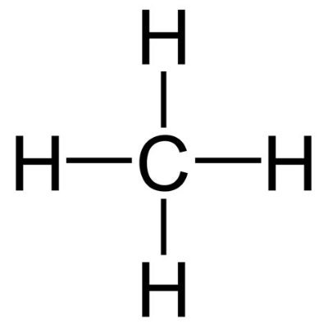
What Proof Exists for Hybridization?
Let’s think about how covalent bonds share electrons, and about the electron configurations of the atoms involved.
Lets look at a molecule of methane, CH₄.
Methane is a simple natural gas. Its molecule has a
carbon atom at the center with four hydrogen atoms covalently bonded around it.

Slide 11
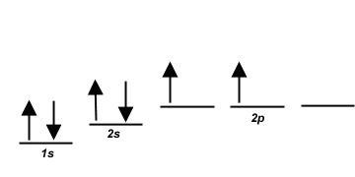
Carbon ground state configuration
What is the expected orbital diagram notation of carbon in its ground state?
Can you see a problem with this?
Hint: How many unpaired electrons does this
carbon atom have available for bonding?

Slide 12
Carbon’s bonding problem
Notice that carbon only has TWO electrons available for bonding. That is not enough!
How does carbon overcome this problem so that it may form four bonds????

Slide 13
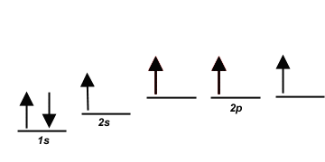
Carbon ground state configuration
The first thought that chemists had was that carbon promotes one of its 2s electrons…
…to the empty 2p orbital.

Slide 14
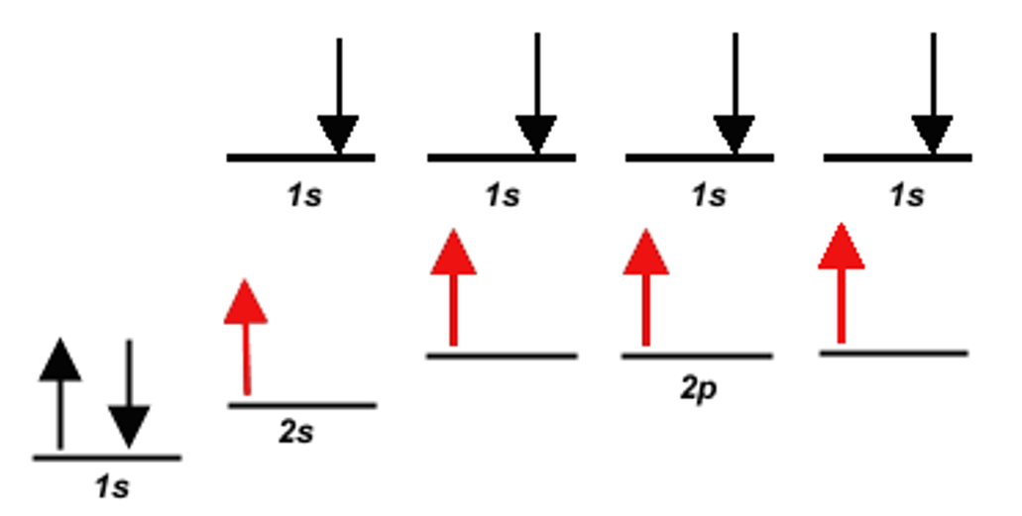
But…
They quickly recognized a problem with such
an arrangement…
This would result in 3 of the carbon-hydrogen bonds involving an electron pair made up of carbon 2p electron combined with a hydrogen 1s electron.
BUT 1 of the carbon-hydrogen bonds would be a carbon 2s electron combined with a hydrogen 1s electron…

Slide 15
This would mean…
This would mean that three of the bonds in a methane
molecule would be identical, because they would involve
electron pairs of equal energy.
But what about the fourth bond…?

Slide 16
This would mean…
That one of the bonds, the carbon 2s and hydrogen 1s bond would have slightly less energy and different bond length than the other three bonds.
BUT WE DON’T SEE THAT!

Slide 17
All the bonds are equal!
Measurements show that all four bonds in methane are equal. So the “promotion” idea doesn’t work.
We need a new theory!
Chemists have proposed an explanation – they call it
Hybridization.
Hybridization is the combining of two or more orbitals of nearly equal energy within the same atom into orbitals of equal energy.

Slide 18
Hybrid Orbitals
In the case of methane, they call the hybridization
sp³, meaning that an s orbital is combined with three
p orbitals to create four equal hybrid orbitals.
These new orbitals have slightly MORE energy than
the 2s orbital…
… and slightly LESS energy than the 2p orbitals.

Slide 19
Hybridization and Molecular Geometry
Forms | Overall Structure (electronic geometry) | Hybridization of “A”
AX₂ | Linear | sp
AX₃, AX₂E | Trigonal Planar | sp²
AX₄, AX₃E, AX₂E₂ | Tetrahedral | sp³
AX₅, AX₄E, AX₃E₂, AX₂E₃ | Trigonal bipyramidal | ??
AX₆, AX₅E, AX₄E₂ | Octahedral | ??
A = central atom
X = atoms bonded to A
E = nonbonding electron pairs on A

Slide 20
Do d-orbitals Hybridize?
They used to think so, but don’t think so anymore.
Your chart has d-hybridization listed. AP will avoid asking any questions that would involve it just to be safe. In class we might ask.
So what theory do they think happens instead????
“Molecular Orbital Theory”
Its complicated. And hard. College level stuff. We barely dip our toe into it.

Slide 21
YouTube Link to Presentation
https://youtu.be/9p9wnazGp9I
YouTube Link to someone else’s presentation – they have some nice computer graphics that I don’t have the ability to make ☺ .
https://youtu.be/vHXViZTxLXo

