Slide 1
N24 – Bonding
Sigma and Pi Bonds

Slide 2
N24 – Bonding
Sigma and Pi Bonds
Target: I can describe and count sigma and pi bonds in a molecule, and how it explains resonance and bond strengths.

Slide 3
Types of Bonds
When we say “types of bonds” people often assume we mean ionic, covalent or metallic. Or they think we mean single, double, triple. Or polar, non-polar.
BUT we can also be talking about how the bonds are formed in 3-dimensional space, describing how the orbitals overlap to form the bond.

Slide 4
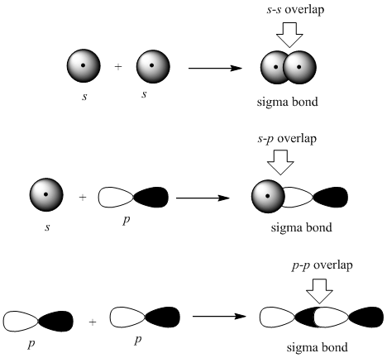
Sigma Bond
A sigma (s or σ) bond forms when the atomic orbitals of two atoms line up along the axis directly between the nuclei.
Either standard atomic orbitals or hybrids
s-s, p-p, hybrid-hybrid, s-hybrid, etc.

Slide 5
Pi Bond
A pi (p or π) bond forms when the atomic orbitals of two atoms line up above and below the plane where the nuclei are.
The unhybridized p orbitals from the two atoms that are parallel to each other.

Slide 6
Strength of Bonds
σ bonds are stronger than π bonds.
Sigma orbitals directly overlap between the nuclei
Pi bonds are reaching up and over, they are further apart and less overlap than sigma bonds
That makes them weaker.
But if pi bonds aren’t as strong, why is a double/triple bond stronger than a single bond?
Because there are MORE bonds present, a sigma plus a pi is still stronger than just a sigma!

Slide 7
When Do You Have Each Kind?
Single Bond 1 sigma bond
Double Bond 1 sigma bond
1 pi bond
Triple Bond 1 sigma bond
2 pi bonds

Slide 8
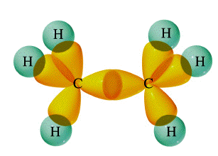
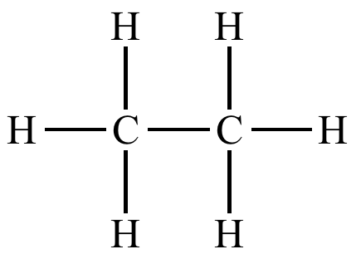
Example: Ethane
7 single bonds
7 σ bonds

Slide 9
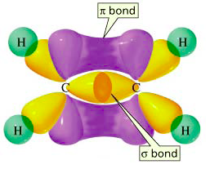
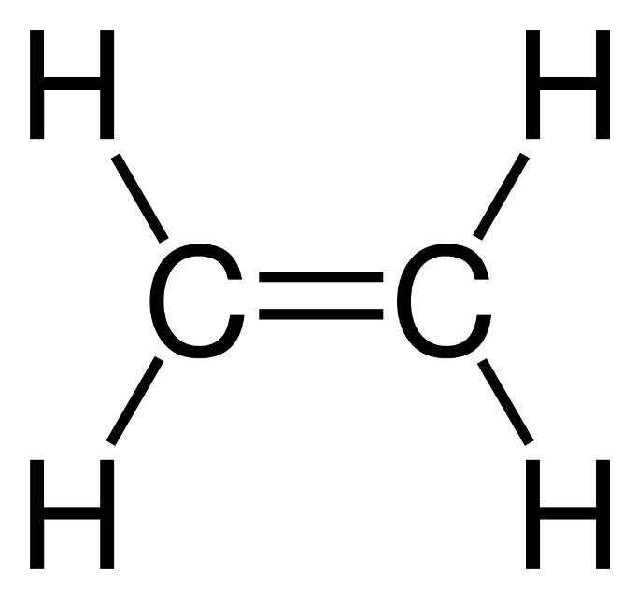
Example: Ethene
4 single bonds
4 σ bonds
1 double bond
1 σ bond
1 π bond
+
=
5 σ bonds
1 π bond

Slide 10
Example: Ethene
4 single bonds
4 σ bonds
1 double bond
1 σ bond
1 π bond
+
=
5 σ bonds
1 π bond
1 π bond
*** The pi bond is on top and bottom – that is ONE pi bond not two.
1 σ bond

Slide 11
Example: Ethyne
2 single bonds
2 σ bonds
1 triple bond
1 σ bond
2 π bonds
+
=
3 σ bonds
2 π bonds

Slide 12
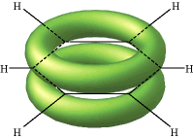
The De-Localized Electron Model
Pi bonds (π) contribute to the delocalized model of electrons in bonding, and help explain resonance
Electron density from π bonds can be distributed symmetrically all around the ring, above and below the plane.

Slide 13
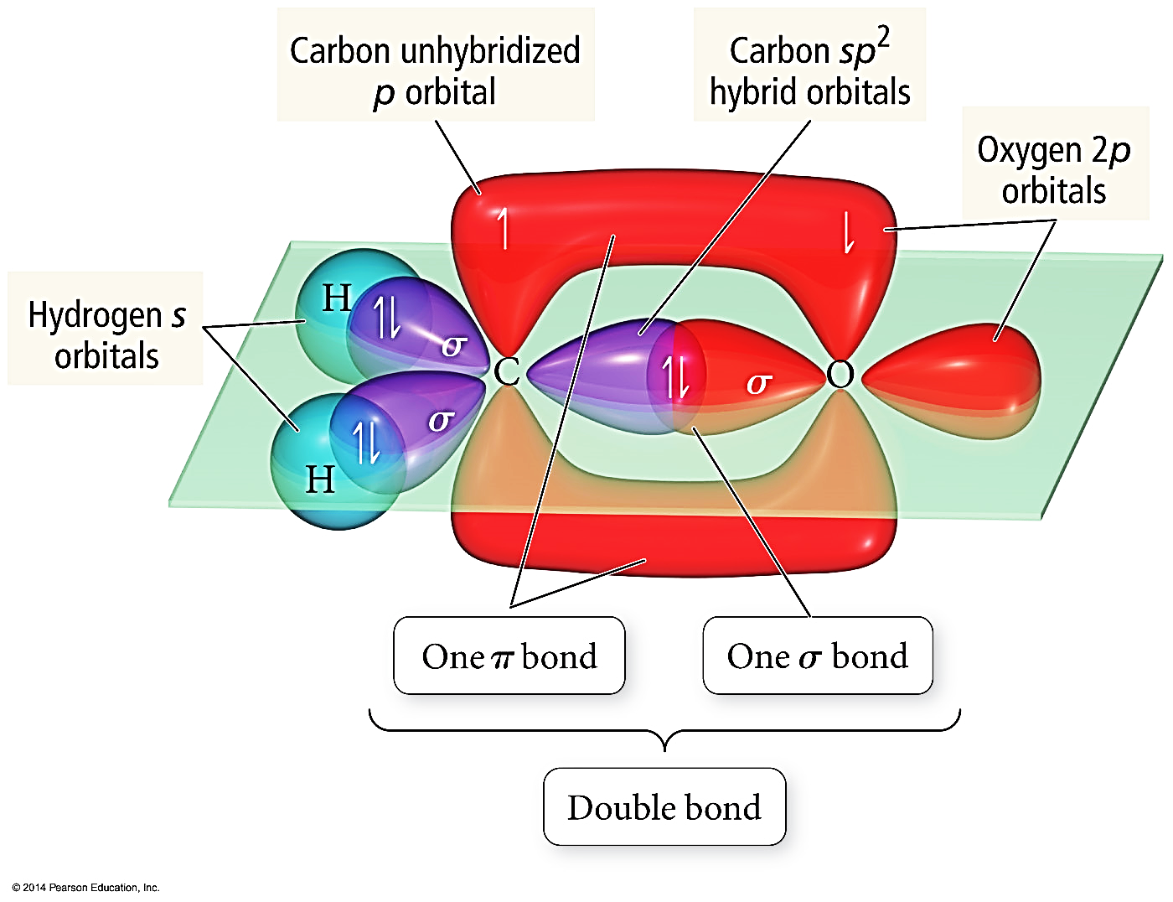
Looking at which orbitals are overlapping
σ Bond - Overlap between a hybrid orbital on one atom and either a hybrid or nonhybridized orbital on another atom
π Bond – Overlap between unhybridized p orbitals on bonded atoms

Slide 14
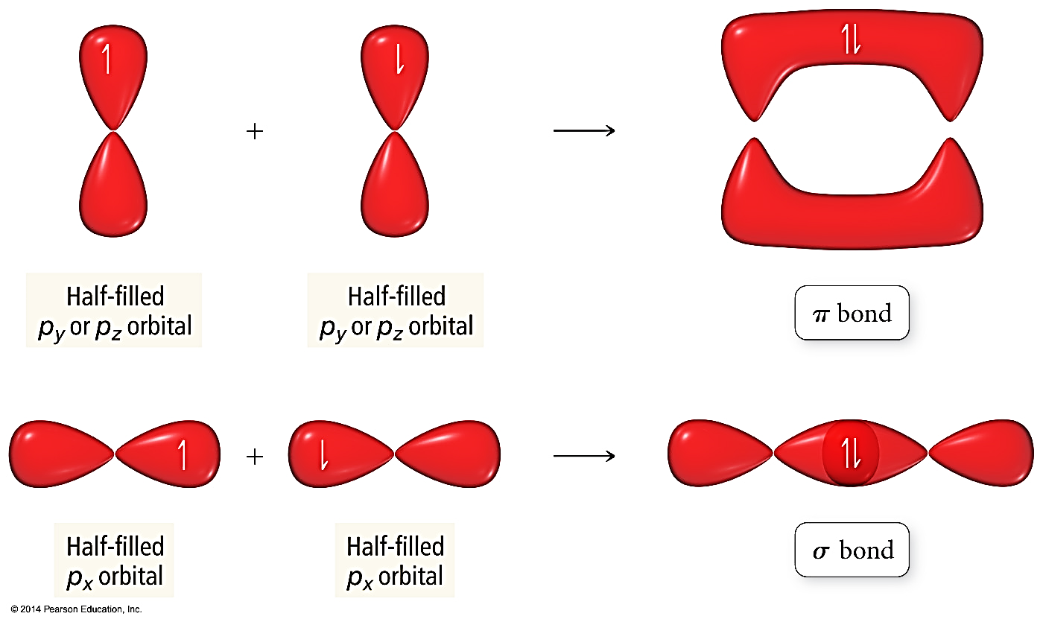
Looking at which orbitals are overlapping

Slide 15
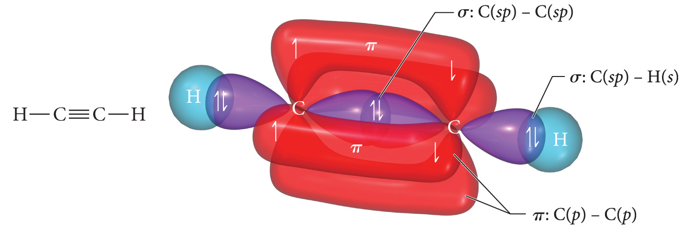
Looking at which orbitals are overlapping

Slide 16
Looking at which orbitals are overlapping

Slide 17
YouTube Link to Presentation: https://youtu.be/iGzTW2S7Qf8

