Slide 1
N24b – Bonding
Metallic Bonding & Alloys
YouTube Link to Presentation: No video as of now. So sorry!

Slide 2
N24b – Bonding
Metallic Bonding & Alloys
Target: I can describe the delocalization of electrons in metallic bonds, and can describe two types of alloys.

Slide 3
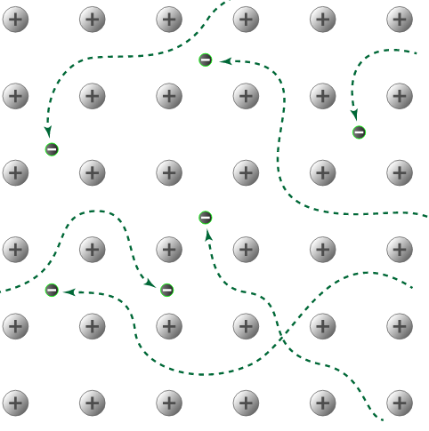
“Sea of Electrons”
In a metallic bond the valence electrons are delocalized, they move freely around the positive metal ions

Slide 4
Types of Alloys
Based on how similar the size of the metals are.

Slide 5
Types of Alloys
If both metals are similar sizes the “impurity” will replace/displace/substitute some of the other metal atoms.

Slide 6
Types of Alloys
If the atoms are significantly different sizes the smaller atom will occupy the “interstitial spaces” between the other atoms.

Slide 7
Types of Alloys
Professor Dave Explains – Alloys: Types and Examples
https://youtu.be/388TPL5M9us

Slide 8
YouTube Link to Presentation: No video as of now. So sorry!

