Slide 1
Gases
Density & More

Slide 2
Gas Density
… so at STP…

Slide 3
Density and the Ideal Gas Law
Combining the formula for density with the Ideal
Gas law, substituting and rearranging algebraically:
M = Molar Mass
P = Pressure
R = Gas Constant
T = Temperature in Kelvins

Slide 4
Kinetic Energy of Gas Particles
At the same conditions of temperature, all gases
have the same average kinetic energy.

Slide 5
The Meaning of Temperature
Kelvin temperature is an index of the random motions of gas particles (higher T means greater motion.)

Slide 6
Diffusion
Diffusion: describes the mixing of gases. The rate of diffusion is the rate of gas mixing.

Slide 7
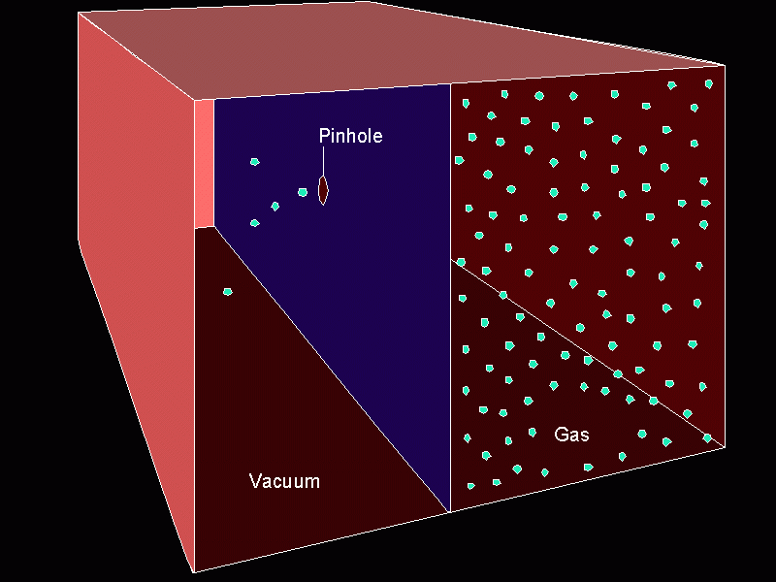
Effusion
Effusion: describes the passage of gas into an evacuated chamber.

Slide 8
Graham’s Law Rates of Effusion and Diffusion
Effusion:
Diffusion:

Slide 9
Practice
Under the same conditions of temperature and pressure, does hydrogen iodide or ammonia effuse faster? Calculate the relative rates at which they effuse.
$\frac{Rate of {NH}_{3}}{Rate of HI}=\frac{\sqrt{HI}}{\sqrt{{NH}_{3}}}=\frac{\sqrt{127}}{\sqrt{17}}=2.74$

Slide 10
Real Gases
Must correct ideal gas behavior when at high pressure (smaller volume) and low temperature (attractive forces become important).
corrected pressure
corrected volume
P_{ideal}
V_{ideal}
Attractive force = less collisions
Actual volume of particles

Slide 11
Root Mean Square Velocity
R = universal gas constant (the energy one)
T = Kelvin Temperature
M = molar mass in KILOGRAMS (b/c of the Joule in “R”)

Slide 12
Gas Stoichiometry #1
If reactants and products are at the same conditions of temperature and pressure, then mole ratios of gases are also volume ratios.
3 H₂(g) + N₂(g) → 2NH₃(g)
3 moles H₂ + 1 mole N₂ → 2 moles NH₃
3 liters H₂ + 1 liter N₂ → 2 liters NH₃

Slide 13
Gas Stoichiometry #2
How many liters of ammonia can be produced when 12 liters of hydrogen react with an excess of nitrogen?
3 H₂(g) + N₂(g) → 2NH₃(g)
12 L H₂
2
L NH₃
= L NH₃
8.0
3
L H₂

Slide 14
Gas Stoichiometry #3
How many liters of oxygen gas, at STP, can be collected from the complete decomposition of 50.0 grams of potassium chlorate?
2 KClO₃(s) → 2 KCl(s) + 3 O₂(g)
50.0 g KClO₃
1 mol KClO₃
3 mol O₂
22.4 L O₂
122.55 g KClO₃
2 mol KClO₃
1 mol O₂
= L O₂
13.7

Slide 15
Gas Stoichiometry #4
How many liters of oxygen gas, at 37.0°C and 0.930 atmospheres, can be collected from the complete decomposition of 50.0 grams of potassium chlorate?
2 KClO₃(s) → 2 KCl(s) + 3 O₂(g)
50.0 g KClO₃
1 mol KClO₃
3 mol O₂
= “n” mol O₂
122.55 g KClO₃
2 mol KClO₃
0.612
mol O₂
= 16.7 L

Slide 16
Overview: Kinetic Molecular Theory
Particles of matter are ALWAYS in motion
Volume of individual particles is ≈ zero.
Collisions of particles with container walls cause pressure exerted by gas.
Particles exert no forces on each other.
Average kinetic energy ∝ Kelvin temperature of a gas.

