Slide 1
Gases
Ideal Gas
And Laws

Slide 2
Ideal Gas Law
PV = nRT
P = pressure in atm
V = volume in liters
n = moles = m/M; m = mass, M = molar mass
R = proportionality constant
= 0.08206 L·atm/ mol·Κ
= 8.314 L·Kpa/ mol·Κ
= 62.4 L·mmHg/ mol·Κ
T = temperature in Kelvins
Holds closely at P < 1 atm

Slide 3
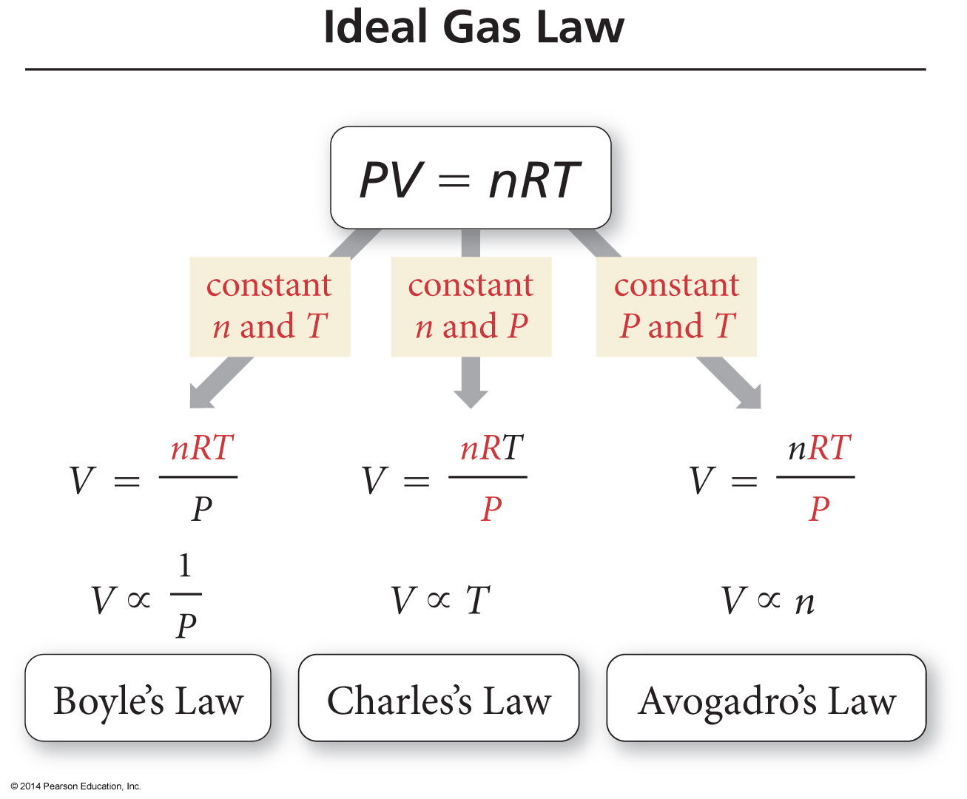
Ideal Gas Law

Slide 4
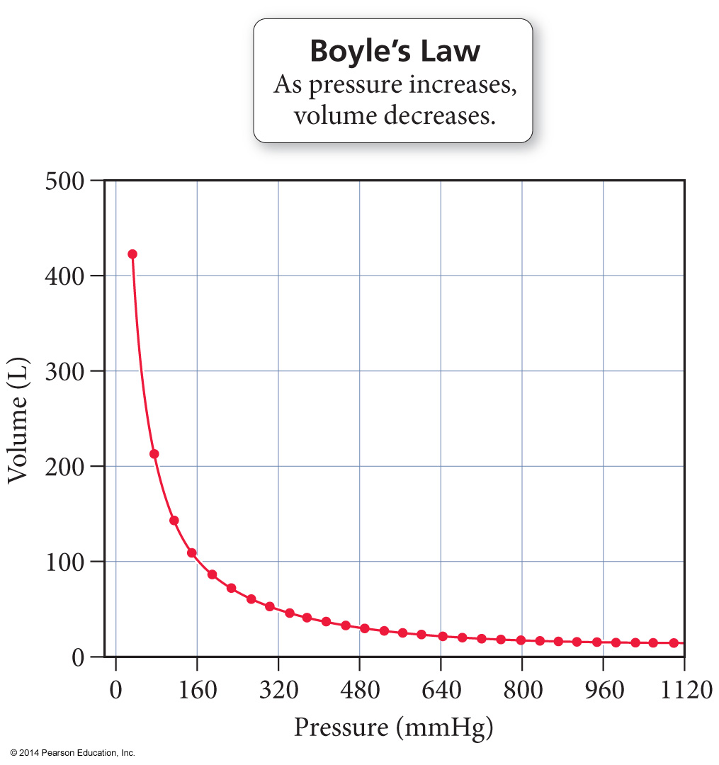
Boyle’s Law

Slide 5
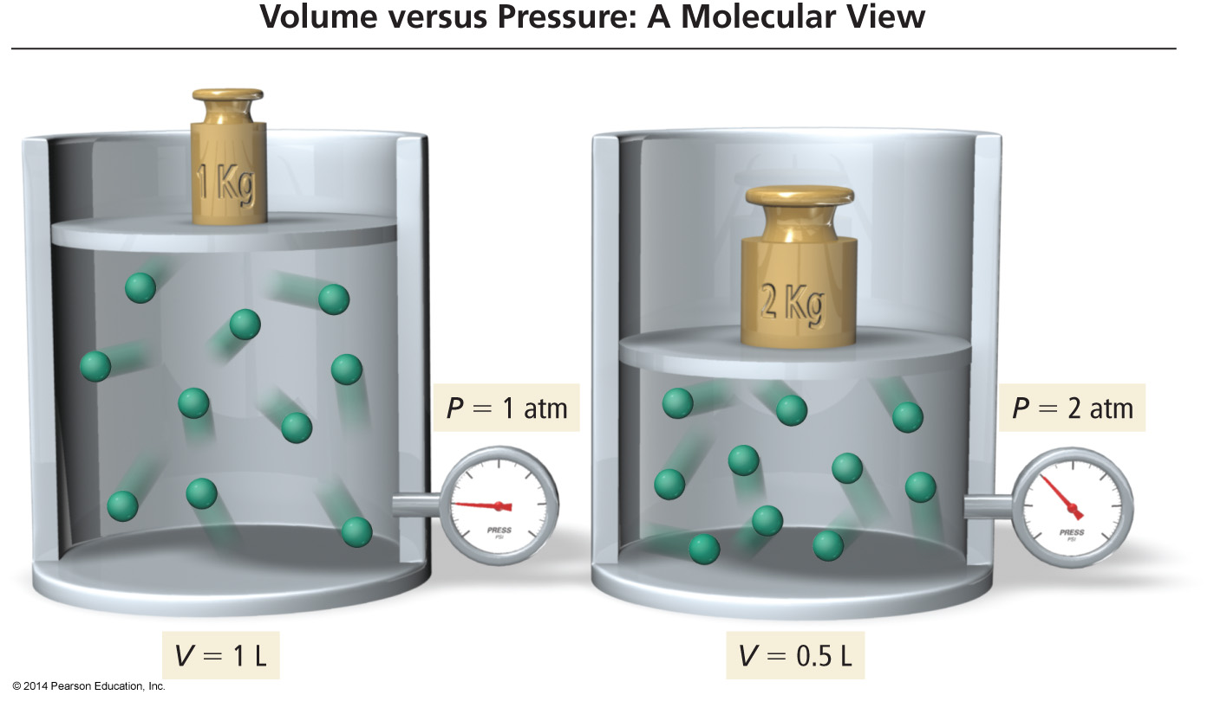
Molecular Interpretation of Boyle’s Law
As the volume of a gas sample is decreased, gas molecules collide with surrounding surfaces more frequently, resulting in greater pressure.

Slide 6
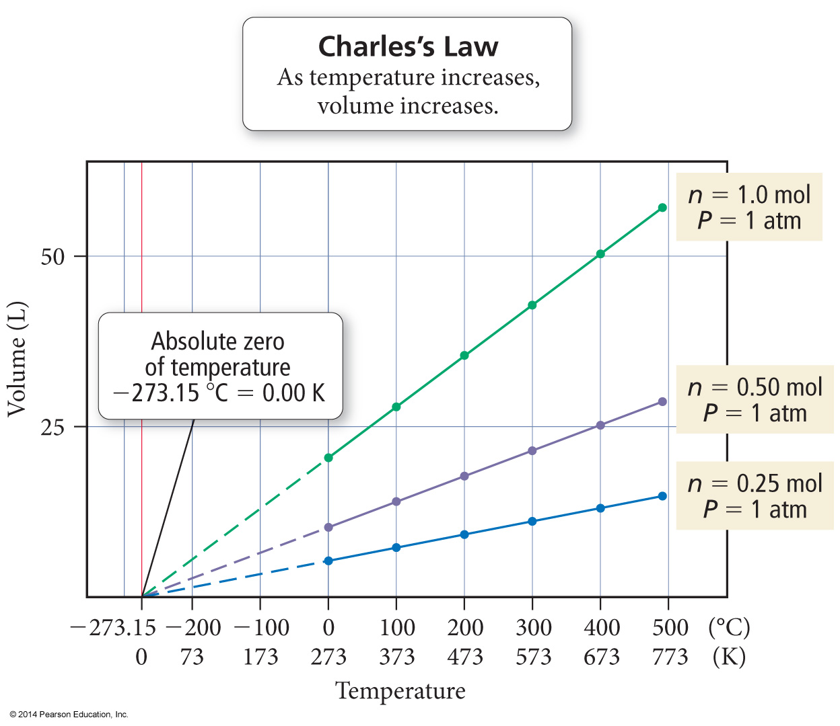
Charles’s Law
If the lines are extrapolated back to a volume of “0,” they all show the same temperature, −273.15 °C = 0 K, called absolute zero
The extrapolated lines cannot be measured experimentally because all gases condense into liquids before –273.15 °C is reached.

Slide 7
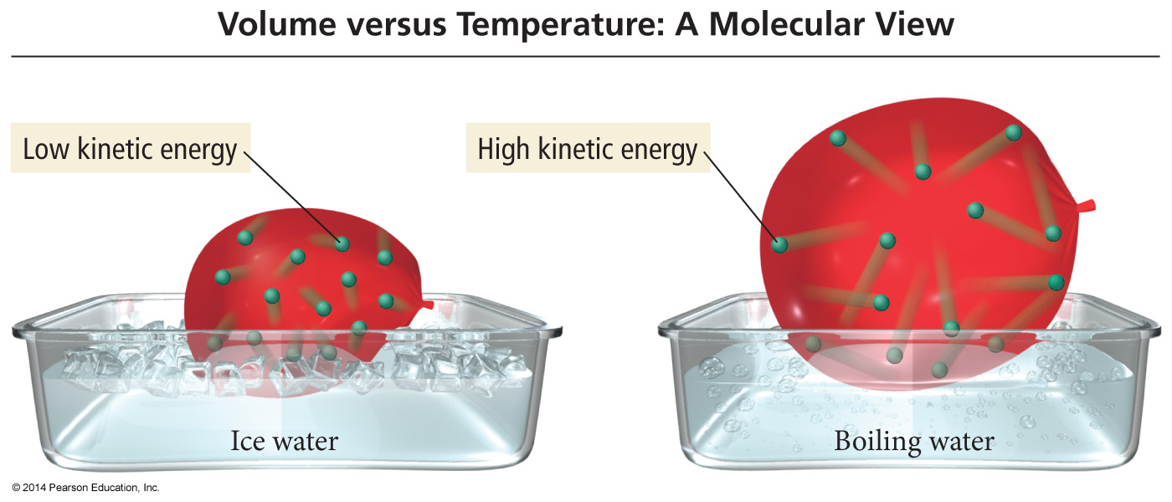
Charles’s Law – A Molecular View
If we move a balloon from an ice water bath to a boiling water bath, its volume expands as the gas particles within the balloon move faster (due to the increased temperature) and collectively occupy more space.

Slide 8
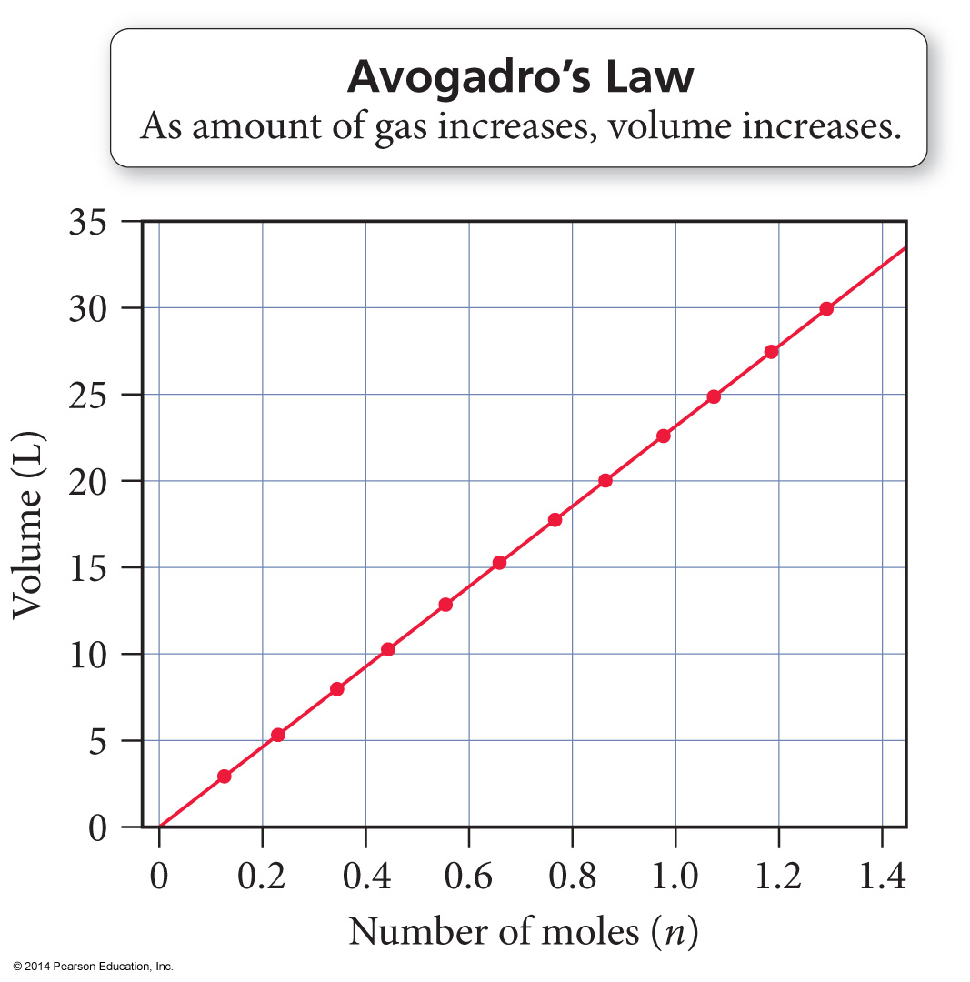
Avogadro’s Law
When the amount of gas in a sample increases at constant temperature and pressure, its volume increases in direct proportion because the greater number of gas particles fill more space.
The volume of a gas sample increases linearly with the number of moles of gas in the sample.

Slide 9
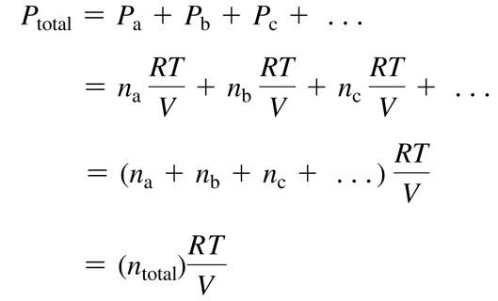
Dalton’s Law of Partial Pressures
P total is the total pressure and P_{a}, P_{b}, P_{c}, . . . are the partial pressures of the components. This relationship is known as Dalton’s law of partial pressures.

Slide 10
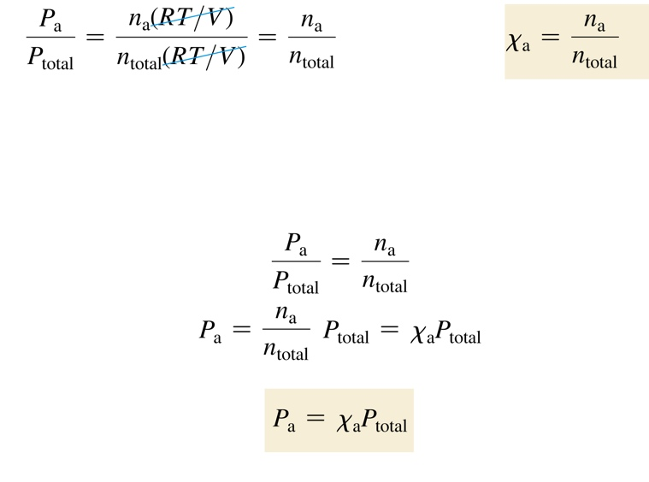
Mole Fraction
The ratio of the partial pressure a single gas contributes and total pressure is equal to the mole fraction.
The number of moles of a component in a mixture divided by the total number of moles in the mixture, is the mole fraction.

Slide 11
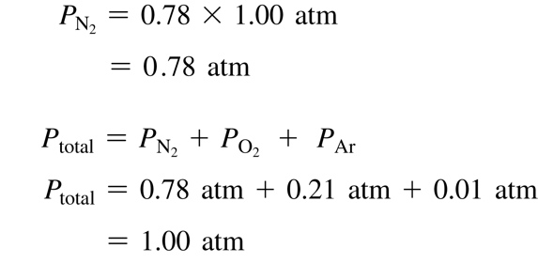
Mole Fraction
The partial pressure of a component in a gaseous mixture is its mole fraction multiplied by the total pressure.
For gases, the mole fraction of a component is equivalent to its percent by volume divided by 100%.
Nitrogen has a 78% composition of air; find its partial pressure.

