Slide 1
Gases

Slide 2
Pressure Buildup in a Bottle of Champagne

Slide 3
The Nature of Gases
Gases expand to fill their containers
Gases are fluid – they flow
Gases have low density
1/1000 the density of the equivalent liquid or solid
Gases are compressible
Gases effuse and diffuse

Slide 4
Pressure
Is caused by the collisions of molecules with the walls of a container
is equal to force/unit area
SI units = Newton/meter² = 1 Pascal (Pa)
1 atmosphere = 101,325 Pa
1 atmosphere = 1 atm = 760 mm Hg = 760 torr

Slide 5
Standard Temperature and Pressure “STP”
P = 1 atmosphere, 760 torr
T = 0°C, 273 Kelvins
The molar volume of an ideal gas is 22.42 liters at STP

Slide 6
Standard Molar Volume
Equal volumes of all gases at the same temperature and pressure contain the same number of molecules.
- Amedeo Avogadro

Slide 7
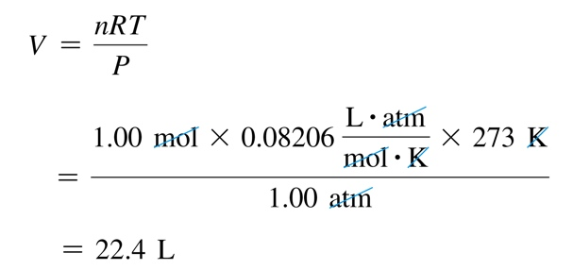
Molar Volume
The volume occupied by one mole of a substance is its molar volume at STP (T =273 K or 0 °C and P = 1atm).

Slide 8
Ideal Gases
Ideal gases are imaginary gases that perfectly
fit all of the assumptions of the KINETIC MOLECULAR
THEORY
Gases consist of tiny particles that are far apart
relative to their size.
Collisions between gas particles and between
particles and the walls of the container are
elastic collisions
No kinetic energy is lost in elastic collisions

Slide 9
Ideal Gases (continued)
Gas particles are in constant, rapid motion. They
therefore possess kinetic energy, the energy of
motion
There are no forces of attraction between gas
particles
The average kinetic energy of gas particles
depends on temperature, not on the identity
of the particle.

Slide 10
Ideal Gas Law
PV = nRT
P = pressure in atm
V = volume in liters
n = moles = m/M; m = mass, M = molar mass
R = proportionality constant
= 0.08206 L·atm/ mol·Κ
= 8.314 L·Kpa/ mol·Κ
= 62.4 L·mmHg/ mol·Κ
T = temperature in Kelvins
Holds closely at P < 1 atm

Slide 11
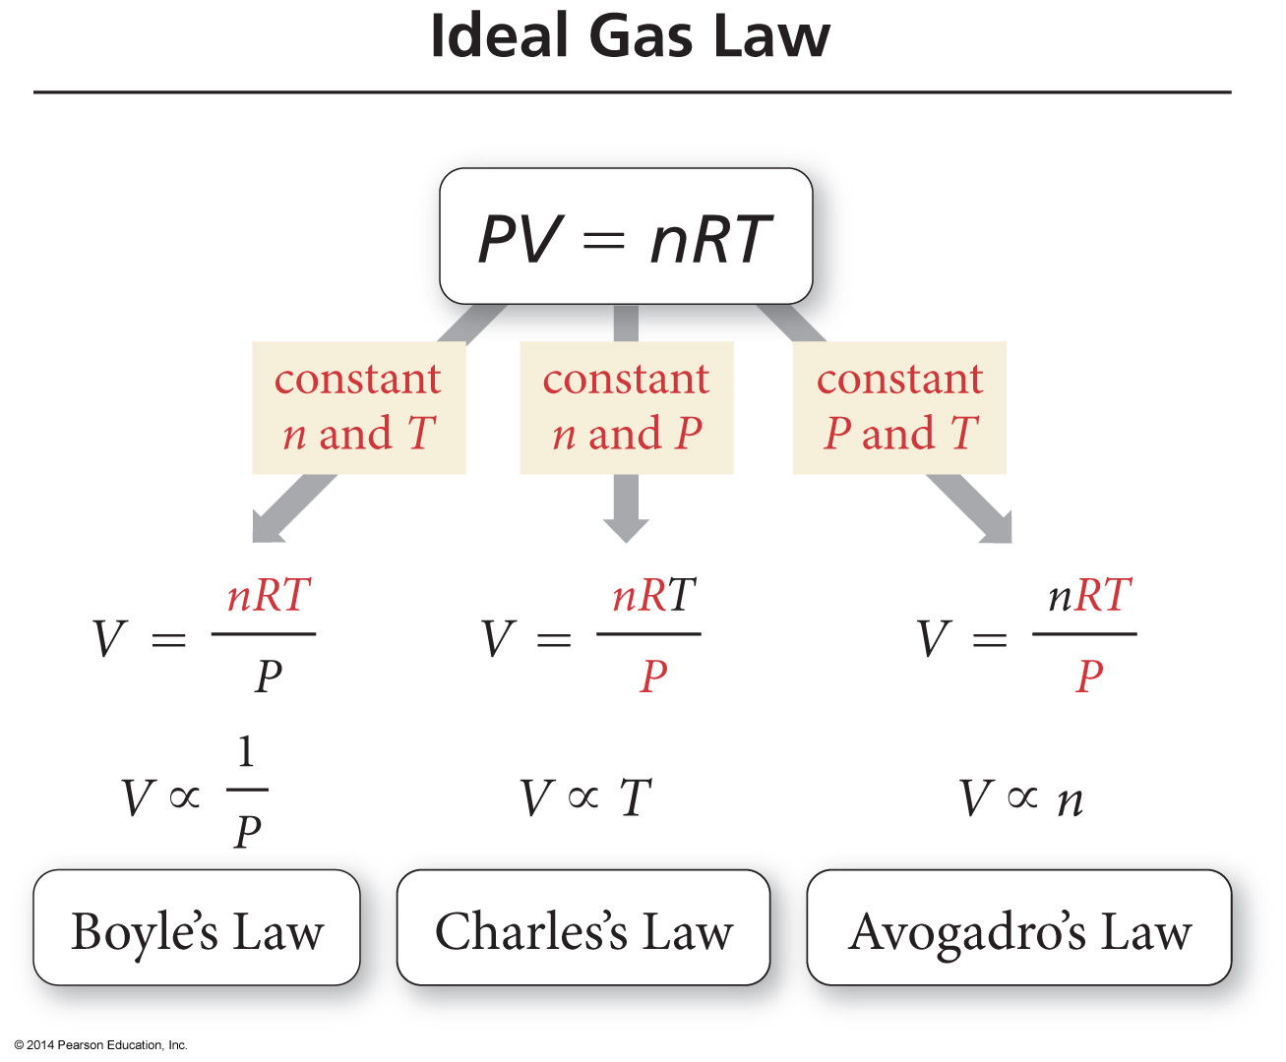
Ideal Gas Law

Slide 12
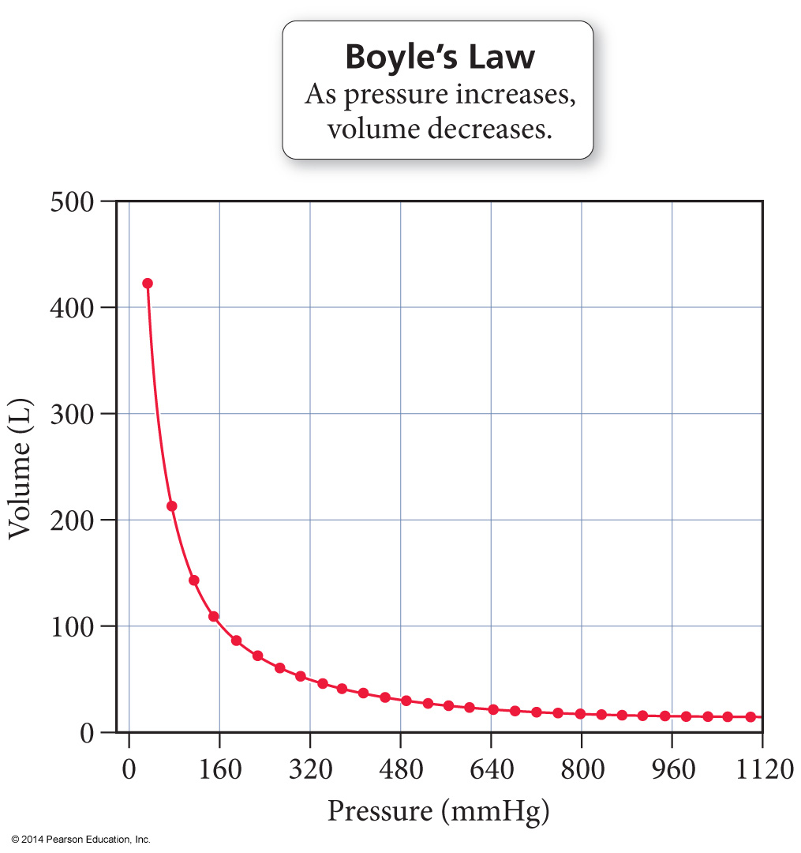
Boyle’s Law

Slide 13
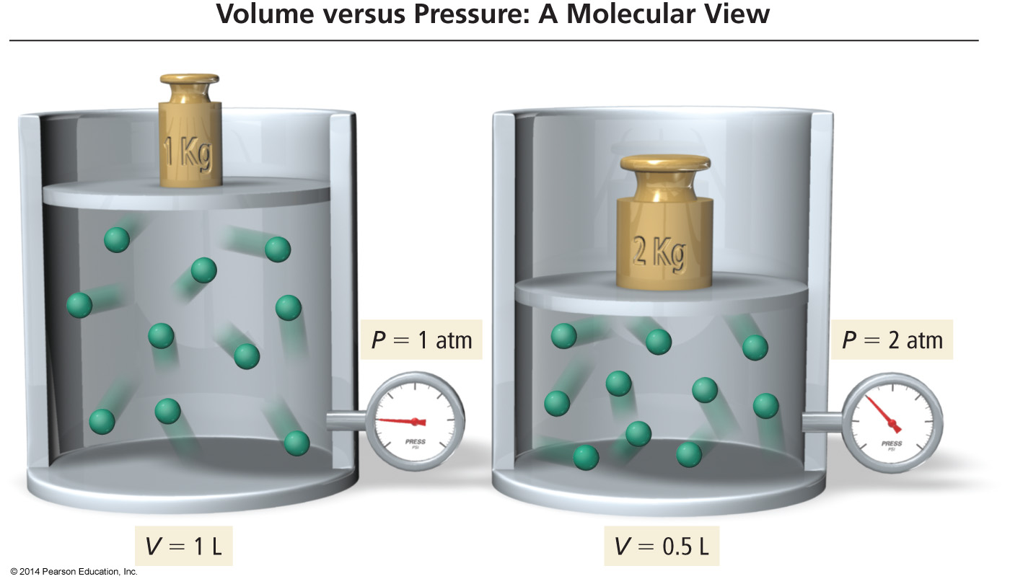
Molecular Interpretation of Boyle’s Law
As the volume of a gas sample is decreased, gas molecules collide with surrounding surfaces more frequently, resulting in greater pressure.

Slide 14
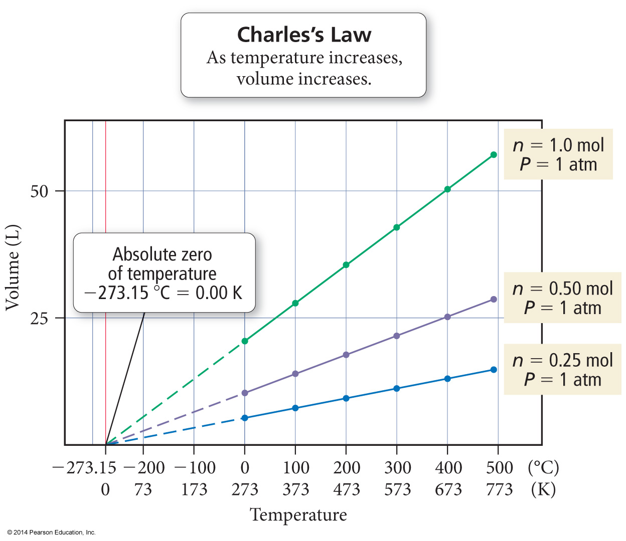
Charles’s Law
If the lines are extrapolated back to a volume of “0,” they all show the same temperature, −273.15 °C = 0 K, called absolute zero
The extrapolated lines cannot be measured experimentally because all gases condense into liquids before –273.15 °C is reached.

Slide 15
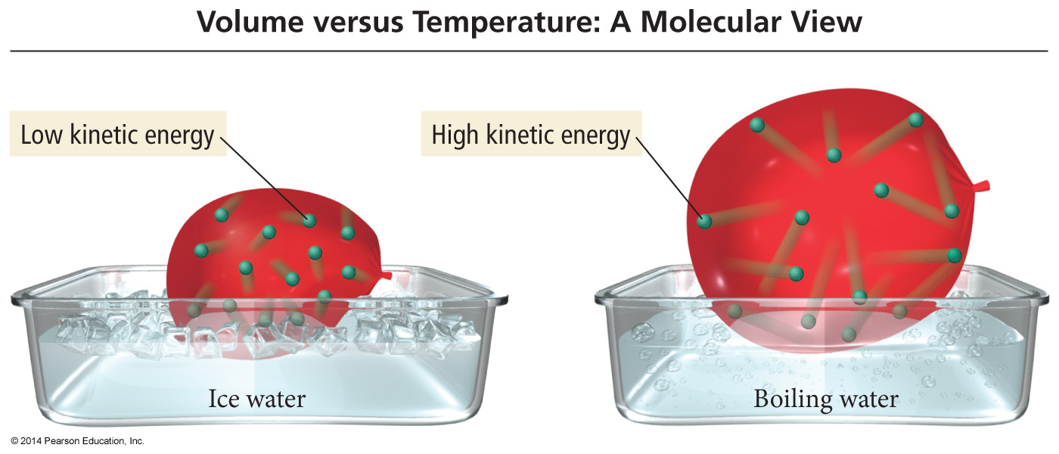
Charles’s Law – A Molecular View
If we move a balloon from an ice water bath to a boiling water bath, its volume expands as the gas particles within the balloon move faster (due to the increased temperature) and collectively occupy more space.

Slide 16
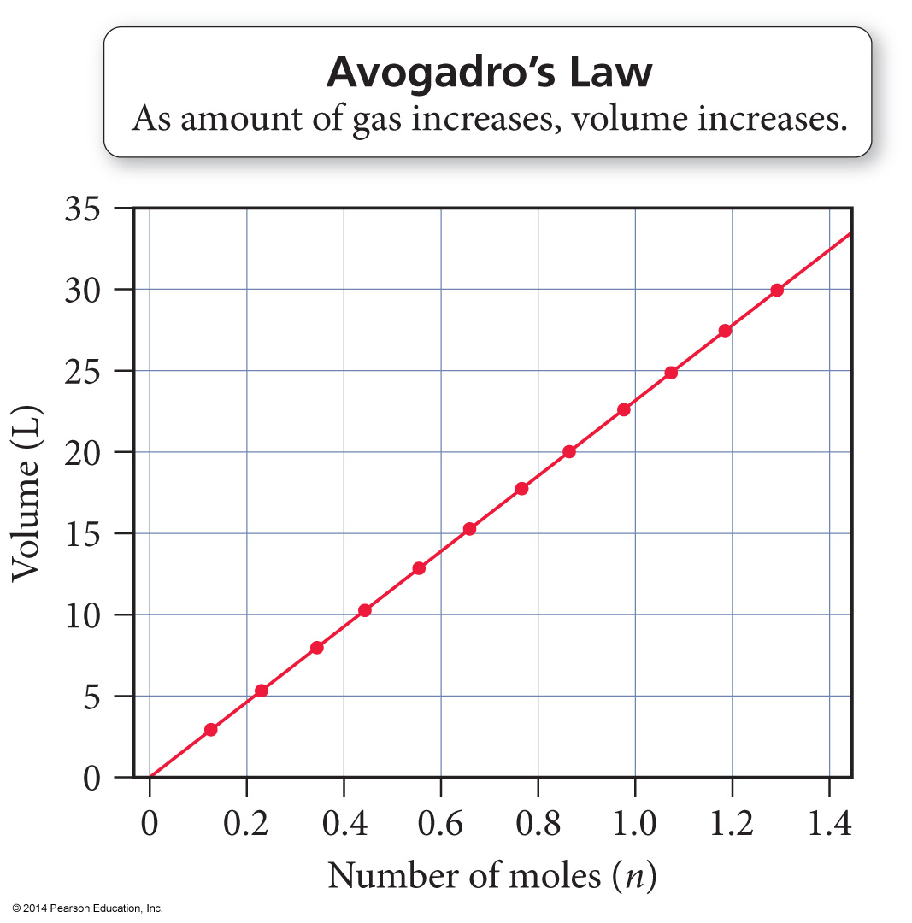
Avogadro’s Law
When the amount of gas in a sample increases at constant temperature and pressure, its volume increases in direct proportion because the greater number of gas particles fill more space.
The volume of a gas sample increases linearly with the number of moles of gas in the sample.

Slide 17
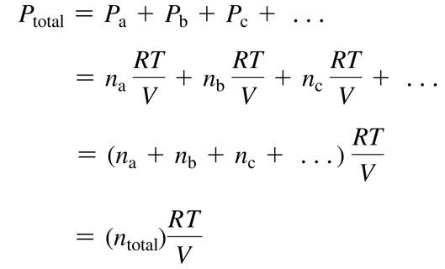
Dalton’s Law of Partial Pressures
P total is the total pressure and P_{a}, P_{b}, P_{c}, . . . are the partial pressures of the components. This relationship is known as Dalton’s law of partial pressures.

Slide 18
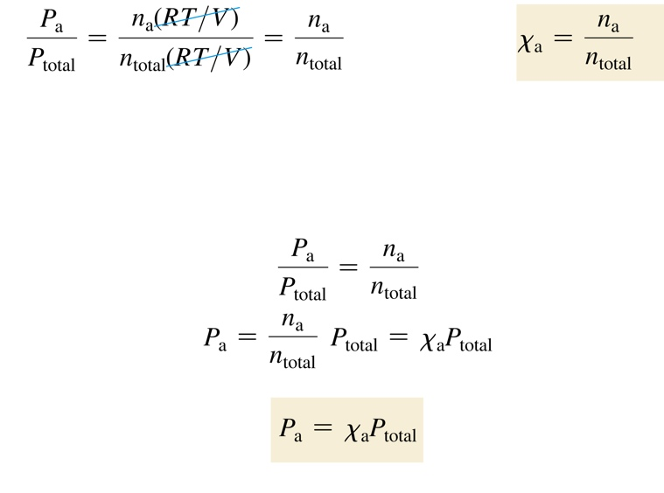
Mole Fraction
The ratio of the partial pressure a single gas contributes and total pressure is equal to the mole fraction.
The number of moles of a component in a mixture divided by the total number of moles in the mixture, is the mole fraction.

Slide 19
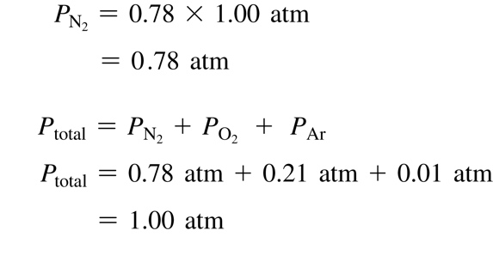
Mole Fraction
The partial pressure of a component in a gaseous mixture is its mole fraction multiplied by the total pressure.
For gases, the mole fraction of a component is equivalent to its percent by volume divided by 100%.
Nitrogen has a 78% composition of air; find its partial pressure.

Slide 20
Gas Density
… so at STP…

Slide 21
Density and the Ideal Gas Law
Combining the formula for density with the Ideal
Gas law, substituting and rearranging algebraically:
M = Molar Mass
P = Pressure
R = Gas Constant
T = Temperature in Kelvins

Slide 22
Kinetic Energy of Gas Particles
At the same conditions of temperature, all gases
have the same average kinetic energy.

Slide 23
The Meaning of Temperature
Kelvin temperature is an index of the random motions of gas particles (higher T means greater motion.)

Slide 24
Diffusion
Diffusion: describes the mixing of gases. The rate of diffusion is the rate of gas mixing.

Slide 25
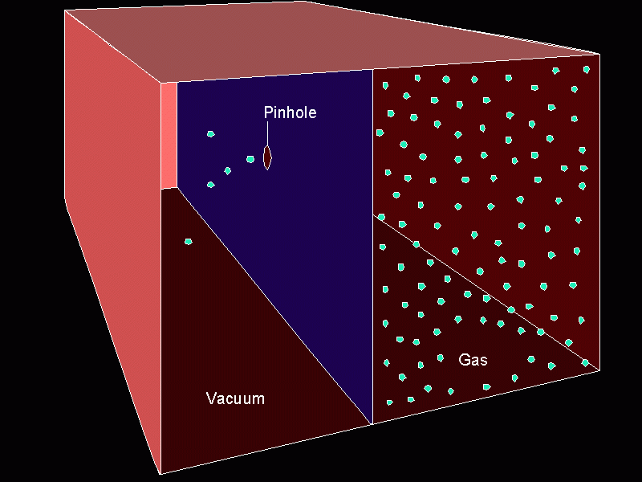
Effusion
Effusion: describes the passage of gas into an evacuated chamber.

Slide 26
Graham’s Law Rates of Effusion and Diffusion
Effusion:
Diffusion:

Slide 27
Practice
Under the same conditions of temperature and pressure, does hydrogen iodide or ammonia effuse faster? Calculate the relative rates at which they effuse.
$\frac{Rate of {NH}_{3}}{Rate of HI}=\frac{\sqrt{HI}}{\sqrt{{NH}_{3}}}=\frac{\sqrt{127}}{\sqrt{17}}=2.74$

Slide 28
Real Gases
Must correct ideal gas behavior when at high pressure (smaller volume) and low temperature (attractive forces become important).
corrected pressure
corrected volume
P_{ideal}
V_{ideal}
Attractive force = less collisions
Actual volume of particles

Slide 29
Root Mean Square Velocity
R = universal gas constant (the energy one)
T = Kelvin Temperature
M = molar mass in KILOGRAMS (b/c of the Joule in “R”)

Slide 30
Gas Stoichiometry #1
If reactants and products are at the same conditions of temperature and pressure, then mole ratios of gases are also volume ratios.
3 H₂(g) + N₂(g) → 2NH₃(g)
3 moles H₂ + 1 mole N₂ → 2 moles NH₃
3 liters H₂ + 1 liter N₂ → 2 liters NH₃

Slide 31
Gas Stoichiometry #2
How many liters of ammonia can be produced when 12 liters of hydrogen react with an excess of nitrogen?
3 H₂(g) + N₂(g) → 2NH₃(g)
12 L H₂
2
L NH₃
= L NH₃
8.0
3
L H₂

Slide 32
Gas Stoichiometry #3
How many liters of oxygen gas, at STP, can be collected from the complete decomposition of 50.0 grams of potassium chlorate?
2 KClO₃(s) → 2 KCl(s) + 3 O₂(g)
50.0 g KClO₃
1 mol KClO₃
3 mol O₂
22.4 L O₂
122.55 g KClO₃
2 mol KClO₃
1 mol O₂
= L O₂
13.7

Slide 33
Gas Stoichiometry #4
How many liters of oxygen gas, at 37.0°C and 0.930 atmospheres, can be collected from the complete decomposition of 50.0 grams of potassium chlorate?
2 KClO₃(s) → 2 KCl(s) + 3 O₂(g)
50.0 g KClO₃
1 mol KClO₃
3 mol O₂
= “n” mol O₂
0.612
mol O₂
122.55 g KClO₃
2 mol KClO₃
= 16.7 L

Slide 34
Kinetic Molecular Theory
Particles of matter are ALWAYS in motion
Volume of individual particles is ≈ zero.
Collisions of particles with container walls cause pressure exerted by gas.
Particles exert no forces on each other.
Average kinetic energy ∝ Kelvin temperature of a gas.

