Slide 1
N25 – Gases
Review

Slide 2
N25 – Gases
A Review
Target: I can make sure that I remember the *concepts* behind Gas Laws, and don’t just focus on the mathematical equations!

Slide 3
Pressure Buildup in a Bottle of Champagne

Slide 4
The Nature of Gases
Expand to fill their containers
Are fluid – they flow
Have low density
1/1000 the density of the equivalent liquid or solid
Are compressible
They effuse and diffuse

Slide 5
Pressure
Caused by the collisions of molecules with the walls of a container
Equal to force/unit area
SI units = Newton/meter² = 1 Pascal (Pa)
1 atmosphere = 101,325 Pa
1 atmosphere = 1 atm = 760 mm Hg = 760 torr

Slide 6
Standard Temperature and Pressure “STP”
P = 1 atmosphere, 760 torr
T = 0°C, 273 Kelvins
The molar volume of an ideal gas is 22.42 liters at STP

Slide 7
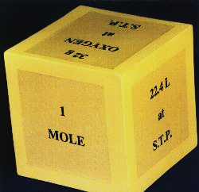
Standard Molar Volume
Equal volumes of all gases at the same temperature and pressure contain the same number of molecules.
- Amedeo Avogadro

Slide 8
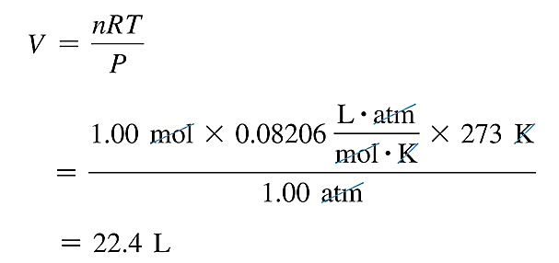
Molar Volume
The volume occupied by one mole of a substance is its molar volume at STP (T =273 K or 0 °C and P = 1atm).

Slide 9
Ideal Gases
Ideal gases are imaginary gases that perfectly fit all of the assumptions of the KINETIC MOLECULAR THEORY
Gases consist of tiny point particles that are far apart relative to their size.
Collisions between gas particles and between particles and the walls of the container are elastic collisions – meaning no kinetic energy is lost in elastic collisions

Slide 10
Ideal Gases (continued)
Gas particles are in constant, rapid, straight line motion. They therefore possess kinetic energy, the energy of motion. (Sometimes described as “chaotic” because the particles all travel individually, not as a group, so it looks like they are bouncing around all crazy, but they are each individually traveling in a straight line.)
There are no forces of attraction or repulsion between gas particles

Slide 11
Ideal Gases (continued)
The average kinetic energy of gas particles depends on temperature, not on the identity of the particle. (proportional to KELVIN temperature not Celsius!) (There is a distribution of speeds at a given temperature. Therefore, there is an average kinetic energy of the sample.)

Slide 12
Ideal Gases (continued)

Slide 13
YouTube Link to Presentation: https://youtu.be/2mMIMRP0ACY

