Slide 1
N26 – Gases
Ideal Gases and Laws

Slide 2
N26 – Gases
Ideal Gases and Laws
Target: I can manipulate Gas Law equations and units to perform more complex Gas Law calculations

Slide 3
Ideal Gas Law
$$PV= \frac{m}{M}RT$$
PV = nRT
P = pressure in atm
V = volume in liters
n = moles
= m/M; m = mass, M = molar mass
R = proportionality constant
= 0.08206 L·atm/ mol·K
= 8.314 L·Kpa/ mol·K
= 62.4 L·mmHg/ mol·K
T = temperature in Kelvins
R holds closely at P < 1 atm

Slide 4
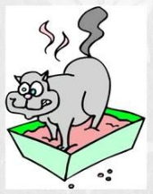
Molar Mass Kitty!
$$M=\frac{mRT}{PV}$$
substitute
$$D= \frac{m}{V}$$
$$M= \frac{DRT}{P}$$
Molar Mass Kitty always puts DIRT over its PEE

Slide 5
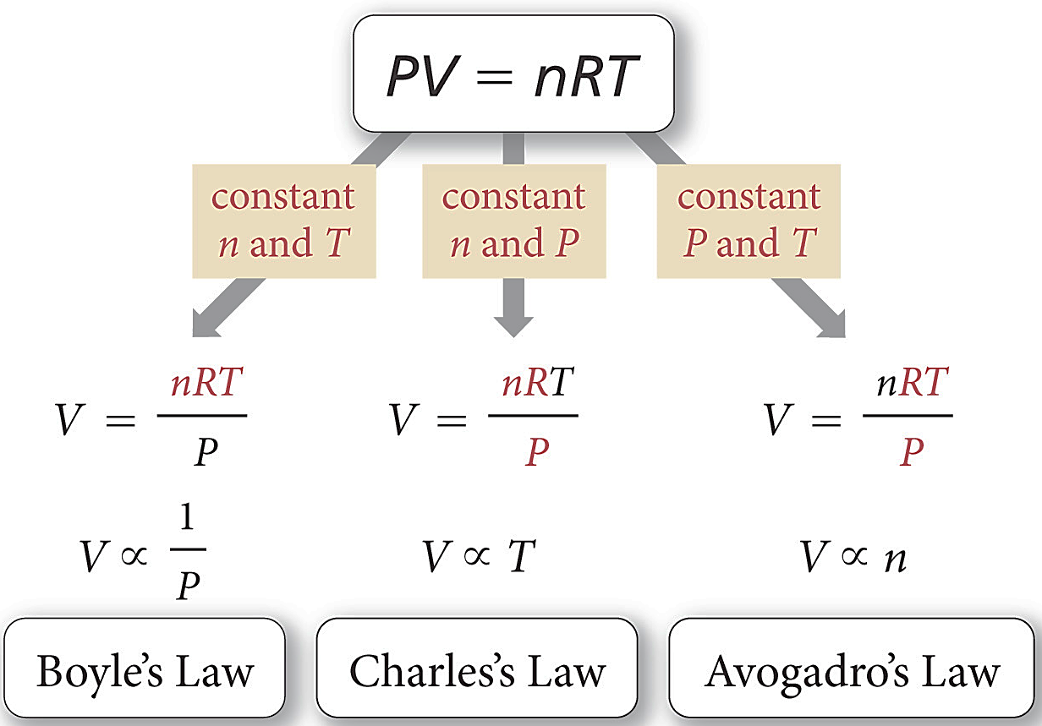
Getting Other Gas Laws from Ideal Gas Law
If some variables are held constant then PV=nRT reduces into the other laws.

Slide 6
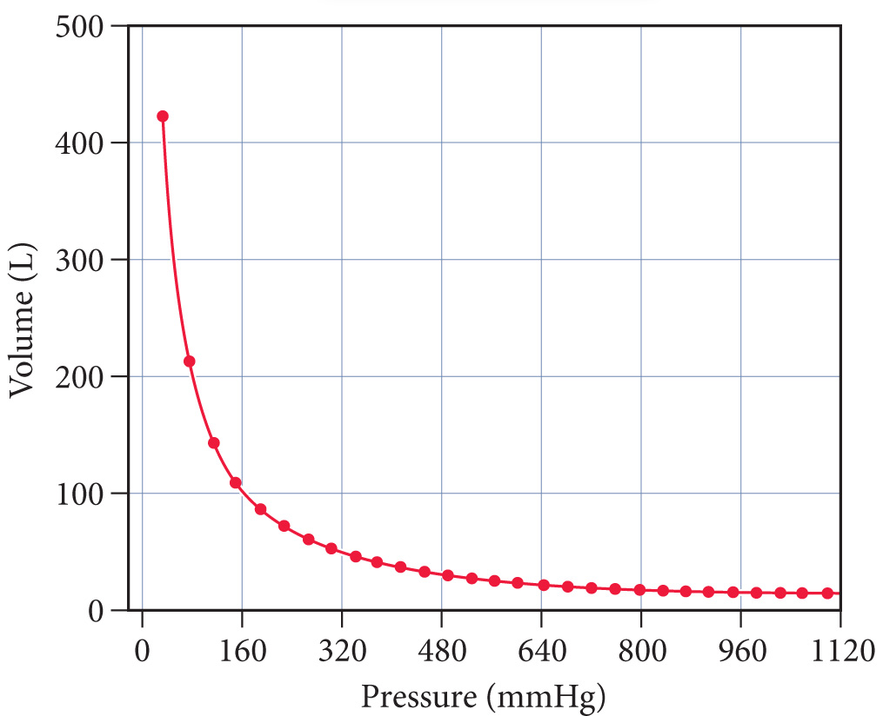
Boyle’s Law
P₁V₁ = P₂V₂
As pressure increases, volume decreases.
Indirect relationship.

Slide 7
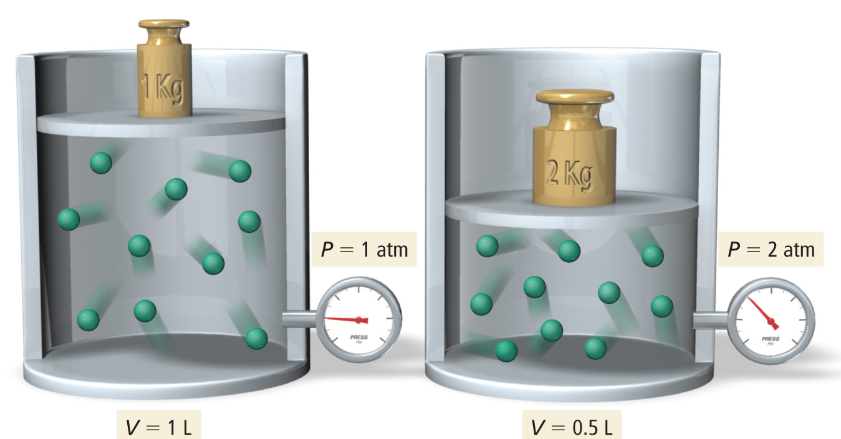
Molecular Interpretation of Boyle’s Law
As the volume of a gas sample is decreased, gas molecules collide with surrounding surfaces more frequently, resulting in greater pressure.

Slide 8
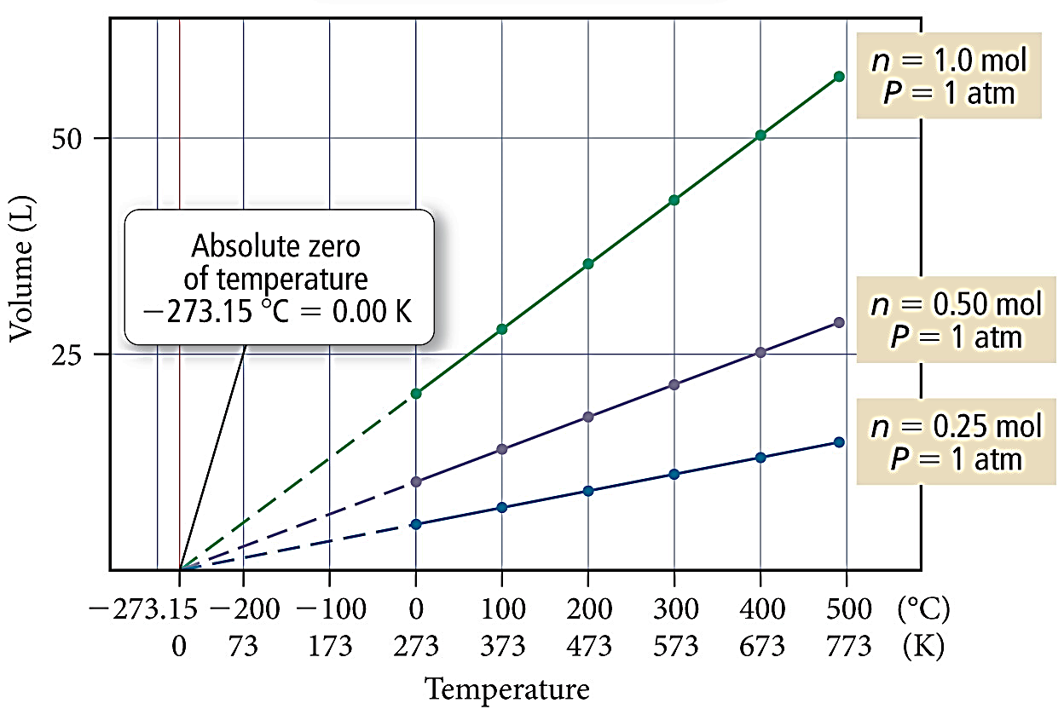
Charles’s Law
$$\frac{V_{1}}{T_{1}}= \frac{V_{2}}{T_{2}}$$
As temperature increases, volume increases.
Direct relationship.

Slide 9
Charles’s Law
$$\frac{V_{1}}{T_{1}}= \frac{V_{2}}{T_{2}}$$
If the lines are extrapolated back to a volume of “0,” they all show the same temperature, −273.15 °C = 0 K, called absolute zero
The extrapolated lines cannot be measured experimentally because all gases condense into liquids before –273.15 °C is reached.

Slide 10
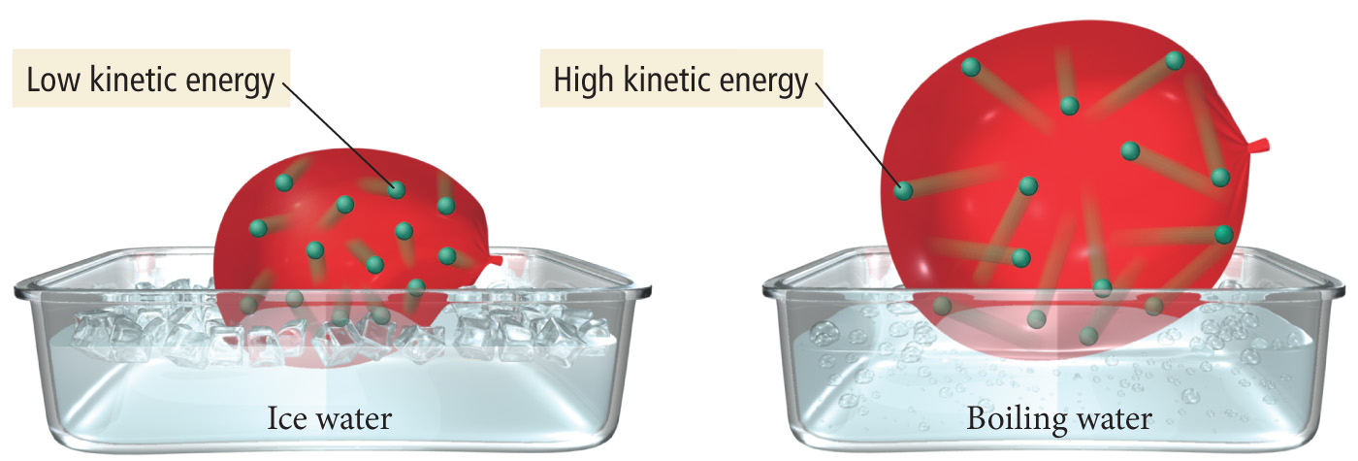
Molecular Interpretation of Charles’s Law
If we move a balloon from an ice water bath to a boiling water bath, its volume expands as the gas particles within the balloon move faster (due to the increased temperature) and collectively occupy more space.

Slide 11
Gay Lusaac’s Law
$$\frac{P_{1}}{T_{1}}= \frac{P_{2}}{T_{2}}$$
As temperature increases, pressure increases.
Direct relationship.

Slide 12
Gay Lusaac’s Law
$$\frac{P_{1}}{T_{1}}= \frac{P_{2}}{T_{2}}$$
If the lines are extrapolated back to a pressure of “0,” they all show the same temperature, −273.15 °C = 0 K, called absolute zero
The extrapolated lines cannot be measured experimentally because all gases condense into liquids before –273.15 °C is reached.

Slide 13
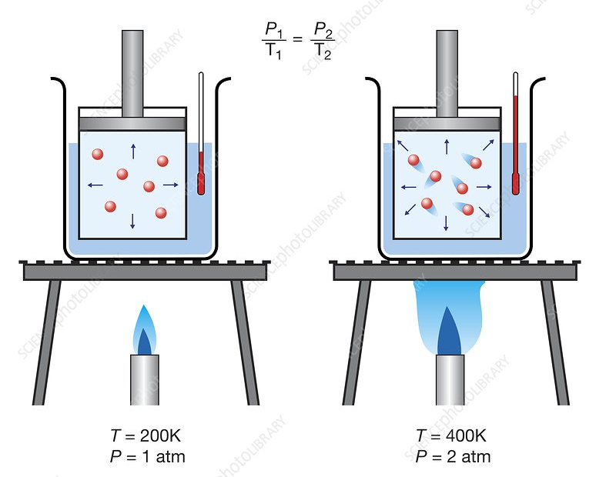
Molecular Interpretation of Gay Lusaac’s Law
Increasing temperature on a constant volume container, results in the particles moving with higher KE (due to the increased temperature/speed) and therefore hit the sides of the container more often with more force, resulting in higher pressure.

Slide 14
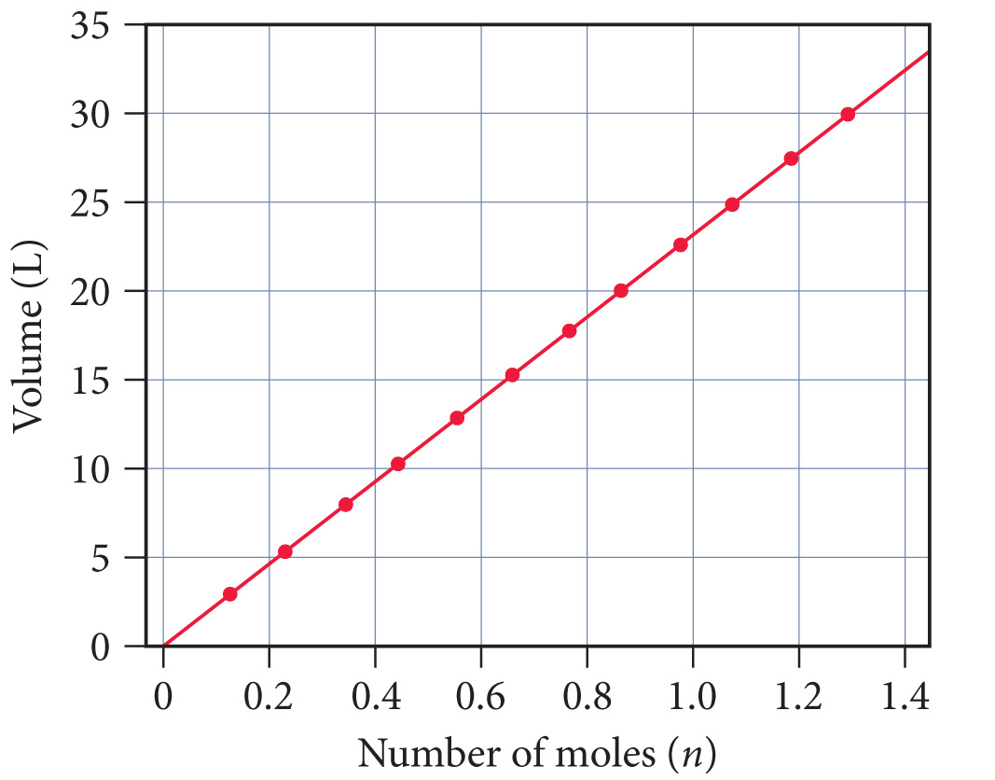
Avogadro’s Law
$$\frac{V_{1}}{n_{1}}= \frac{V_{2}}{n_{2}}$$
As number of moles of gas increases, volume increases.
Direct relationship.

Slide 15
Avogadro’s Law
$$\frac{V_{1}}{n_{1}}= \frac{V_{2}}{n_{2}}$$
When the amount of gas in a sample increases at constant temperature and pressure, its volume increases in direct proportion because the greater number of gas particles fill more space.
The volume of a gas sample increases linearly with the number of moles of gas in the sample.

Slide 16
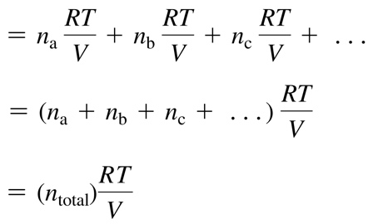
Dalton’s Law of Partial Pressures
$$Ptotal=P1+P2+P3…$$
P_{total} is the total pressure and P₁, P₂, P₃ or P_{a}, P_{b}, P_{c}, . . . are the partial pressures of the components.

Slide 17
Mole Fraction
$$Xa= \frac{na}{ntotal}$$
The ratio of the partial pressure a single gas contributes and total pressure is equal to the mole fraction.
The number of moles of a component in a mixture divided by the total number of moles in the mixture, is the mole fraction.

Slide 18
Mole Fraction

Slide 19
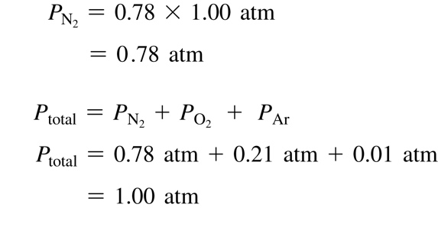
Mole Fraction
The partial pressure of a component in a gaseous mixture is its mole fraction multiplied by the total pressure.
For gases, the mole fraction of a component is equivalent to its percent by volume divided by 100%.
Nitrogen has a 78% composition of air; find its partial pressure.

Slide 20
YouTube Link to Presentation:
https://youtu.be/OcGpbumMNug

