Slide 1
N28 – Intermolecular Forces
Target: I can define and identify different types of Intermolecular Forces

Slide 2
N28 – Intermolecular Forces
An Introduction

Slide 3
Intermolecular Attractions
State of matter (s, l, g) determined by the strength of the attractions between the particles.
At room temperature, moderate to strong attractive forces result in materials being solids or liquids.
The stronger the attractive forces are, the higher the boiling point of the liquid and melting point of the solid.
Other factors also influence the melting point.

Slide 4
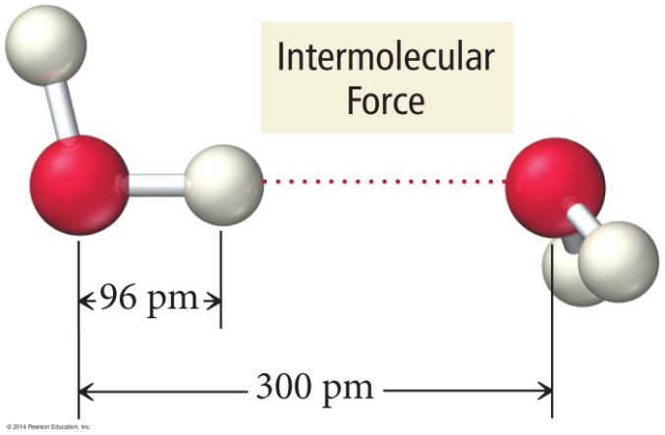
Why are molecules attracted to each other?
Intermolecular attractions are due to attractive forces between opposite charges.
+ ion to − ion
+ end of polar molecule to − end of polar molecule
H-bonding especially strong
Even nonpolar molecules will have temporary charges

Slide 5
Why are molecules attracted to each other?
Larger charge = stronger attraction
Longer distance = weaker attraction
However, these attractive forces are small relative to the bonding forces between atoms.
Generally smaller charges
Generally over much larger distances

Slide 6
Trends in the Strength of Intermolecular Attractions
The stronger the attractions between the atoms or molecules, the more energy it will take to separate them.

Slide 7
Trends in the Strength of Intermolecular Attractions
Boiling a liquid requires that we add enough energy to overcome all the attractions between the particles.
However, not breaking the covalent bonds

Slide 8
Trends in the Strength of Intermolecular Attractions
The higher the normal boiling point of the liquid, the stronger the intermolecular attractive forces.
Normal BP happens when vapor pressure = atmospheric pressure

Slide 9
Kinds of Attraction
London Dispersion Forces
Temporary polarity in the molecules due to unequal electron distribution leads to attractions

Slide 10
Kinds of Attraction
Dipole-Dipole Attractions
Permanent polarity in the molecules due to their structure leads to attractive forces

Slide 11
Kinds of Attraction
Hydrogen Bonds
An especially strong dipole–dipole attraction results when H is attached to an extremely electronegative atom [N,O,F].

Slide 12
Relative Magnitude of Forces
The types of bonding forces vary in their strength as measured by average bond energy.
Strongest
Weakest
Network Covalent bonds (400 kcal/mol)
Hydrogen bonding (12-16 kcal/mol)
Dipole-dipole interactions (2-0.5 kcal/mol)
London forces (less than 1 kcal/mol)

Slide 13
Practice
What type of IMF is in
H₂O?
Hydrogen Bonding

Slide 14
Practice
What type of IMF is in
Ammonia?
Hydrogen Bonding

Slide 15
Practice
What type of IMF is in
HCl?
Dipole-Dipole

Slide 16
Practice
What type of IMF is in
CO₂?
London Dispersion

Slide 17
Practice
What type of IMF is in
CH₄?
London Dispersion

Slide 18
Practice
What type of IMF is in
Hydrogen Sulfide?
Dipole-Dipole

Slide 19
YouTube Link to Presentation:
https://youtu.be/KukAW2h1wI4

