Slide 1
N29 – Intermolecular Forces
Going in Depth

Slide 2
N29 – Intermolecular Forces
Going in Depth
Target: I can give detailed and complex reasoning for how various IMFs work, and how they affect the properties of various substances.

Slide 3
Types of IMFs
London Dispersion Forces
Dipole-Dipole
Hydrogen Bond
Ion-Dipole Forces
Ion Induced Dipole
Dipole Induced Dipole
These three talked about in Honors Chem
These three talked are probably new

Slide 4
Dipole – Dipole Attractions
Polar molecules have a permanent dipole.
Bond polarity and shape
Dipole moment
The permanent dipole...
adds to attractive forces between the molecules,
raising the boiling and melting points compared to nonpolar molecules of similar size and shape.

Slide 5
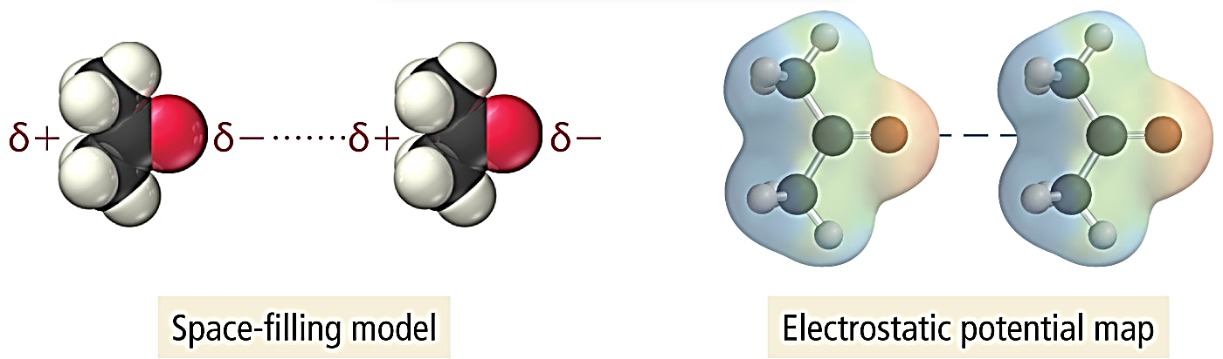
Dipole – Dipole Attractions
The partial positive end of a polar molecule is attracted to the partial negative end of its neighbor.

Slide 6
Effect of DP-DP Attractions on BP and MP
Formaldehyde has DP-DP and higher BP and MP

Slide 7
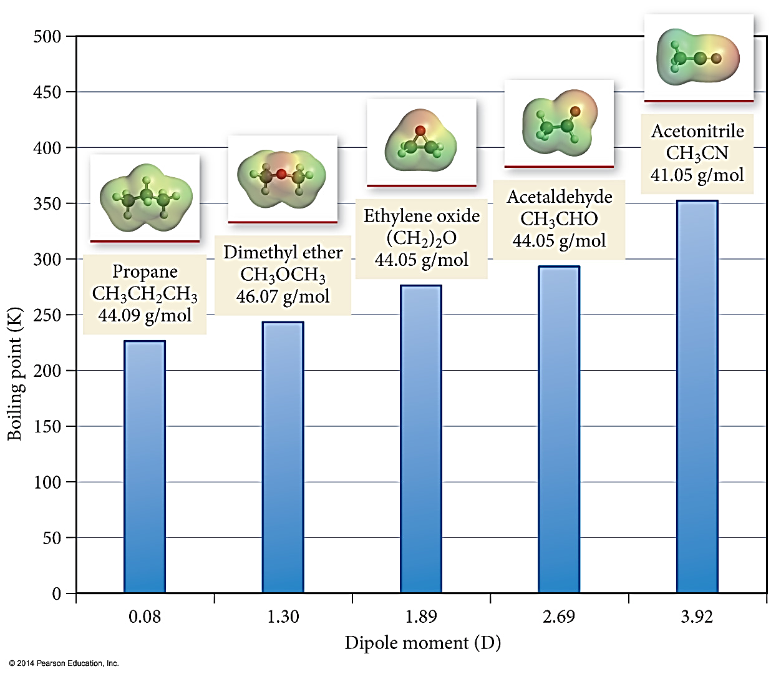
Dipole Moment and Boiling Point

Slide 8
Hydrogen Bonding
H – NOF:
Way to remember it but don’t write it on AP test!
When a very electronegative atom is bonded to H, it strongly pulls the bonding electrons toward it.
ONLY :N─H :O─H or :F─H
Because H has no other electrons, when its e- is pulled away, the nucleus becomes de-shielded, exposing the H proton.
The exposed proton acts as a very strong partial positive charge, attracting e- clouds from neighboring molecules.

Slide 9
Hydrogen Bonding
Results in higher boiling points and melting points than similar substances that cannot.
H-bonds are very strong intermolecular attractive forces.
(Usually) stronger than dipole–dipole or dispersion forces
But H-bonds are not nearly as strong as chemical bonds.
2–5% the strength of covalent bonds

Slide 10
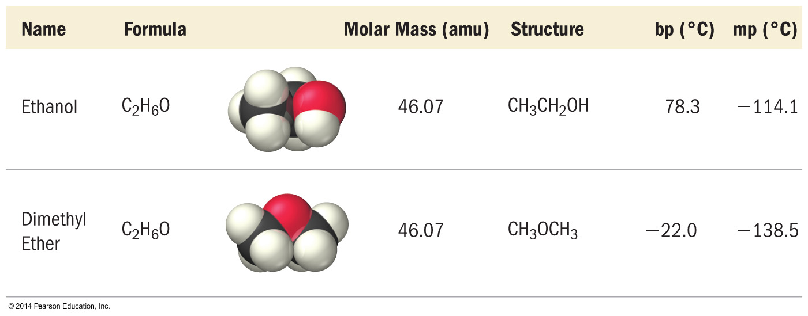
Effect of H-Bonding on BP
Ethanol has H-Bonding and higher BP and MP

Slide 11
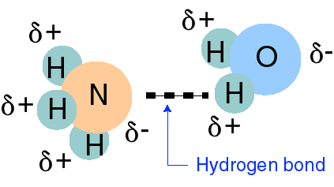
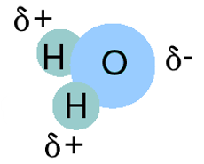
Hydrogen Bonding
Some substances can hydrogen bond with themselves.
:
:
:
:
Hydrogen bonding between water and water

Slide 12
Hydrogen Bonding
Some substances can also hydrogen bond with other molecules.
:
:
:
Hydrogen bonding between ammonia and water

Slide 13
Hydrogen Bonding
Some substance can hydrogen bond with other molecules, but not with themselves
:
:
O
:
C
:
H
H
Hydrogen bonding between formaldehyde and water

Slide 14
(not) Hydrogen Bonding
Some substance can hydrogen bond with other molecules, but NOT with themselves
:
:
O
O
C
:
C
H
:
H
H
H
NO HYDROGEN BONDING!
Proton on H is not exposed enough!
Yes Dipole-Dipole. NO hydrogen bond

Slide 15
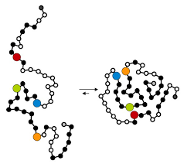
Hydrogen Bonding in DNA and Proteins
Thymine hydrogen bonds to Adenine
Cytosine hydrogen bonds to Guanine
T
A
C
G
Protein folding

Slide 16
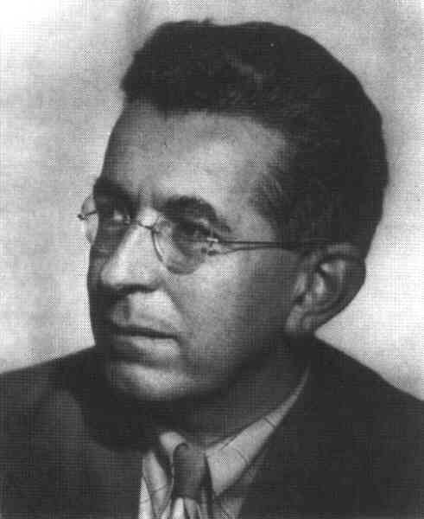
London Dispersion Forces
London force attractions
The temporary (or instantaneous) separations of charge that lead to the attraction of one nonpolar/noble gas molecule to its neighbors.
Fritz London
1900-1954

Slide 17
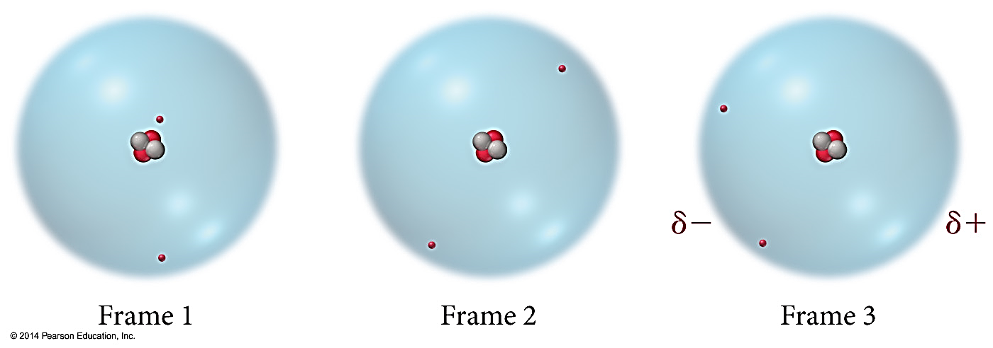
London Dispersion Forces

Slide 18
London Dispersion Forces
Electrons are not stationary – they move randomly.
It is possible to have temporary unequal distribution of e⁻’s.
Region with excess electron density has partial (–) charge
Region with depleted electron density has partial (+) charge
Results in a temporary dipole.
Called dispersion forces (aka London Dispersion Forces)

Slide 19
London Dispersion Forces
All molecules and atoms will have them.
As a temporary dipole is established in one molecule, it induces a dipole in all the surrounding molecules.

Slide 20
Size of the Induced Dipole
DO NOT SAY MORE ELECTRONS, BIGGER, LARGER MASS OR SIZE!
The magnitude of the induced dipole depends on several factors.
Polarizability of the electrons
Volume of the electron cloud
USUALLY: More electrons = larger electron cloud = increased polarizability = stronger attractions
Shape of the molecule
More surface area for interactions = larger induced dipole = stronger attraction

Slide 21
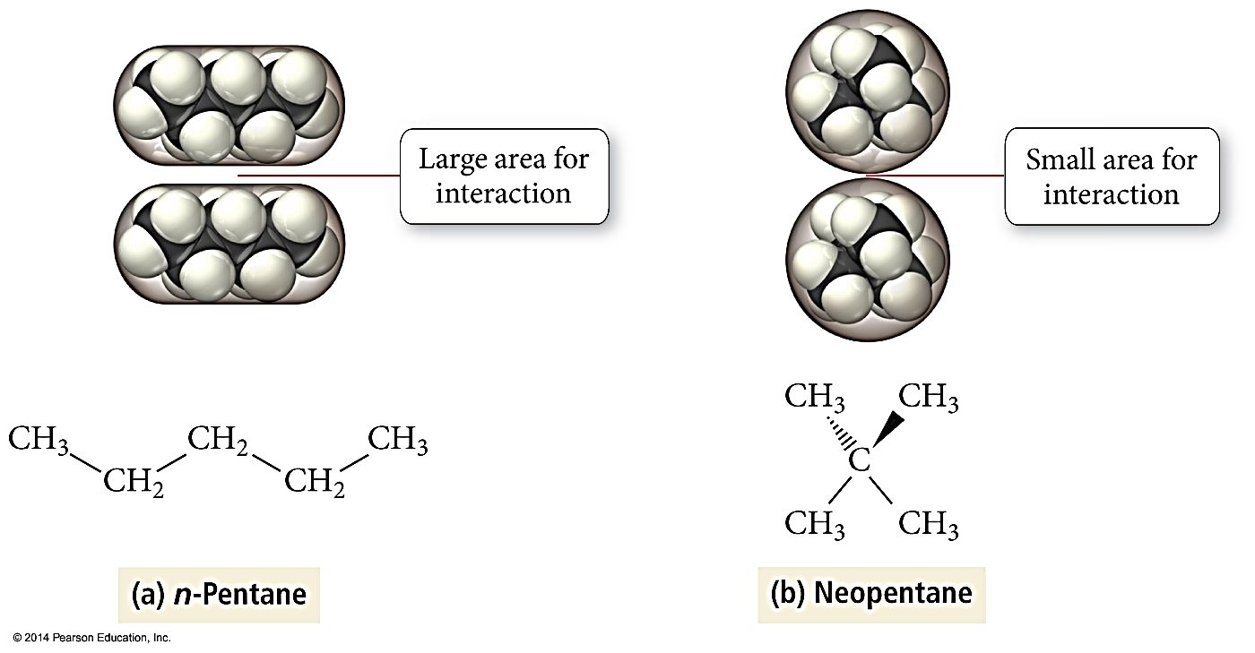
Effect of Surface Area on Size of LDF

Slide 22
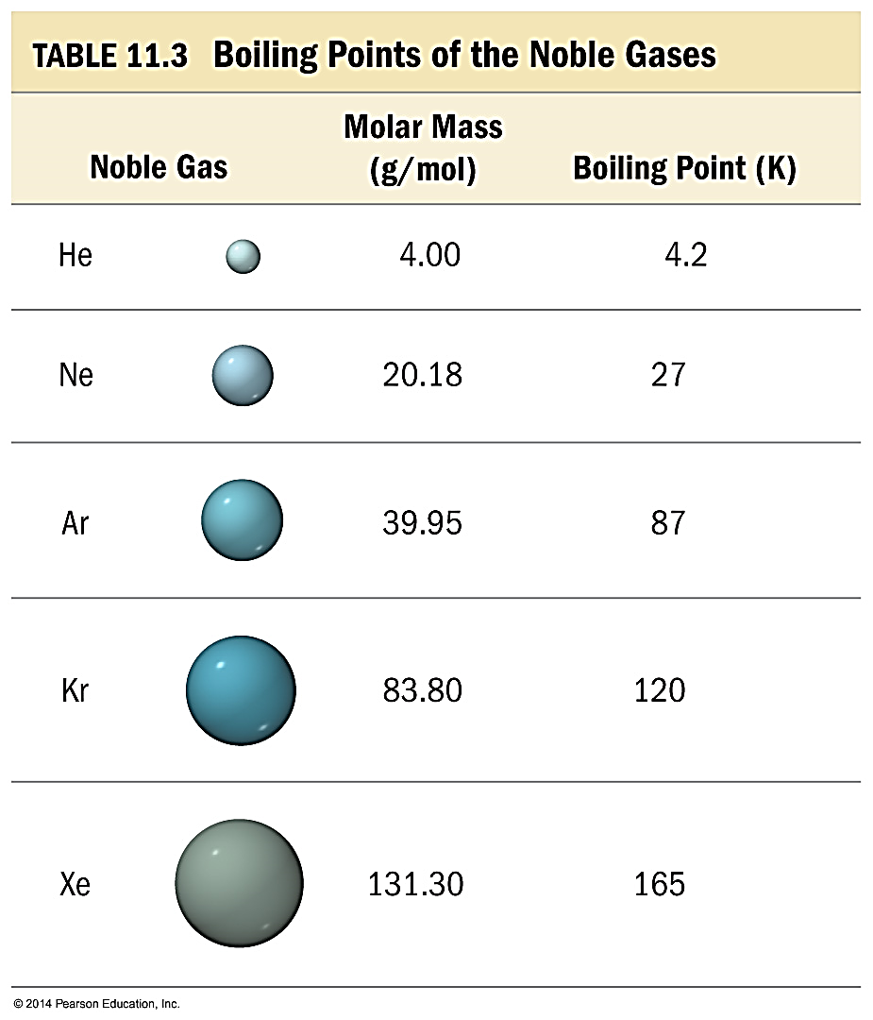
Effect of e- Cloud Size on Size of LDF
Noble gases are all nonpolar atomic elements.
The stronger the attractive forces between the molecules, the higher the boiling point will be.
DON’T TALK ABOUT MASS!!!

Slide 23
Effect of e- Cloud Size on Size of LDF
As the number of electrons increase, the size of the electron cloud increases and it is more “polarizable” – more likely to result in unequal electron distribution. Therefore, the strength of the dispersion forces increases.
The stronger the attractive forces between the molecules, the higher the boiling point will be.
DON’T TALK ABOUT MASS!!!

Slide 24
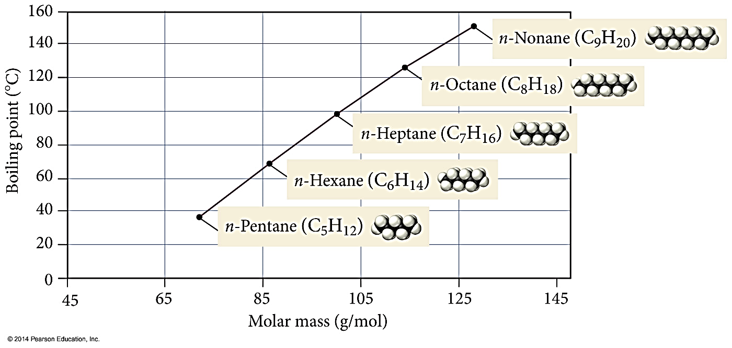
Boiling Points of n-Alkanes
DON’T TALK ABOUT MASS!!!

Slide 25
BP as a Measure of IMFs

Slide 26
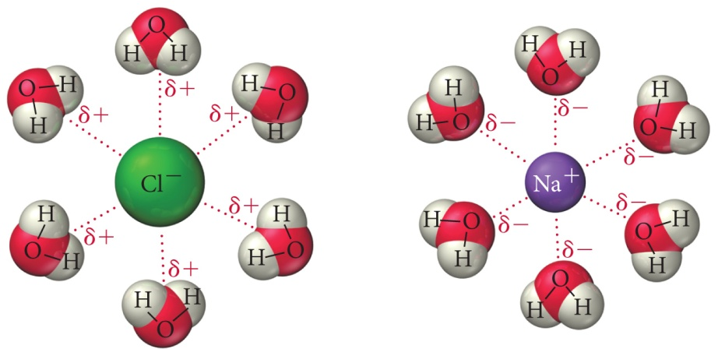
Ion-Dipole Attraction
In a mixture, ions from an ionic compound are attracted to the dipole of polar molecules.
The strength of the ion–dipole attraction is one of the main factors that determines the solubility of ionic compounds in water.

Slide 27
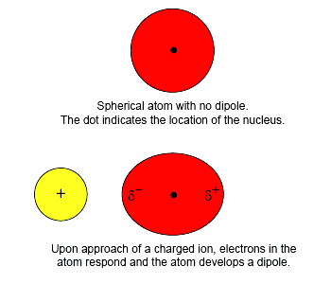
Ion Induced Dipole
An ion can induce a dipole in a nonpolar molecule.
By attracting the electrons in the nonpolar molecule the ion causes the nonpolar molecule to become slightly polar.

Slide 28
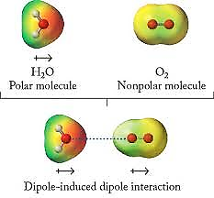
Dipole Induced Dipole
An dipole can induce a dipole in a nonpolar molecule.
By attracting the electrons in the nonpolar molecule the dipole causes the nonpolar molecule to become slightly polar.

Slide 29
Be Careful When Ranking Things
It can be hard to rank the strength of IMFs in various molecules without lab data like BP or MP.
AP will usually give you data!
Don’t argue with their data!
A ton of a weak force can result in a larger sum of attractive force than expected!

Slide 30
Be Careful When Listing Things
Don’t just list the dominant IMF!
List ALL the forces!
Water = LDF, DP-DP, H-bond
CO₂ = LDF
How do you know when to just report one versus all of them? Who knows! Look for key words, err on the side of listing all unless a key word implies they just want dominant.

Slide 31
Be Careful with Phrasing Answers
When comparing substances you HAVE TO MENTION BOTH THE MOLECULES in the question! They specifically wont give points if you only mention one.
Example: Why does H₂O have a higher BP than CO₂
Bad answer: H₂O has a higher BP because it has H-bonding.
Good answer: While CO₂ has LDF forces, H₂O has LDF AND H-Bonding. The H-Bonding in H₂O results in more intermolecular attractions so it has a higher BP than CO₂ does.

Slide 32
Summary – London Forces
The weakest of the intermolecular attractions.
Present in all molecules and atoms.
Magnitude increases with increasing polarizability and surface area.
There can be so many LDFs that the sum of all the LDFs makes higher BP than expected.

Slide 33
Summary – Dipole-Dipole and H-Bonding
Polar molecules have LDF and dipole–dipole forces.
H-Bonds are the strongest of the intermolecular attractive forces a pure substance can have.
H-bonds will be present when a molecule has H directly bonded to either O, N, or F atoms.

Slide 34
Summary – Ion-Dipole
Present in mixtures of ionic compounds with polar molecules.
Often the strongest intermolecular attraction.
Especially important in aqueous solutions of ionic compounds.

Slide 35
Summary – Induced Dipoles
Ion induced Dipole attractions are when an ion can induce a dipole in a normally nonpolar molecule.
Dipole induced Dipole attractions are when a dipole can induce a dipole in a normally nonpolar molecule.
Be very careful with the difference between “Ion-Dipole” and “Ion Induced Dipole” - they are not the same! And be careful about the difference between “Dipole-Dipole” and “Dipole Induced Dipole” – they are not the same

Slide 36
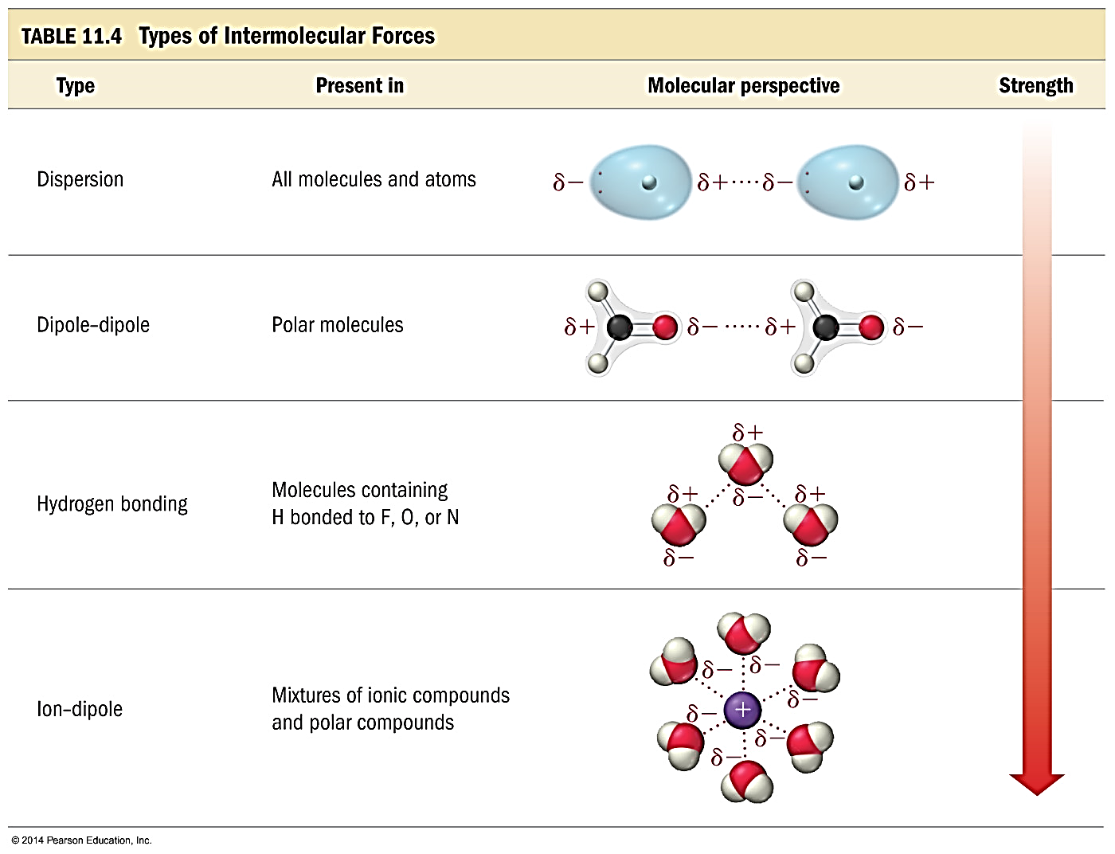
Summary Generic Ranking of Common IMFs
Dispersion
Dipole-Dipole
Hydrogen Bonding
Ion-Dipole

Slide 37
YouTube Link to Presentation:
https://youtu.be/i4JT1_E9kCs

