Slide 1
Intermolecular Forces an introduction

Slide 2
Intermolecular Attractions
The strength of the attractions between the particles of a substance determines its state.
At room temperature, moderate to strong attractive forces result in materials being solids or liquids.
The stronger the attractive forces are, the higher will be the boiling point of the liquid and the melting point of the solid.
Other factors also influence the melting point.

Slide 3
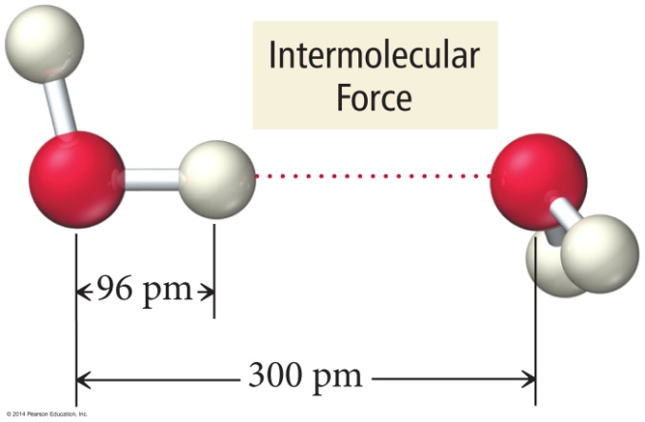
Why Are Molecules Attracted to Each Other?
Intermolecular attractions are due to attractive forces between opposite charges.
+ ion to − ion
+ end of polar molecule to − end of polar molecule
H-bonding especially strong
Even nonpolar molecules will have temporary charges

Slide 4
Why Are Molecules Attracted to Each Other?
Larger charge = stronger attraction
Longer distance = weaker attraction
However, these attractive forces are small relative to the bonding forces between atoms.
Generally smaller charges
Generally over much larger distances

Slide 5
Trends in the Strength of Intermolecular Attraction
The stronger the attractions between the atoms or molecules, the more energy it will take to separate them.

Slide 6
Trends in the Strength of Intermolecular Attraction
Boiling a liquid requires that we add enough energy to overcome all the attractions between the particles.
However, not breaking the covalent bonds

Slide 7
Trends in the Strength of Intermolecular Attraction
The higher the normal boiling point of the liquid, the stronger the intermolecular attractive forces.
Normal BP: vapor pressure = atmospheric pressure

Slide 8
Kinds of Attractive Forces
Temporary polarity in the molecules due to unequal electron distribution leads to attractions called London dispersion forces.

Slide 9
Kinds of Attractive Forces
Permanent polarity in the molecules due to their structure leads to attractive forces called dipole–dipole attractions.

Slide 10
Kinds of Attractive Forces
An especially strong dipole–dipole attraction results when H is attached to an extremely electronegative atom [N,O,F]. These are called hydrogen bonds.

Slide 11
Relative Magnitudes of Forces
The types of bonding forces vary in their strength as measured by average bond energy.
Strongest
Weakest
Network Covalent bonds (400 kcal/mol)
Hydrogen bonding (12-16 kcal/mol)
Dipole-dipole interactions (2-0.5 kcal/mol)
London forces (less than 1 kcal/mol)

Slide 12
Practice
What type of IMF is in
H₂O?
Hydrogen Bonding

Slide 13
Practice
What type of IMF is in
Ammonia?
Hydrogen Bonding

Slide 14
Practice
What type of IMF is in
HCl?
Dipole-Dipole

Slide 15
Practice
What type of IMF is in
CO₂?
Londone Dispersion

Slide 16
Practice
What type of IMF is in
CH₄?
London Dispersion

Slide 17
Practice
What type of IMF is in
Hydrogen Sulfide?
Dipole-Dipole

