Slide 1
Intermolecular Forces Going in-depth

Slide 2
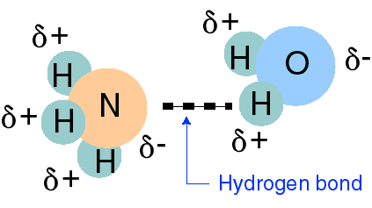
Hydrogen Bonding
Bonding between hydrogen and more electronegative neighboring atoms such as oxygen and nitrogen
Hydrogen bonding between ammonia and water

Slide 3
Hydrogen Bonding in DNA
Thymine hydrogen bonds to Adenine
T
A

Slide 4
Hydrogen Bonding in DNA
Cytosine hydrogen bonds to Guanine
C
G

Slide 5
Hydrogen Bonding
When a very electronegative atom is bonded to hydrogen, it strongly pulls the bonding electrons toward it.
:O─H, :N─H, or :F─H
Because hydrogen has no other electrons, when its electron is pulled away, the nucleus becomes de-shielded, exposing the H proton.
The exposed proton acts as a very strong center of positive charge, attracting all the electron clouds from neighboring molecules.

Slide 6
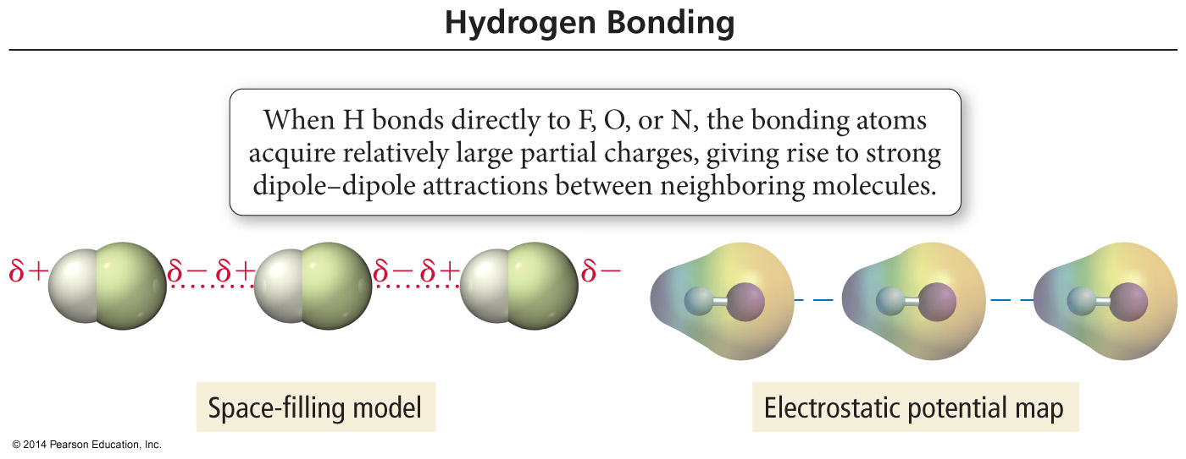
Hydrogen Bonding

Slide 7
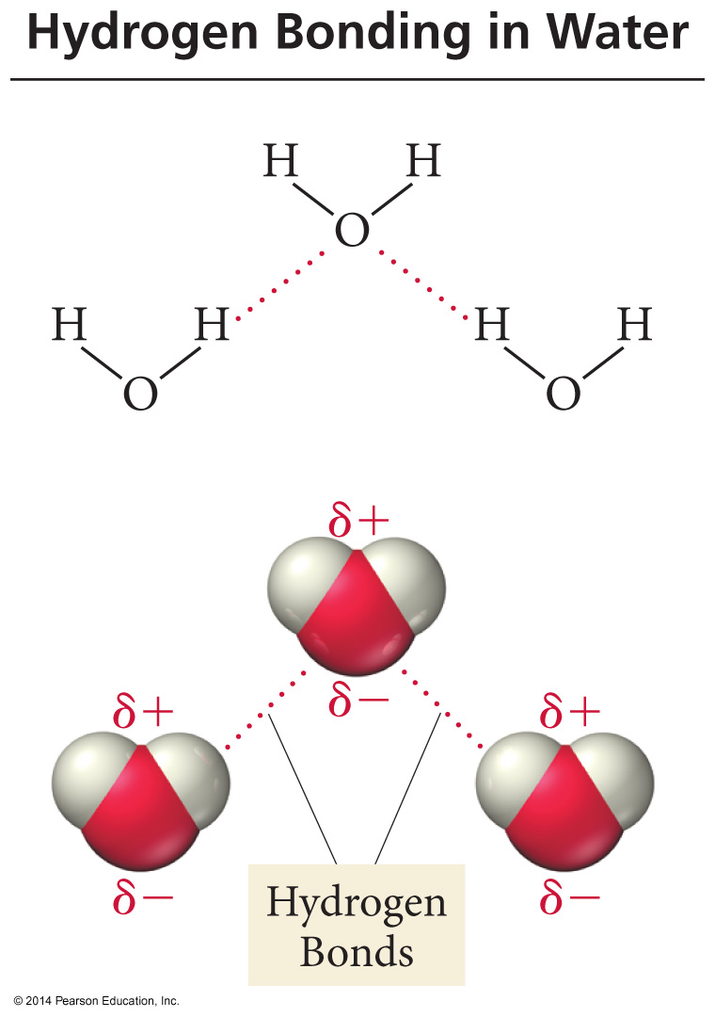
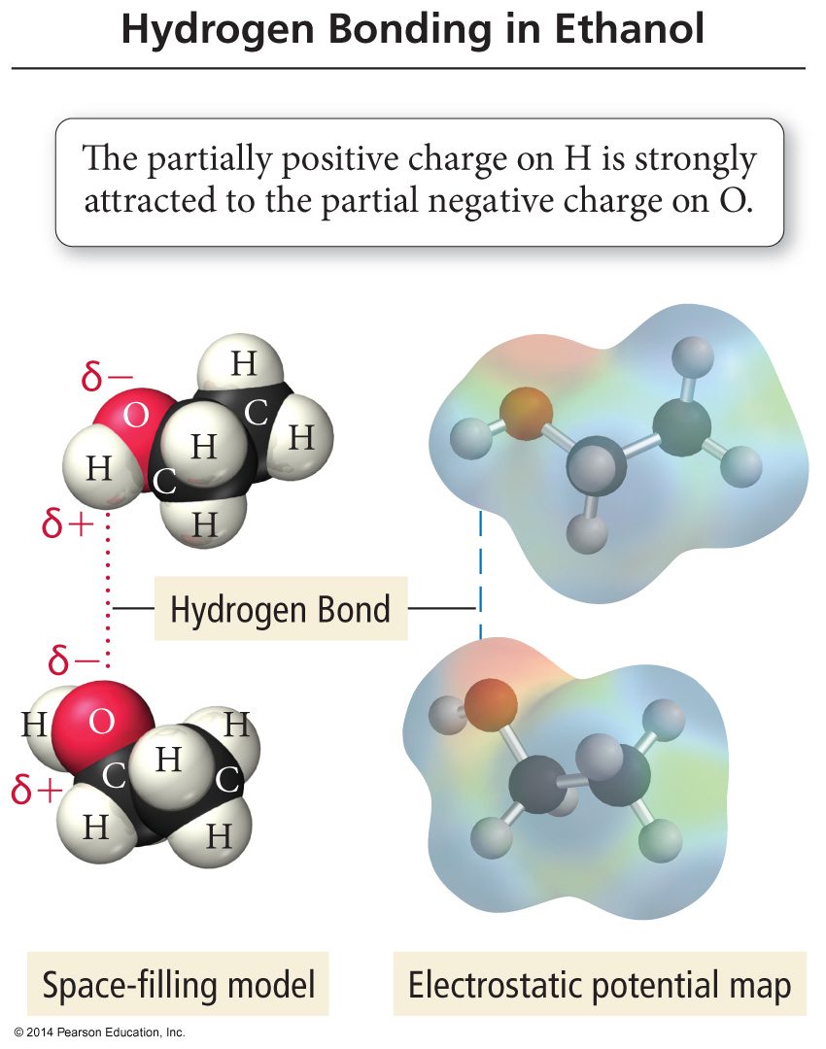
H–Bonding in Water and Ethanol

Slide 8
Hydrogen Bonds
Hydrogen bonds are very strong intermolecular attractive forces.
Stronger than dipole–dipole or dispersion forces
Substances that can hydrogen bond will have higher boiling points and melting points than similar substances that cannot.
But hydrogen bonds are not nearly as strong as chemical bonds.
2–5% the strength of covalent bonds

Slide 9
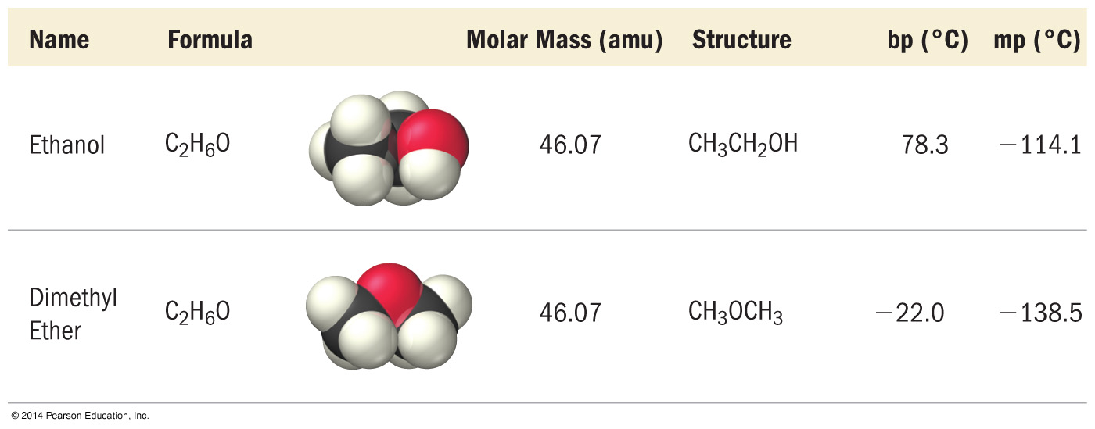
Effect of H–Bonding on BP

Slide 10
Dipole–Dipole Attractions
Polar molecules have a permanent dipole.
Bond polarity and shape
Dipole moment
The always present induced dipole
The permanent dipole adds to the attractive forces between the molecules, raising the boiling and melting points relative to nonpolar molecules of similar size and shape.

Slide 11
Dipole–Dipole Attractions

Slide 12
Effect of Dipole–Dipole Attraction on BP and MP

Slide 13
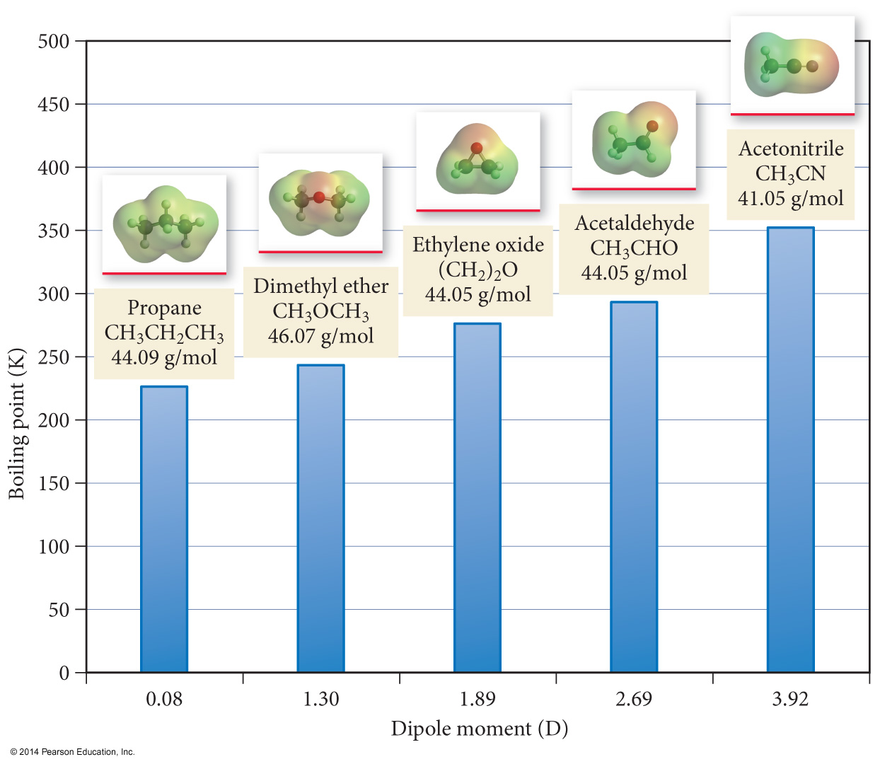
Dipole Movement and Boiling Point

Slide 14
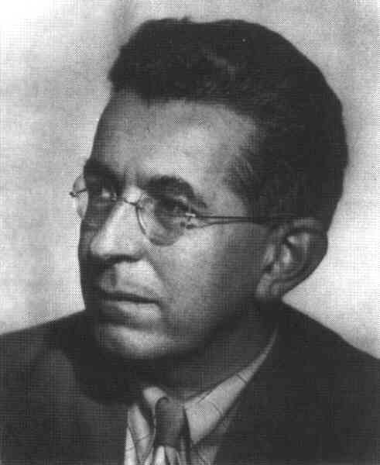
London Dispersion Forces
The temporary separations of charge that lead to the London force attractions are what attract one nonpolar/noble gas molecule to its neighbors.
London forces increase with the size of the molecules and increase in number of e-’s.
Fritz London
1900-1954

Slide 15
Dispersion Forces
Fluctuations in the electron distribution in atoms and molecules result in a temporary dipole.
Region with excess electron density has partial (–) charge
Region with depleted electron density has partial (+) charge
The attractive forces caused by these temporary dipoles are called dispersion forces.
Aka London Forces

Slide 16
Dispersion Forces
All molecules and atoms will have them.
As a temporary dipole is established in one molecule, it induces a dipole in all the surrounding molecules.

Slide 17
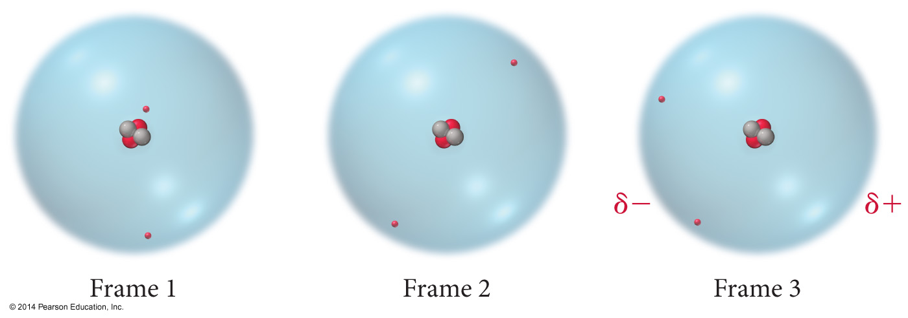
Dispersion Force

Slide 18
Dispersion Force

Slide 19
Size of the Induced Dipole
The magnitude of the induced dipole depends on several factors.
Polarizability of the electrons
Volume of the electron cloud
Larger molar mass = more electrons = larger electron cloud = increased polarizability = stronger attractions
Shape of the molecule
More surface-to-surface contact = larger induced dipole = stronger attraction

Slide 20
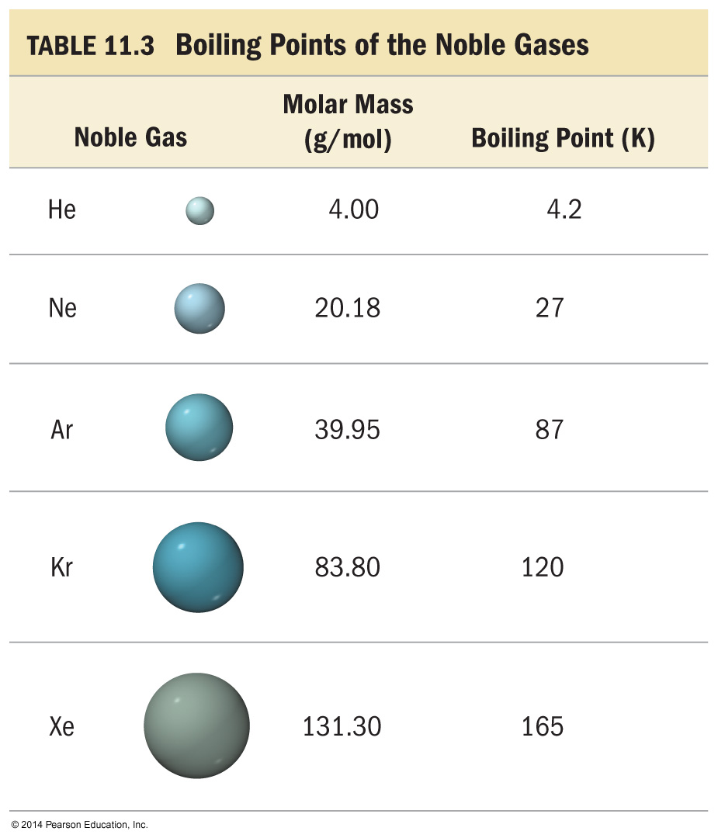
Effect of Molecular Size on Size of Dispersion Force
The Noble gases are all nonpolar atomic elements.
The stronger the attractive forces between the molecules, the higher the boiling point will be.

Slide 21
Effect of Molecular Size on Size of Dispersion Force
As the molar mass increases, the number of electrons increases. Therefore, the strength of the dispersion forces increases.
The stronger the attractive forces between the molecules, the higher the boiling point will be.

Slide 22
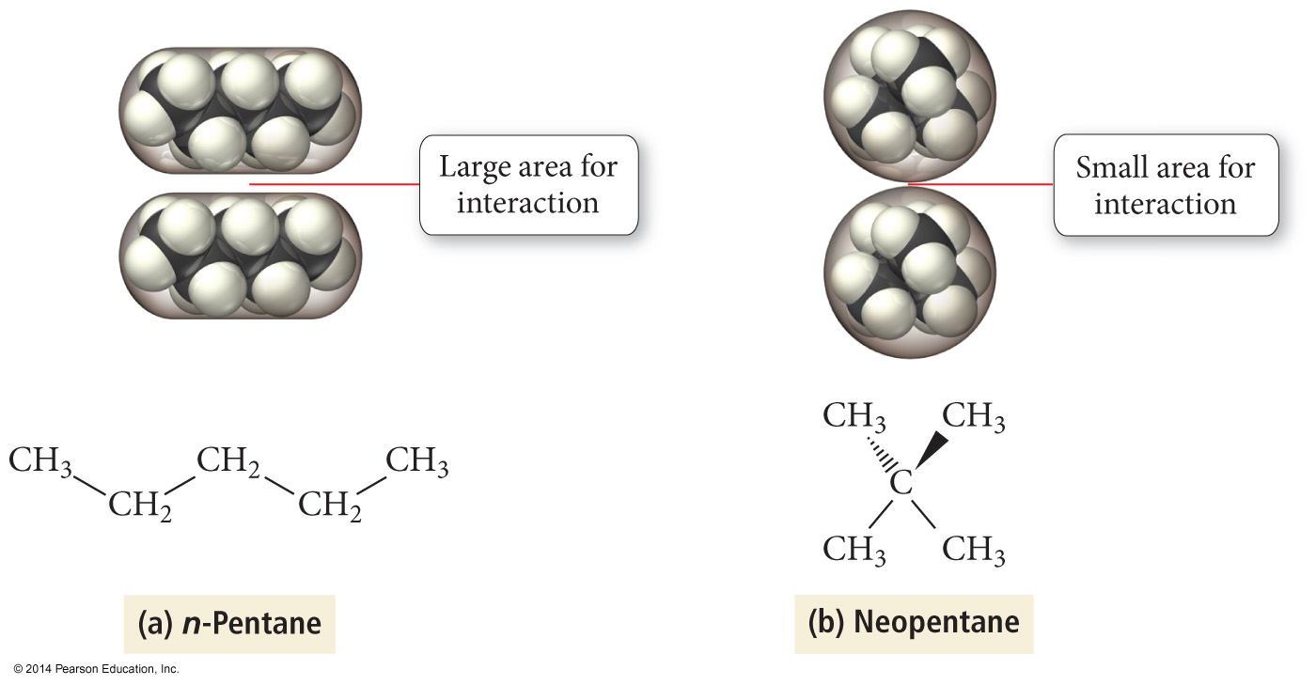
Effect of Molecular Shape on Size of Dispersion Force

Slide 23
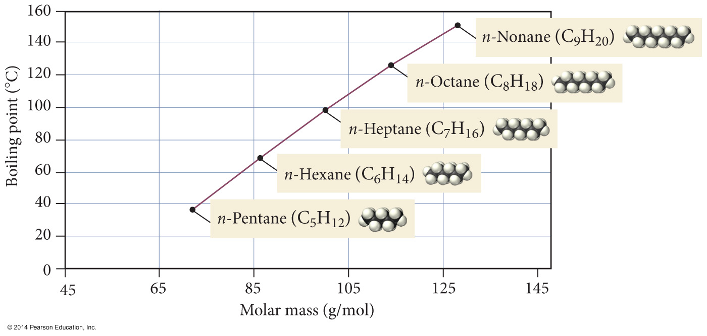
Boiling Points of n-Alkanes

Slide 24
Boiling point as a measure of intermolecular attractive forces

Slide 25
Ion–Dipole Attraction
In a mixture, ions from an ionic compound are attracted to the dipole of polar molecules.
The strength of the ion–dipole attraction is one of the main factors that determines the solubility of ionic compounds in water.

Slide 26
Summary
Dispersion forces are the weakest of the intermolecular attractions.
Dispersion forces are present in all molecules and atoms.
The magnitude of the dispersion forces increases with molar mass.
Polar molecules also have dipole–dipole attractive forces.

Slide 27
Summary (cont.)
Hydrogen bonds are the strongest of the intermolecular attractive forces a pure substance can have.
Hydrogen bonds will be present when a molecule has H directly bonded to either O, N, or F atoms.
The only example of H bonded to F is HF.
Ion–dipole attractions are present in mixtures of ionic compounds with polar molecules.
Ion–dipole attractions are the strongest intermolecular attraction.
Ion–dipole attractions are especially important in aqueous solutions of ionic compounds.

Slide 28
