Slide 1
N30 – Intermolecular Forces
Vapor Pressure & Phase Changes

Slide 2
N30 – Intermolecular Forces
Vapor Pressure & Phase Changes
Target: I can describe the connection between IMFs and vapor pressure, and can use heating curves and phase diagrams to determine information about how substances go through phase changes

Slide 3
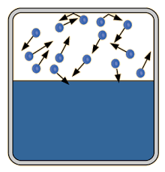
Vapor Pressure
The pressure exerted by the vapor when it is in dynamic equilibrium with its liquid
Example: using Dalton’s Law of Partial Pressures to account for the pressure of the water vapor when collecting gases by water displacement.
If there is some liquid present, then there is some vapor present!

Slide 4
Equilibrium Vapor Pressure
H₂O(l) ↔ H₂O(g)
The pressure of the vapor present at equilibrium.
Determined (mostly) by the strength of IMFs in the liquid.
Increases significantly with temperature.
Volatile liquids have high vapor pressures.
Boiling Point Temp at which vapor pressure = atmospheric pressure

Slide 5
Vapor Pressure
The weaker the attractive forces between the molecules, the more molecules will be in the vapor.
WEAKER attractive forces = HIGHER vapor pressure.
The higher the vapor pressure, the more volatile the liquid.
HIGH IMF’s
LOW Vapor Pressure
LOW IMF’s
HIGH Vapor Pressure

Slide 6
Vapor-Liquid Dynamic Equilibrium
Normally... A(l) + B(l) ↔ C(g) + D(g)
K = (P_{C})(P_{D})
If you decrease volume of container, P increases.
Therefore Q is larger than K.
Reverse reaction rate increases until you reestablish equilibrium
Same K, new P_{C} and P_{D} values
Pretend K = 6 6 = (6)(1) or (3)(2) or (6)(1), etc
Remember from Honors Chem? →
During Stress
After
Stress
Before Stress

Slide 7
Vapor-Liquid Dynamic Equilibrium
BUT... H₂O(l) ↔ H₂O(g)
K = (P_{H2O})
If you decrease volume of container, P increases.
Therefore Q is larger than K.
Reverse reaction rate increases until you reestablish equilibrium
But your ending pressure of water HAS to match what it was before!!!
Because there is only ONE component in your K expression!!!
Pretend K = 6, so P_{H2O} has to be 6 every time!
During Stress
Before Stress
After
Stress

Slide 8
Explain Vapor-Liquid Dynamic Equilibrium
So what if this time...
If you ↑ Volume of chamber = ↓ Pressure inside chamber
Then there are fewer vapor molecules in a given volume
Causing the rate of condensation to slow.
Therefore, for a period of time, the rate of vaporization will be faster than the rate of condensation,
Causing the amount of vapor to increase.

Slide 9
Explain Vapor-Liquid Dynamic Equilibrium
Eventually enough vapor accumulates
Until the rate of the condensation increases to the point where it is once again as fast as evaporation.
Causing equilibrium to be reestablished!
Therefore the vapor pressure will be back to the original!
This time the equilibrium point will be the SAME as it started. Different than a “normal” eq. scenario where it goes back towards the original but never reaches it.

Slide 10
Water phase changes
Phase Changes
constant
Temperature remains __________
during a phase change.

Slide 11
Heating Curves
REVIEW THE HONORS CHEM MATERIAL!
Not going to cover it again...but it will show up on exams!

Slide 12
Phase Diagrams
Represents phases as a function of temperature and pressure.

Slide 13
Phase Diagrams
Critical temperature: temperature above which the vapor can not be liquefied.
Critical pressure
Pressure required to liquefy AT the critical temperature.
Critical point
Critical temperature and pressure
(for water, T_{c} = 374°C and 218 atm).

Slide 14
Phase Diagrams
Triple Point
The point at which all three phases are present at the same time.

Slide 15
Phase Changes by Name

Slide 16
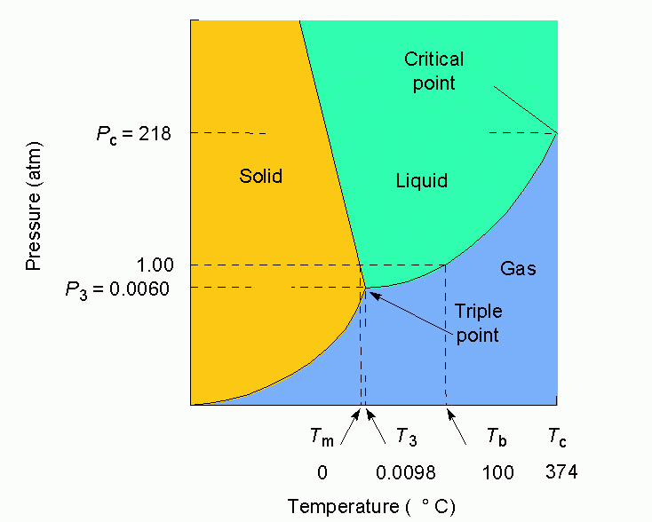
Water
Do you notice how the slope between solid and liquid has a negative slope?
That is not common.
Its because the solid phase of water is less dense than the liquid.

Slide 17
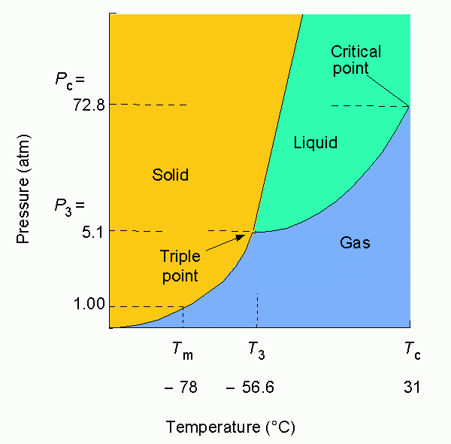
Carbon dioxide
This time the slope between solid and liquid is a positive slope.
More common.
Solid is more dense than the liquid.

Slide 18
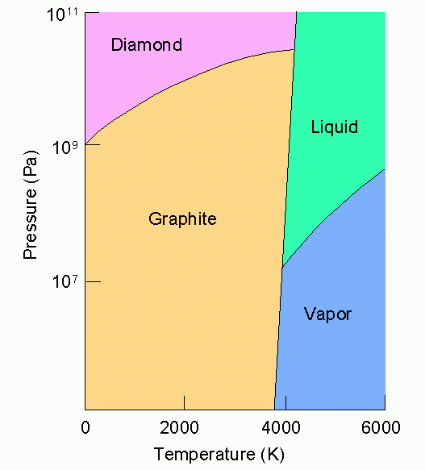
Carbon
Some substances have more phases than we are used to seeing because there might be different versions of the solid. Different crystal structures.
See how carbon can be diamond or graphite when solid?
At higher pressures it is diamond.

Slide 19
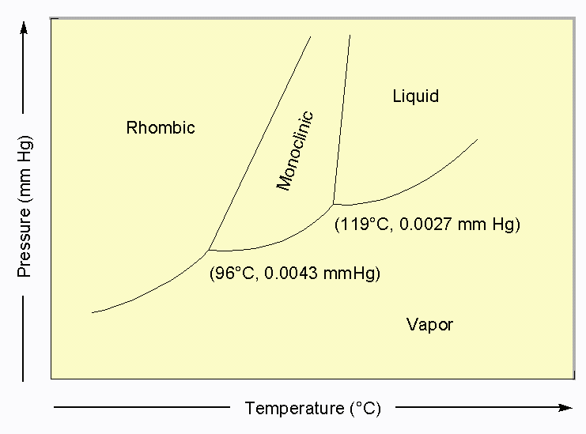
Sulfur

Slide 20
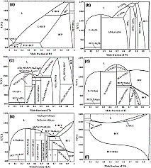
They get REALLY crazy!

Slide 21
YouTube Link to Presentation:
https://youtu.be/LTxUFe7jIV4

Slide 22
Can stop here! Different types of crystal structures are not covered anymore. You can keep going if interested though!

Slide 23
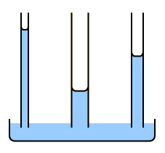
Some Properties of a Liquid
Surface Tension: The resistance to an increase in its surface area (polar molecules, liquid metals).
Capillary Action: Spontaneous rising of a liquid in a narrow tube.

Slide 24
Some Properties of a Liquid
Viscosity: Resistance to flow
High viscosity is an
indication of strong
intermolecular forces

Slide 25
Types of Solids
Crystalline Solids: highly regular arrangement of their components

Slide 26
Types of Solids
Amorphous solids: considerable disorder in their structures (glass).

Slide 27
Representation of Components in a Crystalline Solid
Lattice: A 3-dimensional system of points designating the centers of components (atoms, ions, or molecules) that make up the substance.

Slide 28
Crystal Structures - Cubic
Simple
Face-Centered
Body-Centered

Slide 29
Crystal Structures - Monoclinic
Simple
End Face-Centered

Slide 30
Crystal Structures - Tetragonal
Simple
Body-Centered

Slide 31
Crystal Structures - Orthorhombic
Simple
End
Face-Centered
Body
Centered
Face
Centered

Slide 32
Crystal Structures – Other Shapes
Rhombohedral
Hexagonal
Triclinic

Slide 33
Packing in Metals
Packing uniform, hard spheres to best use available space. This is called closest packing. Each atom has 12 nearest neighbors.

Slide 34
Closest Packing Holes

Slide 35
Metal Alloys
Substitutional Alloy: some metal atoms replaced by others of similar size.
Brass = Cu/Zn
Bronze = Sn/Cu

Slide 36
Metal Alloys
Interstitial Alloy: Interstices (holes) in closest packed metal structure are occupied by small atoms.
steel = iron + carbon

