Slide 1
Intermolecular Forces Vapor Pressure & Phase Diagrams

Slide 2
Equilibrium Vapor Pressure
The pressure of the vapor present at equilibrium.
Determined principally by the size of the intermolecular forces in the liquid.
Increases significantly with temperature.
Volatile liquids have high vapor pressures.
B.P. T at which vapor pressure = atmospheric pressure

Slide 3
Vapor Pressure
The pressure exerted by the vapor when it is in dynamic equilibrium with its liquid is called the vapor pressure.
Remember using Dalton’s Law of Partial Pressures to account for the pressure of the water vapor when collecting gases by water displacement?
The weaker the attractive forces between the molecules, the more molecules will be in the vapor.
Therefore, the weaker the attractive forces, the higher the vapor pressure.
The higher the vapor pressure, the more volatile the liquid.

Slide 4
Vapor–Liquid Dynamic Equilibrium
If the volume of the chamber is increased, it will decrease the pressure of the vapor inside the chamber.
At that point, there are fewer vapor molecules in a given volume, causing the rate of condensation to slow.
Therefore, for a period of time, the rate of vaporization will be faster than the rate of condensation, and the amount of vapor will increase.

Slide 5
Vapor–Liquid Dynamic Equilibrium
Eventually, enough vapor accumulates so that the rate of the condensation increases to the point where it is once again as fast as evaporation.
Equilibrium is reestablished.
At this point, the vapor pressure will be the same as it was before.

Slide 6
Water phase changes
constant
Temperature remains __________
during a phase change.
Energy

Slide 7
Phase Diagram
Represents phases as a function of temperature and pressure.
Critical temperature: temperature above which the vapor can not be liquefied.

Slide 8
Phase Diagram
Critical pressure: pressure required to liquefy AT the critical temperature.
Critical point: critical temperature and pressure (for water, T_{c} = 374°C and 218 atm).

Slide 9
Phase changes by Name

Slide 10
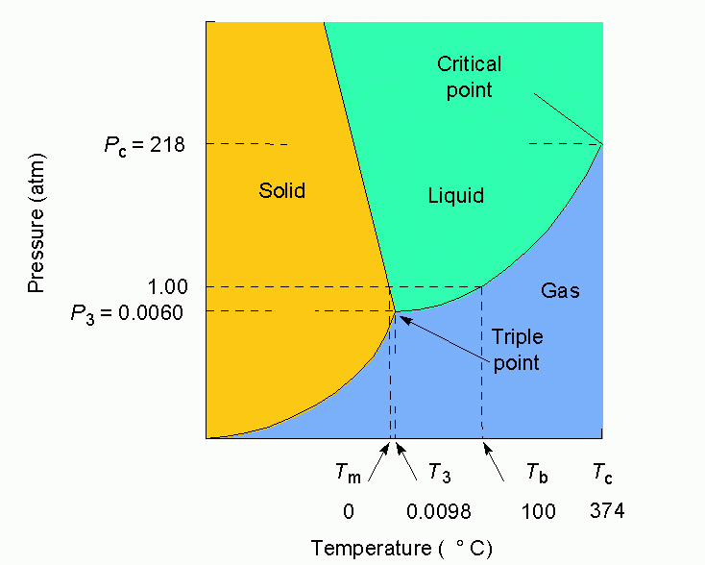
Water

Slide 11
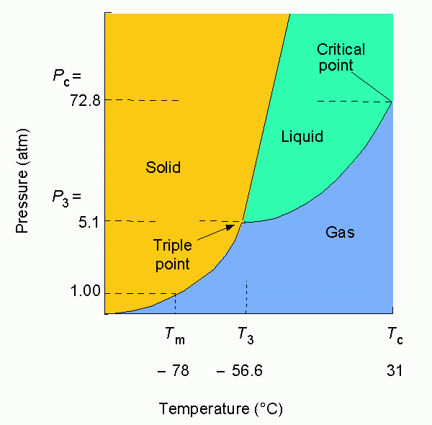
Carbon dioxide

Slide 12
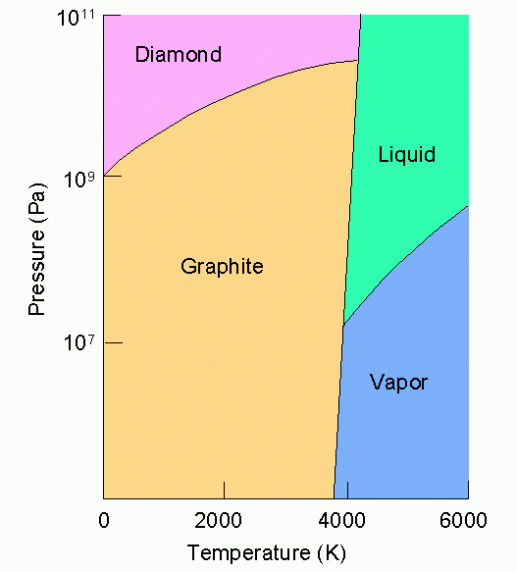
Carbon

Slide 13
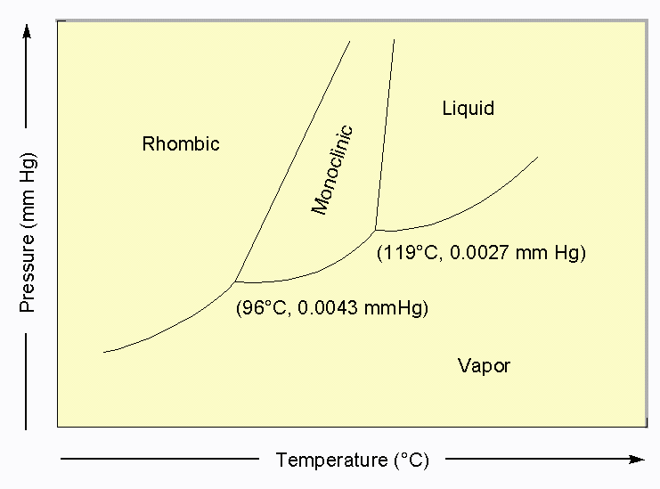
Sulfur

Slide 14
Stop

Slide 15
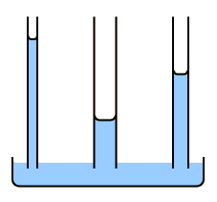
Some Properties of a Liquid
Surface Tension: The resistance to an increase in its surface area (polar molecules, liquid metals).
Capillary Action: Spontaneous rising of a liquid in a narrow tube.

Slide 16
Some Properties of a Liquid
Viscosity: Resistance to flow
High viscosity is an
indication of strong
intermolecular forces

Slide 17
Types of Solids
Crystalline Solids: highly regular arrangement of their components

Slide 18
Types of Solids
Amorphous solids: considerable disorder in their structures (glass).

Slide 19
Representation of Components in a Crystalline Solid
Lattice: A 3-dimensional system of points designating the centers of components (atoms, ions, or molecules) that make up the substance.

Slide 20
Crystal Structures - Cubic
Simple
Face-Centered
Body-Centered

Slide 21
Crystal Structures - Monoclinic
Simple
End Face-Centered

Slide 22
Crystal Structures - Tetragonal
Simple
Body-Centered

Slide 23
Crystal Structures - Orthorhombic
Simple
End
Face-Centered
Body
Centered
Face
Centered

Slide 24
Crystal Structures – Other Shapes
Rhombohedral
Hexagonal
Triclinic

Slide 25
Packing in Metals
Model: Packing uniform, hard spheres to best use available space. This is called closest packing. Each atom has 12 nearest neighbors.

Slide 26
Closest Packing Holes

Slide 27
Metal Alloys
Substitutional Alloy: some metal atoms replaced by others of similar size.
brass = Cu/Zn
Bronze = Sn/Cu

Slide 28
Metal Alloys (continued)
Interstitial Alloy: Interstices (holes) in closest packed metal structure are occupied by small atoms.
steel = iron + carbon

