Slide 1
Liquids and Solids ---IMF---

Slide 2
Intermolecular Attractions
The strength of the attractions between the particles of a substance determines its state.
At room temperature, moderate to strong attractive forces result in materials being solids or liquids.
The stronger the attractive forces are, the higher will be the boiling point of the liquid and the melting point of the solid.
Other factors also influence the melting point.

Slide 3
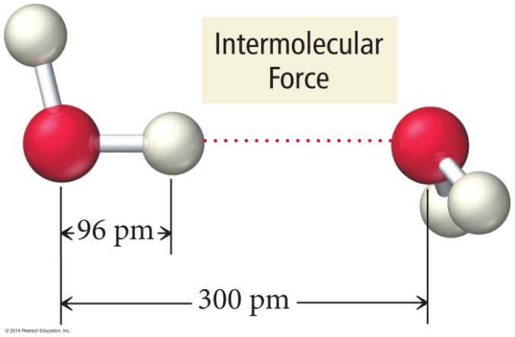
Why Are Molecules Attracted to Each Other?
Intermolecular attractions are due to attractive forces between opposite charges.
+ ion to − ion
+ end of polar molecule to − end of polar molecule
H-bonding especially strong
Even nonpolar molecules will have temporary charges
Larger charge = stronger attraction
Longer distance = weaker attraction
However, these attractive forces are small relative to the bonding forces between atoms.
Generally smaller charges
Generally over much larger distances

Slide 4
Trends in the Strength of Intermolecular Attraction
The stronger the attractions between the atoms or molecules, the more energy it will take to separate them.
Boiling a liquid requires that we add enough energy to overcome all the attractions between the particles.
However, not breaking the covalent bonds
The higher the normal boiling point of the liquid, the stronger the intermolecular attractive forces.

Slide 5
Kinds of Attractive Forces
Temporary polarity in the molecules due to unequal electron distribution leads to attractions called London dispersion forces.
Permanent polarity in the molecules due to their structure leads to attractive forces called dipole–dipole attractions.
An especially strong dipole–dipole attraction results when H is attached to an extremely electronegative atom. These are called hydrogen bonds.

Slide 6
Relative Magnitudes of Forces
The types of bonding forces vary in their strength as measured by average bond energy.
Strongest
Weakest
Network Covalent bonds (400 kcal/mol)
Hydrogen bonding (12-16 kcal/mol )
Dipole-dipole interactions (2-0.5 kcal/mol)
London forces (less than 1 kcal/mol)

Slide 7
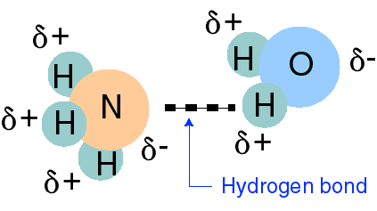
Hydrogen Bonding
Bonding between hydrogen and more electronegative neighboring atoms such as oxygen and nitrogen
Hydrogen bonding between ammonia and water

Slide 8
Hydrogen Bonding in DNA
Thymine hydrogen bonds to Adenine
T
A

Slide 9
Hydrogen Bonding in DNA
Cytosine hydrogen bonds to Guanine
C
G

Slide 10
Hydrogen Bonding
When a very electronegative atom is bonded to hydrogen, it strongly pulls the bonding electrons toward it.
:O─H, :N─H, or :F─H
Because hydrogen has no other electrons, when its electron is pulled away, the nucleus becomes de-shielded, exposing the H proton.
The exposed proton acts as a very strong center of positive charge, attracting all the electron clouds from neighboring molecules.

Slide 11
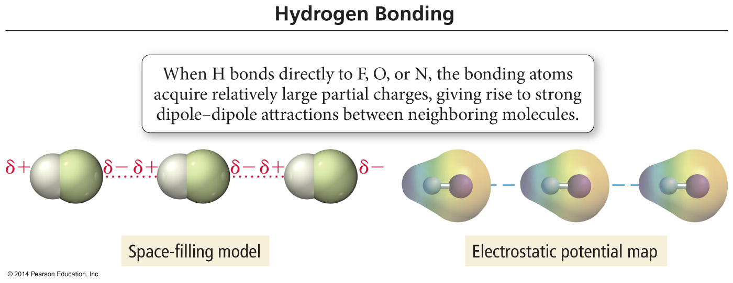
Hydrogen Bonding

Slide 12
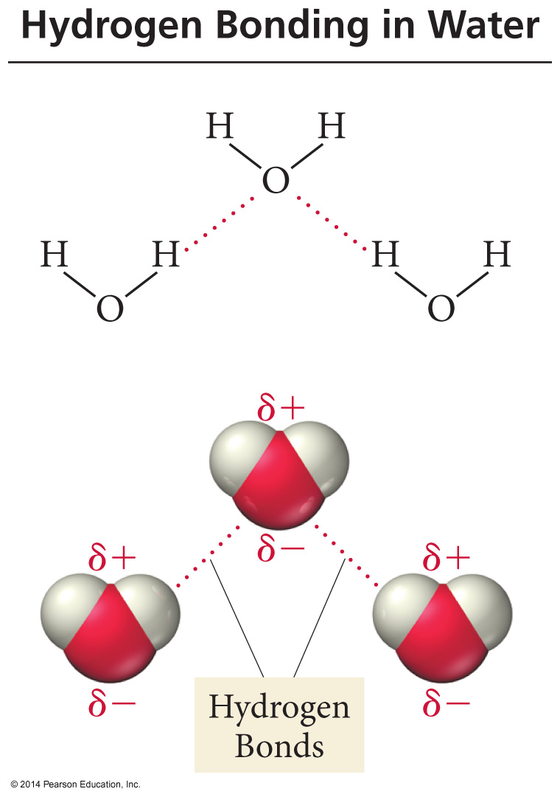
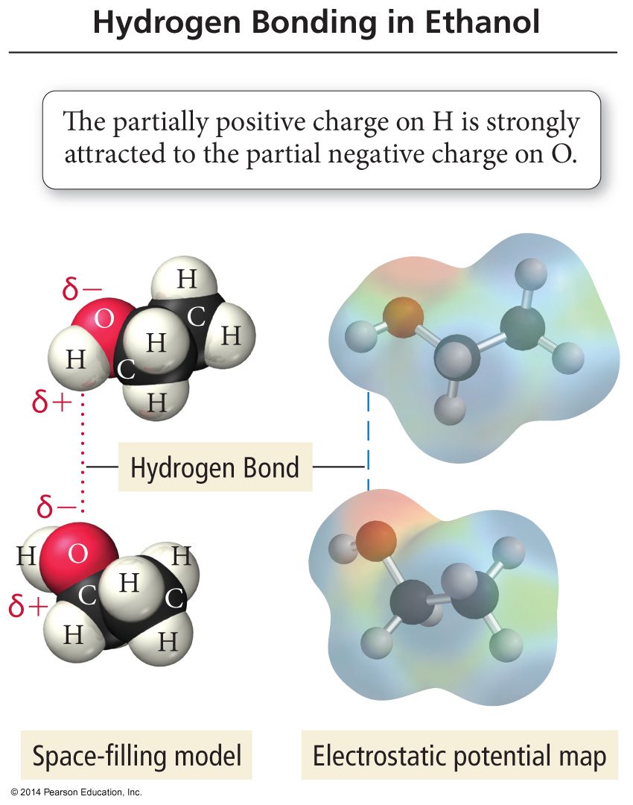
H–Bonding in Water and Ethanol

Slide 13
H–Bonds
Hydrogen bonds are very strong intermolecular attractive forces.
Stronger than dipole–dipole or dispersion forces
Substances that can hydrogen bond will have higher boiling points and melting points than similar substances that cannot.
But hydrogen bonds are not nearly as strong as chemical bonds.
2–5% the strength of covalent bonds

Slide 14
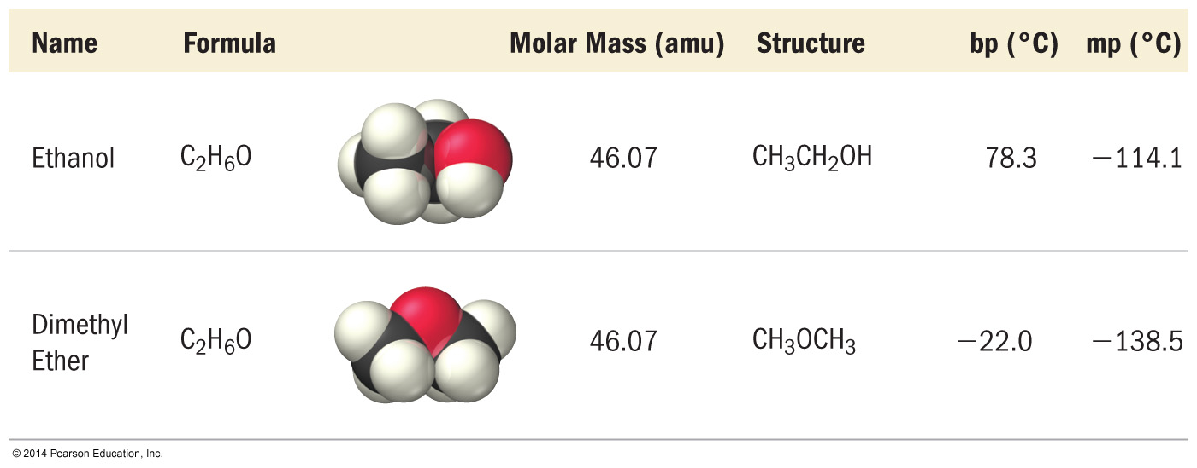
Effect of H–Bonding on Boiling Point

Slide 15
Dipole–Dipole Attractions
Polar molecules have a permanent dipole.
Bond polarity and shape
Dipole moment
The always present induced dipole
The permanent dipole adds to the attractive forces between the molecules, raising the boiling and melting points relative to nonpolar molecules of similar size and shape.

Slide 17
Effect of Dipole–Dipole Attraction on Boiling and Melting Points

Slide 18
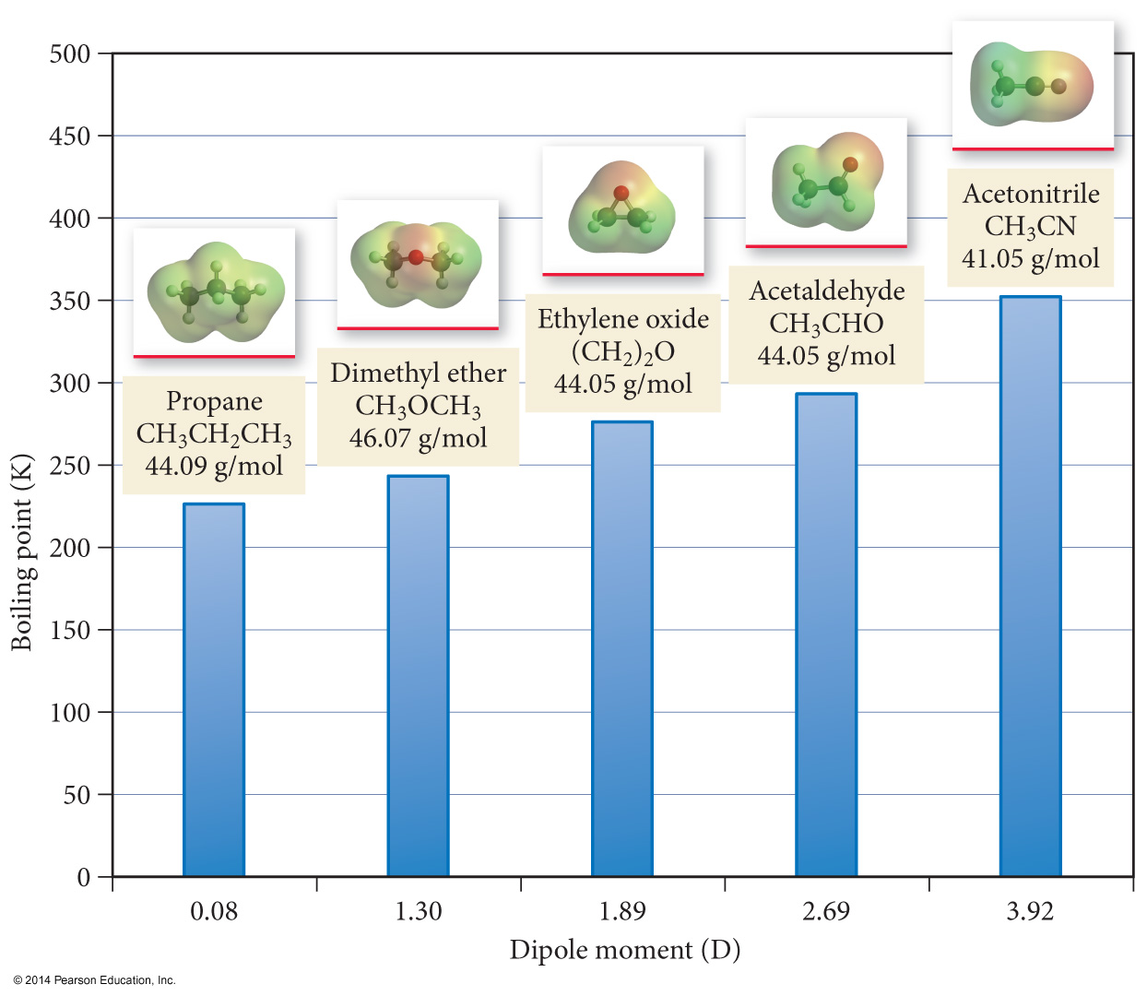
Dipole Movement and Boiling Point

Slide 19
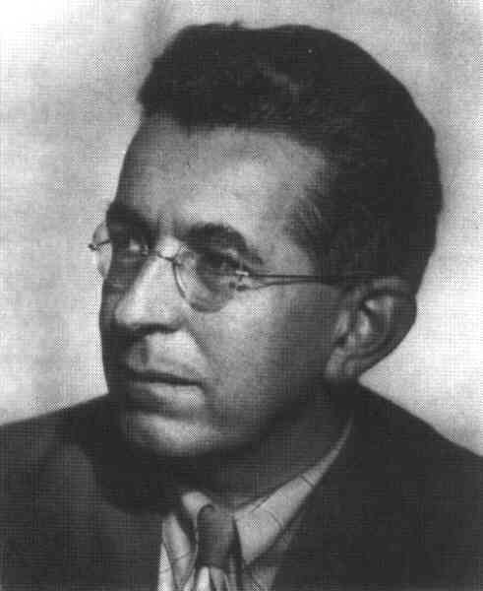
London Dispersion Forces
The temporary separations of charge that lead to the London force attractions are what attract one nonpolar/noble gas molecule to its neighbors.
London forces increase with the size of the molecules and increase in number of e-’s.
Fritz London
1900-1954

Slide 20
Dispersion Forces
Fluctuations in the electron distribution in atoms and molecules result in a temporary dipole.
Region with excess electron density has partial (–) charge
Region with depleted electron density has partial (+) charge
The attractive forces caused by these temporary dipoles are called dispersion forces.
Aka London Forces
All molecules and atoms will have them.
As a temporary dipole is established in one molecule, it induces a dipole in all the surrounding molecules.

Slide 21
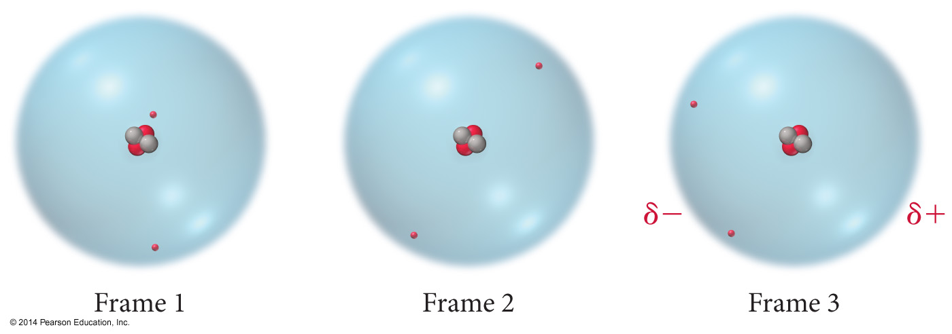
Dispersion Force

Slide 22
Dispersion Force

Slide 23
Size of the Induced Dipole
The magnitude of the induced dipole depends on several factors.
Polarizability of the electrons
Volume of the electron cloud
Larger molar mass = more electrons = larger electron cloud = increased polarizability = stronger attractions
Shape of the molecule
More surface-to-surface contact = larger induced dipole = stronger attraction

Slide 24
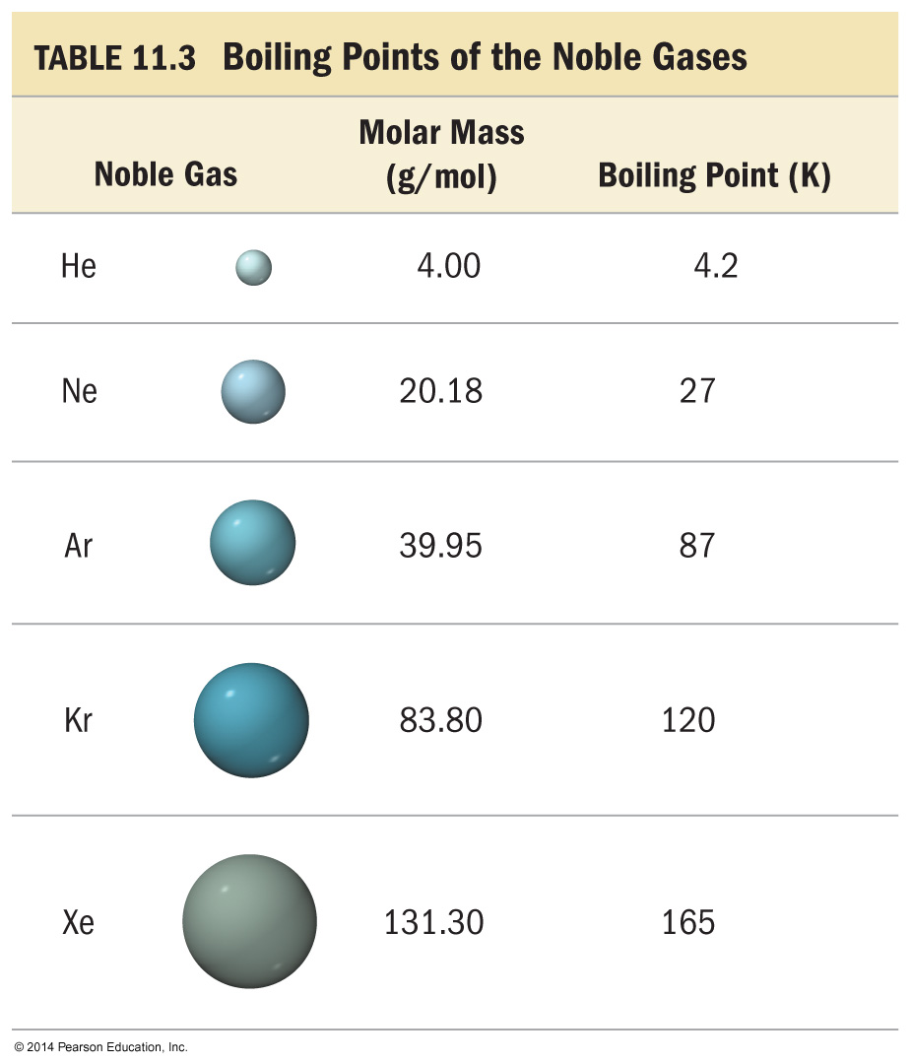
Effect of Molecular Size on Size of Dispersion Force
The Noble gases are all nonpolar atomic elements.
The stronger the attractive forces between the molecules, the higher the boiling point will be.

Slide 25
Effect of Molecular Size on Size of Dispersion Force
As the molar mass increases, the number of electrons increases. Therefore, the strength of the dispersion forces increases.
The stronger the attractive forces between the molecules, the higher the boiling point will be.

Slide 26
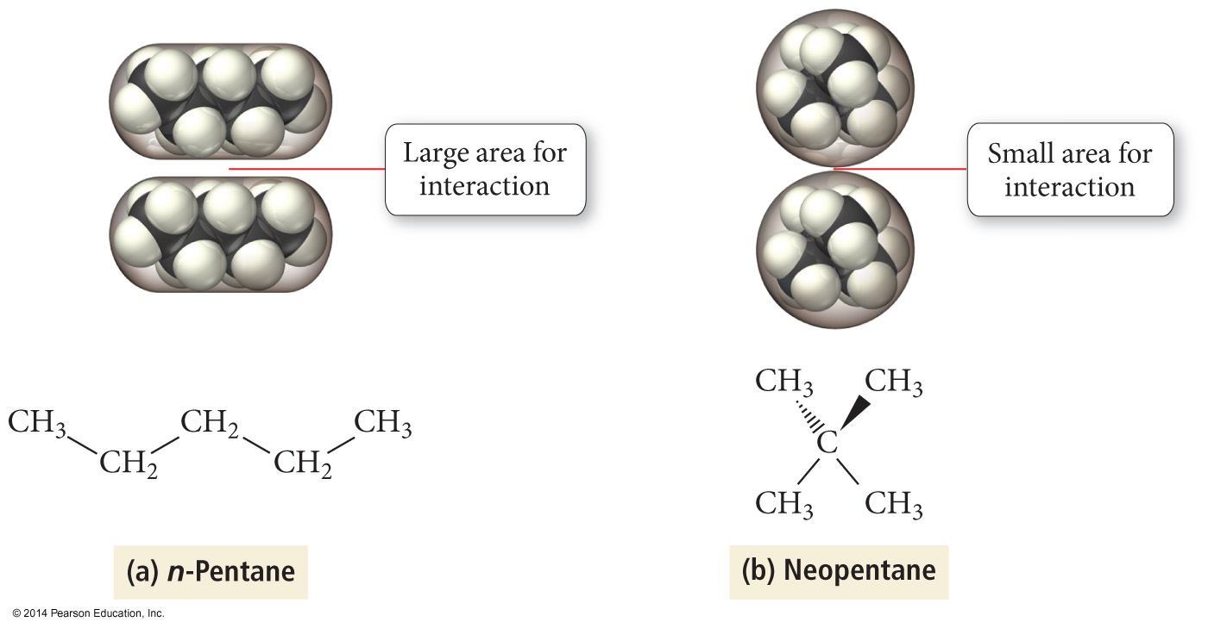
Effect of Molecular Shape on Size of Dispersion Force

Slide 27
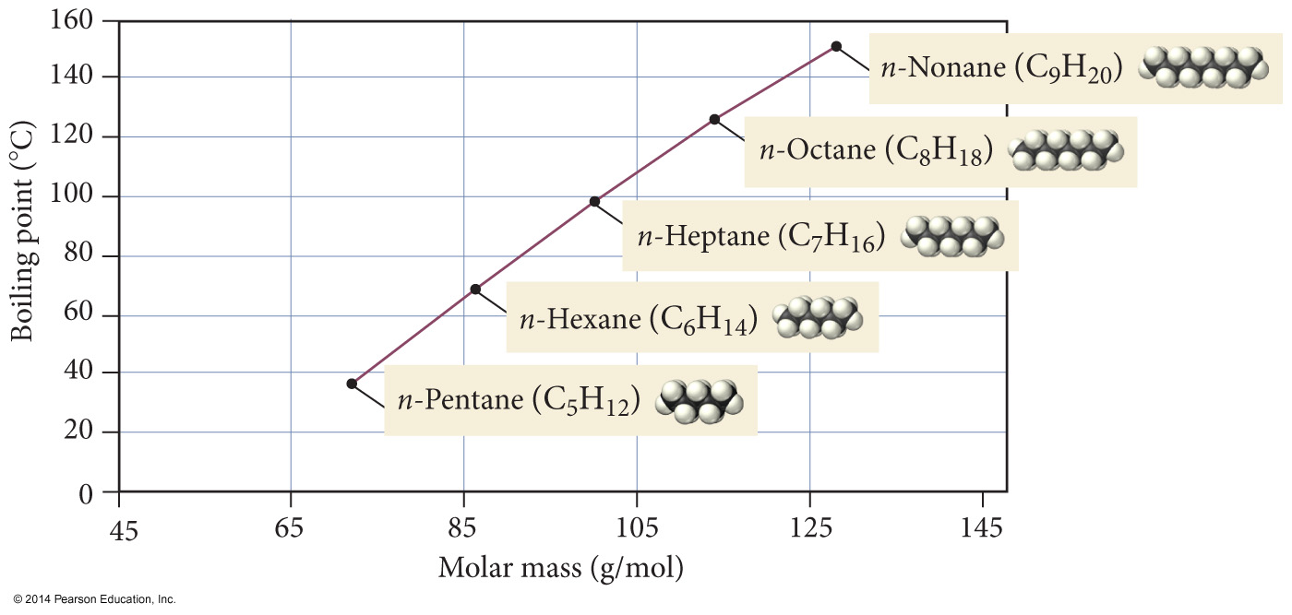
Boiling Points of n-Alkanes

Slide 28
Boiling point as a measure of intermolecular attractive forces

Slide 29
Ion–Dipole Attraction
In a mixture, ions from an ionic compound are attracted to the dipole of polar molecules.
The strength of the ion–dipole attraction is one of the main factors that determines the solubility of ionic compounds in water.

Slide 30
Summary
Dispersion forces are the weakest of the intermolecular attractions.
Dispersion forces are present in all molecules and atoms.
The magnitude of the dispersion forces increases with molar mass.
Polar molecules also have dipole–dipole attractive forces.

Slide 31
Summary (cont.)
Hydrogen bonds are the strongest of the intermolecular attractive forces a pure substance can have.
Hydrogen bonds will be present when a molecule has H directly bonded to either O, N, or F atoms.
The only example of H bonded to F is HF.
Ion–dipole attractions are present in mixtures of ionic compounds with polar molecules.
Ion–dipole attractions are the strongest intermolecular attraction.
Ion–dipole attractions are especially important in aqueous solutions of ionic compounds.

Slide 32
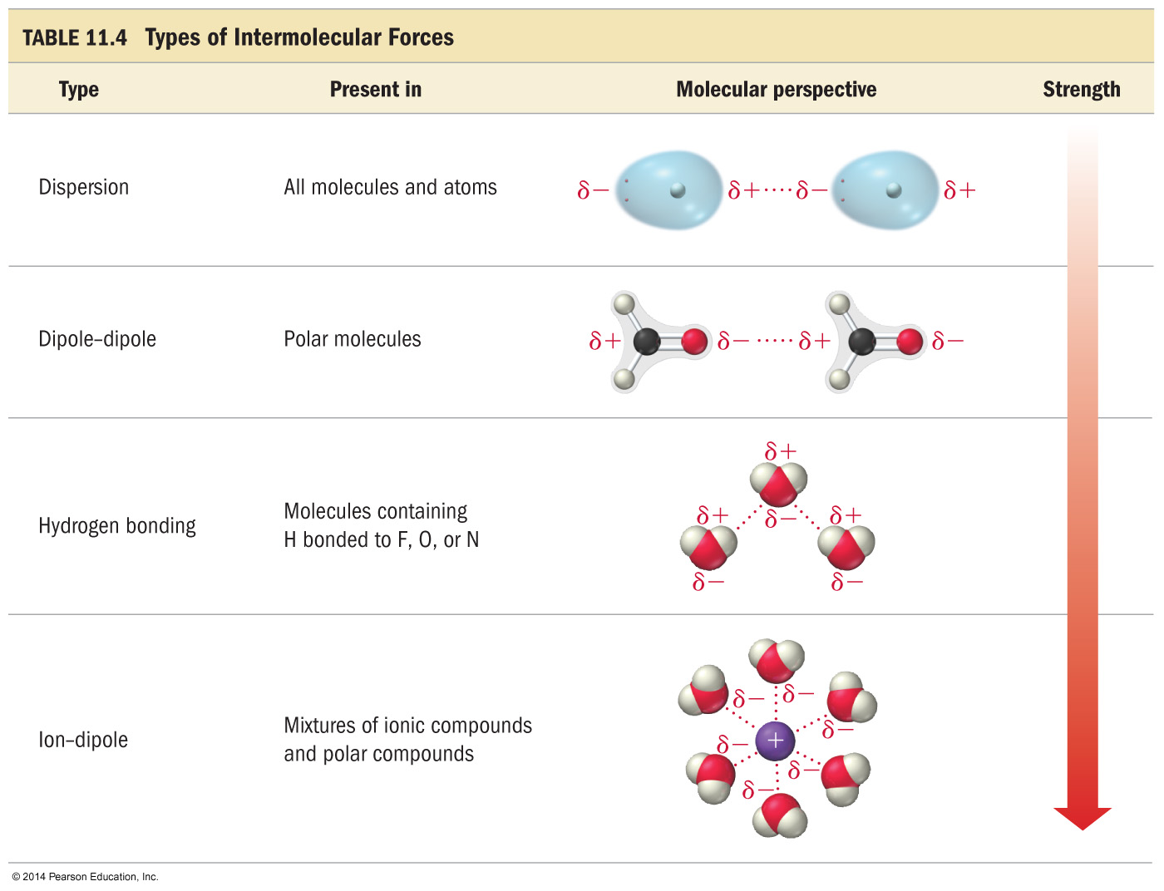

Slide 33
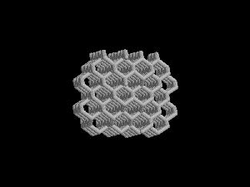
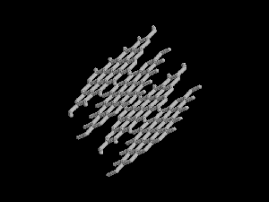
Network Atomic Solids
Some covalently bonded substances DO NOT form discrete molecules.
Diamond, a network of covalently bonded carbon atoms
Graphite, a network of covalently bonded carbon atoms

Slide 34
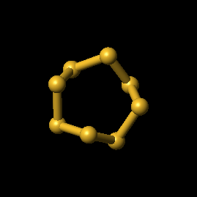
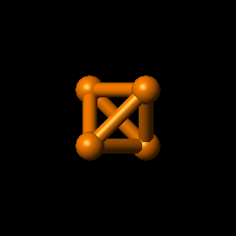
Molecular Solids
Strong covalent forces within molecules
Weak covalent forces between molecules
Sulfur, S₈
Phosphorus, P₄

Slide 35
Equilibrium Vapor Pressure
The pressure of the vapor present at equilibrium.
Determined principally by the size of the intermolecular forces in the liquid.
Increases significantly with temperature.
Volatile liquids have high vapor pressures.
B.P. T at which vapor pressure = atmospheric pressure

Slide 36
Vapor Pressure
The pressure exerted by the vapor when it is in dynamic equilibrium with its liquid is called the vapor pressure.
Remember using Dalton’s Law of Partial Pressures to account for the pressure of the water vapor when collecting gases by water displacement?
The weaker the attractive forces between the molecules, the more molecules will be in the vapor.
Therefore, the weaker the attractive forces, the higher the vapor pressure.
The higher the vapor pressure, the more volatile the liquid.

Slide 37
Vapor–Liquid Dynamic Equilibrium
If the volume of the chamber is increased, it will decrease the pressure of the vapor inside the chamber.
At that point, there are fewer vapor molecules in a given volume, causing the rate of condensation to slow.
Therefore, for a period of time, the rate of vaporization will be faster than the rate of condensation, and the amount of vapor will increase.
Eventually, enough vapor accumulates so that the rate of the condensation increases to the point where it is once again as fast as evaporation.
Equilibrium is reestablished.
At this point, the vapor pressure will be the same as it was before.

Slide 38
Water phase changes
constant
Temperature remains __________
during a phase change.
Energy

Slide 39
Phase Diagram
Represents phases as a function of temperature and pressure.
Critical temperature: temperature above which the vapor can not be liquefied.
Critical pressure: pressure required to liquefy AT the critical temperature.
Critical point: critical temperature and pressure (for water, T_{c} = 374°C and 218 atm).

Slide 40
Phase changes by Name

Slide 41
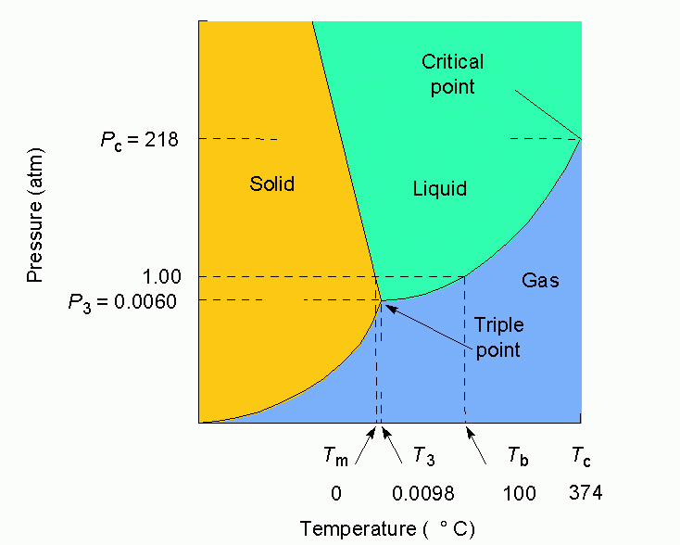
Water

Slide 42
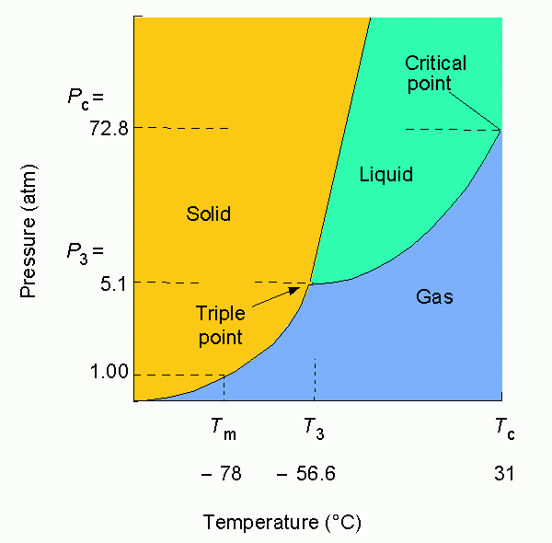
Carbon dioxide

Slide 43
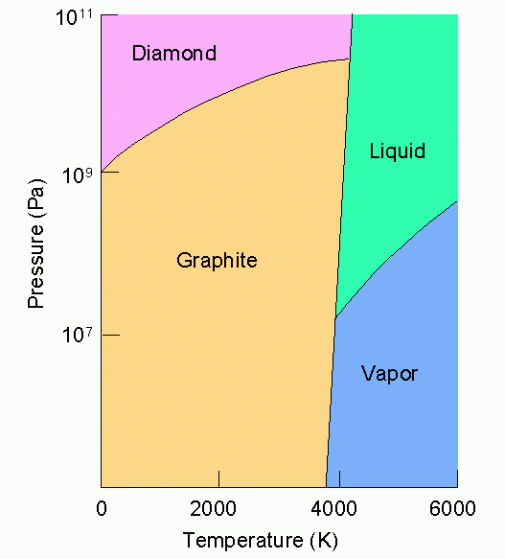
Carbon

Slide 44
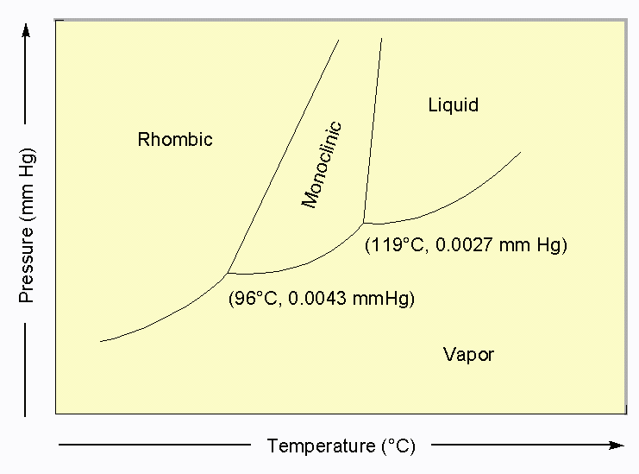
Sulfur

Slide 45
stop

Slide 46
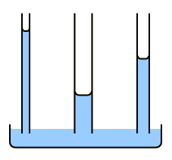
Some Properties of a Liquid
Surface Tension: The resistance to an increase in its surface area (polar molecules, liquid metals).
Capillary Action: Spontaneous rising of a liquid in a narrow tube.

Slide 47
Some Properties of a Liquid
Viscosity: Resistance to flow
High viscosity is an
indication of strong
intermolecular forces

Slide 48
Types of Solids
Crystalline Solids: highly regular arrangement of their components

Slide 49
Types of Solids
Amorphous solids: considerable disorder in their structures (glass).

Slide 50
Representation of Components in a Crystalline Solid
Lattice: A 3-dimensional system of points designating the centers of components (atoms, ions, or molecules) that make up the substance.

Slide 51
Crystal Structures - Cubic
Simple
Face-Centered
Body-Centered

Slide 52
Crystal Structures - Monoclinic
Simple
End Face-Centered

Slide 53
Crystal Structures - Tetragonal
Simple
Body-Centered

Slide 54
Crystal Structures - Orthorhombic
Simple
End
Face-Centered
Body
Centered
Face
Centered

Slide 55
Crystal Structures – Other Shapes
Rhombohedral
Hexagonal
Triclinic

Slide 56
Packing in Metals
Model: Packing uniform, hard spheres to best use available space. This is called closest packing. Each atom has 12 nearest neighbors.

Slide 57
Closest Packing Holes

Slide 58
Metal Alloys
Substitutional Alloy: some metal atoms replaced by others of similar size.
brass = Cu/Zn
Bronze = Sn/Cu

Slide 59
Metal Alloys (continued)
Interstitial Alloy: Interstices (holes) in closest packed metal structure are occupied by small atoms.
steel = iron + carbon

