Slide 1
N32 - SOLUTIONS
Target: I can perform calculations to determine if making a particular solution is an endothermic or exothermic reaction.

Slide 2
N32 - SOLUTIONS
Heat of Solution

Slide 3
Heat of Solution
The Heat of Solution is the amount of heat energy absorbed (endothermic) or released (exothermic) when a specific amount of solute dissolves in a solvent.
Substance | Heat of Solution (kJ/mol)
NaOH | -44.51
NH₄NO₃ | +25.69
KNO₃ | +34.89
HCl | -74.84

Slide 4
Heat of Solution
When some compounds, such as NaOH, dissolve in water, a lot of heat is released.
The container gets hot.
When other compounds, such as NH₄NO₃, dissolve in water, heat is absorbed from the surroundings.
The container gets cold.
Why is this???

Slide 5
Energetics of Solution Formation: The Enthalpy of Solution
To make a solution you must
Overcome all attractions between the solute particles; therefore, ΔH_{solute} is endothermic. ΔH₁
Overcome some attractions between solvent molecules; therefore, ΔH_{solvent} is endothermic. ΔH₂
3. Form new attractions between solute particles and solvent molecules; therefore, ΔH_{mix} is exothermic. ΔH₃

Slide 6
Energetics of Solution Formation: The Enthalpy of Solution
The overall ΔH for making a solution depends on the relative sizes of the ΔH for these three processes.
ΔH_{sol’n} = ΔH_{solute} + ΔH_{solvent} + ΔH_{mix}

Slide 7
The Solution Process
Step 1:
Separating the solute into its constituent particles

Slide 8
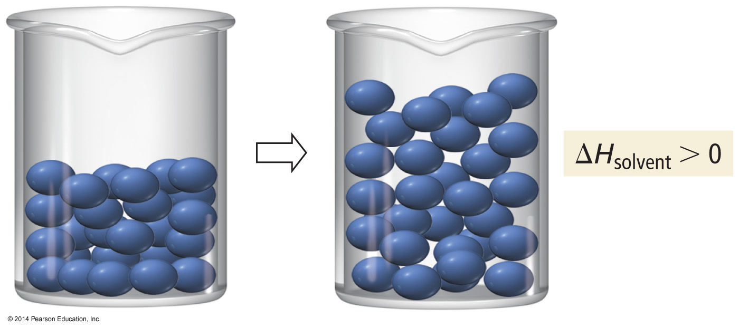
The Solution Process
Step 2:
Separating the solvent particles from each other to make room for the solute particles

Slide 9
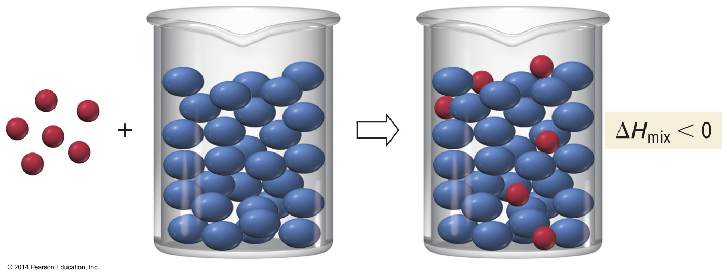
The Solution Process
Step 3:
Mixing the solute particles with the solvent particles

Slide 10
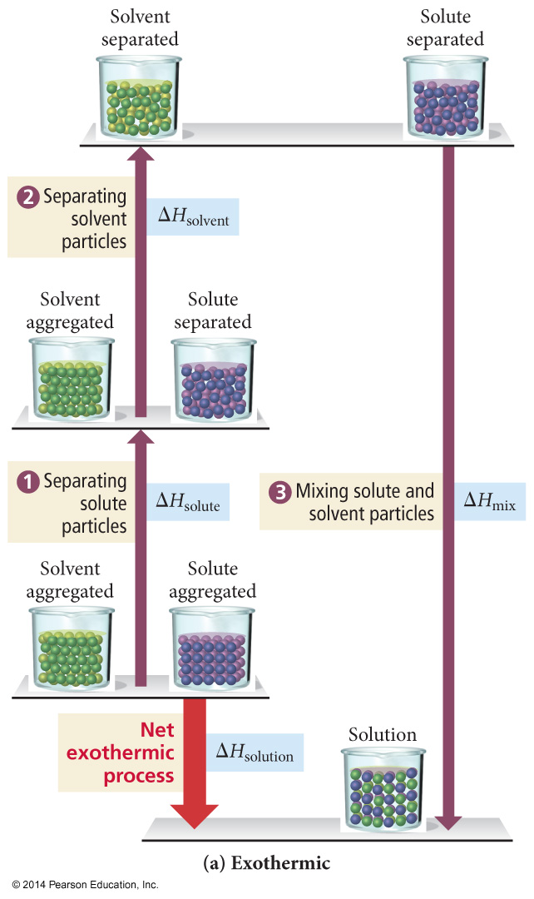
Energetics of Solution Formation
If the total energy cost for breaking attractions between particles in the pure solute and pure solvent is less than the energy released in making the new attractions between the solute and solvent, the overall process will be exothermic.

Slide 11
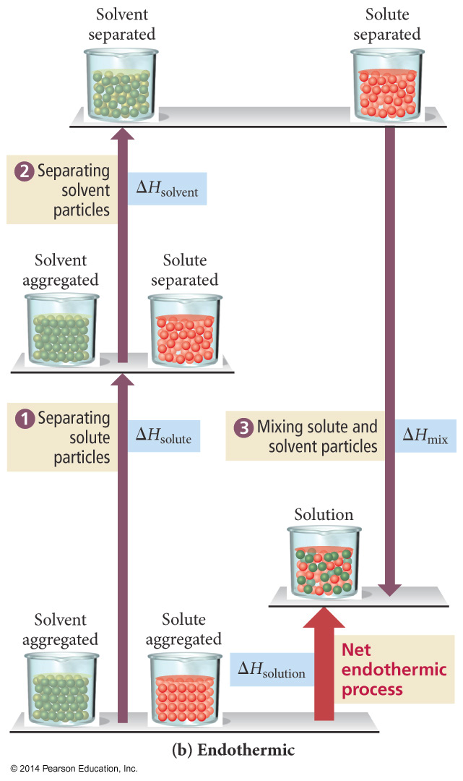
Energetics of Solution Formation
If the total energy cost for breaking attractions between particles in the pure solute and pure solvent is greater than the energy released in making the new attractions between the solute and solvent, the overall process will be endothermic.

Slide 12
Relative Interactions & Solution Formation
When endothermic -
Solute-Solvent attractions
<
Solute-Solute + Solvent-Solvent attractions
The solution will only form if the energy difference is small enough to be overcome by a large enough increase in entropy from mixing.

Slide 13
Relative Interactions & Solution Formation

Slide 14
“Like Dissolves Like”
Nonpolar solutes dissolve best in nonpolar solvents
Fats | Benzene
Steroids | Hexane
Waxes | Toluene
Polar and ionic solutes dissolve best in polar solvents
Inorganic Salts | Water
Sugars | Small alcohols
 | Acetic acid

Slide 15
Predicting Solution Formation
Solute/ Solvent/ | ΔH₁ | ΔH₂ | ΔH₃ | ΔH_{sol’n} | Outcome
Polar/ Polar | + large | + large | - large | +/-small | (usually) Solution Forms
Nonpolar/ Polar | + small | + large | +/- small | + large | No solution forms
Nonpolar/ Nonpolar | + small | + small | +/- small | +/- small | (usually) Solution Forms
Polar/ Nonpolar | + large | + small | +/- small | + large | No solution forms

Slide 16
Factors Favoring Solution Formation
Negative value of ΔH_{sol’n} (exothermic)
Positive ΔS = Increase entropy
For positive values of ΔH_{sol’n} it is the increase in entropy that outweighs the increase in energy and causes the solution process of occur
Back to Thermodynamics!
We want ∆G° = negative! Spontaneous!

Slide 17
Link to YouTube Presentation
https://youtu.be/lxOK4y3Jm-Y

