Slide 1
Properties of Solutions

Slide 2
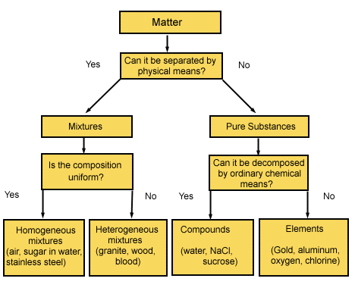
Classification of Matter
Solutions are homogeneous mixtures

Slide 3
Solute
A solute is the dissolved substance in a solution.
Salt in salt water
Sugar in soda drinks
Carbon dioxide in soda drinks
Solvent
A solvent is the dissolving medium in a solution.
Water in salt water
Water in soda

Slide 4
Solution Concentration: Molarity
Moles of solute per 1 liter of solution
Describes how many molecules of solute in each liter of solution
If a sugar solution concentration is 2.0 M,
1 liter of solution contains 2.0 moles of sugar
2 liters = 4.0 moles sugar
0.5 liters = 1.0 mole sugar

Slide 5
Solution Concentration: Molality, m
Moles of solute per 1 kilogram of solvent
Defined in terms of amount of solvent, not solution
Like the others
Does not vary with temperature
Because based on masses, not volumes

Slide 6
Parts Solute in Parts Solution
Parts can be measured by mass or volume.
Parts are generally measured in the same units.
By mass in grams, kilogram, lbs, etc.
By volume in mL, L, gallons, etc.
Mass and volume combined in grams and mL

Slide 7
Parts Solute in Parts Solution
Percentage = parts of solute in every 100 parts solution
If a solution is 0.9% by mass, then there are 0.9 grams of solute in every 100 grams of solution (or 0.9 kg solute in every 100 kg solution).
Parts per million = parts of solute in every 1 million parts solution
If a solution is 36 ppm by volume, then there are 36 mL of solute in 1 million mL of solution.

Slide 8
PPM
Grams of solute per 1,000,000 g of solution
mg of solute per 1 kg of solution
1 liter of water = 1 kg of water
For aqueous solutions we often approximate the kg of the solution as the kg or L of water.
For dilute solutions, the difference in density between the solution and pure water is usually negligible.

Slide 9
Parts Per Billion Concentration
Notes:
9

Slide 10
Solution Concentrations: Mole Fraction, X_{A}
The mole fraction is the fraction of the moles of one component in the total moles of all the components of the solution.
Total of all the mole fractions in a solution = 1.
Unitless
The mole percentage is the percentage of the moles of one component in the total moles of all the components of the solution.
= mole fraction × 100%

Slide 11
Converting Concentration Units
1. Write the given concentration as a ratio.
2. Separate the numerator and denominator.
Separate into the solute part and solution part
3. Convert the solute part into the required unit.
4. Convert the solution part into the required unit.
5. Use the definitions to calculate the new concentration units.

Slide 12
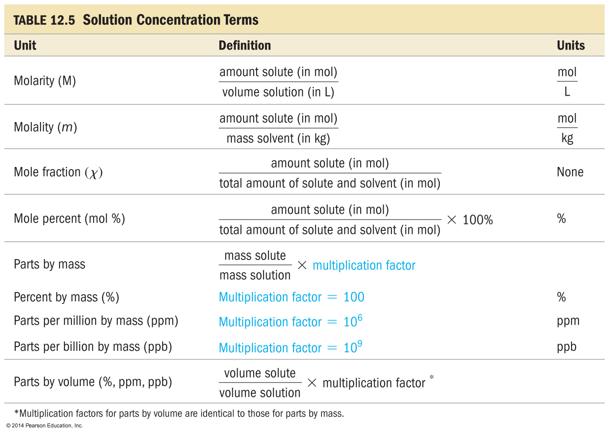
Concentrations

Slide 13
Calculations of Solution Concentration
Mass percent - the ratio of mass units of solute to mass units of solution, expressed as a percent

Slide 14
Find the mass percent of CuSO₄ in a solution whose density is 1.30 g/ml and whose molarity is 4.73 M.
41.9%
6.15%
58.1%
6.03%
None of these

Slide 15
Calculations of Solution Concentration
Mole fraction – the ratio of moles of solute to total moles of solution

Slide 16
What is the mole percent of ethanol (C₂H₅OH), which consists of 71.0 g of ethanol for every 14.3 g of water present?
66.0%
1.94%
1.52%
83.2%
34.0%

Slide 17
Calculations of Solution Concentration
Molality – moles of solute per kilogram of solvent

Slide 18
What is the molality of solution of 33.5 g propanol (CH₃CH₂CH₂OH) in 152 ml water, if the density of water is 1.00 g/ml?
3.67 m
0.00367 m
0.273 m
0.557 m
None of these

Slide 19
Calculations of Solution Concentration
Molarity - the ratio of moles of solute to liters of solution

Slide 20
A solution containing 481.6 g of Mg(NO₃)₂ per liter has a density of 1.114 g/ml. The molarity of the solution is:
3.247 M
2.915 M
9.740 M
3.617 M
None of these

