Slide 1
Properties of Solutions Raoult’s Law

Slide 2
Raoult’s Law
The presence of a nonvolatile solute lowers the vapor pressure of the solvent.
P_{solution} = Observed Vapor pressure of
the solution
χ_{solvent} = Mole fraction of the solvent
P⁰_{solvent} = Vapor pressure of the pure solvent

Slide 3
Vapor Pressure Lowering
The vapor pressure of a solvent in a solution is always lower than the vapor pressure of the pure solvent.
The vapor pressure of the solution is directly proportional to the amount of the solvent in the solution.
The difference between the vapor pressure of the pure solvent and the vapor pressure of the solvent in solution is called the vapor pressure lowering.
ΔP = P°_{solvent} − P_{solution} = χ_{solute} ∙ P°_{solvent}

Slide 4
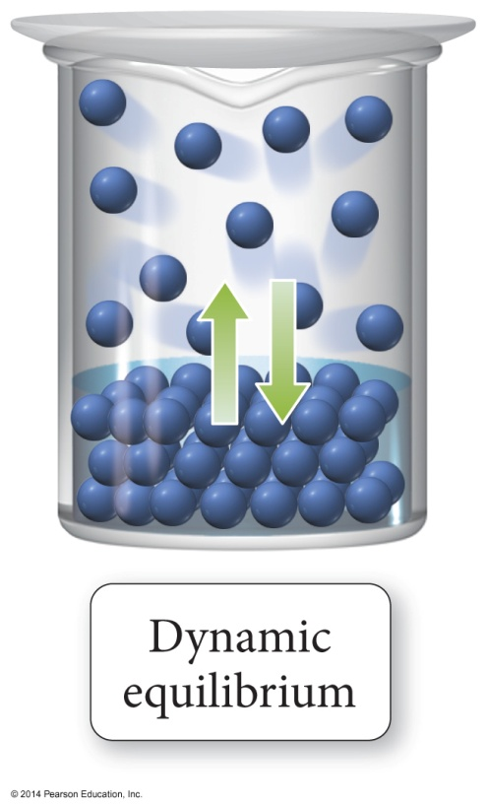
Vapor Pressure of Solutions
The vapor pressure of a solvent above a solution is lower than the vapor pressure of the pure solvent.
The solute particles replace some of the solvent molecules at the surface.
The pure solvent establishes a liquid vapor equilibrium.

Slide 5
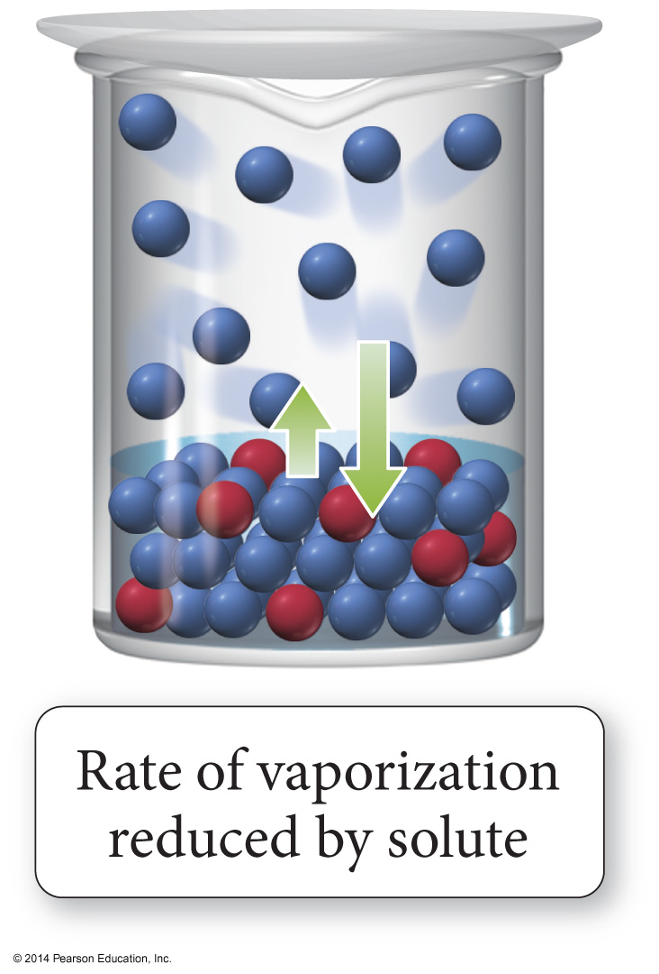
Vapor Pressure of Solutions
Addition of a nonvolatile solute reduces the rate of vaporization, decreasing the amount of vapor.

Slide 6
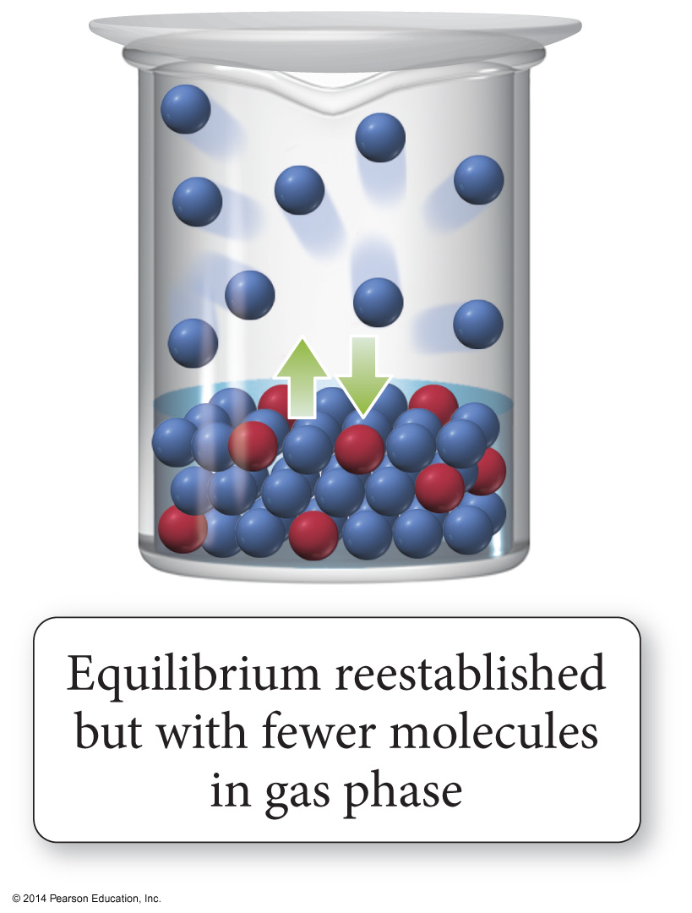
Vapor Pressure of Solutions
Eventually, equilibrium is re-established, but with a smaller number of vapor molecules; therefore, the vapor pressure will be lower.

Slide 7
Liquid-liquid solutions in which both components are volatile (Non-Ideal)
Modified Raoult's Law:
P⁰ is the vapor pressure of the pure solvent
P_{A} and P_{B} are the partial pressures

Slide 8
Ideal Sol’n
1. Liquid-liquid solution that obeys Raoult's law
a. No solution is perfectly ideal, though some are close
2. Negative deviations from Raoult's law (lower than predicted vapor pressure for the solution)
a. Solute and solvent are similar, with strong forces of attraction
b. ΔHsol'n is large and negative
3. Positive deviations from Raoult's law (higher than predicted vapor pressure for the solution)
a. Solute and solvent are dissimiliar, with only weak forces of attraction
b. Particles easily escape attractions in solution to enter the vapor phase

Slide 9
Ideal versus Nonideal Solution
In ideal solutions, the made solute–solvent interactions are equal to the sum of the broken solute–solute and solvent–solvent interactions.
Ideal solutions follow Raoult’s law
Effectively, the solute is diluting the solvent.
If the solute–solvent interactions are stronger or weaker than the broken interactions the solution is nonideal.

Slide 10
Vapor Pressure of a Non-ideal Solution
When the solute–solvent interactions are stronger than the solute–solute + solvent–solvent, the total vapor pressure of the solution will be less than predicted by Raoult’s law, because the vapor pressures of the solute and solvent are lower than ideal.
When the solute–solvent interactions are weaker than the solute–solute + solvent–solvent, the total vapor pressure of the solution will be more than predicted by Raoult’s Law.

Slide 11
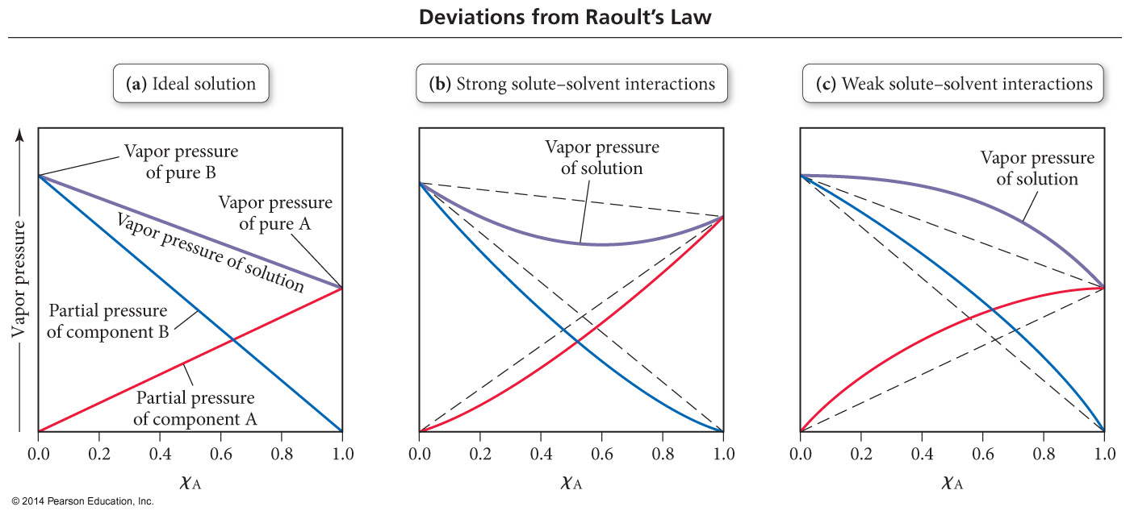
Deviations from Raoult’s Law

