Slide 1
Properties of Solutions Solubility

Slide 2
Solubility Trends
The solubility of MOST solids increases with temperature.
The rate at which solids dissolve increases with increasing surface area of the solid.
The solubility of gases decreases with increases in temperature.
The solubility of gases increases with the pressure above the solution.

Slide 3
Therefore…
Solids tend to dissolve best when:
Heated
Stirred
Ground into small particles
Gases tend to dissolve best when:
The solution is cold
Pressure is high

Slide 4
Solubility Limit
A solution that has the solute and solvent in dynamic equilibrium is said to be saturated.
If you add more solute it will not dissolve.
The saturation concentration depends on the temperature and pressure of gases.
A solution that has less solute than saturation is said to be unsaturated.
More solute will dissolve at this temperature.
A solution that has more solute than saturation is said to be supersaturated.

Slide 5
Temperature Dependence of Solubility of Solids in Water
Solubility is generally given in grams of solute that will dissolve in 100 g of water.
For most solids, the solubility of the solid increases as the temperature increases.
When ΔH_{solution} is endothermic
Solubility curves can be used to predict whether a solution with a particular amount of solute dissolved in water is saturated (on the line), unsaturated (below the line), or supersaturated (above the line).

Slide 6
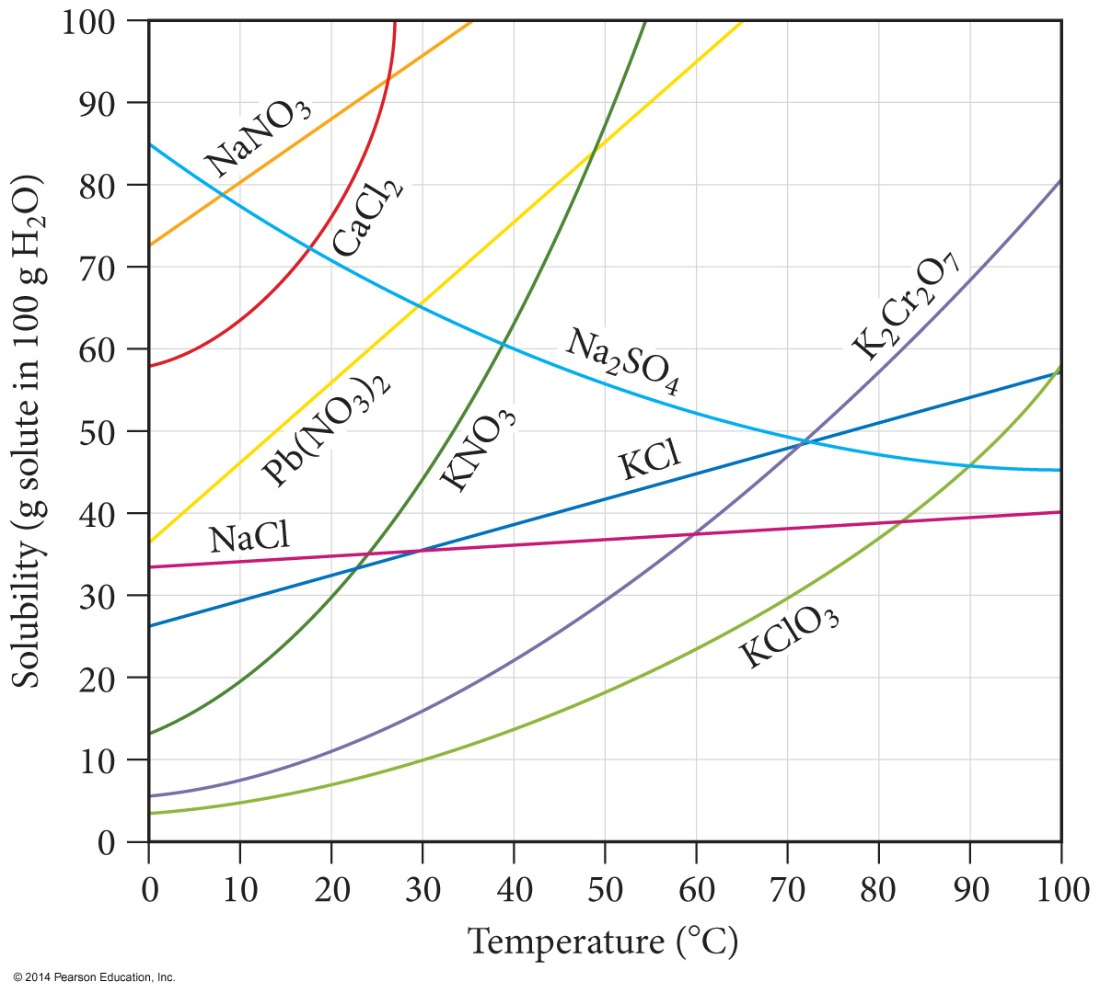
Solubility Curves

Slide 7
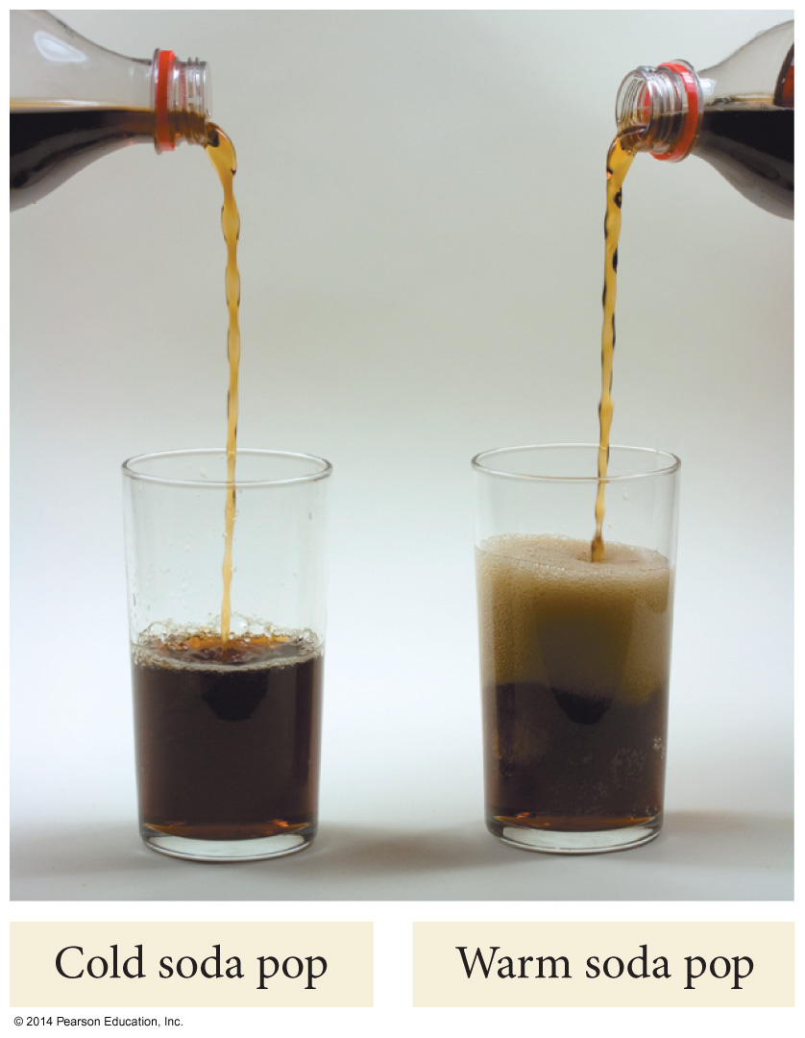
Temperature Dependence of Solubility of Gases in Water

Slide 8
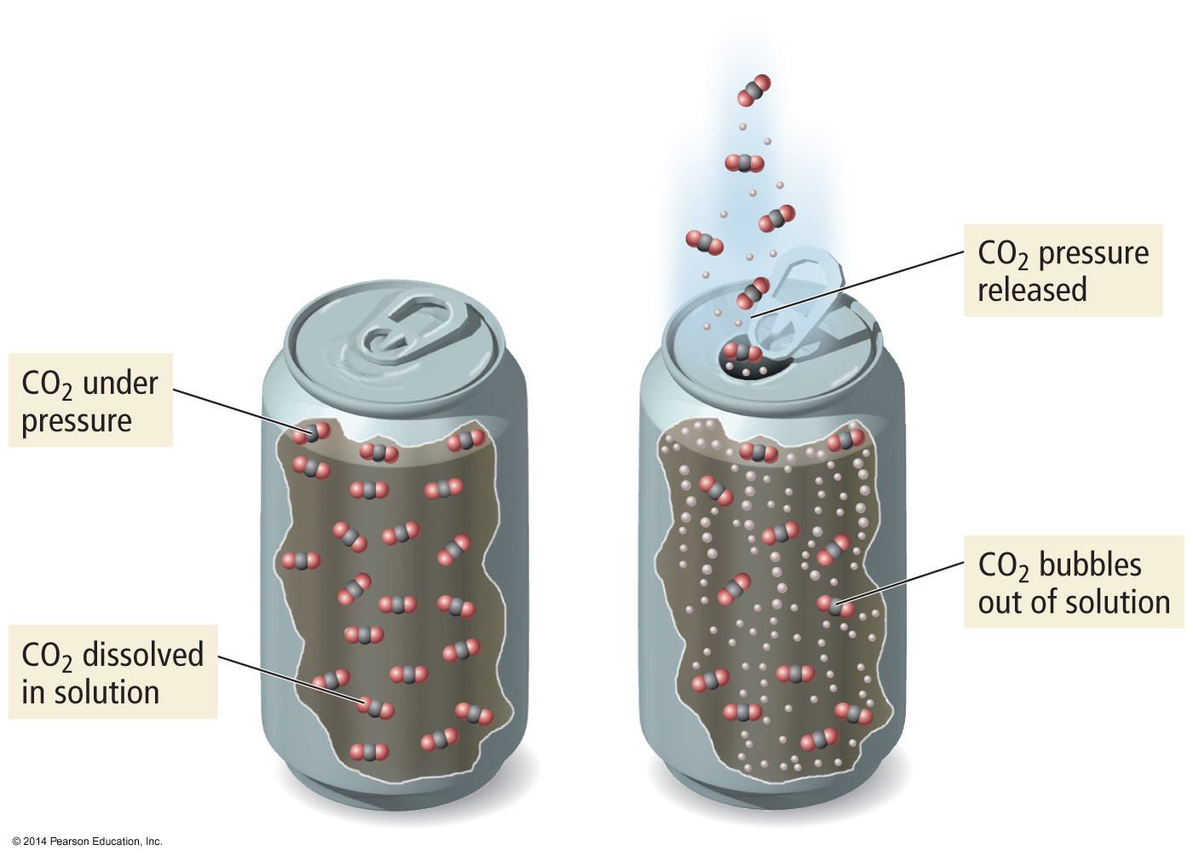
Pressure Dependence of Solubility of Gases in Water
The larger the partial pressure of a gas in contact with a liquid, the more soluble the gas is in the liquid.

Slide 9
Ionic Solutes
Dissociation of ionic compounds has nearly two, three or more times the vapor pressure lowering of nonionic (nonelectrolyte) solutes

Slide 10
Definition of Electrolytes and Nonelectrolytes
An electrolyte is:
A substance whose aqueous solution conducts
an electric current.
A nonelectrolyte is:
A substance whose aqueous solution does not
conduct an electric current.
Try to classify the following substances as
electrolytes or nonelectrolytes…

Slide 11
Electrolytes vs. Nonelectrolytes
The ammeter measures the flow of electrons (current)
through the circuit.
If the ammeter measures a current, and the bulb
glows, then the solution conducts.
If the ammeter fails to measure a current, and the
bulb does not glow, the solution is non-conducting.

Slide 12
Electrolytes?
Pure water
Tap water
Sugar solution
Sodium chloride solution
Hydrochloric acid solution
Lactic acid solution
Ethyl alcohol solution
Pure sodium chloride

Slide 13
Answers to Electrolytes
ELECTROLYTES:
NONELECTROLYTES:
Tap water (weak)
NaCl solution
HCl solution
Lactate solution (weak)
Pure water
Sugar solution
Ethanol solution
Pure NaCl

