Slide 1
Properties of Solutions Colligative

Slide 2
Colligative Properties
Colligative properties are properties whose value depends only on the number of solute particles, and not on what they are.
Value of the property depends on the concentration of the solution.
The difference in the value of the property between the solution and the pure substance is generally related to the different attractive forces and solute particles occupying solvent molecules positions.
Notes:
2

Slide 3
Colligative Properties
Colligative properties are those that depend on the concentration of particles in a solution, not upon the identity of those properties.
Boiling Point Elevation
Freezing Point Depression
Osmotic Pressure

Slide 4
The van’t Hoff Factor, i
Electrolytes may have two, three or more times the effect on boiling point, freezing point, and osmotic pressure, depending on its dissociation.

Slide 5
Dissociation Equations and the Determination of i
i = 2
NaCl(s) →
Na⁺(aq) + Cl⁻(aq)
i = 2
AgNO₃(s) →
Ag⁺(aq) + NO₃⁻(aq)
i = 3
MgCl₂(s) →
Mg²⁺(aq) + 2 Cl⁻(aq)
i = 3
Na₂SO₄(s) →
2 Na⁺(aq) + SO₄²⁻(aq)
AlCl₃(s) →
Al³⁺(aq) + 3 Cl⁻(aq)
i = 4

Slide 6
Ideal vs. Real van’t Hoff Factor
The ideal van’t Hoff Factor is only achieved in VERY DILUTE solution.

Slide 7
Freezing Point Depression
Each mole of solute particles lowers the freezing point of 1 kilogram of water by 1.86 degrees Celsius.
K_{f} = 1.86 °C ⋅ kilogram/mol
m = molality of the solution
i = van’t Hoff factor

Slide 8
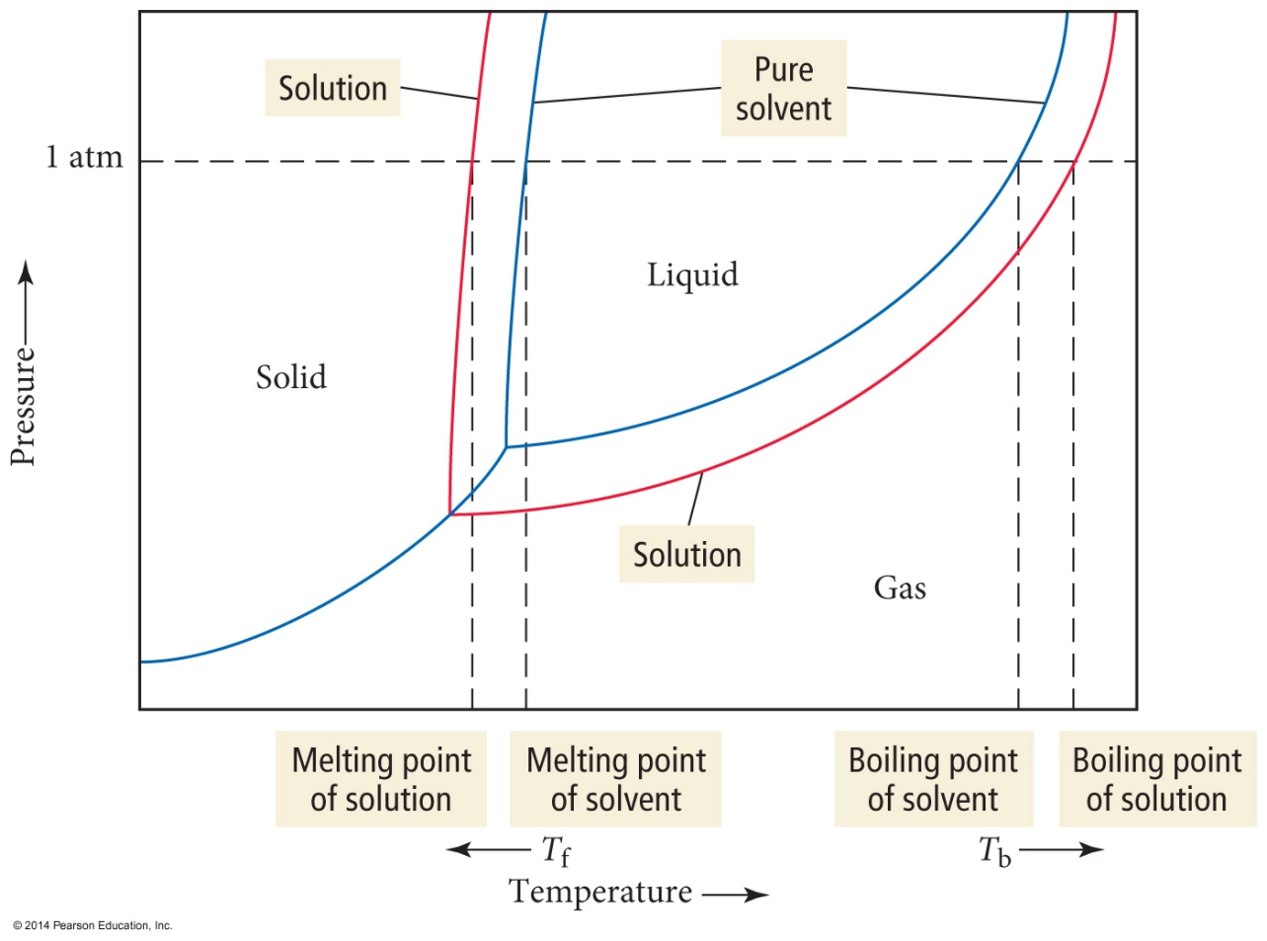
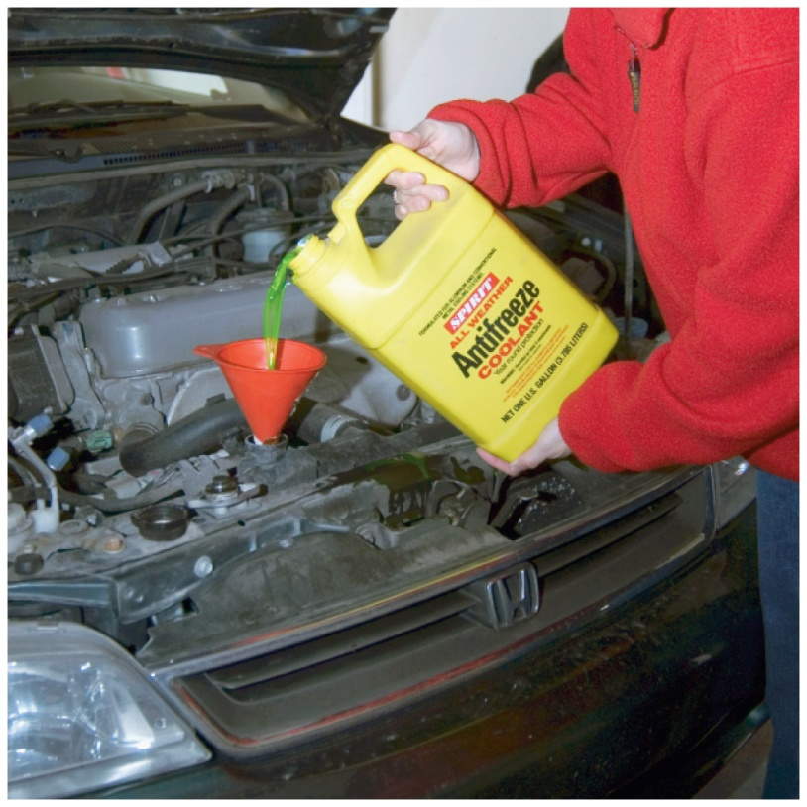
Freezing Point Depression and Boiling Point Elevation

Slide 9
Boiling Point Elevation
Each mole of solute particles raises the boiling point of 1 kilogram of water by 0.51 degrees Celsius.
K_{b} = 0.51 °C ⋅ kilogram/mol
m = molality of the solution
i = van’t Hoff factor

Slide 10
Freezing Point Depression and Boiling Point Elevation Constants, °C/m
Solvent | K_{f} | K_{b}
Acetic acid | 3.90 | 3.07
Benzene | 5.12 | 2.53
Nitrobenzene | 8.1 | 5.24
Phenol | 7.27 | 3.56
Water | 1.86 | 0.512

Slide 11
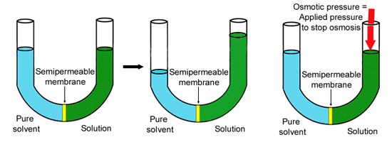
Osmotic Pressure
The minimum pressure that stops the osmosis is equal to the osmotic pressure of the solution

Slide 12
Osmotic Pressure Calculations
Π = Osmotic pressure
M = Molarity of the solution
R = Gas Constant = 0.08206 L⋅atm/mol⋅K
T = Absolute Temperature

Slide 13
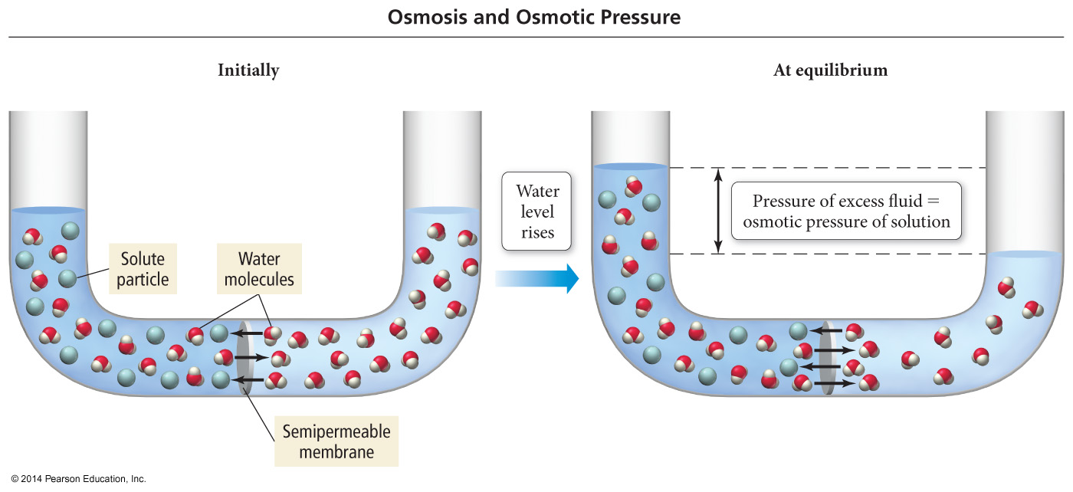
An Osmosis Cell

Slide 14
Suspensions and Colloids
Suspensions and colloids are NOT solutions.
Suspensions: The particles are so large that they settle out of the solvent if not constantly stirred.
Colloids: The particles intermediate in size between those of a suspension and those of a solution.

Slide 15
Types of Colloids
Examples | Dispersing Medium | Dispersed Substance | Colloid Type
Fog, aerosol sprays | Gas | Liquid | Aerosol
Smoke, airborn germs | Gas | Solid | Aerosol
Whipped cream, soap suds | Liquid | Gas | Foam
Milk, mayonnaise | Liquid | Liquid | Emulsion
Paint, clays, gelatin | Liquid | Solid | Sol
Marshmallow, Styrofoam | Solid | Gas | Solid Foam
Butter, cheese | Solid | Liquid | Solid Emulsion
Ruby glass | Solid | Solid | Solid sol

Slide 16
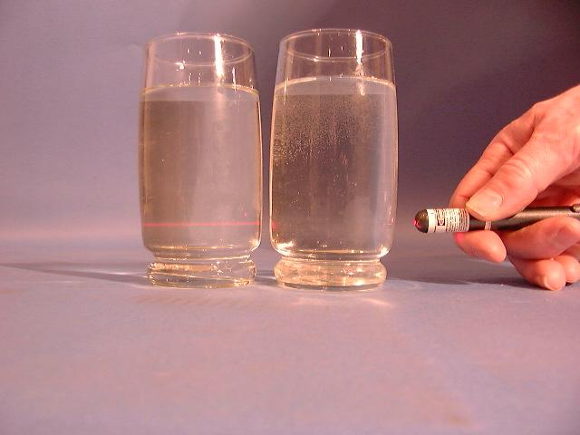
The Tyndall Effect
Colloids scatter light, making a beam visible. Solutions do not scatter light.
Which glass contains a colloid?
colloid
solution

Slide 17
All of the following are colligative properties except:
Osmotic Pressure
Boiling Point elevation
Freezing Point depression
Density elevation
None of these

Slide 18
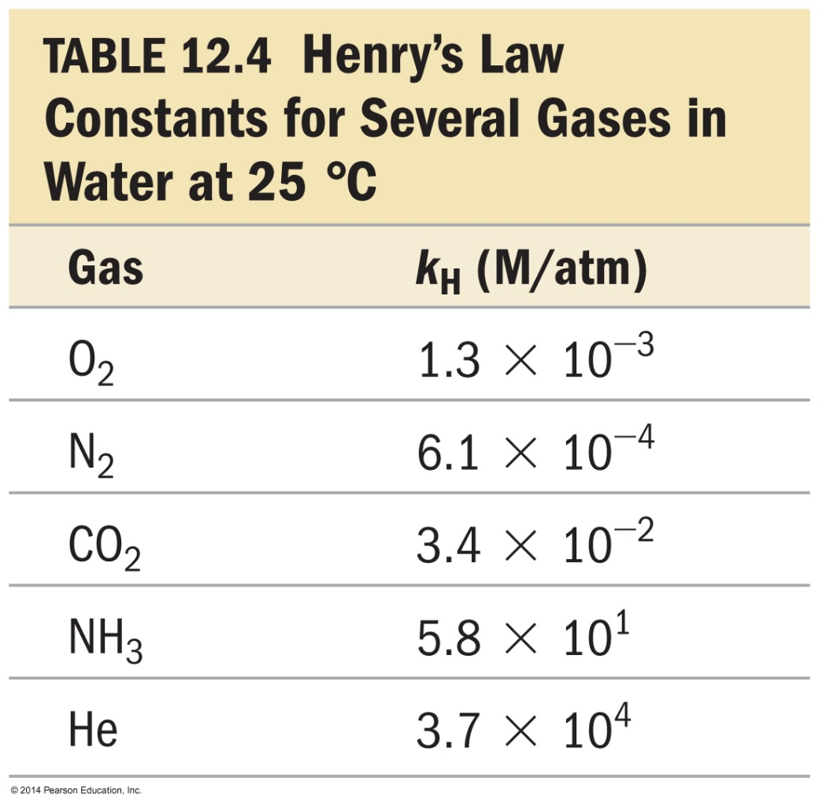
Henry’s Law (removed from AP)
The solubility of a gas (S_{gas}) is directly proportional to its partial pressure, (P_{gas}).
S_{gas} = k_{H}P_{gas}
k_{H} is called the Henry’s law constant.

Slide 19
A correct statement of Henry's law is:
the concentration of a gas in solution is inversely proportional to temperature.
the concentration of a gas in solution is directly proportional to the mole fraction of solvent.
the concentration of a gas in solution is independent of pressure.
the concentration of a gas in a solution is inversely proportional to pressure.
none of these

Slide 20
The solubility of O₂ in water is 0.590g/L at an oxygen pressure of around 14.7 atm. What is the Henry’s Law constant for O₂ (in units of L·atm/mol)?
4.01E⁻²
1.25E⁻³
7.97E²
2.71E⁻¹
None of them are within 5% of the correct answer

Slide 21
121.2 g of NaCl completely dissolve (producing Na⁺ and Cl⁻ ions) in 1.00 Kg of water at 25°C. The vapor pressure of pure water at this temperature is 23.8 torr. Determine the vapor pressure of the solution
22.1 torr
22.9 torr
20.6 torr
19.9 torr
23.8 torr

Slide 22
At 40°C, heptane has a vapor pressure of about 92.0 torr and octane has a vapor pressure of about 31.2 torr. Assuming ideal behavior, what is the vapor pressure of a solution that contains twice as many moles of heptane as octane?
61.3 torr
51.5 torr
71.7 torr
82.1 torr
None of these

Slide 23
A 7.12 g sample of a compound is dissolved in 250. grams of benzene. The freezing point of this solution is 1.02°C below that of pure benzene. What is the molar mass of this compound? (K_{f} _{benzene} = 5.12 °C/m). Ignor sig. figs.
35.7 g/mol
143 g/mol
286 g/mol
5.67 g/mol
71.5 g/mol

Slide 24
What is the boiling point change for a solution containing 0.681 moles of naphthalene (a nonvolatile, nonionizing compound) in 250. g of liquid benzene? (K_{b} = 2.53 °C/m for benzene)
6.89 °C
0.93 °C
3.72 °C
1.723 °C
0.431 °C

Slide 25
Determine the Osmotic Pressure of a solution that contains 0.017 g of a hydrocarbon solute (molar mass = 340 g/mol) dissolved in benzene to make 350-ml solution. The temperature is 20.0°C
0.18 torr
0.9 torr
1.2 torr
2.6 torr
2.4 torr

