Slide 1
N31 - SOLUTIONS
Separation Techniques and Concentration Calculations

Slide 2
N31 - SOLUTIONS
Separation Techniques and Concentration Calculations
Target: I can describe ways to separate the components in a solution and can perform various concentration related calculations.

Slide 3
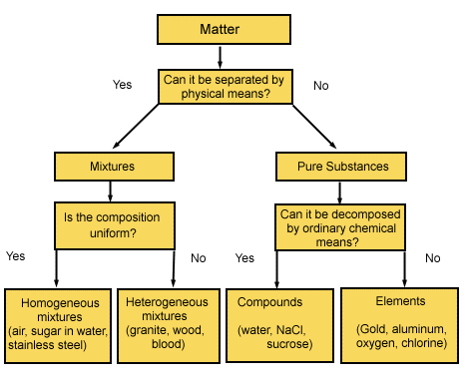
Classification of Matter
Solutions are homogeneous mixtures

Slide 4
Classification of Matter
Homogeneous
“the macroscopic properties do not vary throughout the sample”
It is “uniformly mixed”
Heterogeneous
“the macroscopic properties depend on the location in the mixture”
It is “NOT uniformly mixed”

Slide 5
Solute
A solute is the dissolved substance in a solution.
Salt in salt water
Sugar in soda drinks
Carbon dioxide in soda drinks
Solvent
A solvent is the dissolving medium in a solution.
Water in salt water
Water in soda

Slide 6
Types of Solutions
Solution Phase | Solute Phase | Solvent Phase | Example
Gaseous Solutions | Gas Liquid Solid* | Gas Gas Gas* | Air (mostly N₂ and O₂) Humid air (H₂O droplets in air) Moth balls*
Liquid solutions | Gas Liquid Solid | Liquid Liquid Liquid | Soda (CO₂ in H₂O) Rubbing Alcohol (alcohol in H₂O) Seawater (NaCl in H₂O)
Solid solutions | Gas* Liquid Solid | Solid* Solid Solid | Gas Stove Lighter (H₂ and Pd)* Dental fillings and other Amalgams Brass Alloy (Zn in Cu)
Combinations in italics and with a * are rare, very few “normal” examples. Most charts leave them off because there are so few examples – they are still possible, just rare

Slide 7
Separating Components of Mixtures and Solutions
Heterogeneous
Separation techniques take advantage of things such as particle size or location.
Examples:
Solid + Liquid/Aqueous → Filtration
Two phases that are not miscible → Decanting (hard to do well...not sure AP would ask you about it?)

Slide 8
Separating Components of Mixtures and Solutions
Homogeneous Solution
Separation techniques take advantage of things such as differences in intermolecular forces.
Examples:
Distillation → Differences in Boiling Point
Chromatography → Differences in IMFs btwn mobile/stationary phases

Slide 9
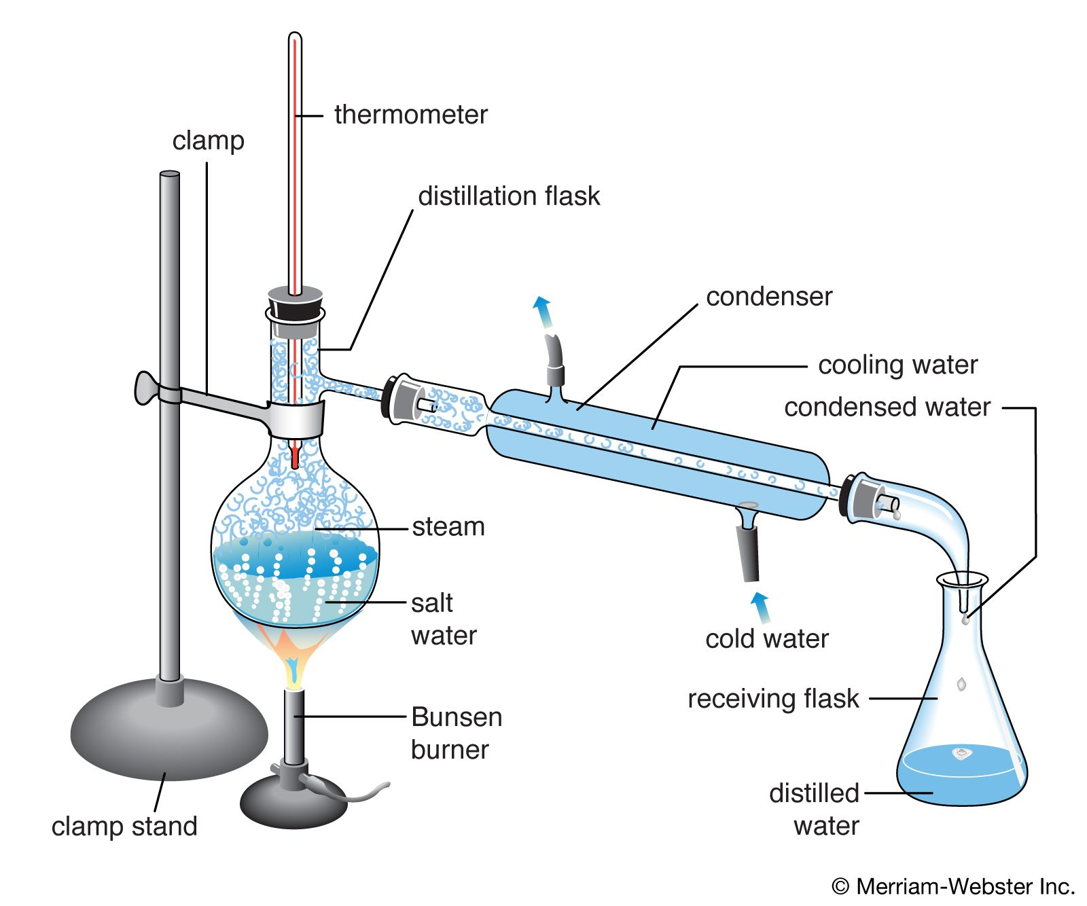
Distillation
Less IMFs
Higher Vapor Pressure, lower Boiling Point
Therefore, will boil off sooner, at a lower temp.
More IMFs
Lower Vapor Pressure, higher Boiling Point
Therefore, will boil off later, at a higher temp.

Slide 10
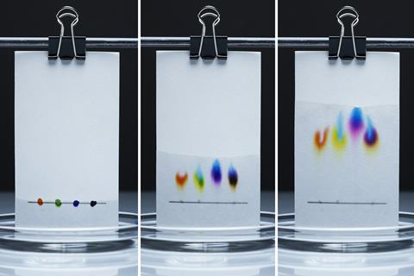
Chromatography
All about the polarity of the two phases
Polar things attracted to polar things.
Less/non-polar things attracted to less/non-polar things.

Slide 11
Chromatography
Stationary phase
Paper Chromatography → Strip of paper
Thin layer (TLC) → glass plate covered in silica
Column Chromatography → column filled with silica gel
Mobile phase
Various solvents that can wick up the stationary phase.

Slide 12
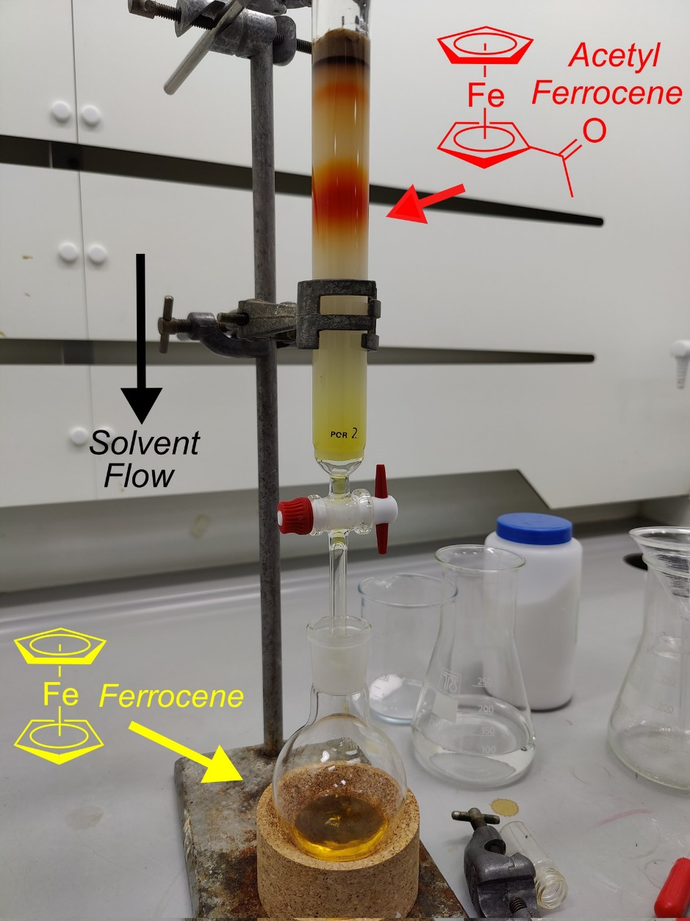
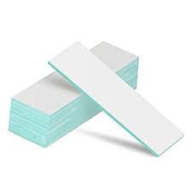
Chromatography
Paper
Good for quick identification/comparison.
TLC
Tend to get better results, less blurring. Can separate different types of compounds.
Column
Good if you want to collect a component to use for something.

Slide 13
Polarity of the Phases
Stationary Phase The –OH groups in cellulose (paper) or in silica gel have attraction for H₂O molecule, so surface will be polar. BUT they could tell you to use a non-polar stationary phase!
Mobile Phase Usually a non-polar solvent like hexane, or something like ethanol – still polar, but less polar than pure water. BUT - Could be something like salt water which is more polar than water! So be careful!

Slide 14
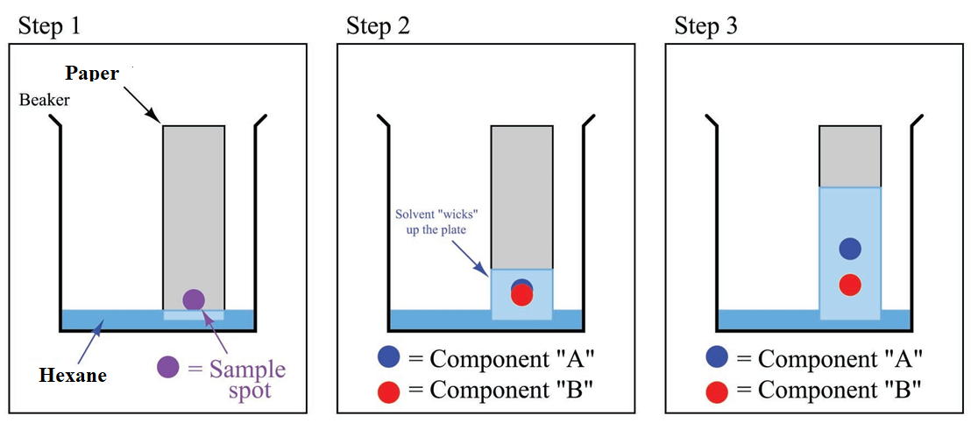
Chromatography
Which Component is MORE polar?
B because it traveled less, more attracted to polar stationary phase!

Slide 15
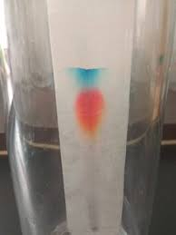
Chromatography
Potential Issues
Not enough separation between components
Components all traveled too far up stationary phase
Fix: pretty much always is to change polarity of the solvent!

Slide 16
Calculations

Slide 17
Molarity
Moles of solute per 1 liter of solution - Describes how many molecules of solute in each liter of solution
If a sugar solution concentration is 2.0 M,
1 liter of solution contains 2.0 moles of sugar
2 liters = 4.0 moles sugar
0.5 liters = 1.0 mole sugar
$$Molarity, M= \frac{moles of solute}{Liters of solution}$$

Slide 18
Mole Fraction X_{A}
Mole fraction - the fraction of the moles of one component in the total moles of all the components of the solution.
Total of all the mole fractions in a solution = 1.
No units
Mole percentage - the percentage of the moles of one component in the total moles of all the components of the solution.
= mole fraction × 100%
$$XA= \frac{nA}{nA+nB+…}$$
$$XA= \frac{nA}{nA+nB+…}x 100$$

Slide 19
Making Dilutions
When you take one more concentrated solution and take a small amount of it and dilute it down by adding more solvent.
$$M1V1=M2V2$$
Concentrated
Diluted

Slide 20
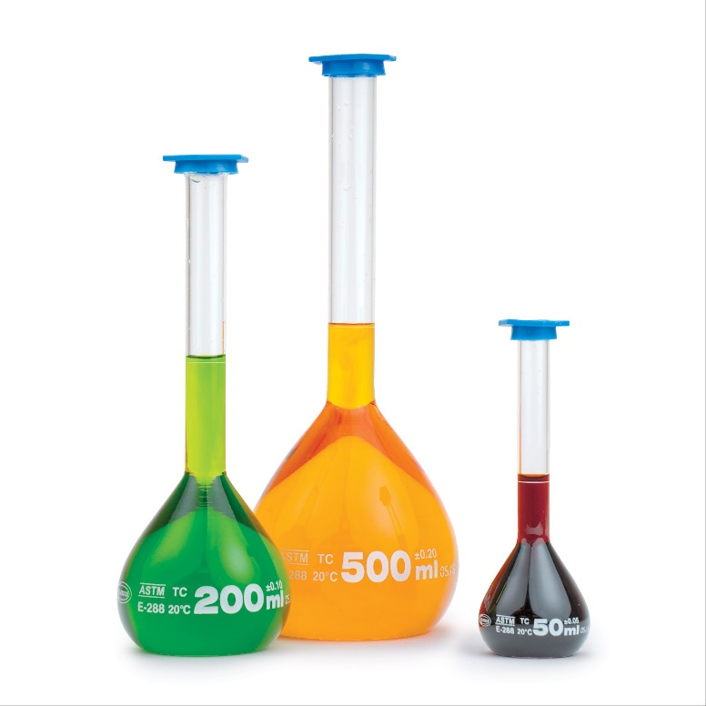
Volumetric Flasks
Very accurate marking for a specific volume. You can put a small amount of your concentrated solution into the flask (the V1 amount) and then fill to the line to get the desired diluted solution volume (V2).
Pro: Very precise
Con: Only one volume marking. Can’t use it to measure out various amounts. (Use a volumetric pipette, or a graduated cylinder to measure out different volumes. They have lots of markings.

Slide 21
Lots of lab techniques!
Making solutions
Using graduated cylinders
sing graduated pipettes
Using volumetric pipettes
Using volumetric flasks
Serial Dilutions
UV-VIS Spectroscopy – Remember Beer’s law?! It is back again! ☺

Slide 22
Converting Concentration Units
WRITE YOUR UNITS. SERIOUSLY.
Write the given concentration as a ratio.
3. Separate the numerator and denominator.
Think about each separately
Separate into the solute part and solution part
4. Convert the solute part into the required unit.
5. Convert the solution part into the required unit.
6. Use the definitions to calculate the new final concentration units.

Slide 23
Practice
How much of a 2.3 M solution do you have to use in order to make 750mL of a 0.6 M solution?
$$\left(2.3M\right)\left(V1\right)=\left(0.6M\right)\left(750mL\right)$$
$$V1=195.65 mL of the \\ 2.3M solution is needed$$
How much water did you add???
Extra H₂O
750-195.65 = 554.35mL H₂O
750mL of 0.6 M SOLUTION
2.3M
195.65mL of the STRONGER STUFF
2.3M

Slide 24
What is the mole percent of ethanol (C₂H₅OH), which consists of 71.0 g of ethanol for every 14.3 g of water present?
66.0%
1.94%
$$XA= \frac{nA}{nA+nB+…}x 100$$
1.52%
83.2%
34.0%

Slide 25
What is the mole percent of ethanol (C₂H₅OH), which consists of 71.0 g of ethanol for every 14.3 g of water present?
71.0g
1mol
= 1.54 mol ethanol
66.0%
46.08g
1.94%
14.3g
1mol
= 0.794 mol water
18.02g
1.52%
83.2%
1.54mol
x 100 = 65.99%
(1.54mol + 0.794mol)
34.0%

Slide 26
A solution containing 481.6 g of Mg(NO₃)₂ per liter has a density of 1.114 g/ml. The molarity of the solution is:
3.247 M
2.915 M
$$Molarity, M= \frac{moles of solute}{Liters of solution}$$
9.740 M
3.617 M
None of these

Slide 27
A solution containing 481.6 g of Mg(NO₃)₂ per liter has a density of 1.114 g/ml. The molarity of the solution is:
3.247 M
481.6g
1mol
= 3.247 mol
solute
2.915 M
148.33g
9.740 M
= 3.247 mol/1L = 3.247 M
3.617 M
*Density was just extra info! Very common in solutions problems to have more info than you need.
None of these

Slide 28
The next few types of calculations are not “officially” in the class anymore. We are still going to quickly cover them because every once in a while there is some kind of “clever” question that essentially requires these types of calculations. Better safe than sorry!

Slide 29
Molality
Moles of solute per 1 kilogram of solvent
Careful! Defined in terms of amount of solvent, not the solution like most of the other calculations
Does not vary with temperature
Because based on masses, not volumes
$$Molality, m= \frac{moles of solute}{kg of solvent}$$

Slide 30
Parts Solute in Parts Solution
Parts can be measured by mass or volume.
Parts are generally measured in the same units.
By mass in grams, kilogram, lbs, etc.
By volume in mL, L, gallons, etc.
Mass and volume combined in grams and mL

Slide 31
Parts Solute in Parts Solution
Percentage = parts of solute in every 100 parts solution
If a solution is 0.9% by mass, then there are 0.9 grams of solute in every 100 grams of solution (or 0.9 kg solute in every 100 kg solution).
Parts per million = parts of solute in every 1 million parts solution
If a solution is 36 ppm by volume, then there are 36 mL of solute in 1 million mL of solution.

Slide 32
Mass Percent
Mass percent - the ratio of mass units of solute to mass units of solution, expressed as a percent
$$mass percent= \frac{mass of solute}{mass of solution}x100$$

Slide 33
Parts per Million - PPM
Grams of solute per 1,000,000 g of solution
mg of solute per 1 kg of solution
1 liter of water = 1 kg of water
For aqueous solutions we often approximate the kg of the solution as the kg or L of water. For dilute solutions, the difference in density between the solution and pure water is usually negligible.
Remember that the density of water is 1g/1mL
Same as 1000g/1L
Same as 1kg/1L
$$PPM= \frac{amount of solute}{amount of solution}x{10}^{6}$$

Slide 34
Parts per Billion - PPB
$$PPB= \frac{amount of solute}{amount of solution}x{10}^{9}$$
$$Parts per…= \frac{amount of solute \left(PART\right)}{amount of solution \left(WHOLE\right)}x some factor$$
% = x 100
ppm = x 1,000,000 = x10⁶
ppb = x1,000,000,000 = x10⁹
Notes:
34

Slide 35
Find the mass percent of CuSO₄ in a solution whose density is 1.30 g/ml and whose molarity is 4.73 M.
41.9%
6.15%
$$mass percent= \frac{mass of solute}{mass of solution}x100$$
58.1%
6.03%
None of these

Slide 36
Find the mass percent of CuSO₄ in a solution whose density is 1.30 g/ml and whose molarity is 4.73 M.
1 L solution =
4.73 mol CuSO₄
41.9%
4.73mol
159.62g
= 755g
solute
6.15%
1mol
58.1%
1 L =
1000mL
1.30g
= 1300g solution
6.03%
1mL
755g
x 100 = 58.15%
None of these
1300g

Slide 37
What is the molality of solution of 33.5 g propanol (CH₃CH₂CH₂OH) in 152 ml water, if the density of water is 1.00 g/ml?
3.67 m
0.00367 m
$$Molality, m= \frac{moles of solute}{kg of solvent}$$
0.273 m
0.557 m
None of these

Slide 38
What is the molality of solution of 33.5 g propanol (CH₃CH₂CH₂OH) in 152 ml water, if the density of water is 1.00 g/ml?
3.67 m
33.5g
1mol
= 0.557 mol
solute
60.11g
0.00367 m
0.273 m
0.557mol
= 3.67 m
0.557 m
0.152kg
None of these

Slide 39
Link to YouTube Presentation
OLD VERSION! It does not have the separation techniques part, and it covers concentration calculations we won’t do this year. I will redo it if I get time!
https://youtu.be/op8vqy3uxq8

