Slide 1
N33 - SOLUTIONS
Solubility Trends

Slide 2
N33 - SOLUTIONS
Solubility Trends
Target: I can determine if a substance is soluble, and can describe how the solubility changes based on the phase of the substance.

Slide 3
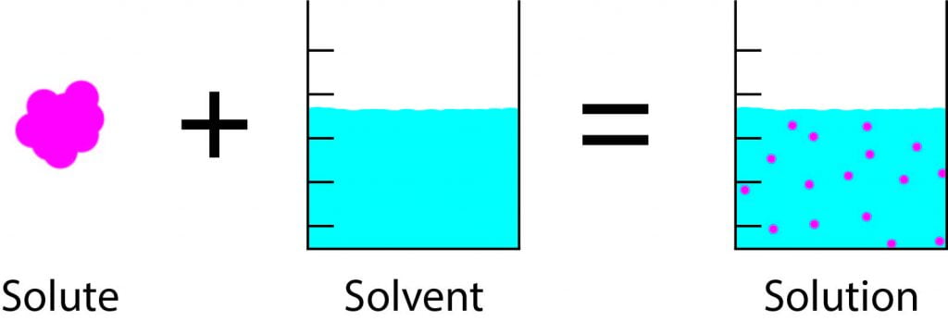
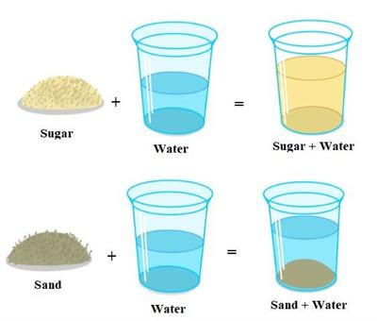
Solubility
Soluble
Insoluble
Mixture AND solution
Mixture NOT solution

Slide 4
Miscibility
Sometimes when you mix a solute and a solvent together you end up with a saturated solution and you can’t keep dissolving more solute.
Example: salt and water – at some point the extra salt will just sit on the bottom of the beaker.
When something is miscible it means that you can mix the two substances to form a homogeneous mixture no matter what the proportions are.
Example: it doesn’t matter how much water and ethanol you mix together, they will always mix.

Slide 5
Dissolving vs.
Dissociating
Dissolving water molecules surround the particles and spread them apart from each other
Dissociating water breaks the ionic bond between particle and they split into individual ions

Slide 6
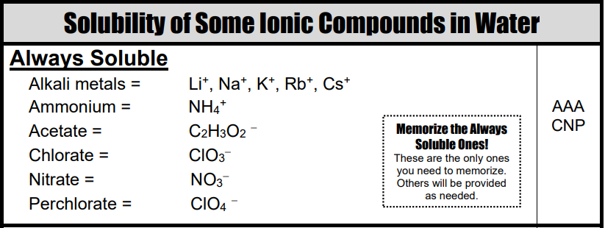
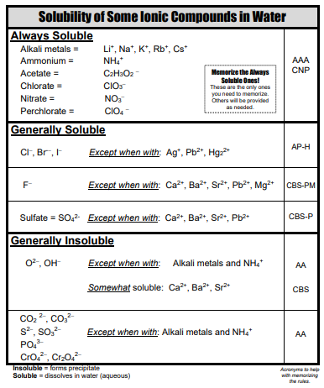
Solubility Rules for Ionic Compounds

Slide 7
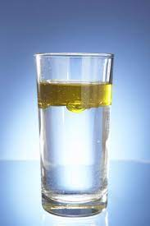
“Like Dissolves Like”
Don’t just say that phrase as if it is an answer!
Things with similar IMFs will mix together.
Polar + Polar
Nonpolar + Nonpolar

Slide 8
Solubility Trends
Solids
Solubility of MOST solids increases with temperature.
The rate at which solids dissolve increases with increasing surface area of the solid.
Gases
Solubility decreases with temperature.
Solubility increases with the pressure above the solution.

Slide 9
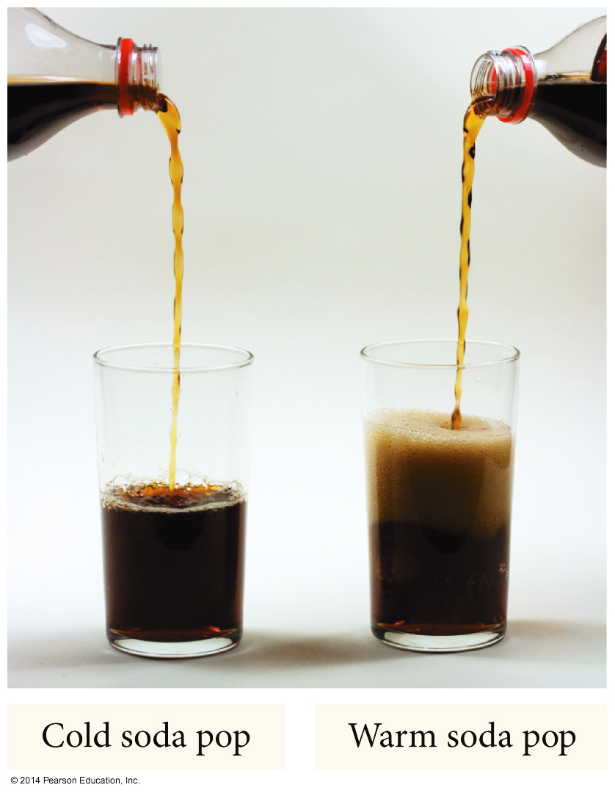
Temperature Dependence of Solubility of Gases in Water

Slide 10
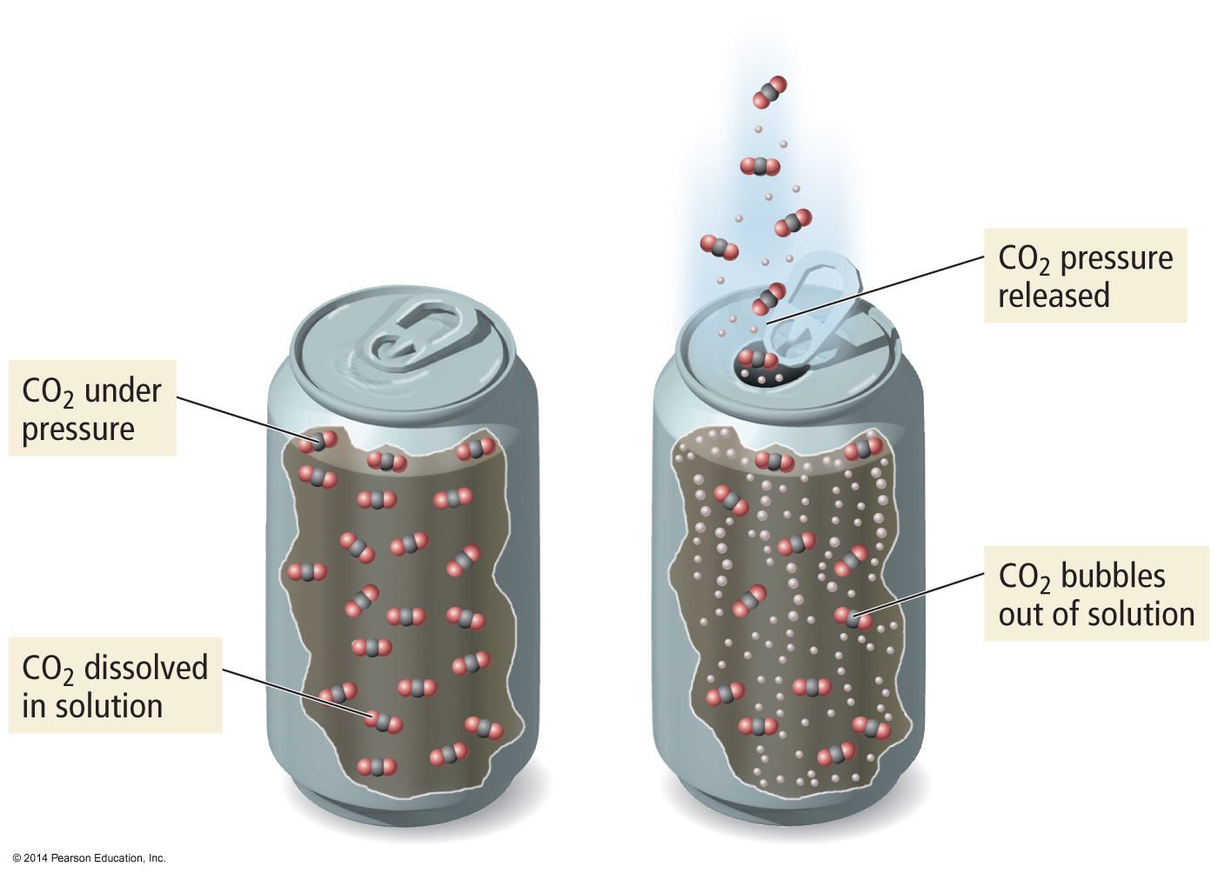
Pressure Dependence of Solubility of Gases in Water
The larger the partial pressure of a gas in contact with a liquid, the more soluble the gas is in the liquid.

Slide 11
Therefore…
Solids tend to dissolve best when:
Heated
Stirred
Ground into small particles
Gases tend to dissolve best when:
The solution is cold
Pressure is high

Slide 12
Solubility Limit
Saturated - When the solute and solvent in dynamic equilibrium
If you add more solute it will not dissolve.
The saturation [ ] depends on the temperature and pressure of gases.
Unsaturated – When there is less solute than when saturated
More solute will dissolve at this temperature.
Supersaturated – When there is more solute than when saturated
Made by heating the solvent up, dissolving more solute than can be dissolved at the lower temperature, and then slowly cooling the solution down. Not a very stable situation, the extra solute will “crash out” if disturbed. http://www.youtube.com/watch?v=0wifFbGDv4I

Slide 13
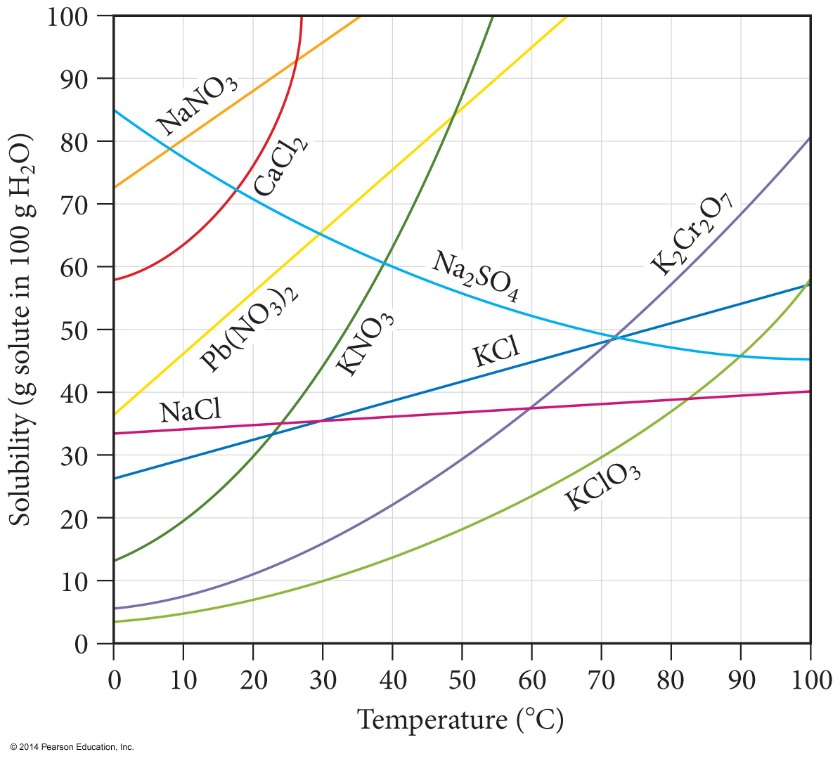
Solubility Curves
Can be used to predict solubility of a solute.
Saturated
On the line
Unsaturated
Below the line
Supersaturated
Above the line

Slide 14
Temperature Dependence of Solubility of Solids in Water
Units - Solubility is often in grams of solute that will dissolve in 100 g of water. Be sure to check though!
For most solids, the solubility of the solid increases as the temperature increases.
When ΔH_{solution} is endothermic
Sometimes, solubility decrease with increase in temp!
When ΔH_{solution} is exothermic

Slide 15
Electrolytes vs. Non-electrolytes
Electrolyte
A substance whose aqueous solution conducts an electric current.
Nonelectrolyte
A substance whose aqueous solution does not conduct an electric current.

Slide 16
Electrolytes vs. Non-electrolytes
The ammeter measures the flow of electrons (current) through the circuit.
If the ammeter measures a current, and the bulb glows, then the sol’n conducts.
If the ammeter fails to measure a current, and the bulb does not glow, the solution is non-conducting.

Slide 17
Electrolytes or Non-electrolytes?
Pure water
Tap water
Sugar solution
Sodium chloride solution
Hydrochloric acid solution
Lactic acid solution
Ethyl alcohol solution
Pure sodium chloride

Slide 18
Answers
ELECTROLYTES:
NONELECTROLYTES:
Tap water (weak)
NaCl solution
HCl solution
Lactic acid solution (weak)
Pure water
Sugar solution
Ethanol solution
Pure NaCl (unless molten!)

Slide 19
YouTube Link to Presentation
OLD VERSION! Does not cover the intro part about solubility in general. I will update it when I can!
https://youtu.be/S6VuAo-LIYw

