Slide 1
N34 - SOLUTIONS
Net Ionic Equations and Particle Diagrams

Slide 2
N34 - SOLUTIONS
Net Ionic Equations and Particle Diagrams
Target: I can write and draw diagrams to represent chemical reactions in a way that focuses attention on just the particles participating.

Slide 3
REVIEW!
This is OLD info!
This is one of those topics that people don’t practice enough in Honors Chem, and they don’t remember.
WE HAVE TO REMEMBER IT!!!!!

Slide 4
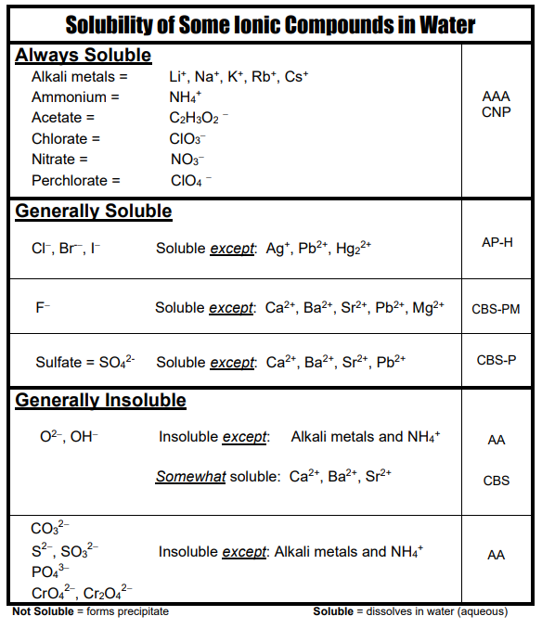
Solubility Chart
Soluble means it dissolves in water.
The right hand column are some acronyms to help you remember the rules. We don’t memorize, but might speed up your homework!
You have a copy in your binder!

Slide 5
Solubility Chart
Na₂O SOLUBLE b/c it has Na⁺ in it!
Mg(OH)₂
INSOLUBLE b/c OH⁻ insoluble and Mg²⁺ not one of the exceptions

Slide 6
Prediction Products Practice #1
Sodium plus Oxygen yields ???
Na + O₂ →
What type of reaction does this look like?
Synthesis
Ionic so cross over! Don’t steal subscripts!
Na + O₂ → NaO₂ NO!!!
+1 -2
Na + O₂ → Na₂O
Fix numbers with balancing
4Na + O₂ → 2Na₂O

Slide 7
Prediction Products Practice #2
Sodium chloride breaks into its components
NaCl→ ???
What type of reaction does this look like?
Decomposition
NaCl→ Na + Cl NO!!!
Diatomic
NaCl→ Na + Cl₂
Balance
2NaCl→ 2Na + Cl₂

Slide 8
Prediction Products Practice #3
What type of rxn does this look like?
Aluminum is added Lead(II) Nitrate
Al + Pb(NO₃)₂ → ???
Single Replacement
Is Al above Pb on Activity Series?
Yes! So rxn will happen!
Does Al make cation or anion?
Cation
Al + Pb(NO₃)₂ → Pb + Al(NO₃)₂ NO!!!
Ionic so cross over!
+3 -1
Al + Pb(NO₃)₂ → Pb + Al(NO₃)₃
Balance
2Al + 3Pb(NO₃)₂ → 3Pb + 2Al(NO₃)₃
NOT DONE!!!! NEED TO THINK ABOUT PHASES!

Slide 9
Prediction Products Practice #3
NOT DONE!!!! NEED TO THINK ABOUT PHASES!
The Balanced Equation
2Al + 3Pb(NO₃)₂ → 3Pb + 2Al(NO₃)₃
The Overall Equation
2Al_{(s)} + 3Pb(NO₃)_{2(aq)} → 3Pb_{(s)} + 2Al(NO₃)_{3(aq)}
The Complete Ionic Equation
2Al_{(s)}+3Pb²⁺_{(aq)}+6NO₃⁻_{(aq)}→3Pb_{(s)}+2Al³⁺_{(aq)}+6NO₃⁻_{(aq)}
Spectator Ions
The Net Ionic Equation
2Al_{(s)}+3Pb²⁺_{(aq)}→3Pb_{(s)}+2Al³⁺_{(aq)}

Slide 10
Prediction Products Practice #4
What type of rxn does this look like?
Pb(NO₃)₂ + KI → ???
Double Replacement
Pb(NO₃)₂ + KI → PbI + K(NO₃) NO!!!
Ionic so cross over!
Pb(NO₃)₂ + KI → PbI₂ + K(NO₃)
Balance
Pb(NO₃)₂ + 2KI → PbI₂ + 2K(NO₃)
NOT DONE!!!! NEED TO THINK ABOUT PHASES!

Slide 11
Prediction Products Practice #4
NOT DONE!!!! NEED TO THINK ABOUT PHASES!
The Balanced Equation
Pb(NO₃)₂ + 2KI → PbI₂ + 2K(NO₃)
The Overall Equation
Pb(NO₃)_{2(aq)} + 2KI_{(aq)} → PbI_{2(s)} + 2K(NO₃)_{(aq)}
The Complete Ionic Equation
Pb²⁺_{(aq)}+2NO₃⁻_{(aq)}+2K⁺_{(aq)}+2 I⁻_{(aq)}→ PbI_{2(s)}+2K⁺_{(aq)} +2NO₃⁻_{(aq)}
Spectator Ions
The Net Ionic Equation
Pb²⁺_{(aq)} + 2 I⁻_{(aq)} → PbI_{2(s)}

Slide 12
Prediction Products Practice #5
What type of rxn does this look like?
A solution of Silver Nitrate with a solution of potassium chloride
Double Replacement
Already neutral!
AgNO₃ + KCl → AgCl + KNO₃
Already Balanced!
AgNO₃ + KCl → AgCl + KNO₃
NOT DONE!!!! NEED TO THINK ABOUT PHASES!

Slide 13
Prediction Products Practice #5
NOT DONE!!!! NEED TO THINK ABOUT PHASES!
The Balanced Equation
AgNO₃ + KCl → AgCl + KNO₃
The Overall Equation
AgNO_{3(aq)} + KCl_{(aq)} → AgCl_{(s)} + KNO_{3(aq)}
The Complete Ionic Equation
Spectator Ions
Ag⁺_{(aq)}+NO₃⁻_{(aq)}+ K⁺_{(aq)}+Cl⁻_{(aq)}→AgCl_{(s)}+K⁺_{(aq)}+NO₃⁻_{(aq)}
The Net Ionic Equation
Ag⁺_{(aq)} + Cl⁻_{(aq)} → AgCl_{(s)}

Slide 14
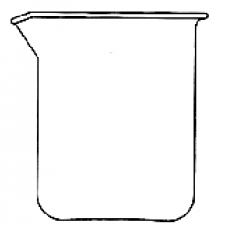
Particulate Diagrams
“Particulate representations of solutions communicate the structure and properties of solutions, by illustration of the relative concentrations of the components in the solution and drawings that show interactions among the components.”
GAS
Use little color coded (or labeled) circles to represent particles
A “particle” can be an atom, an ion, a polyatomic ion, compound or molecule.
Use the right number of circles! Draw them to represent phases too!
LIQUID
SOLID

Slide 15
Prediction Products Practice #3
The Balanced Equation
2Al + 3Pb(NO₃)₂ → 3Pb + 2Al(NO₃)₃
Dump into beaker…
Al
Pb(NO₃)₂
Jars of chemicals in stock room

Slide 16
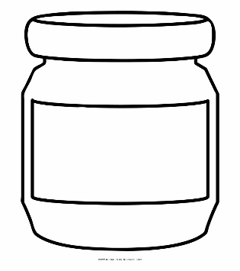
Prediction Products Practice #4
The Balanced Equation
Pb(NO₃)₂ + 2KI → PbI₂ + 2K(NO₃)
Dump into beaker…
Pb(NO₃)₂
KI
Jars of chemicals in stock room

Slide 17
Prediction Products Practice #5
The Balanced Equation
AgNO₃ + KCl → AgCl + KNO₃
Dump into beaker…
AgNO₃
KCl
Jars of chemicals in stock room

Slide 18
New one to try!
Silver nitrate plus calcium bromide →
The Balanced Equation
2AgNO₃ + CaBr₂ → 2AgBr + Ca(NO₃)₂
Dump into beaker…
AgNO₃
CaBr₂
Jars of chemicals in stock room

Slide 19
YouTube Link to Presentation
This is actually the link to the Honors lecture for a similar presentation! If I get time I will update this with a new video for this AP lecture.
https://youtu.be/Jw0uwkF568s

